Slide 1
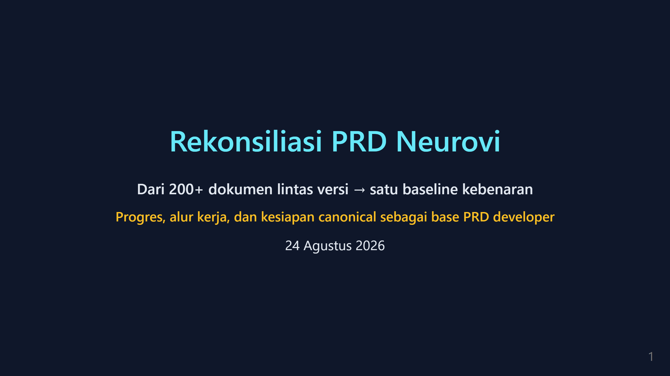

Slide 2
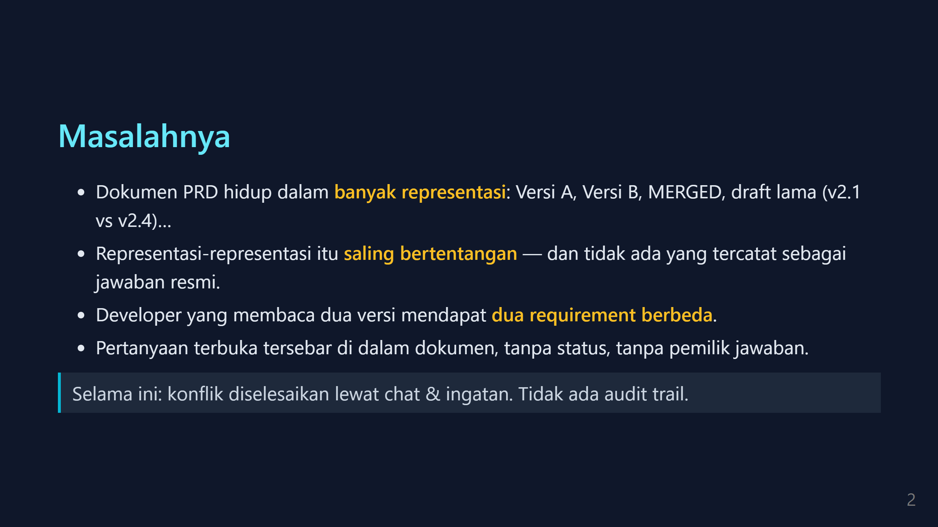

Slide 3
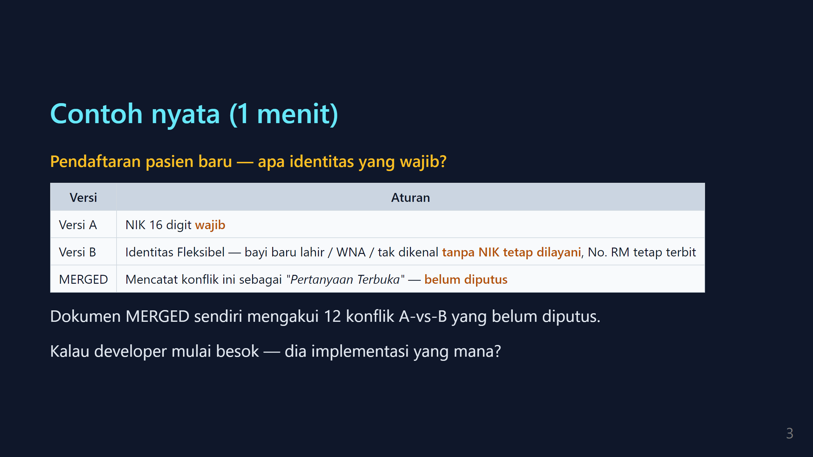

Slide 4
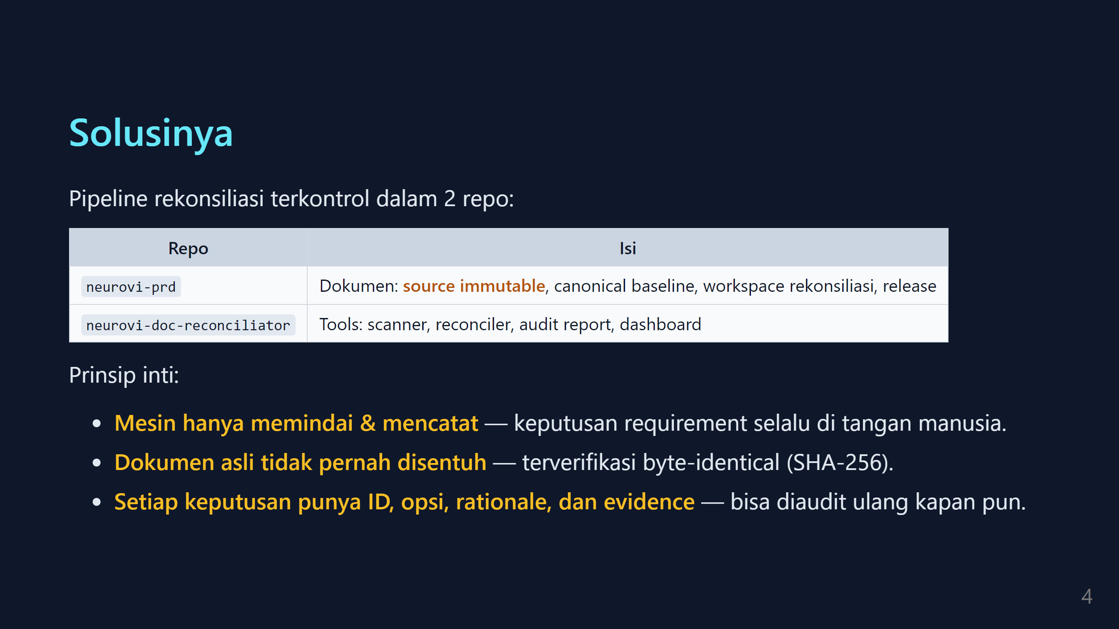

Slide 5
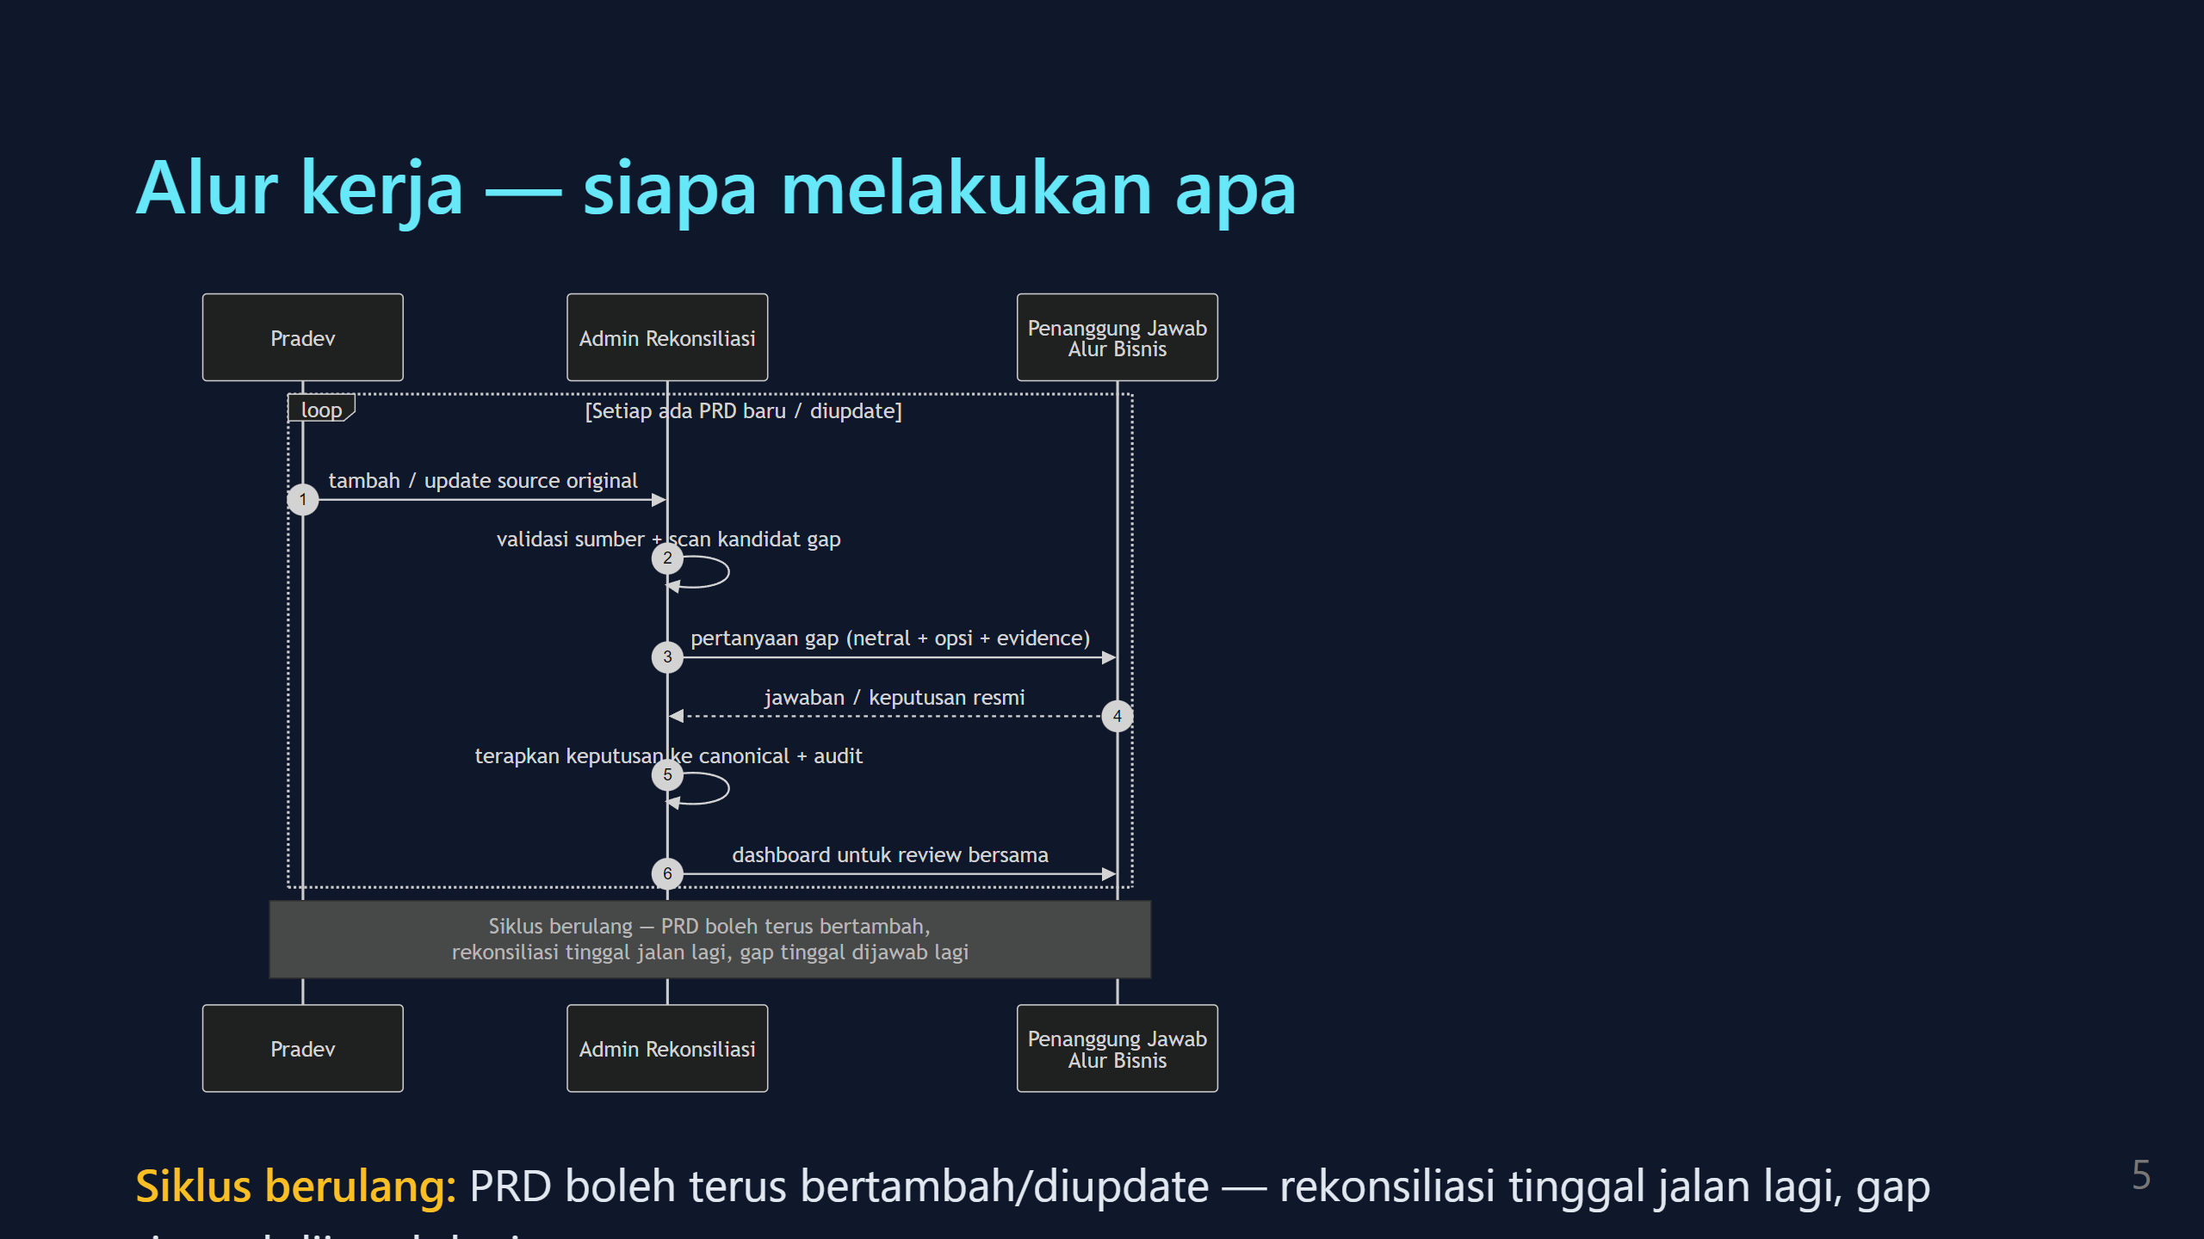
Notes:
sumber diagram: assets/human-workflow.mmd (mermaid sequenceDiagram) — edit .mmd lalu re-render dengan mmdc

Slide 6
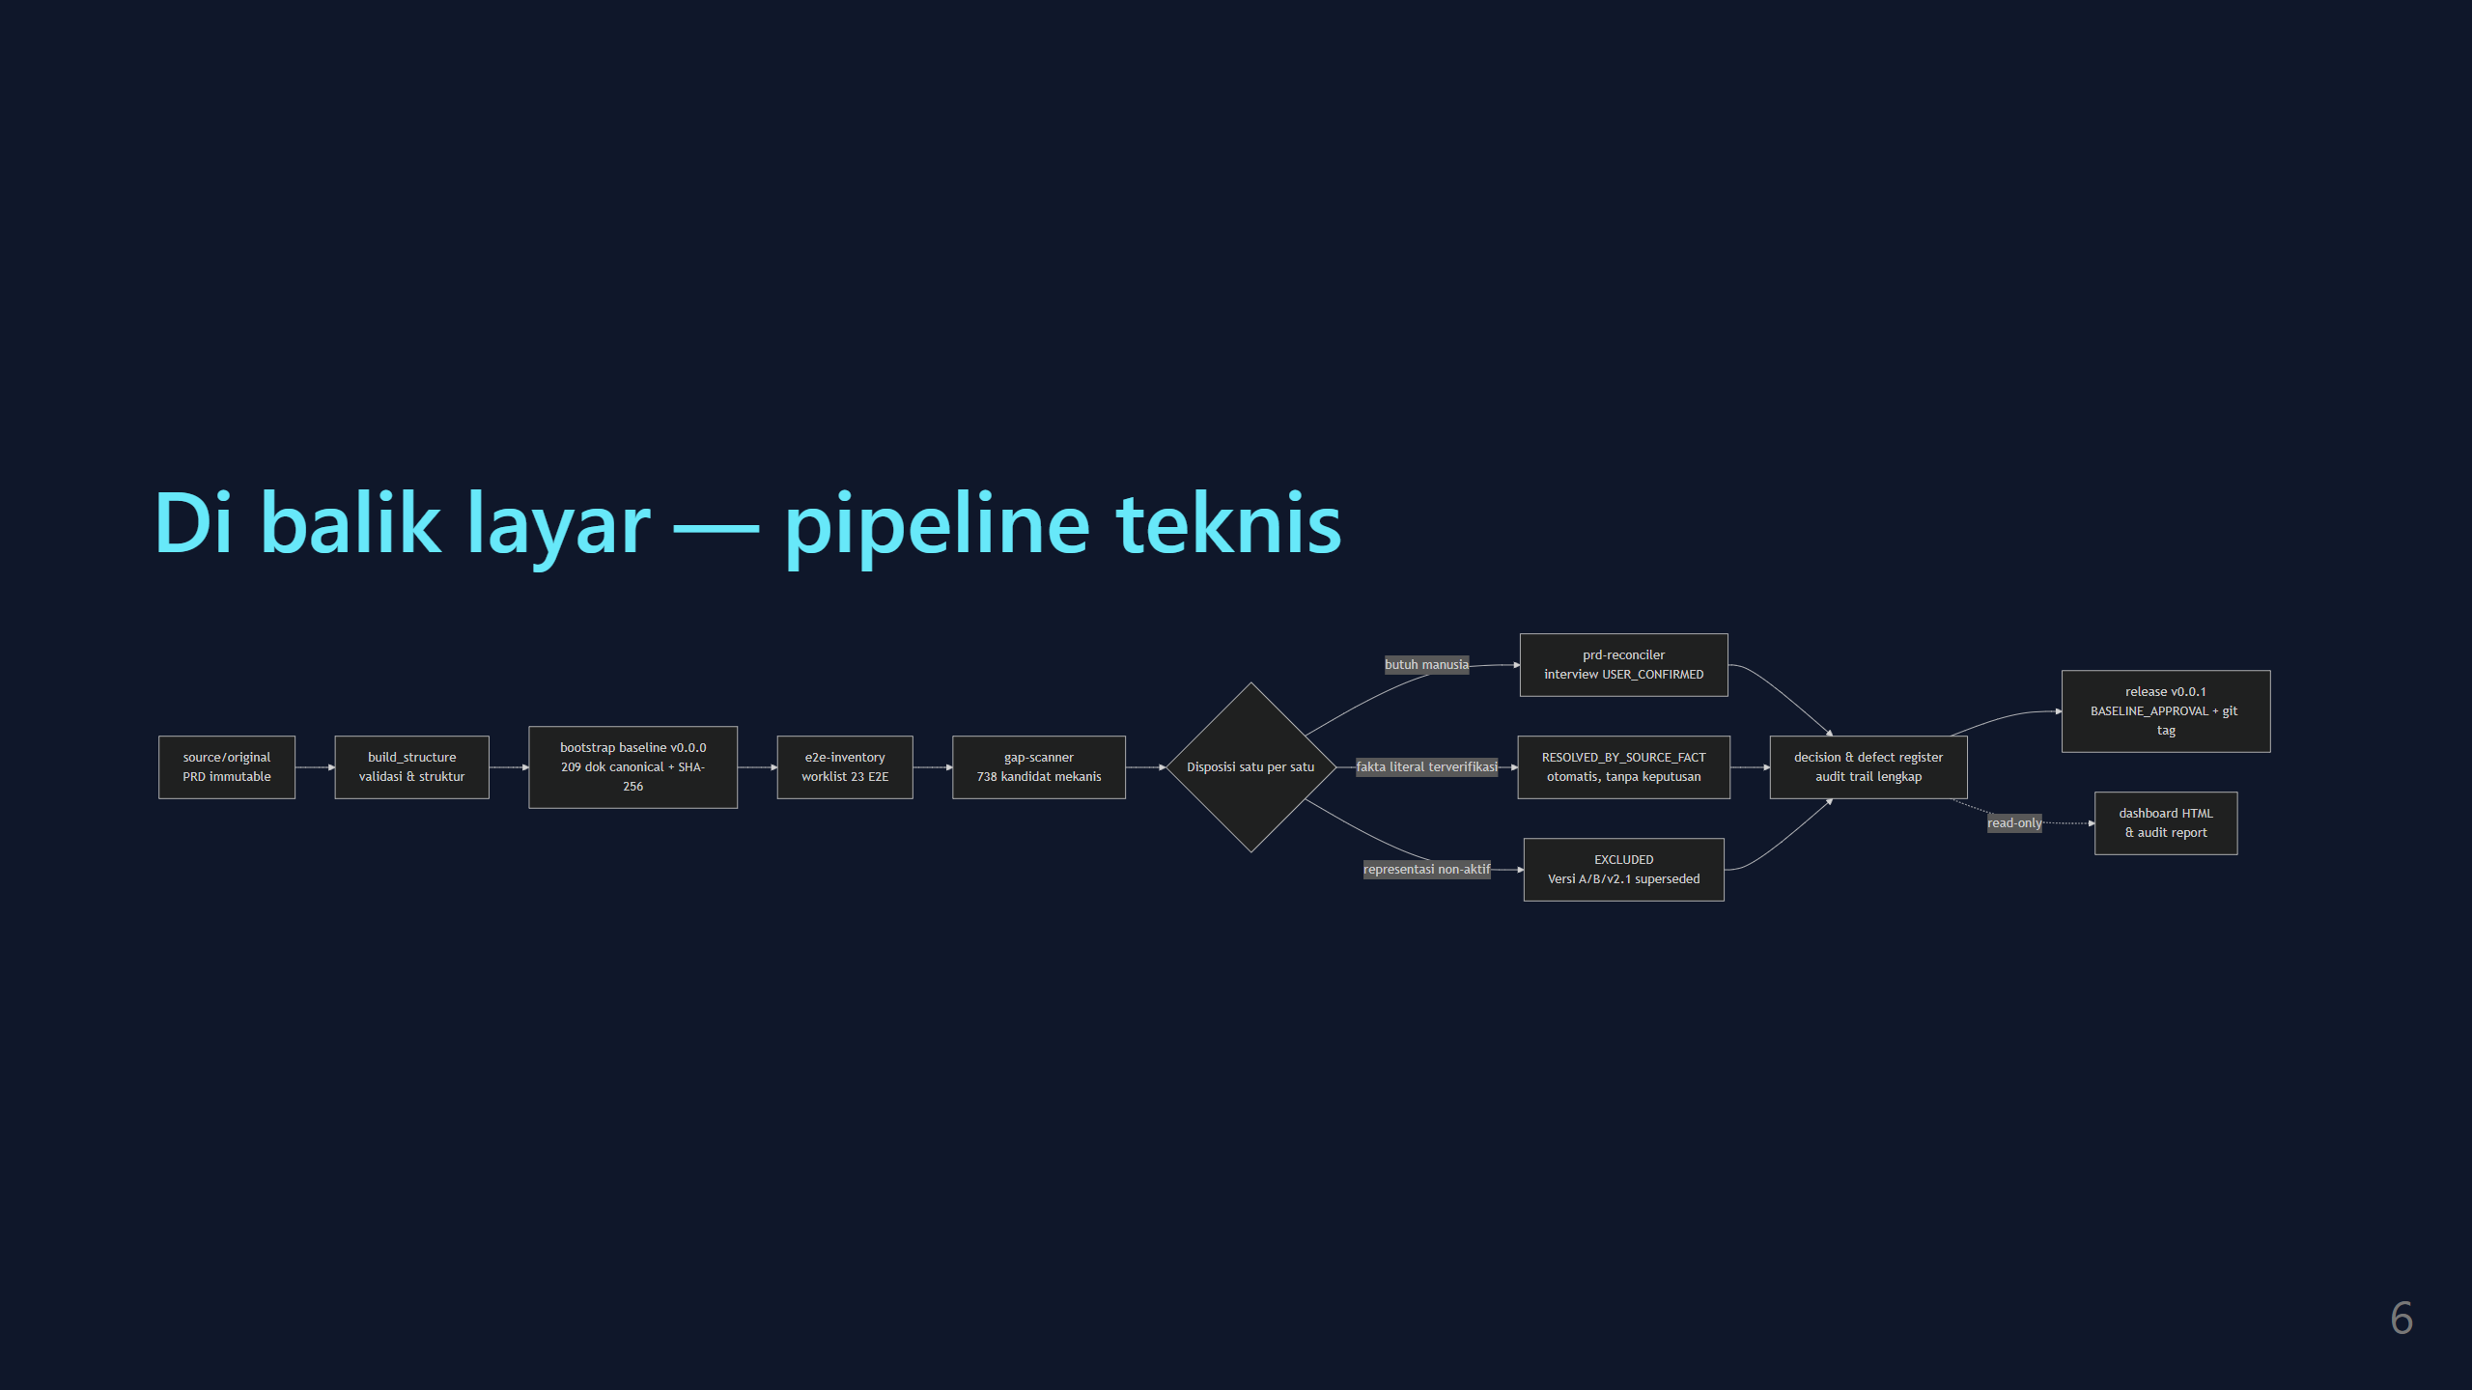
Notes:
sumber diagram: assets/pipeline.mmd (mermaid flowchart LR) — edit .mmd lalu re-render dengan mmdc

Slide 7
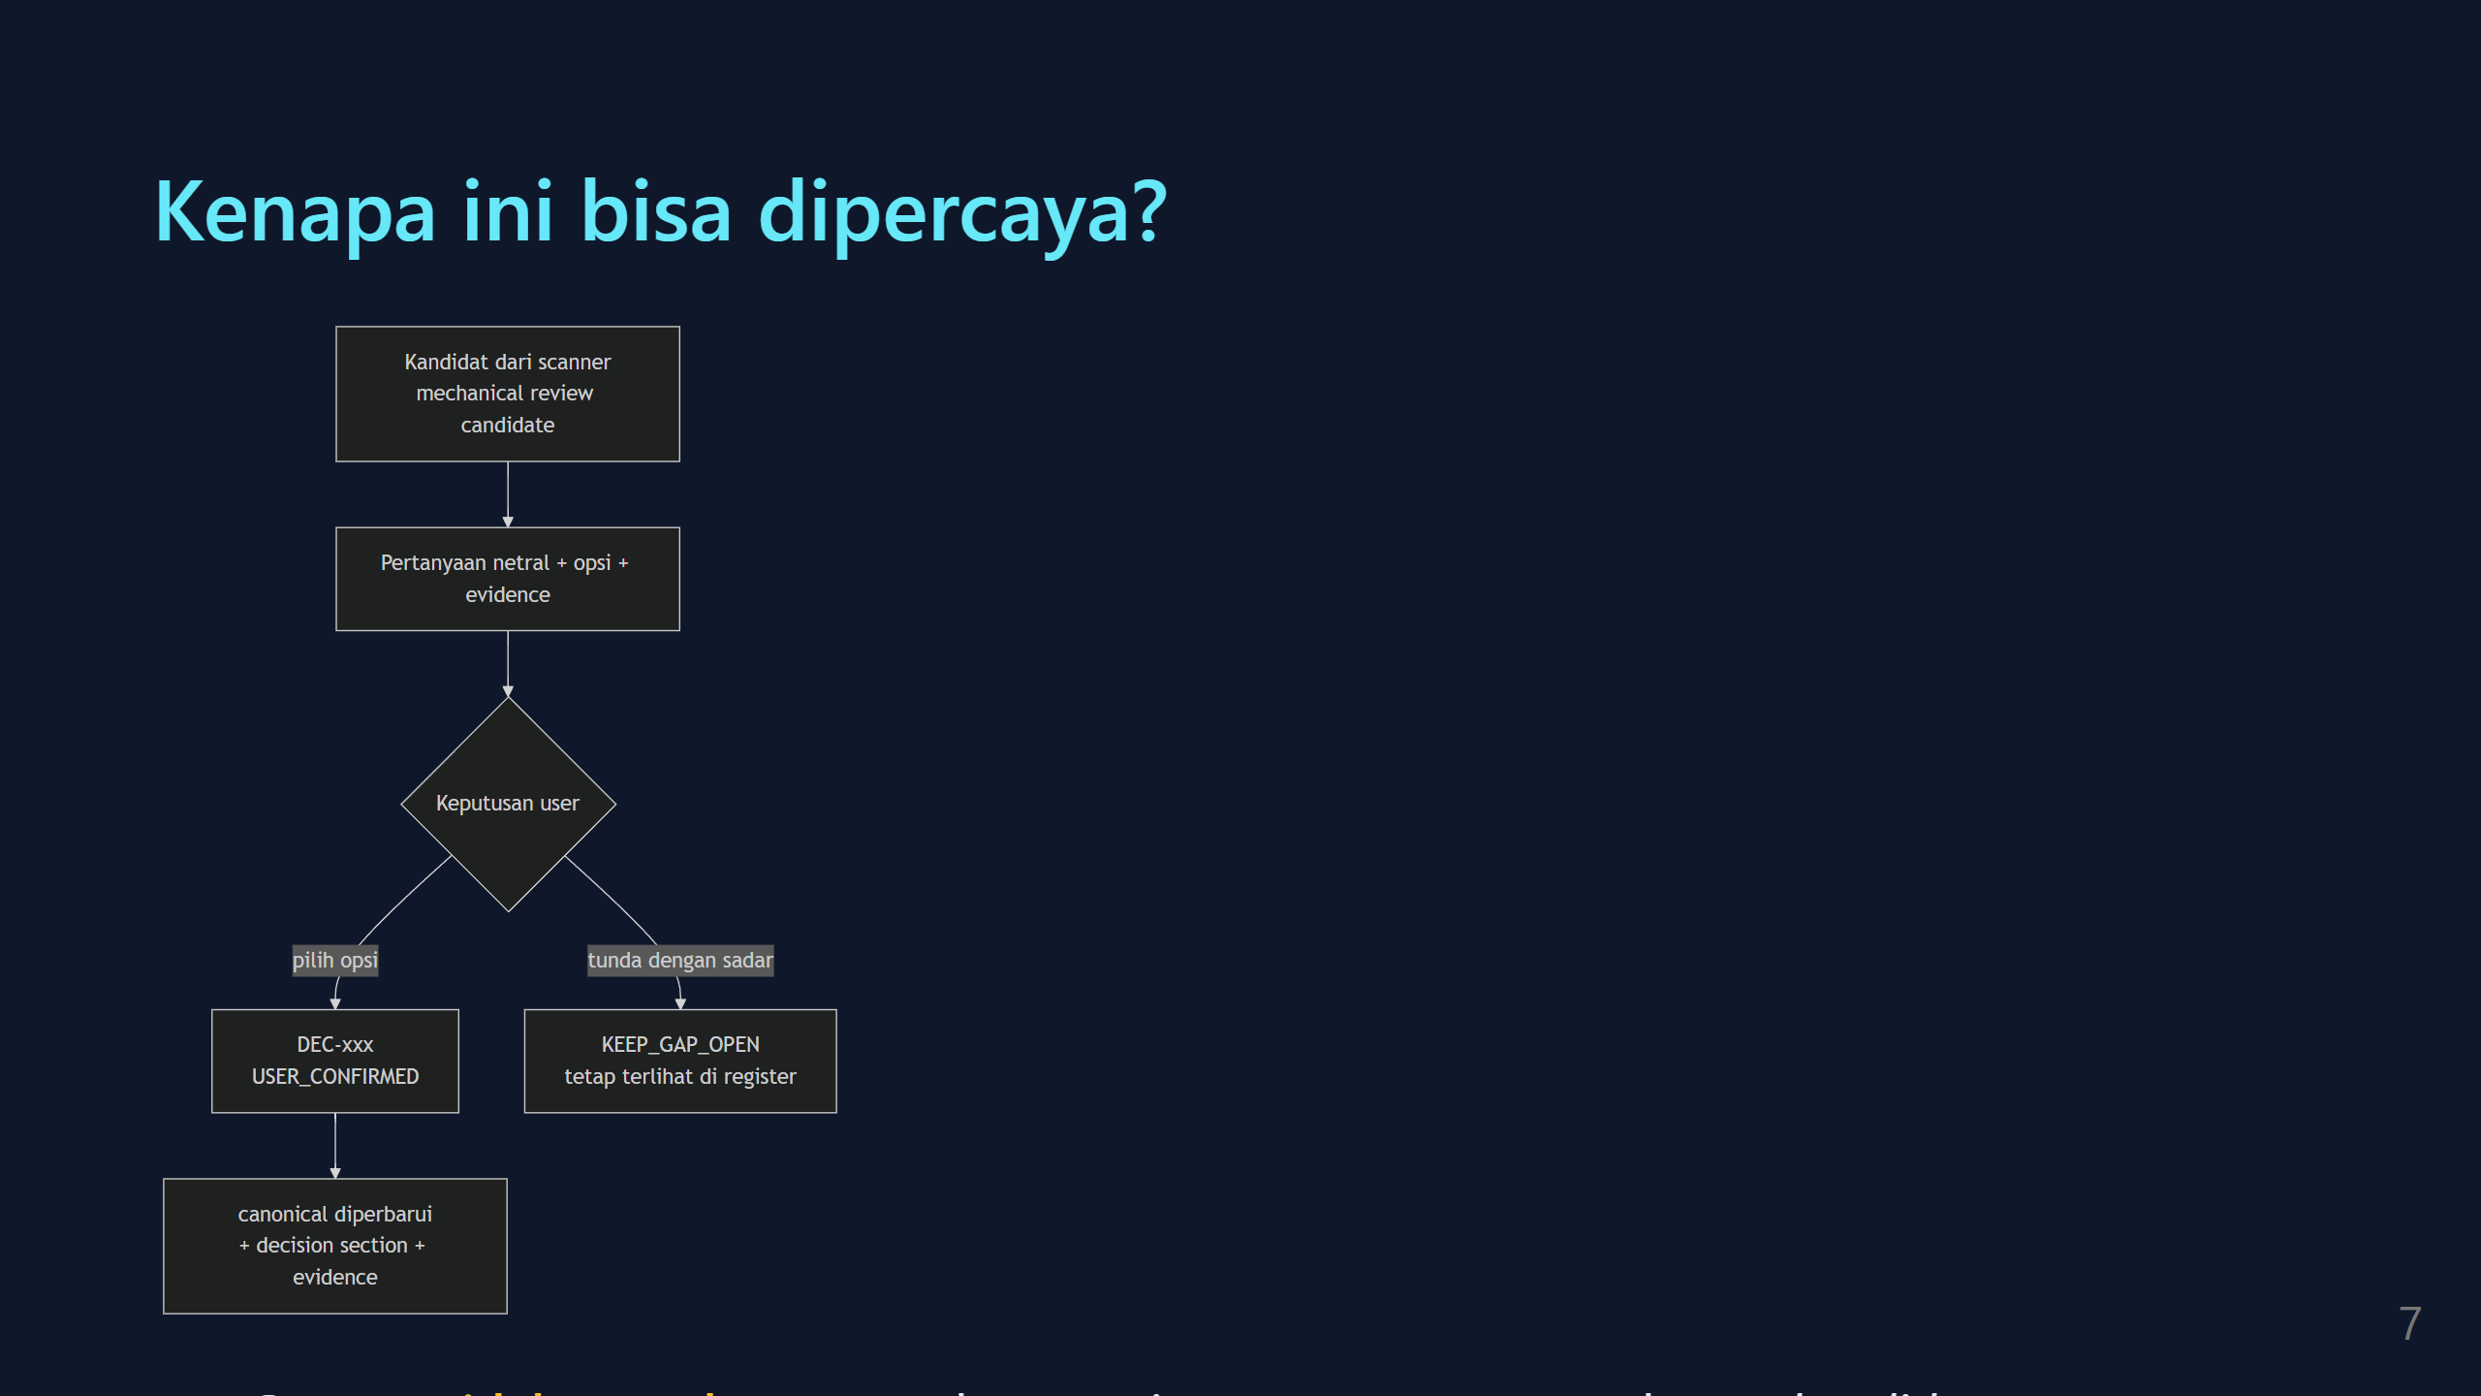
Notes:
sumber diagram: assets/decision-gate.mmd (mermaid flowchart TD) — edit .mmd lalu re-render dengan mmdc

Slide 8
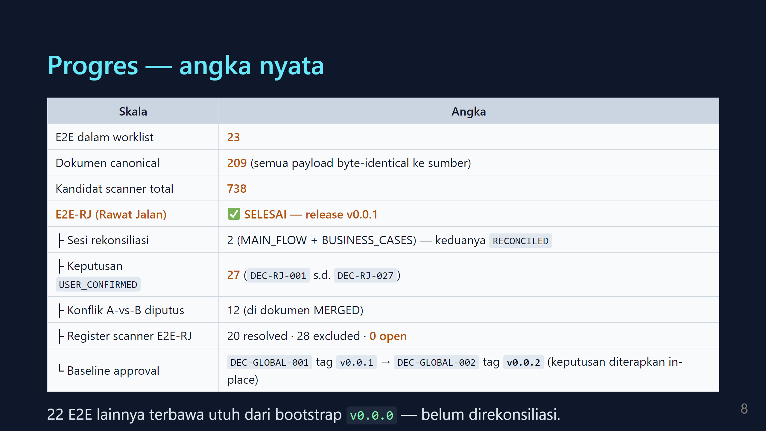

Slide 9
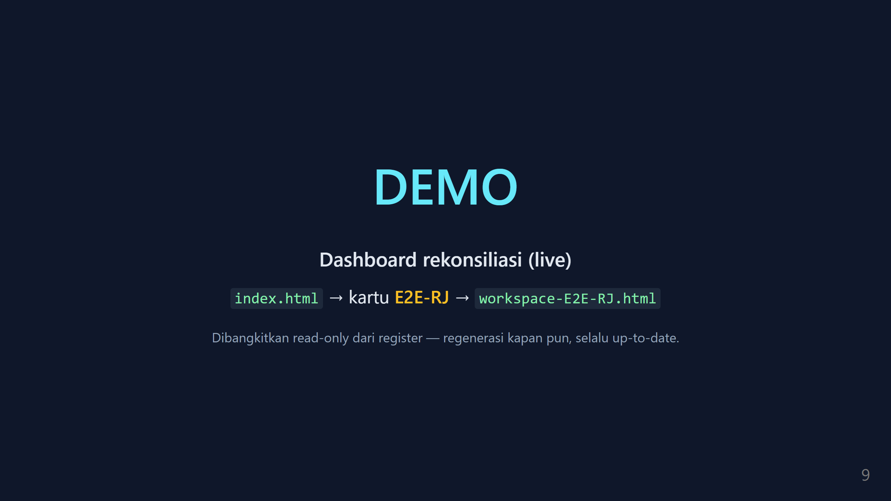

Slide 10
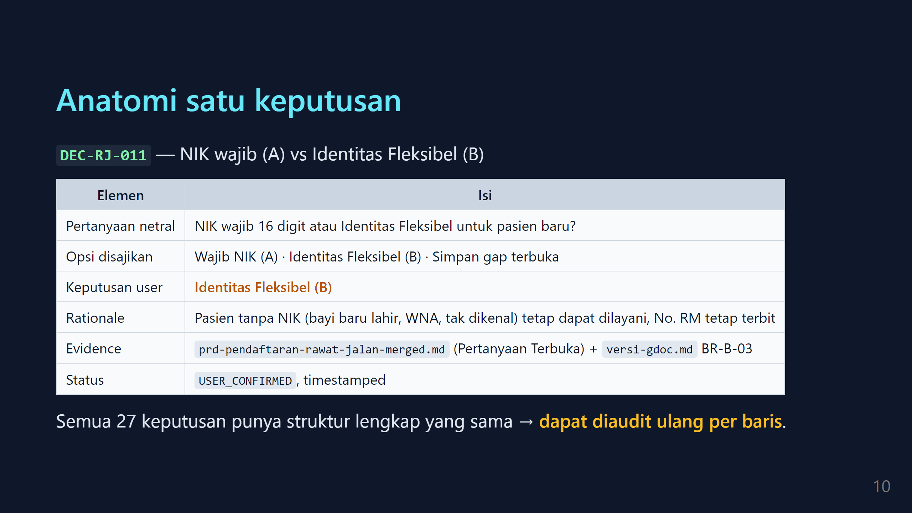

Slide 11
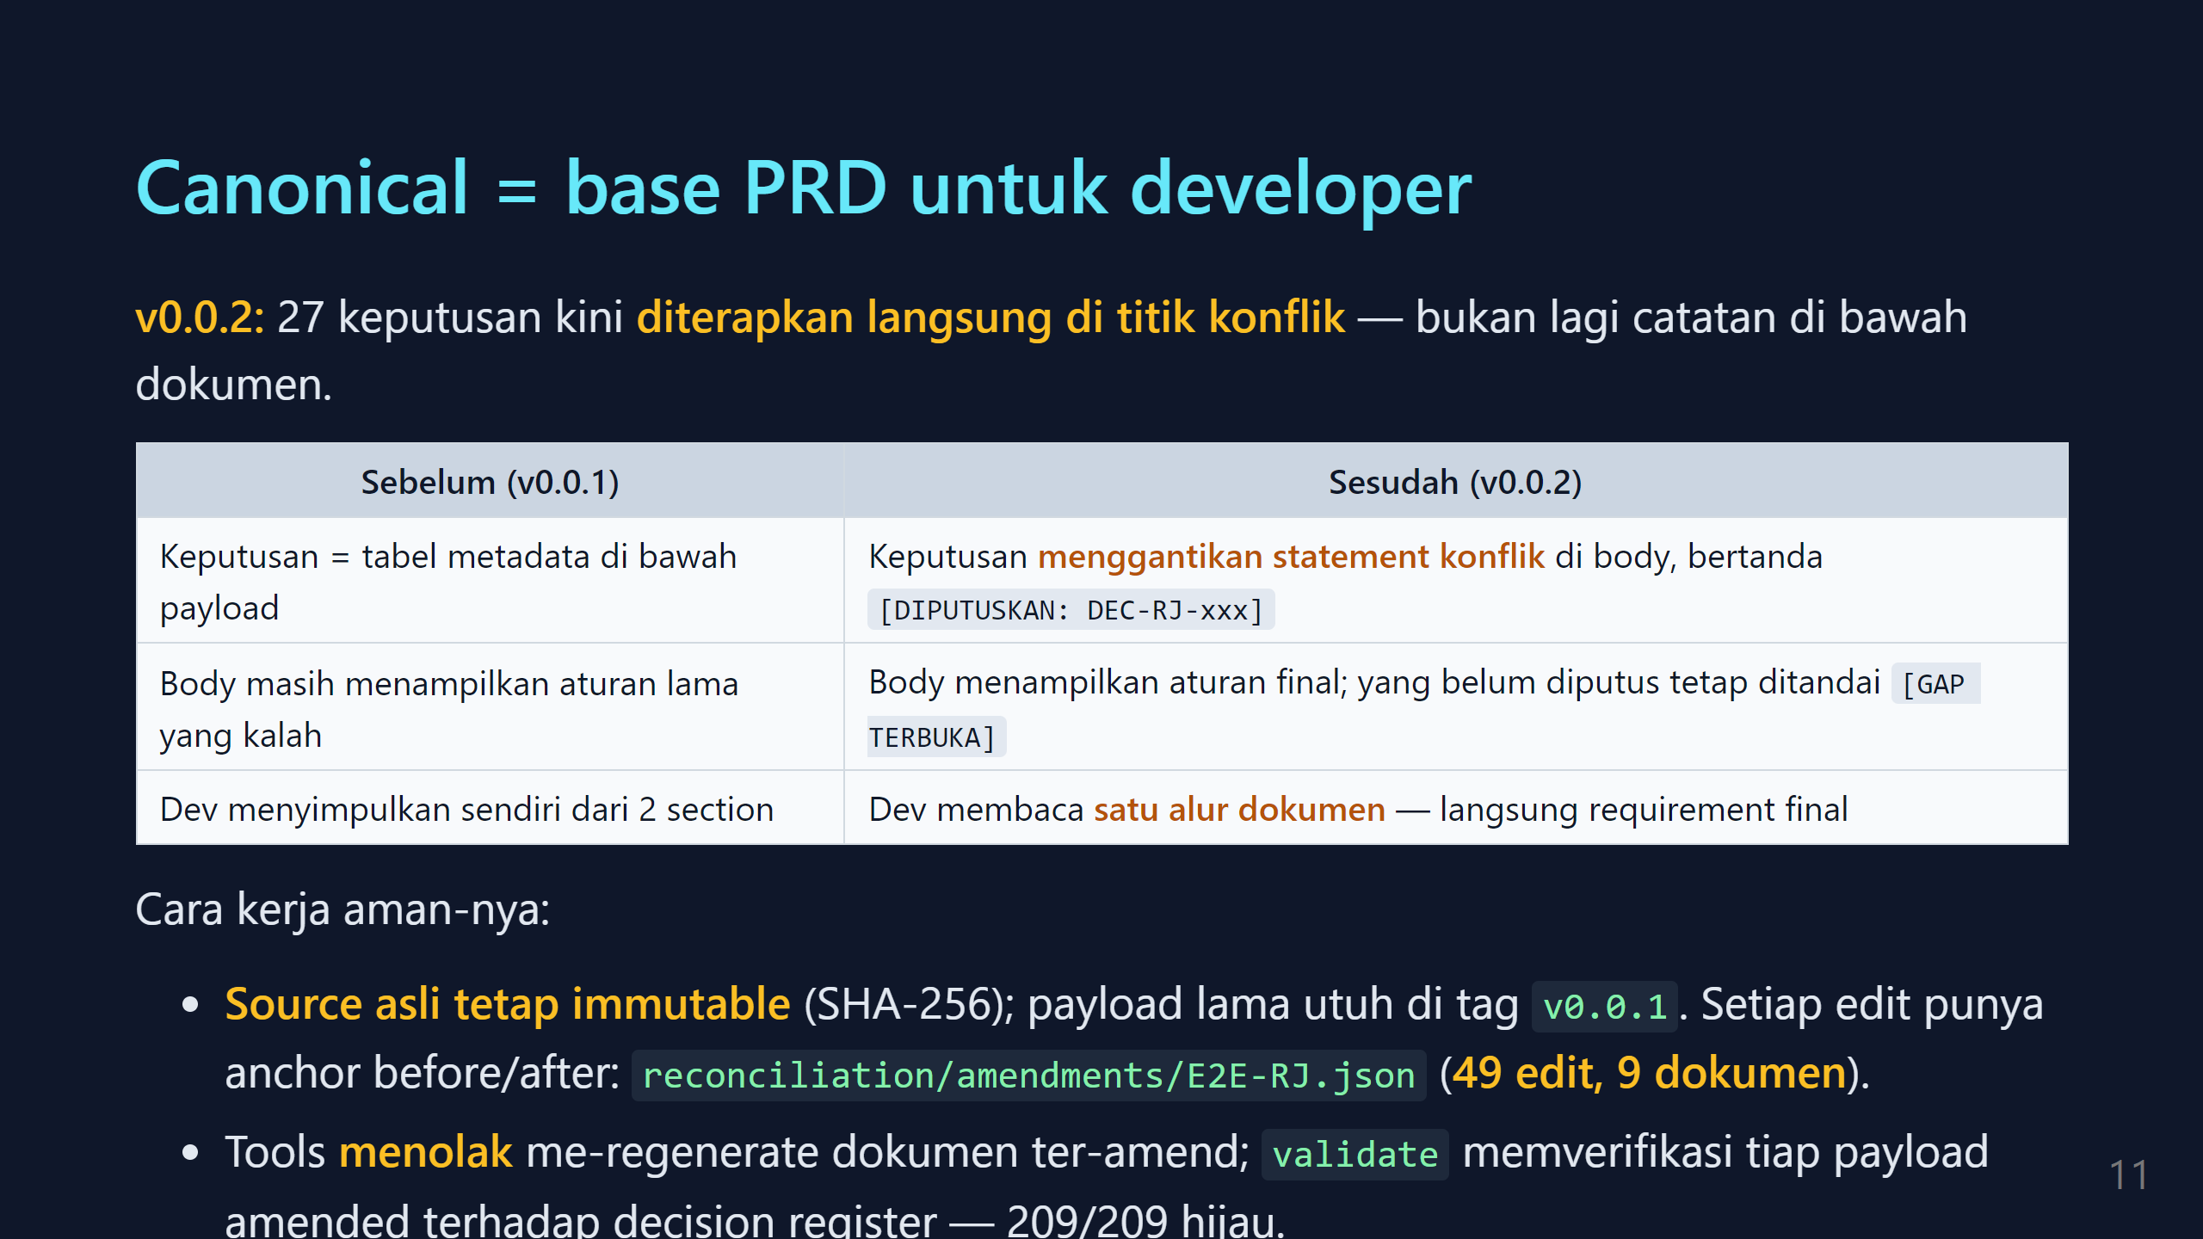

Slide 12
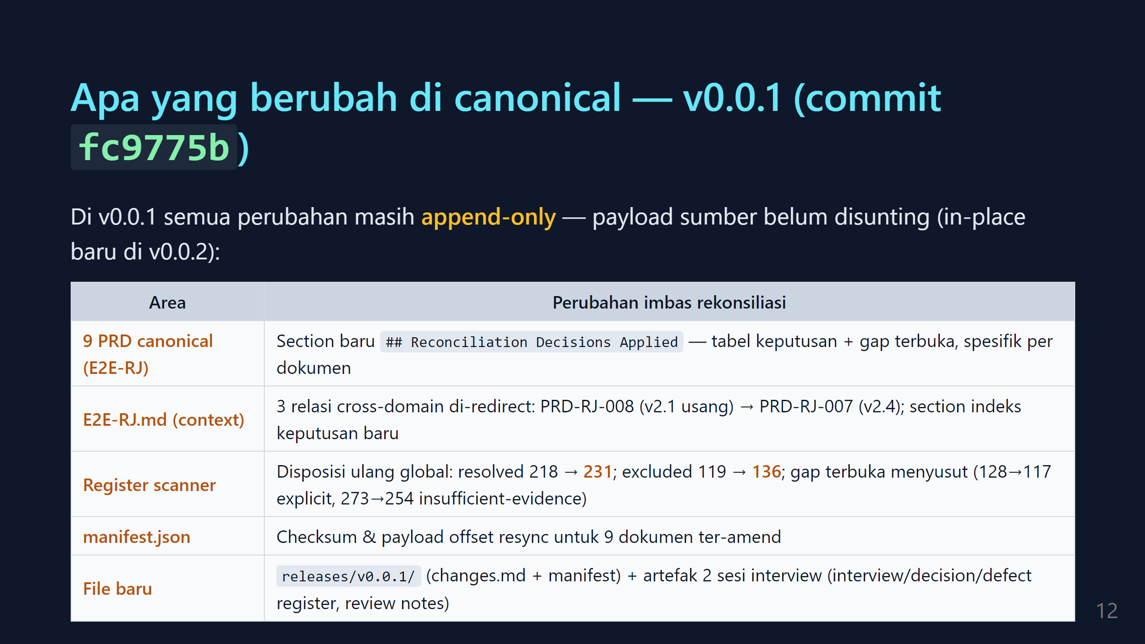

Slide 13
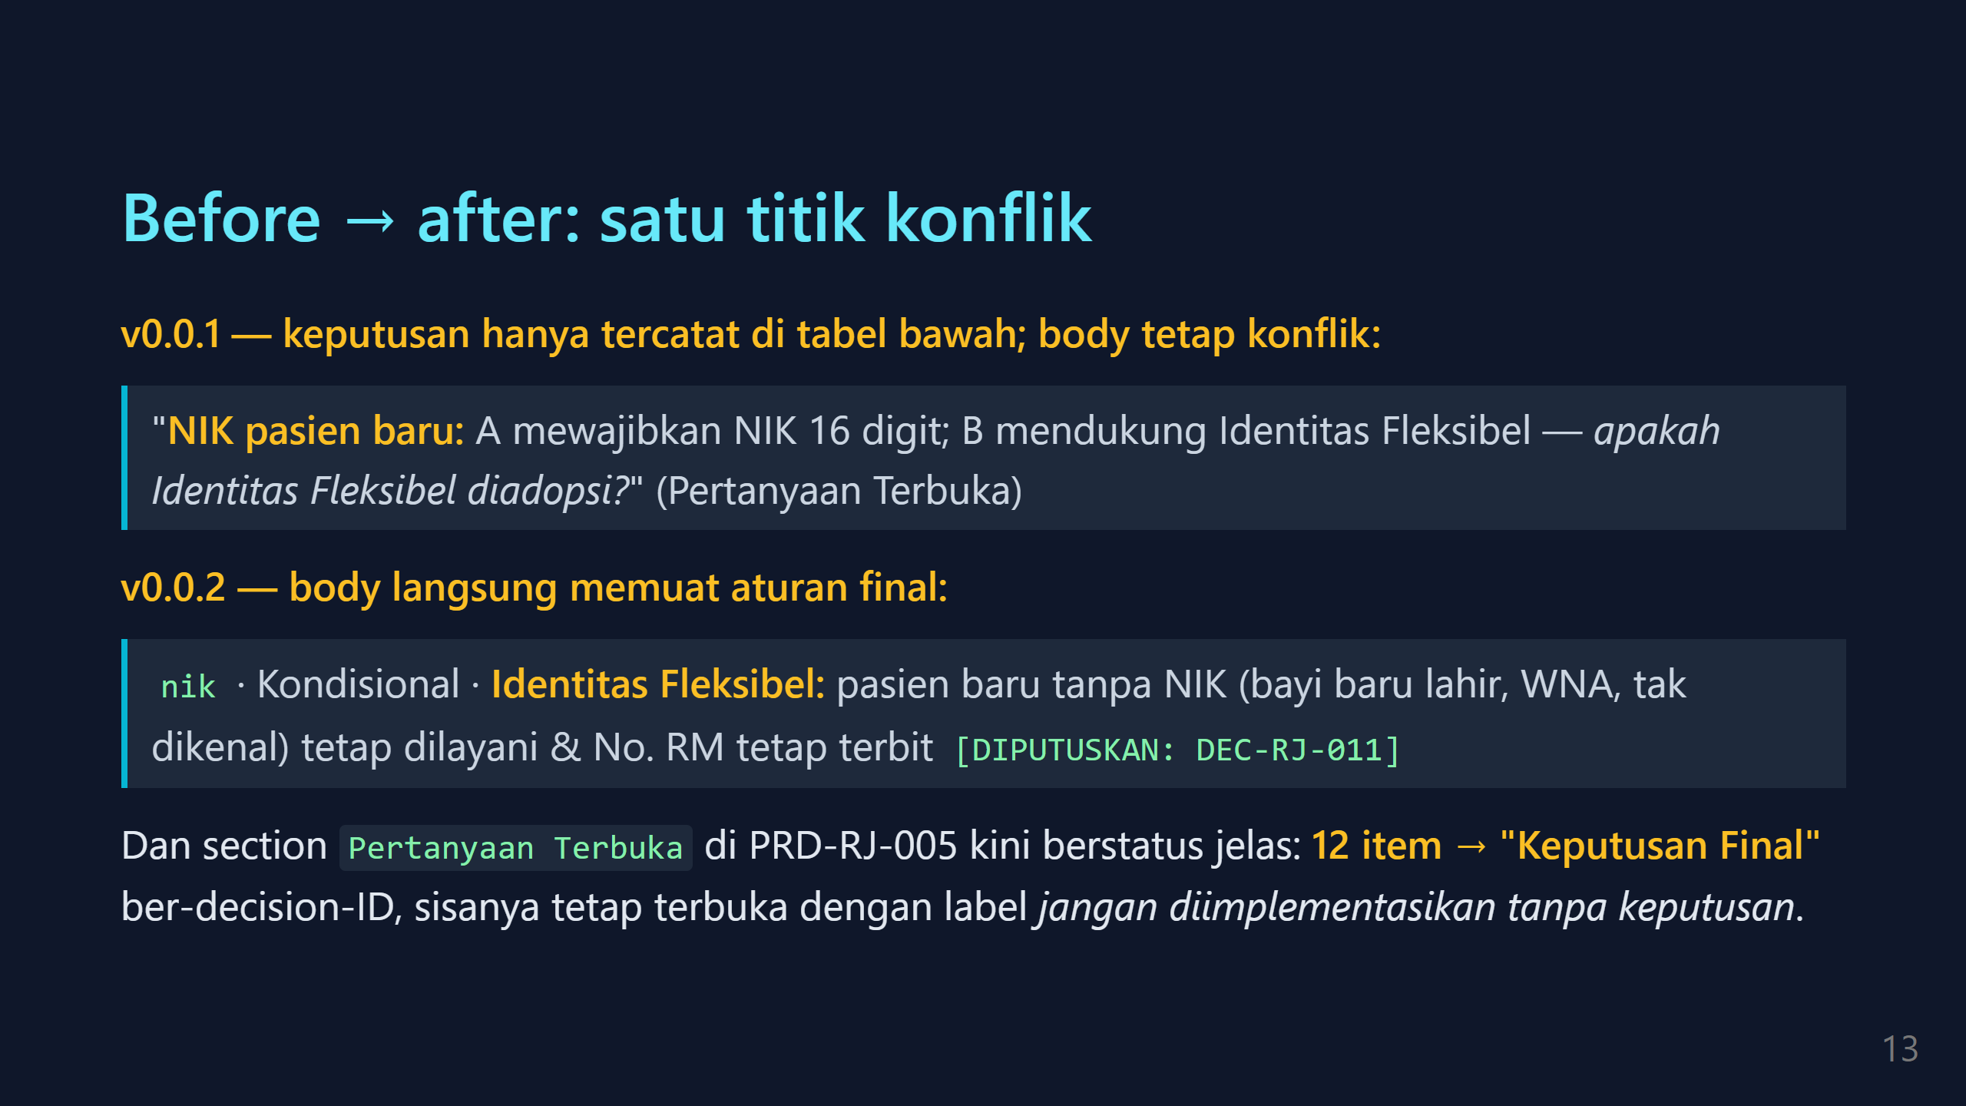

Slide 14
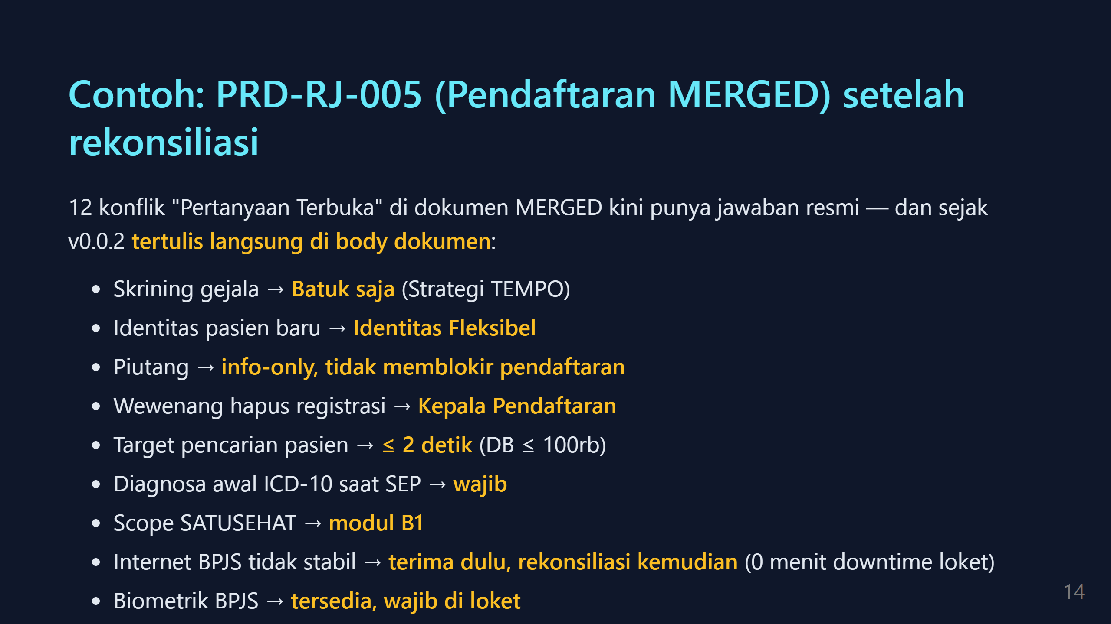

Slide 15
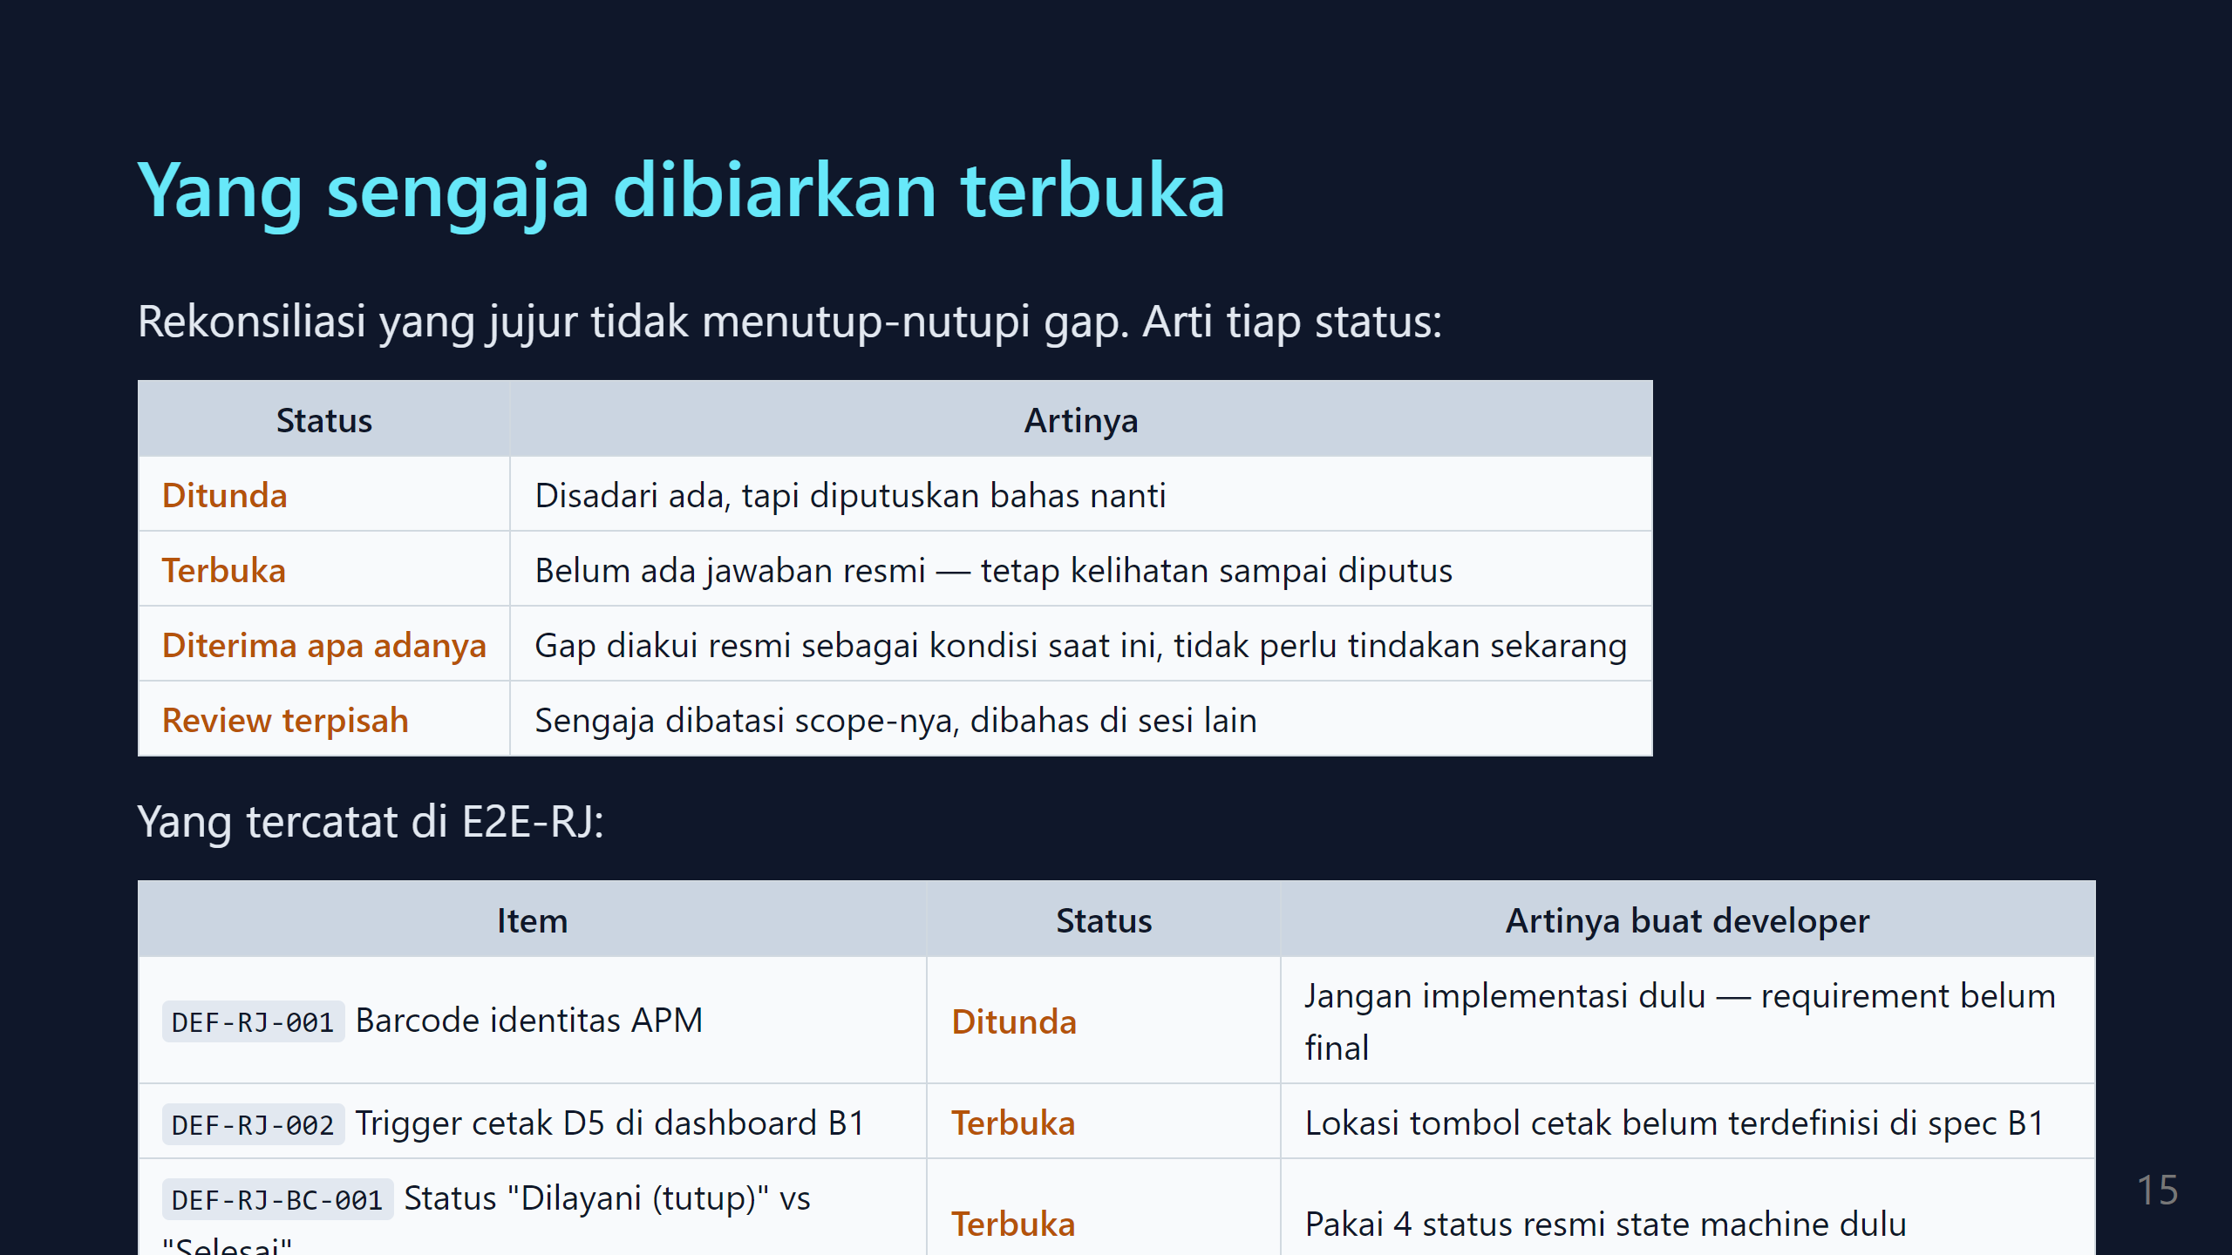

Slide 16
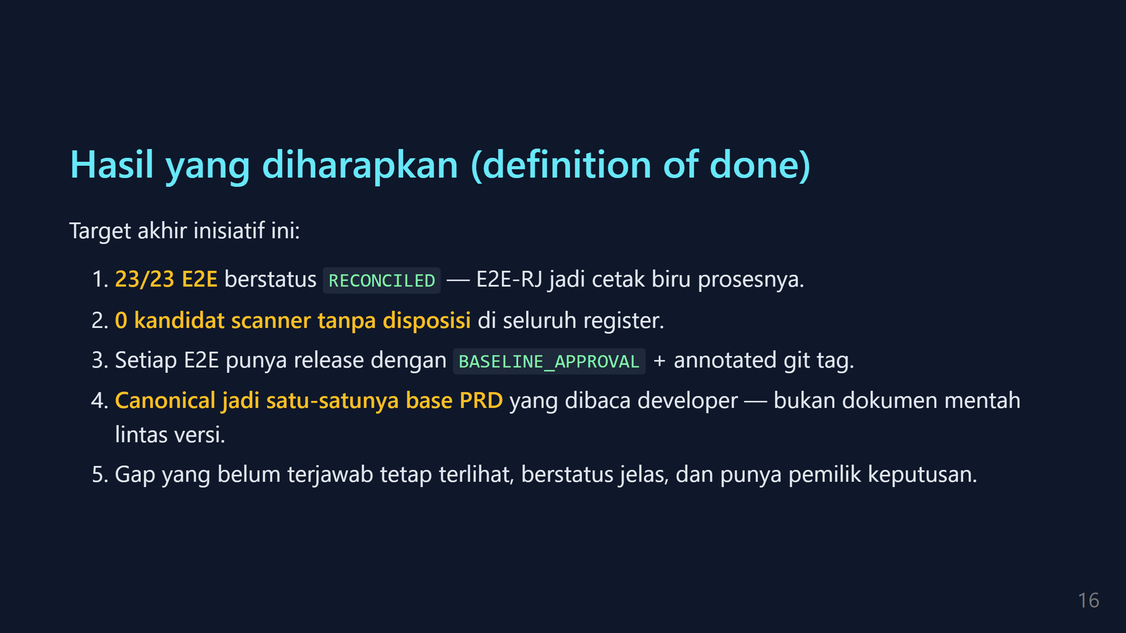

Slide 17
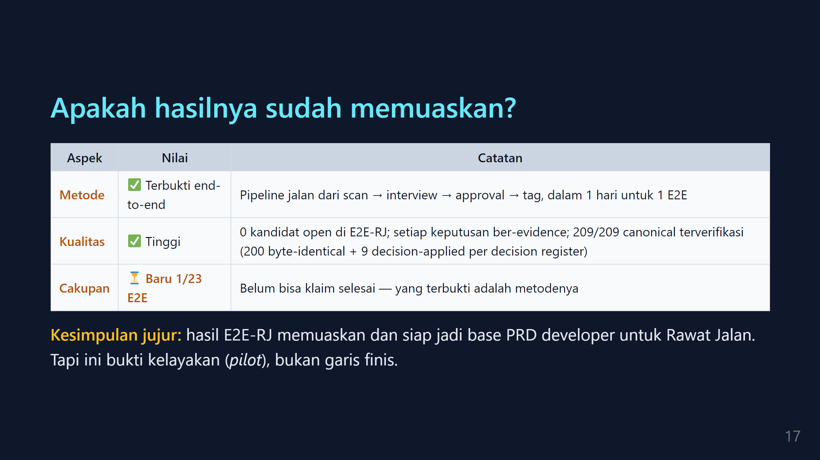

Slide 18
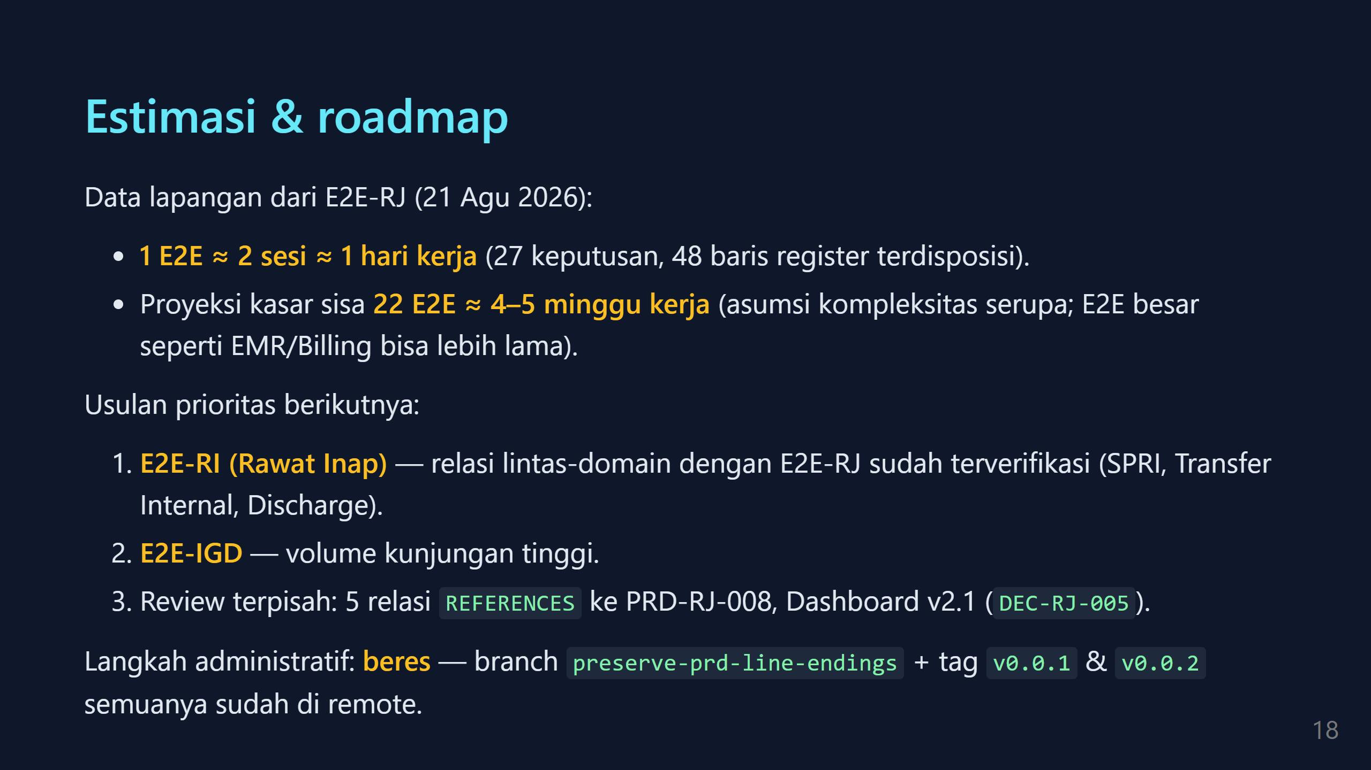

Slide 19
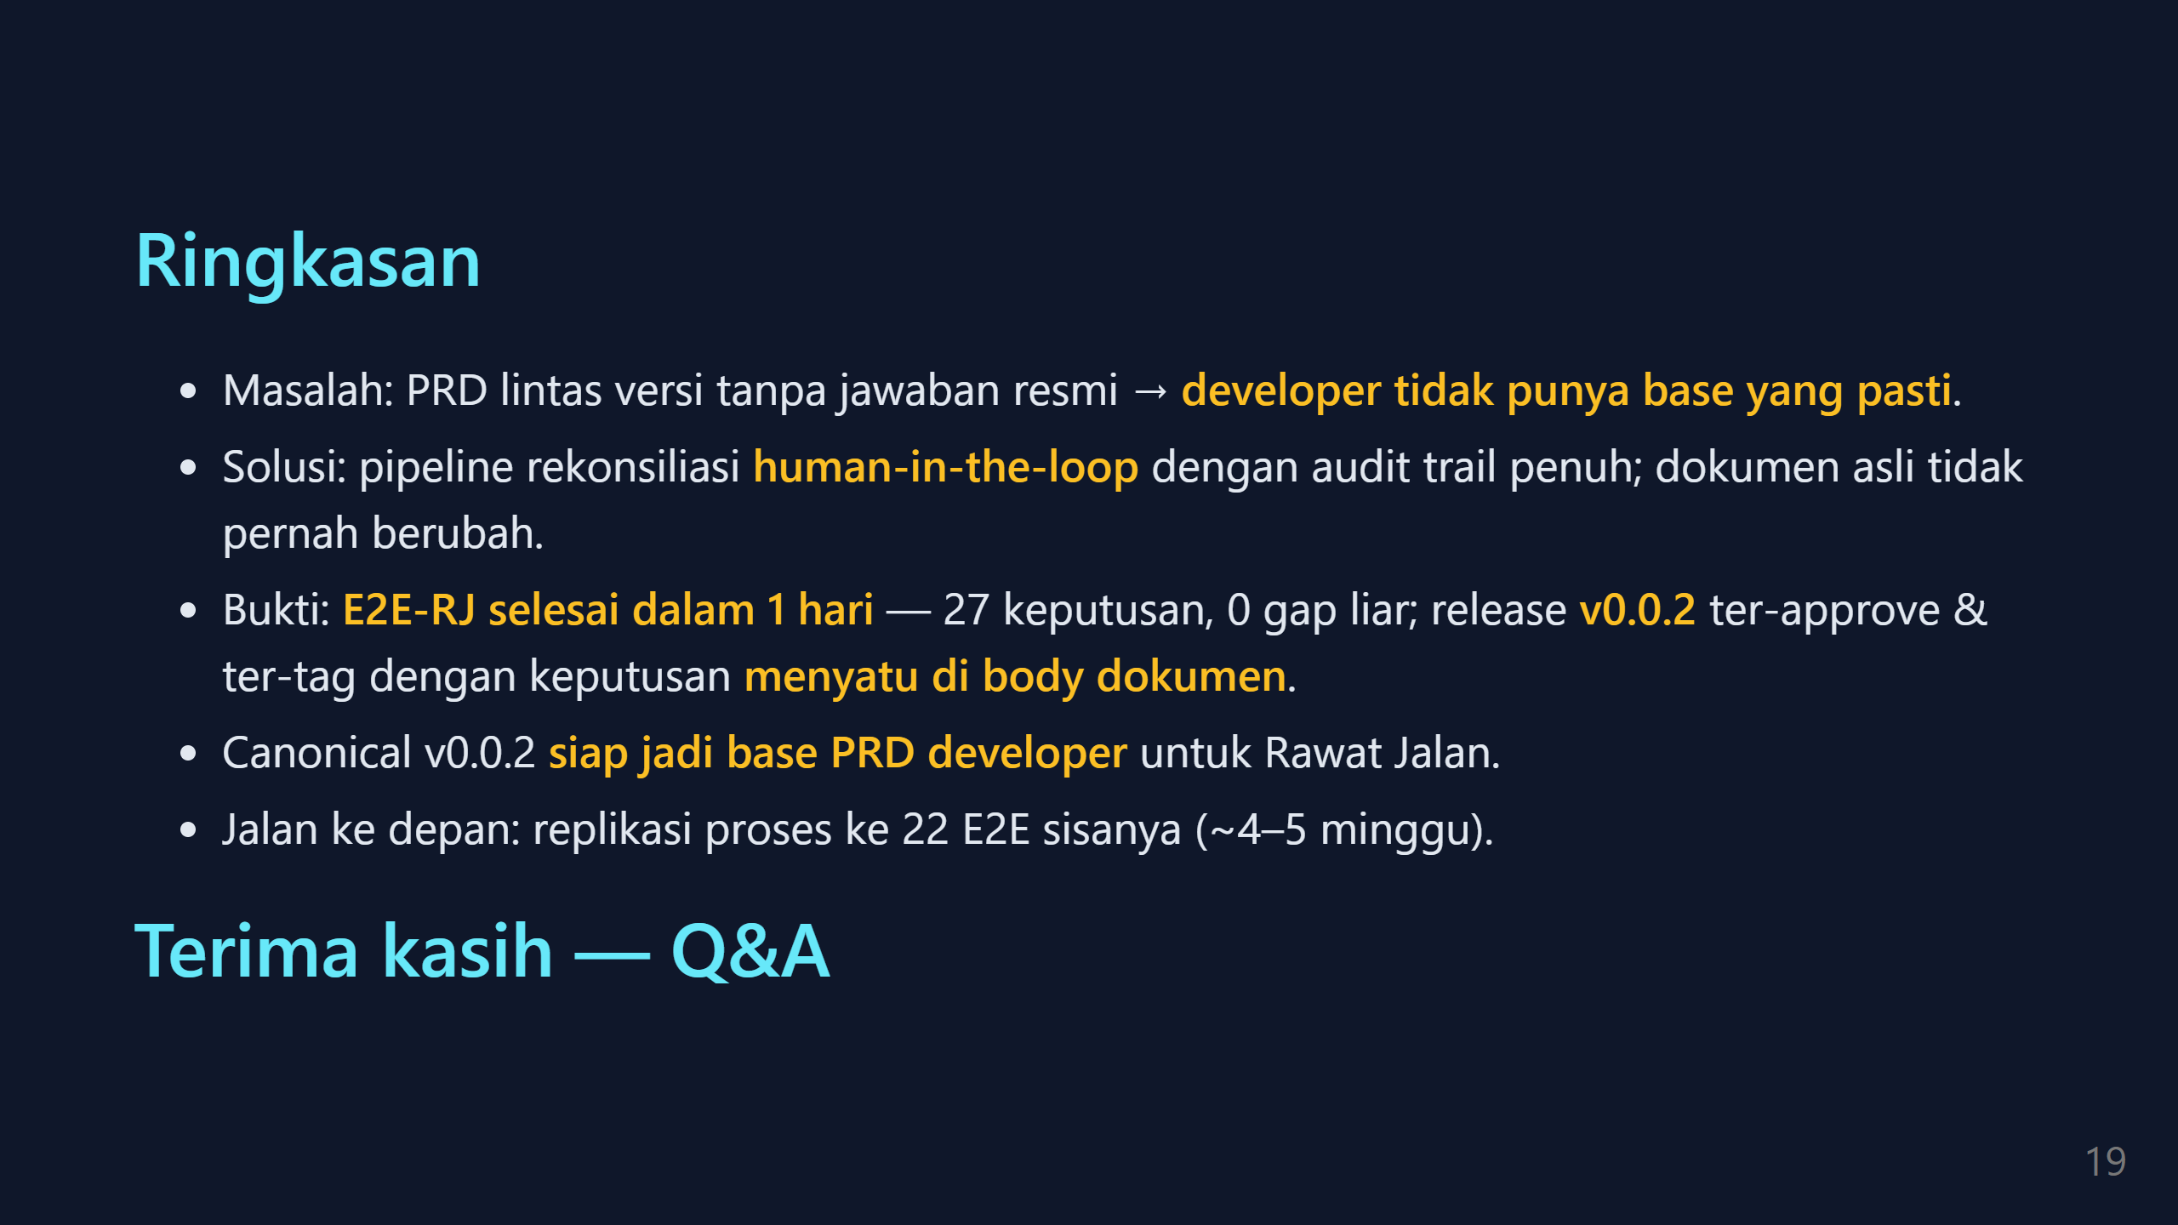

Slide 20
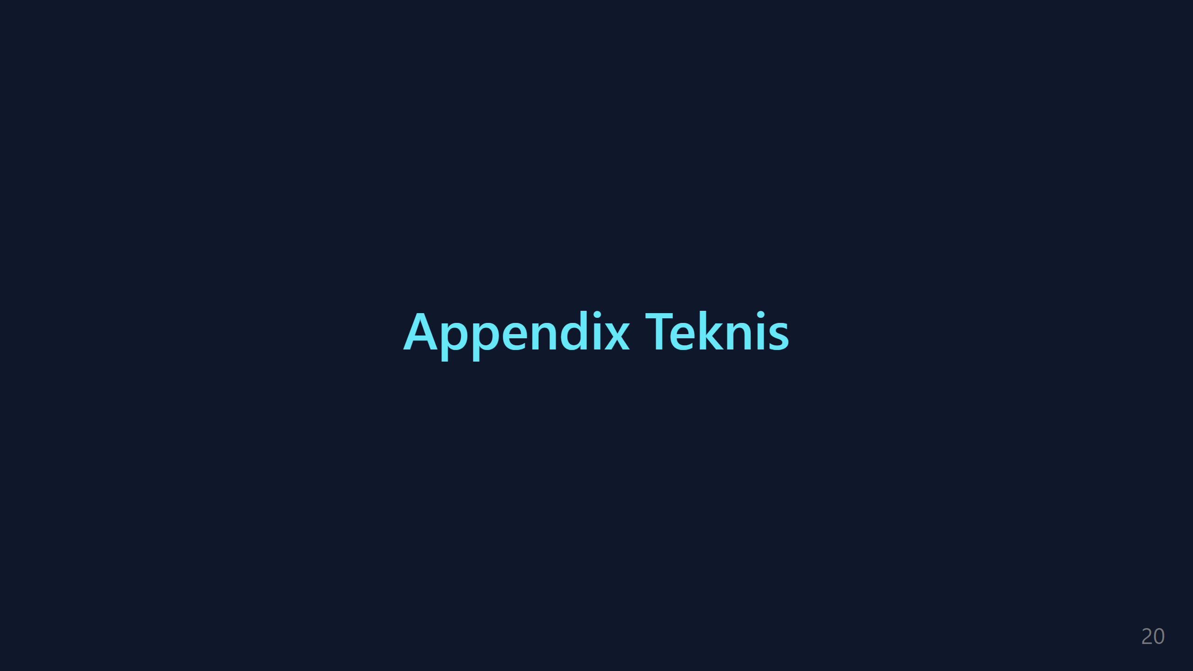

Slide 21
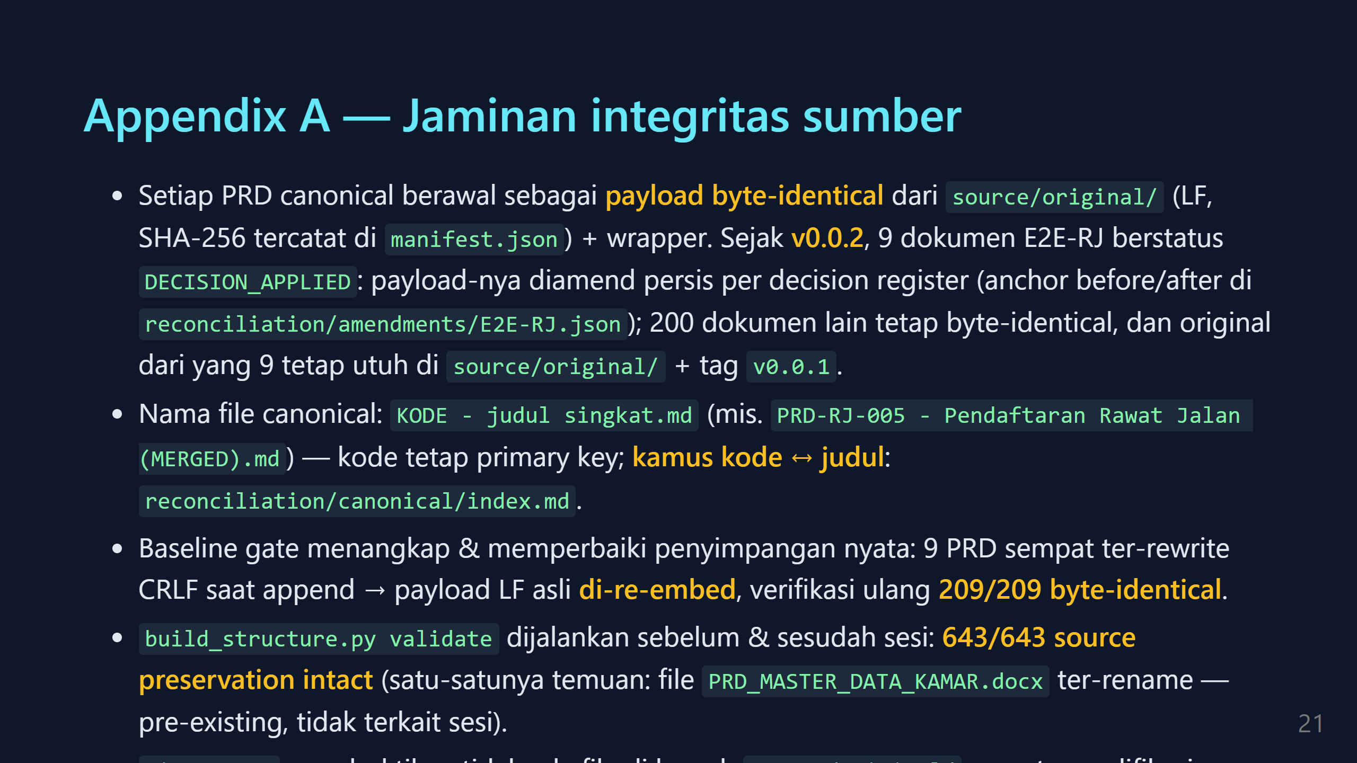

Slide 22
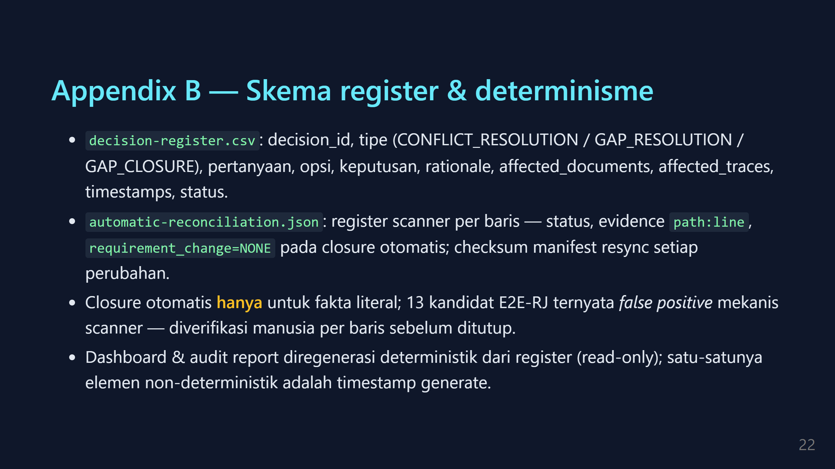

Slide 23
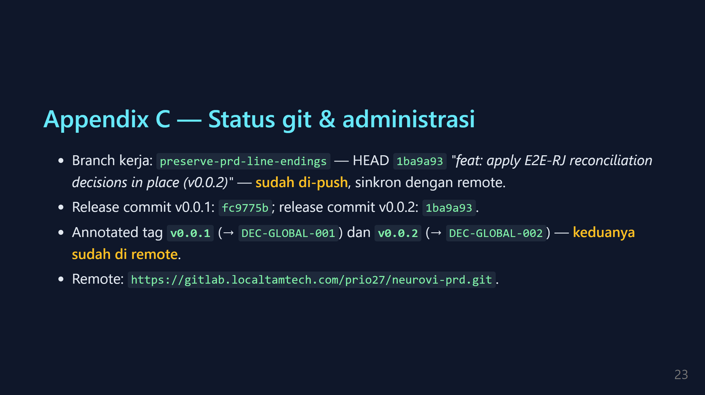

Slide 24
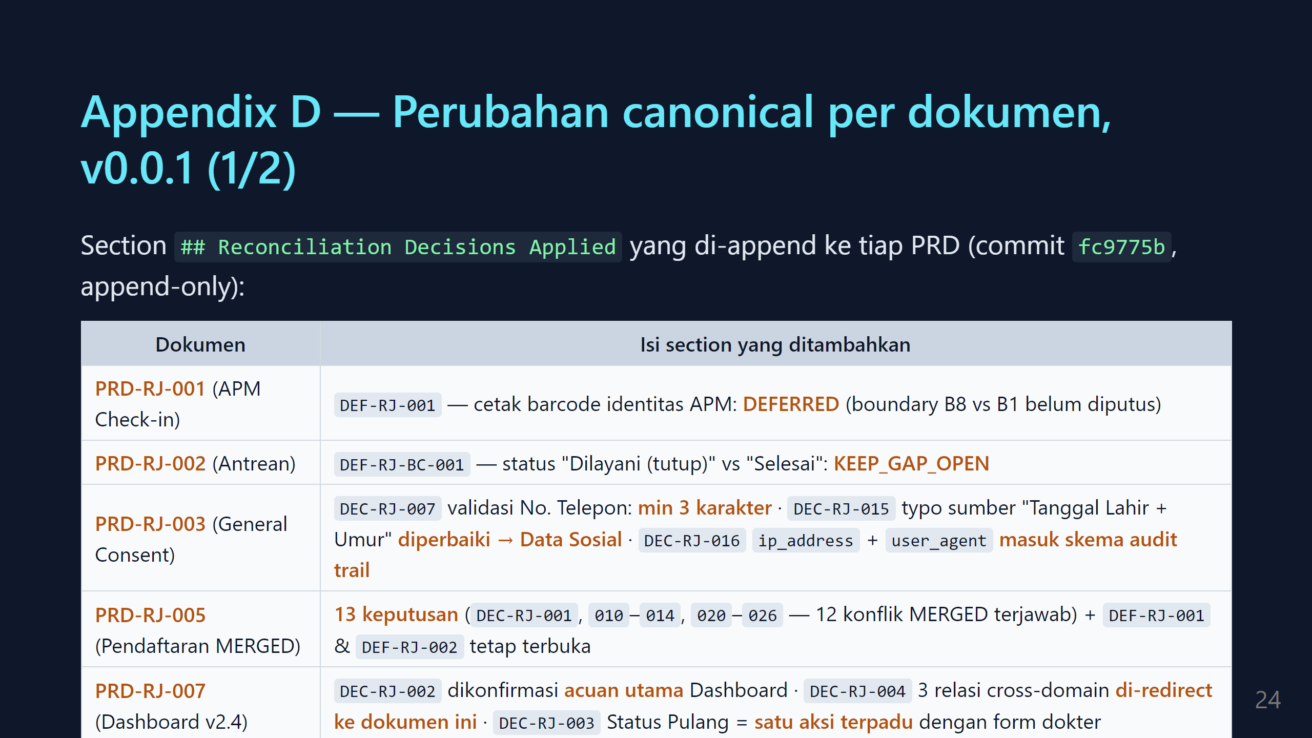

Slide 25
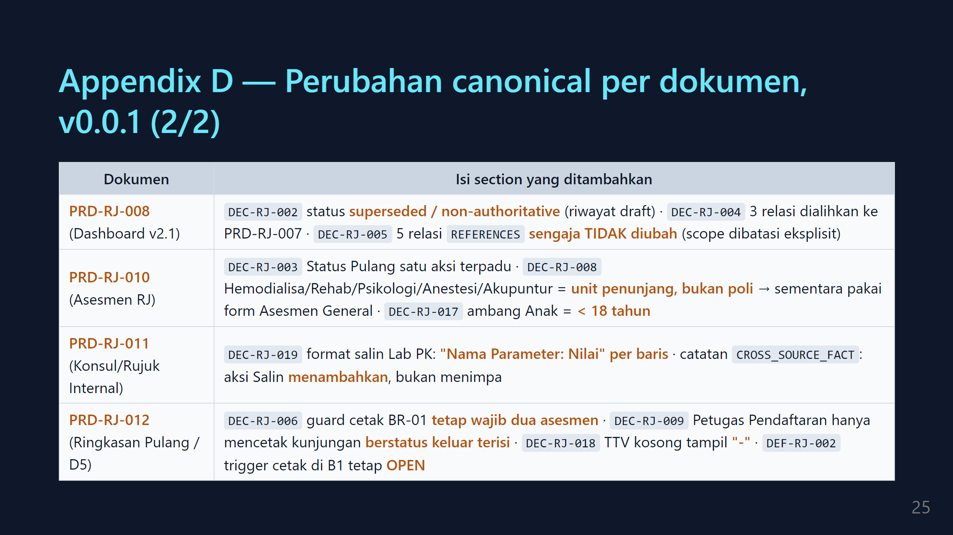

Slide 26
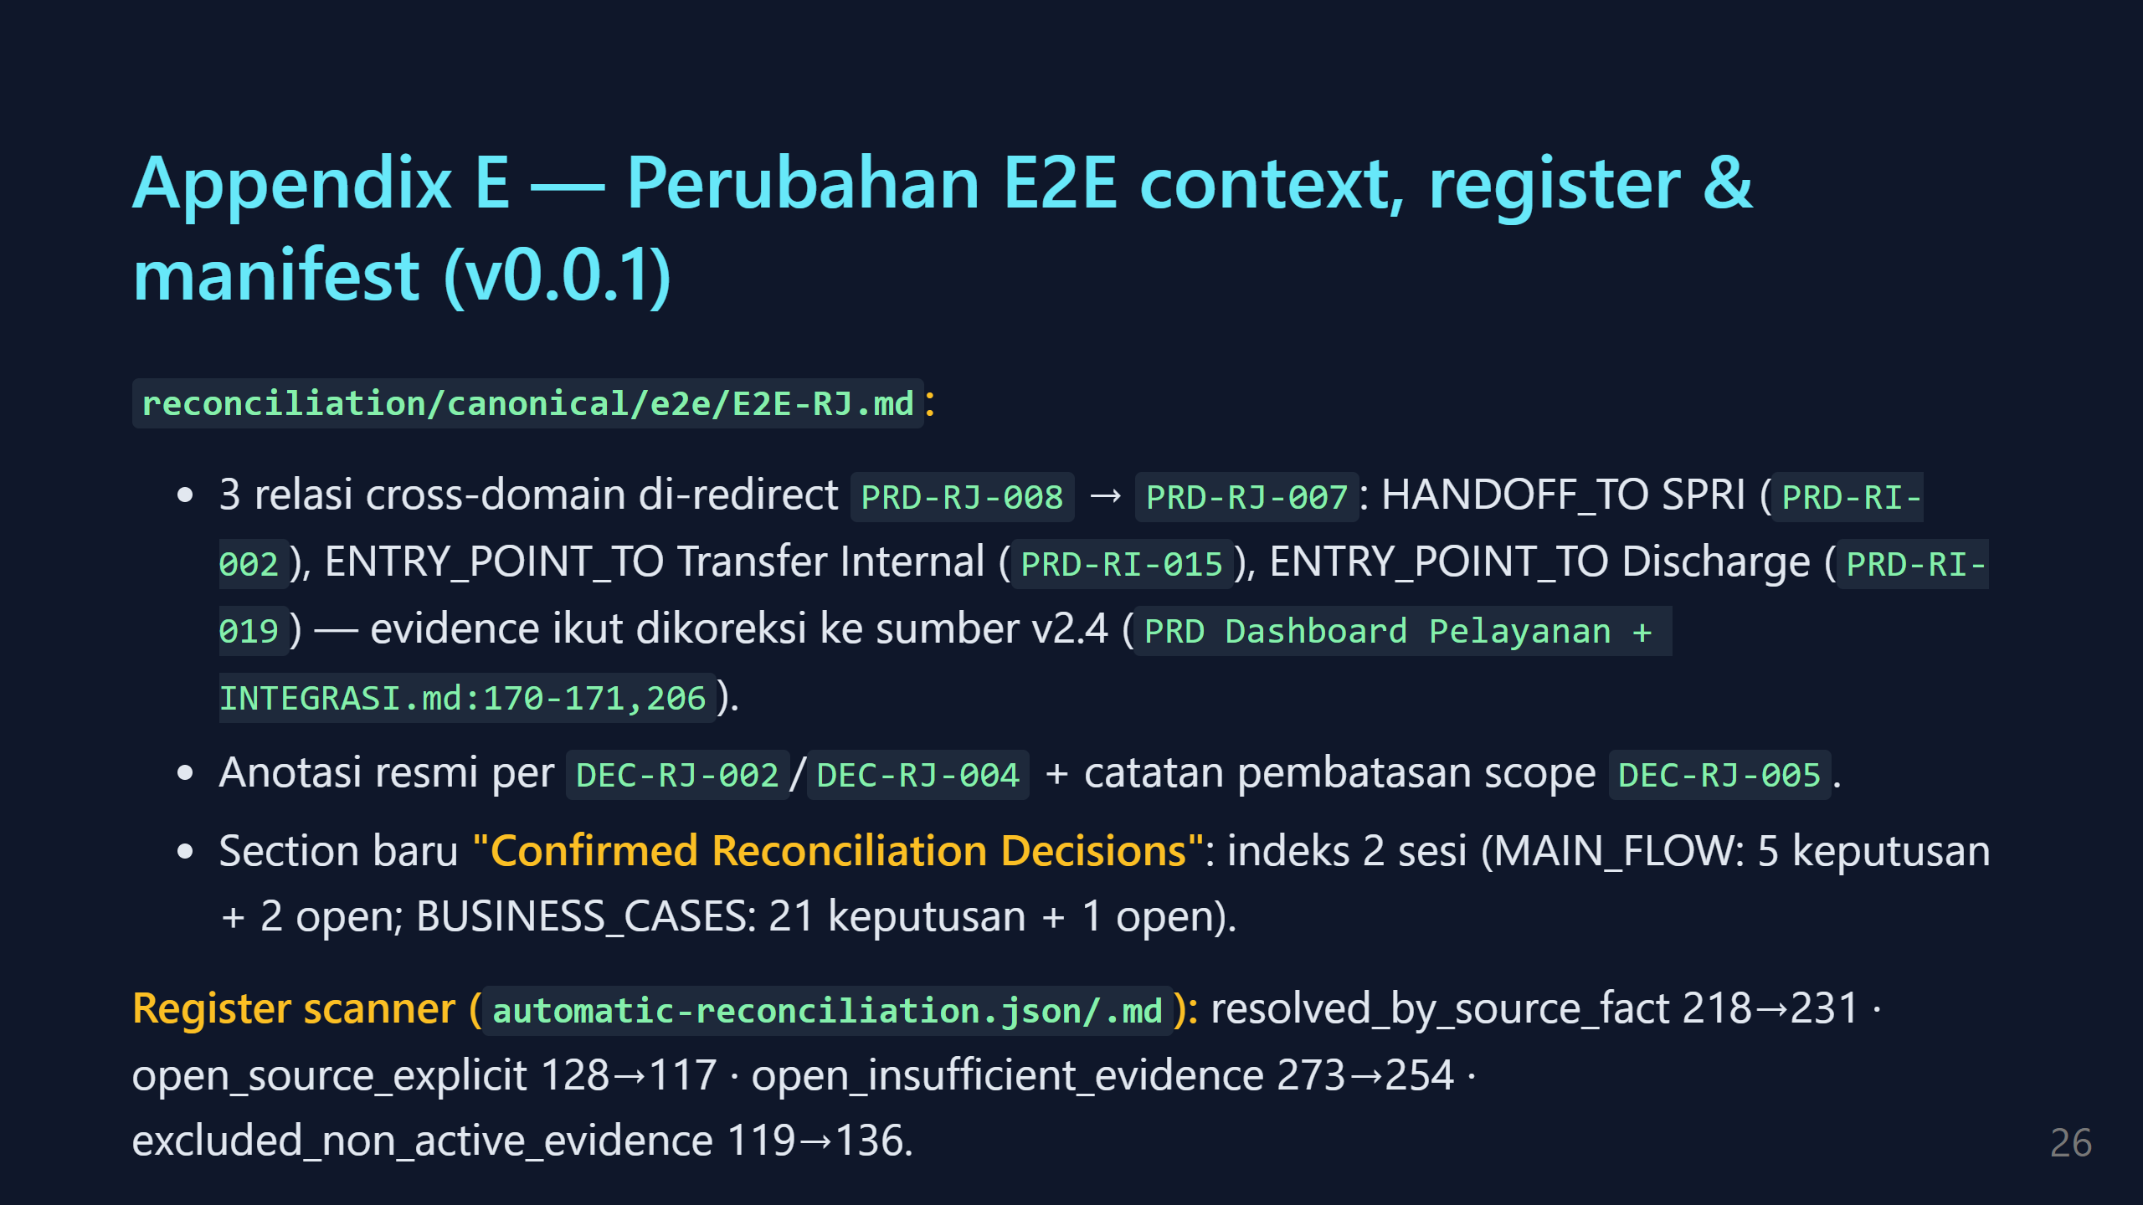

Slide 27
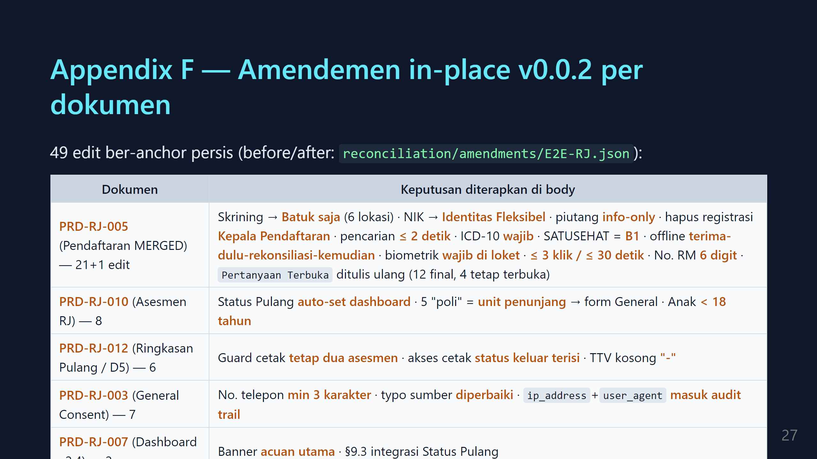

Slide 28

Notes:
===================================================================== CARA RENDER / EXPORT (Marp) ===================================================================== 1. VS Code: install extension "Marp for VS Code" → buka file ini → Ctrl+Shift+P → "Marp: Export Slide As..." → HTML / PDF / PPTX. 2. CLI (tanpa install permanen, dari root repo tools): npx @marp-team/marp-cli -c docs/presentasi/marp.config.js --allow-local-files docs/presentasi/2026-08-24-rekonsiliasi-prd.md --html npx @marp-team/marp-cli -c docs/presentasi/marp.config.js --allow-local-files docs/presentasi/2026-08-24-rekonsiliasi-prd.md --pdf npx @marp-team/marp-cli -c docs/presentasi/marp.config.js --allow-local-files docs/presentasi/2026-08-24-rekonsiliasi-prd.md --pptx Catatan: --allow-local-files wajib agar SVG di assets/ ikut ter-render. Untuk PDF/PPTX tanpa Google Chrome, arahkan ke Edge dulu: $env:CHROME_PATH="C:\Program Files (x86)\Microsoft\Edge\Application\msedge.exe" 3. DIAGRAM: grafik alur adalah SVG hasil render mermaid (sumber .mmd di assets/). Kalau diagram perlu diedit: - edit assets/<nama>.mmd - render ulang (butuh Edge/Chrome, tanpa download Chromium): mmdc -p puppeteer-config.json -i assets/<nama>.mmd -o assets/<nama>.svg -b transparent -s 2 contoh puppeteer-config.json: { "executablePath": "C:\\Program Files (x86)\\Microsoft\\Edge\\Application\\msedge.exe", "args": ["--no-sandbox"] } - export ulang deck seperti langkah 2. CHECKLIST DEMO LIVE (Senin pagi, sebelum masuk ruangan): [ ] Regenerate dashboard: python .codex/skills/neurovi-workspace-dashboard/scripts/workspace_dashboard.py --repo ../neurovi-prd [ ] Buka 2 tab browser: .codex/skills/neurovi-workspace-dashboard/output/index.html .codex/skills/neurovi-workspace-dashboard/output/workspace-E2E-RJ.html [ ] Fallback: slide 7-11 sudah memuat semua angka — presentasi tetap jalan tanpa demo. =====================================================================

