Slide 1
SDAIA ACADEMY · ADVANCED AGENTIC AI SYSTEMS ENGINEERING
Procurement Tender
Compliance & Supplier
Comparison Agent
An auditable path from tender requirements to an evidence-backed award recommendation.
GROUP 5
Alwaleed Alkhdairi · Ammar Al-Ahmadi · Adel Al-Otaibi
27 August 2026
Notes:
Open with the product promise: the system does not replace the procurement committee; it gives the committee a complete, sourced first evaluation pass.
Introduce Group 5 and the capstone context, then move directly to the business risk the product addresses.
[Sources]
- Capstone Project Guide, course presentation and project requirements, 27 Aug 2026.
- Project README.md, title, course statement, and Group 5 team table.

Slide 2
The lowest price can still be the wrong award decision
BUSINESS PROBLEM
Manual tender evaluation is slow, inconsistent, and difficult to defend under review.
01
02
Requirement coverage
Evidence gaps
Every bid must be checked against mandatory and scored criteria.
Missing certificates, SLAs, or schedules can invalidate an offer.
Target user
03
04
Public- and private-sector procurement evaluation teams.
Scoring consistency
Auditability
Weighted criteria must be applied the same way to every supplier.
Every judgement needs a quote, source, and explainable rule.
Expected value
A sourced first-pass evaluation that lets humans review decisions instead of building the matrix from scratch.
02
Notes:
Frame the problem as both an efficiency issue and a governance issue.
Use the BetaGrid example later to prove why price alone cannot determine the award.
The system's value is a complete, sourced draft—not an autonomous procurement decision.
[Sources]
- Project README.md §1–2, business problem, target user, expected value, and agentic justification.
- Capstone Project Guide §1 and §3.1, business goal and target-user requirements.

Slide 3
Supervision separates judgement from arithmetic
Requirement Specialist
Tender interpretation
Vector store
Supervisor
Tender · guidance · bids
Evidence Specialist
Decision package
Procurement officer
Plan · route · validate · aggregate
Bid audit + citations
Recommendation · risks · gaps · sources
Tender · suppliers · instructions
Validated tools
Comparison Specialist
Matrix · score · CSV
Plan-and-Execute
Score · rank · export
Bounded ReAct loops
Judgements stay with agents; reproducible arithmetic stays in tools.
03
Notes:
Explain the main design choice: one supervisor owns the case, while three specialists perform bounded, non-overlapping work.
The supervisor uses Plan-and-Execute. Specialists use bounded ReAct loops to retrieve evidence and call tools.
Emphasize the authority split: agents interpret language; tools calculate matrices, scores, and exports.
[Sources]
- Project README.md §2–3, architecture and reasoning design.
- docs/architecture.md §1 and §3, LangGraph routing and reasoning patterns.
- src/graph/workflow.py and src/agents/ in the submitted repository.

Slide 4
Clear authority boundaries keep the evaluation auditable
01
Supervisor
02
Requirement Specialist
Owns the complete case and decides the next valid step.
Interprets the tender without access to supplier bids.
Plans, routes, checks prerequisites, applies stopping bounds, and combines specialist findings.
Retrieves mandatory requirements, scored criteria, weights, and source sections.
OUTPUT · SupervisorPlan → RouteDecision → FinalReport
OUTPUT · RequirementSet with weights summing to 100
03
Evidence Specialist
04
Comparison Specialist
Audits each supplier against each extracted requirement.
Ranks suppliers without rewriting compliance judgements.
Retrieves bid and guidance passages, quotes evidence, assigns status, and builds the matrix.
Calls deterministic scoring, applies disqualification rules, and exports the comparison CSV.
OUTPUT · EvidenceReport + compliance matrix
OUTPUT · ComparisonResult + exported decision file
04
Notes:
Walk through the contracts quickly: responsibility, permitted actions, output, and completion evidence are explicit in the code and README.
The Requirement Specialist cannot inspect bids, and the Comparison Specialist cannot change the evidence audit. Those boundaries reduce silent bias and duplicated responsibility.
[Sources]
- Project README.md §3, agent contracts table.
- CONTRACT docstrings in src/agents/supervisor.py, requirement_specialist.py, evidence_specialist.py, and comparison_specialist.py.

Slide 5
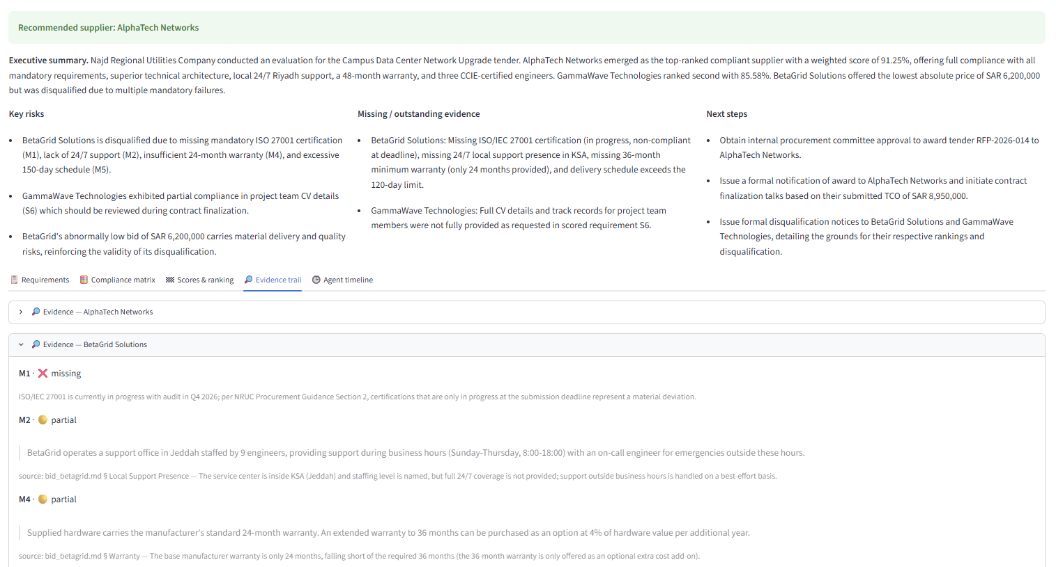
Evidence enters decisions with source metadata intact
AGENTIC RAG
Markdown documents
→ section-aware chunks
→ local MiniLM embeddings
→ persistent Chroma collections
Two scoped collections
Tender knowledge and supplier bids remain separated, while each result carries file, section, and chunk ID.
Three memory layers
TenderState · one run
CaseMemory · active session
Chroma · reusable knowledge
The Evidence Trail exposes the same metadata used by the agents.
05
Notes:
Separate state, short-term memory, and long-term retrieval. The workflow state holds structured artifacts; CaseMemory supports follow-up Q&A; Chroma persists the reusable document knowledge.
Point to the screenshot: retrieval is not decorative. Source metadata flows into compliance judgements and remains visible in the evidence trail.
[Sources]
- docs/architecture.md §2, §5, and §7, state, RAG, and memory layers.
- src/rag/ and src/memory/store.py in the submitted repository.
- User-provided screenshot 3684023b-9359-4693-a409-01370ff82fb5.png.

Slide 6
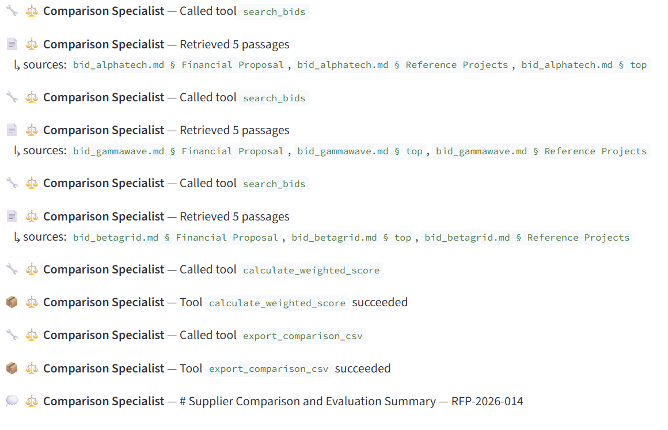
Agents judge; deterministic tools calculate
01
build_compliance_matrix
Creates requirement × supplier status, missing mandatory items, and disqualification flags.
02
calculate_weighted_score
Validates weights and scores, calculates totals, applies tie-breaks, and ranks suppliers.
03
export_comparison_csv
Exports matrix, gaps, scores, evidence, and recommendation in a reviewable file.
Pydantic validation
Structured tool errors
Bounded agent loops
No fabricated success
Python · LangGraph · Gemini/Claude · Chroma · Pydantic · Streamlit · Altair
06
Notes:
Explain that retrieval tools are separate from the three graded business tools shown here.
The registry validates every tool input with Pydantic. Invalid inputs return a structured error to the agent so it can correct itself without crashing the application.
Stopping bounds and honest failure handling prevent runaway delegation and false success.
[Sources]
- Project README.md §3–4, agent tools and technology stack.
- docs/architecture.md §3, §6, and §8, reasoning, tool registry, and error handling.
- User-provided screenshot 10c9be11-b7cd-44b0-a5e2-60350d1312b3.png.

Slide 7
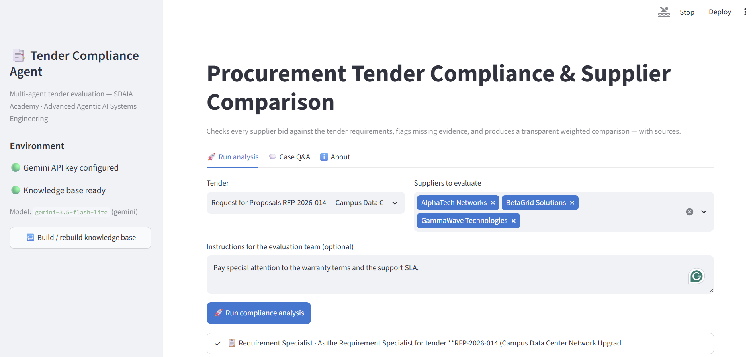
The application exposes every important workflow stage
01
Select the tender and suppliers
02
Add evaluation emphasis
03
Watch routing, evidence, and tools
04
Review matrix, ranking, sources, and CSV
Case Q&A continues from session memory without rerunning the full evaluation.
07
Notes:
Use this as the live-demo bridge. Show the sidebar readiness indicators, select all three suppliers, and keep the instruction about warranty and support SLA.
During the run, call attention to the active agent, retrieval events, tool calls, and completion status—not raw hidden chain-of-thought.
After the run, open Case Q&A and ask: Why was BetaGrid disqualified?
[Sources]
- Project README.md §7, application usage and demo scenario.
- docs/rubric_map.md §3.4–3.5, working application and suggested demo flow.
- User-provided screenshot cf9cf481-7833-4a32-a059-80966253c494.png.

Slide 8
AlphaTech wins on compliance—not price alone
1st · 91.25
AlphaTech Networks
Passes all mandatory requirements; 48-month warranty.
2nd · 85.58
GammaWave Technologies
Qualified; project-team CV evidence needs review.
DQ · 51.00
BetaGrid Solutions
SAR 6.2M; mandatory failures: M1 / M2 / M4 / M5.
Run-specific LLM scores may vary slightly; weighting arithmetic and disqualification rules are deterministic.
08
Notes:
Start with the decision: AlphaTech is recommended because it is the highest-ranked qualified bidder.
Then make the business point: BetaGrid offered the lowest price, but mandatory failures disqualified it. The system prevents price from overriding compliance.
Clarify reproducibility: agents may vary slightly in qualitative scores, while the scoring arithmetic and disqualification logic are deterministic tools.
[Sources]
- User-provided ranking screenshot 8ec4992b-34c2-4568-894e-e40d522694e0.png, showing 91.25, 85.58, and 51.00.
- User-provided executive summary screenshot 13141bec-4745-4895-8602-9c083cde6dbd.png, BetaGrid SAR 6.2M and mandatory failures.
- Project README.md §7, expected demo result and deterministic-tool caveat.

Slide 9
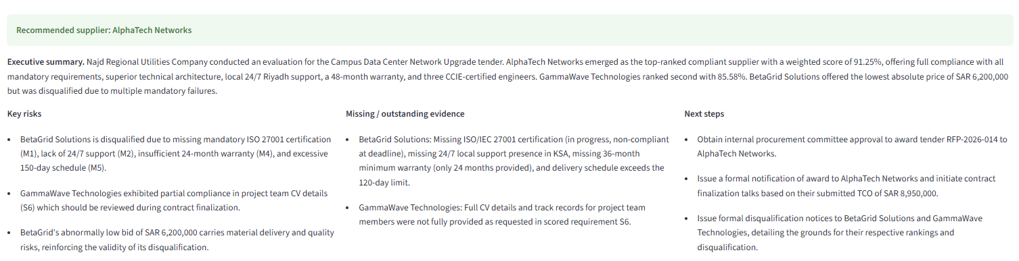
The decision package is reviewable and exportable
01
02
03
04
05
Recommendation
Risk register
Evidence gaps
Comparison
Export
Qualified winner and rationale
Material deviations and caveats
Missing or outstanding documents
Matrix, weighted ranking, and status
Downloadable multi-section CSV
09
Notes:
Show that the product returns more than a ranking. It produces the complete review package: recommendation, risks, missing evidence, matrix, scores, source trail, and CSV.
This is the handoff to a human procurement committee. The committee can review the judgement, verify the evidence, and approve or challenge the recommendation.
[Sources]
- Project README.md §2 and §7, solution outputs and application usage.
- User-provided screenshot 13141bec-4745-4895-8602-9c083cde6dbd.png.
- src/tools/export_comparison.py in the submitted repository.

Slide 10
Next: real documents and human approval gates
HONEST LIMITATIONS
PRACTICAL ROADMAP
01
Markdown-only ingestion; one tender and three synthetic bids.
01
PDF / DOCX + Arabic ingestion
02
Human review checkpoints before finalization
02
Implicit evidence can be judged missing; qualitative scores may vary.
03
Parallel per-supplier evidence audits
03
Specialists run sequentially, increasing end-to-end latency.
04
Golden-case evaluation harness
Accelerate the first pass. Keep the award decision human.
github.com/AlwaleedAlkhdairi/tender-compliance-agent
Group 5 · SDAIA Academy
10
Notes:
State one limitation and one improvement explicitly to satisfy the presentation rubric, then add the rest only if time allows.
Close by resolving the opening promise: the system accelerates evidence collection and comparison while leaving the award authority with humans.
Invite technical questions on LangGraph state, retrieval scoping, tool validation, or failure handling.
[Sources]
- Project README.md §8 and §10, synthetic data, limitations, and future improvements.
- Capstone Project Guide §3.5, requirement to state one honest limitation and one realistic future improvement.
- GitHub repository: https://github.com/AlwaleedAlkhdairi/tender-compliance-agent

