Slide 1
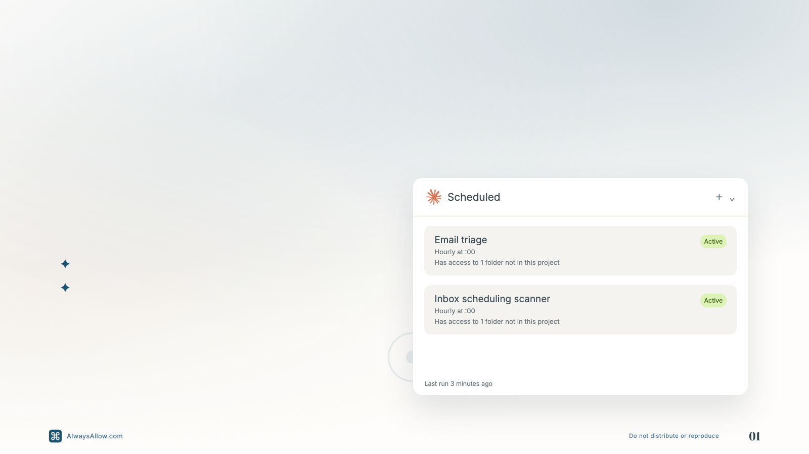
Scheduled tasks make repeated work easier to trust.
Use them for scans, triage, reminders, and recurring checks that should run with project context.
Bespoke tasks stay close to the project.
Reusable tasks handle the patterns you repeat.
Notes:
Slide 1 of 17. Editable text overlays on the approved visual system.

Slide 2
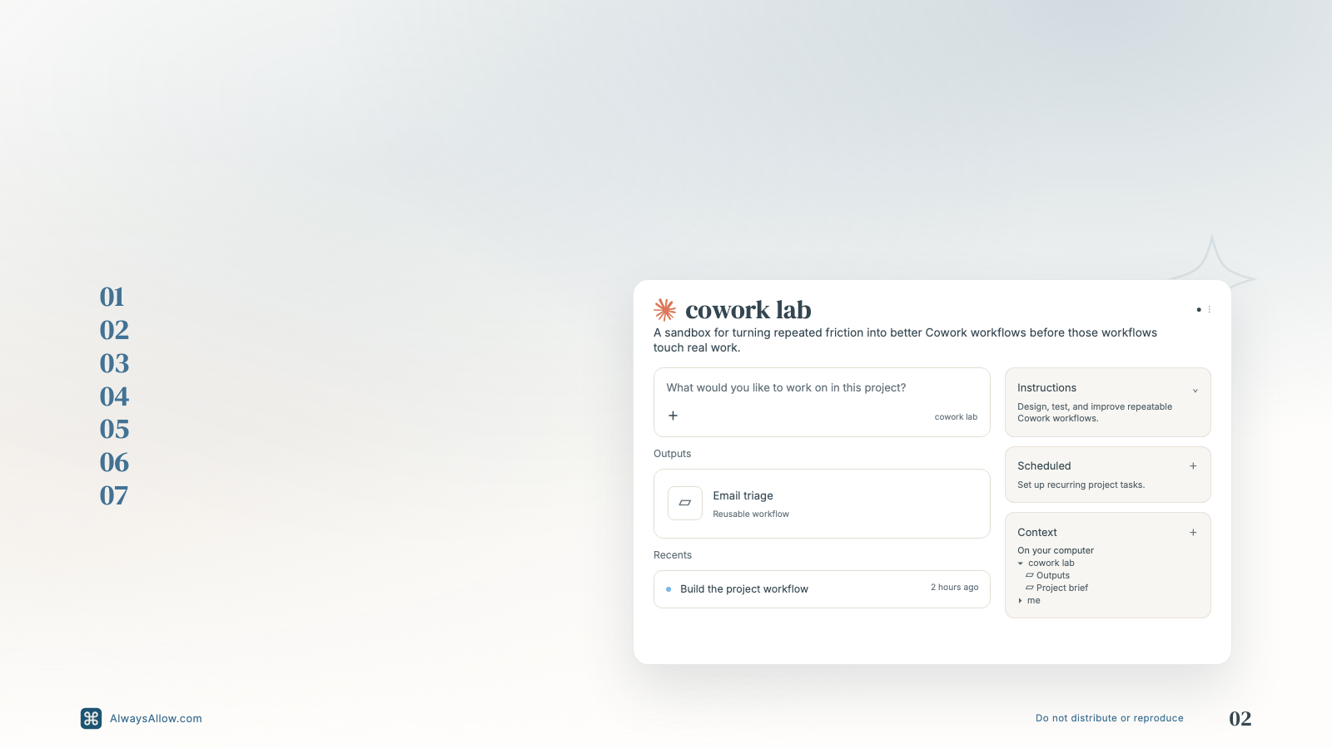
Build the system in Cowork Lab before you trust it with real work.
Open Cowork Lab.
Reorganize the local files.
Build your
/me
context.
Create one focused project.
Sort obvious old chats.
Review the rest for patterns.
Bring friction back to the lab.
Notes:
Slide 2 of 17. Editable text overlays on the approved visual system.

Slide 3
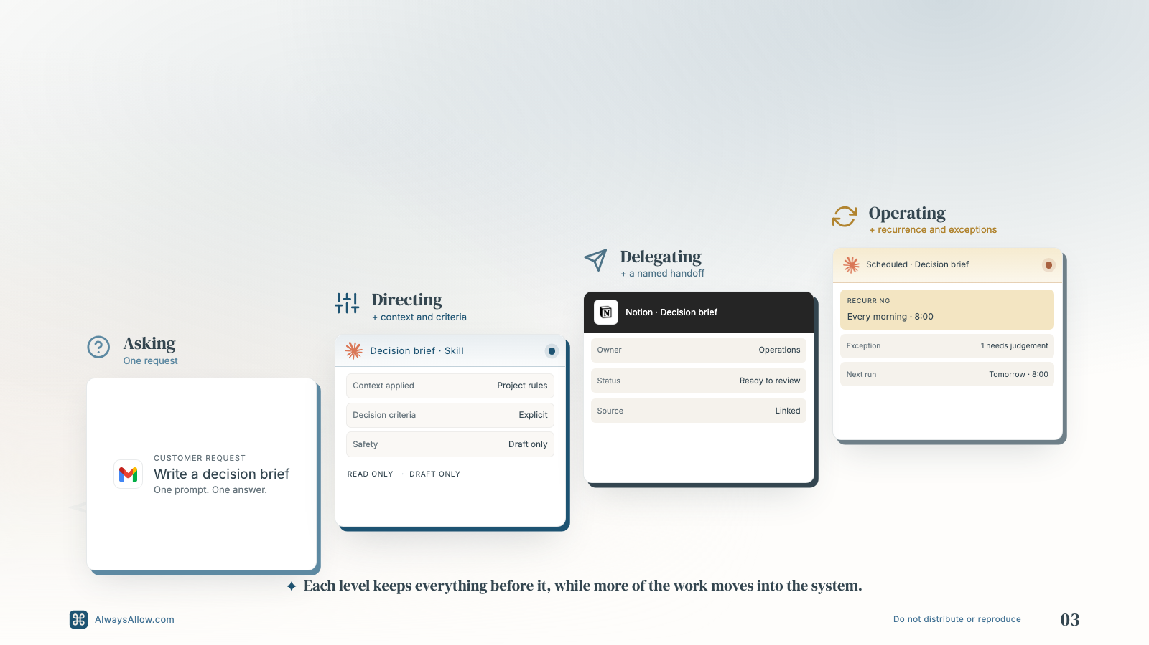
Moving up means adding to what you already do, not starting something new.
Notes:
Slide 3 of 17. Editable text overlays on the approved visual system.

Slide 4
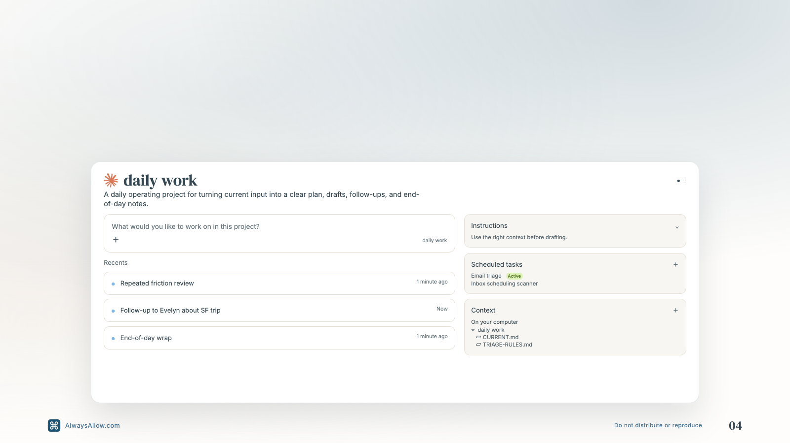
A strong project puts instructions, context, and a visible trail in one place.
Notes:
Slide 4 of 17. Editable text overlays on the approved visual system.

Slide 5
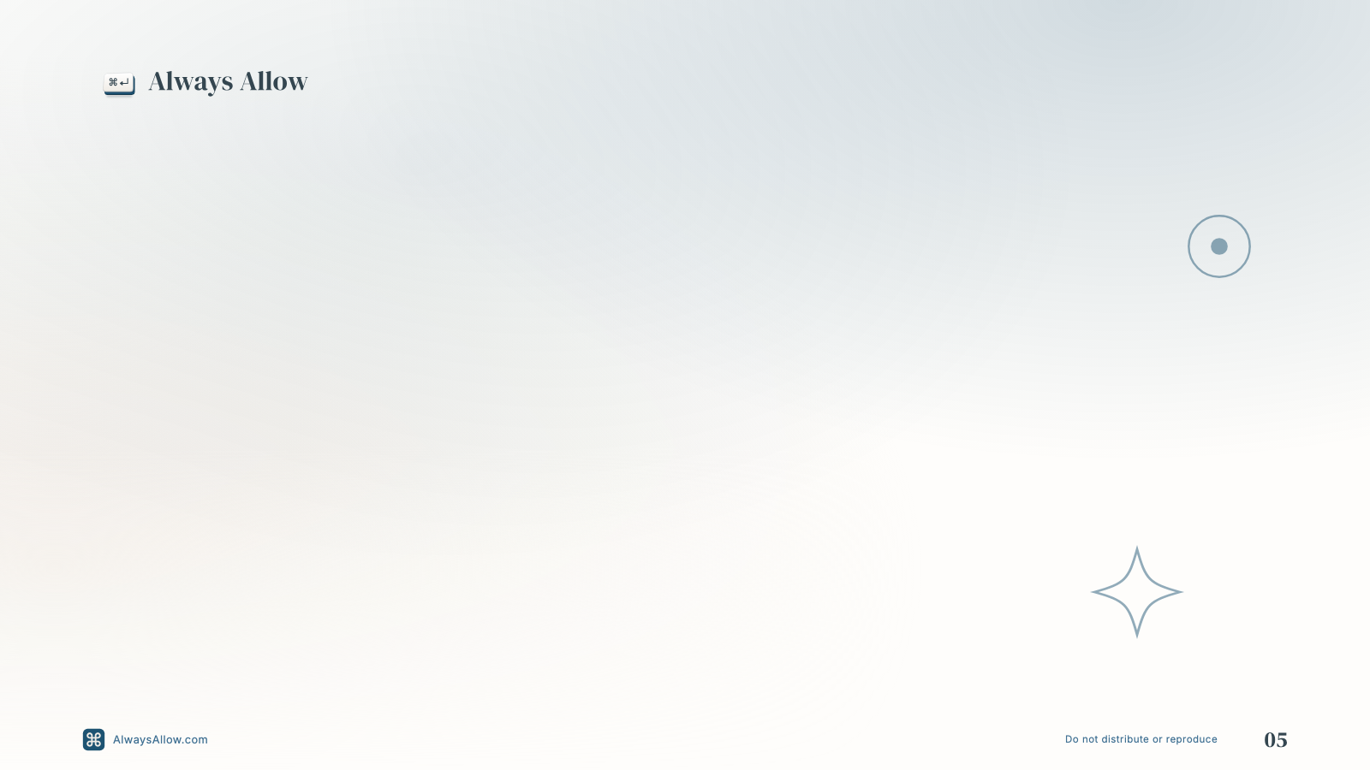
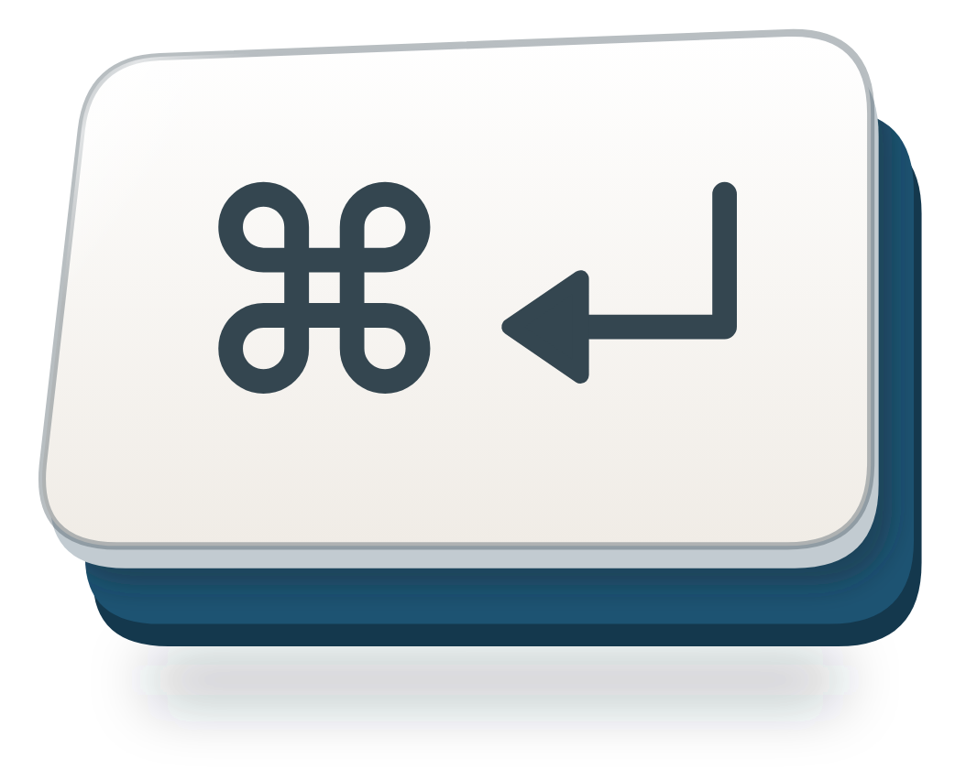







PRIVATE WORKSHOP · SEPTEMBER 2026
Build the
system.
A working session built around the work your team already does.
YOUR STACK
Notes:
Slide 5 of 17. Editable text overlays on the approved visual system. The tool icons are separate, replaceable image objects for a client-specific stack.

Slide 6

The pattern is
already in the work.
Notes:
Slide 6 of 17. Editable text overlays on the approved visual system.

Slide 7

Direct
the work.
Do not decorate
the answer.
The instruction should carry judgement, boundaries, and the finish line.
Notes:
Slide 7 of 17. Editable text overlays on the approved visual system.

Slide 8
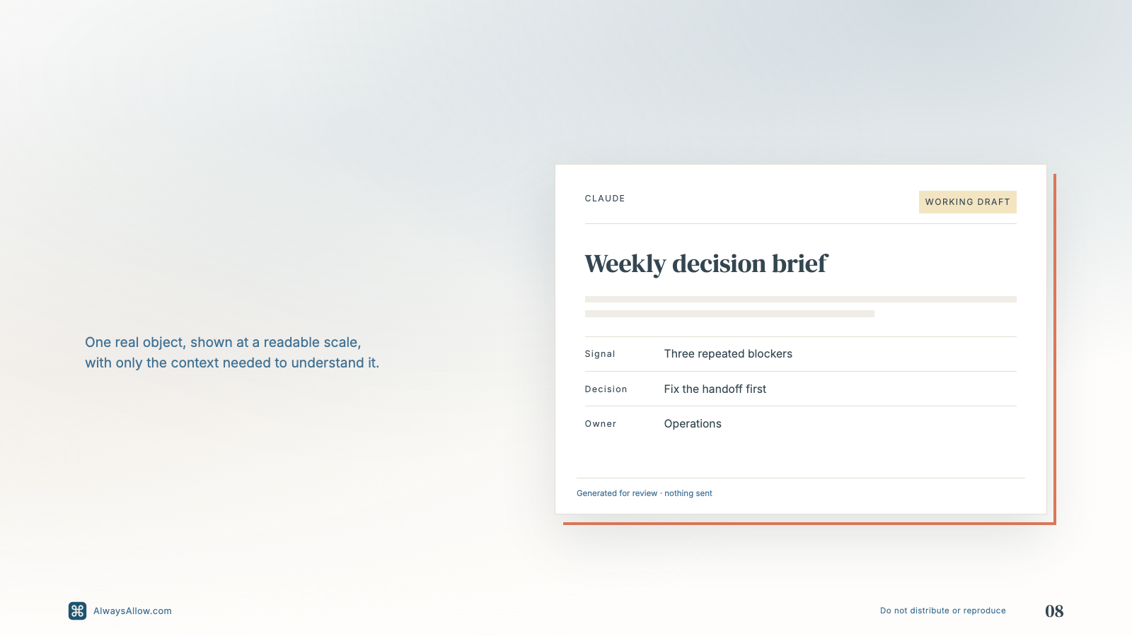
The output
should show
its judgement.
Notes:
Slide 8 of 17. Editable text overlays on the approved visual system.

Slide 9
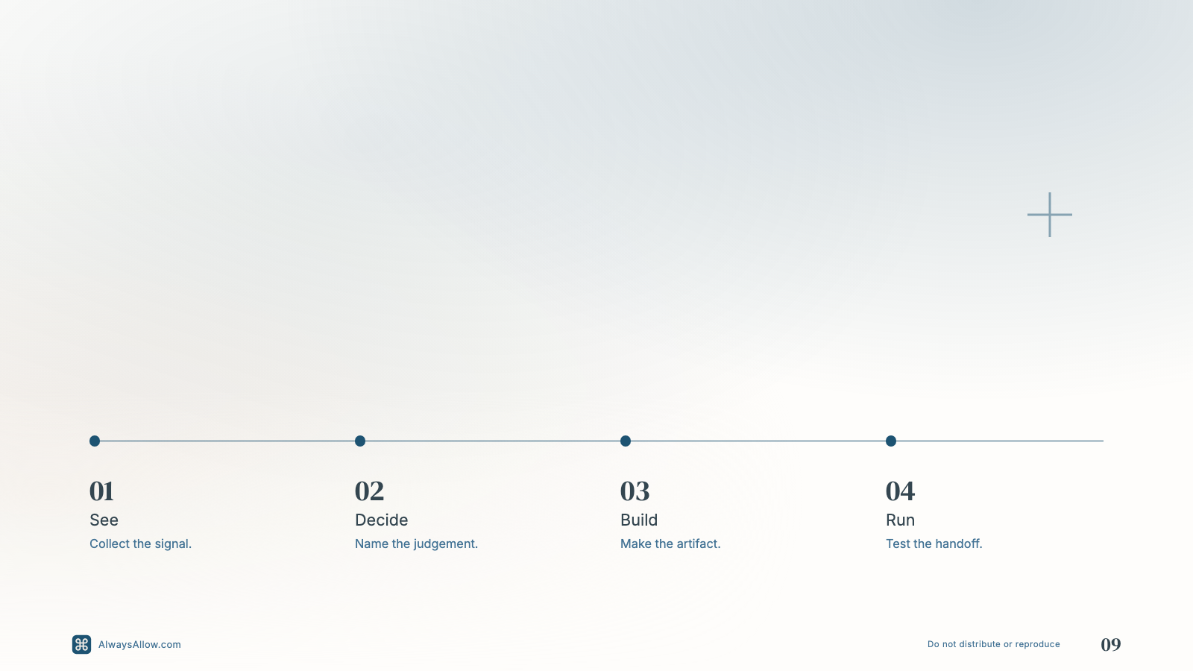
One line carries
the whole handoff.
Notes:
Slide 9 of 17. Editable text overlays on the approved visual system.

Slide 10
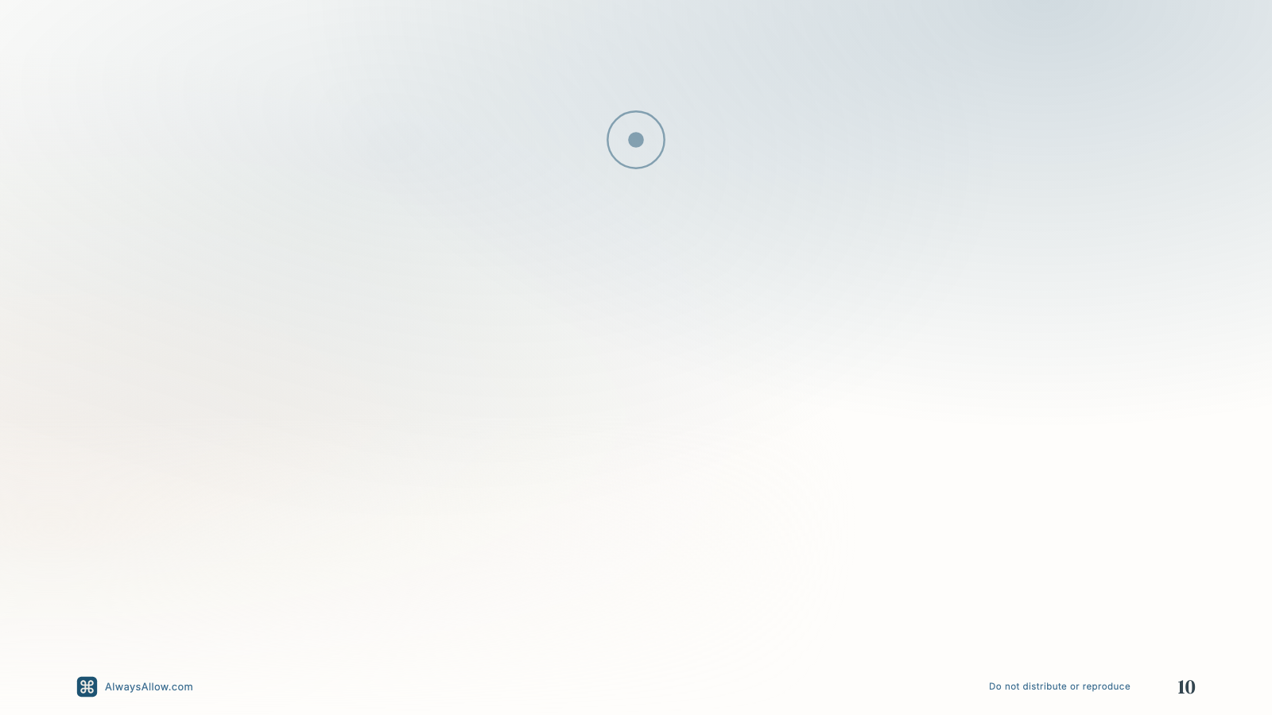
BEFORE
AFTER
“Write me
“Run the
an update.”
update system.”
One request. One answer. The judgement stays hidden.
Inputs, decisions, format, safety, and handoff are explicit.
Notes:
Slide 10 of 17. Editable text overlays on the approved visual system.

Slide 11
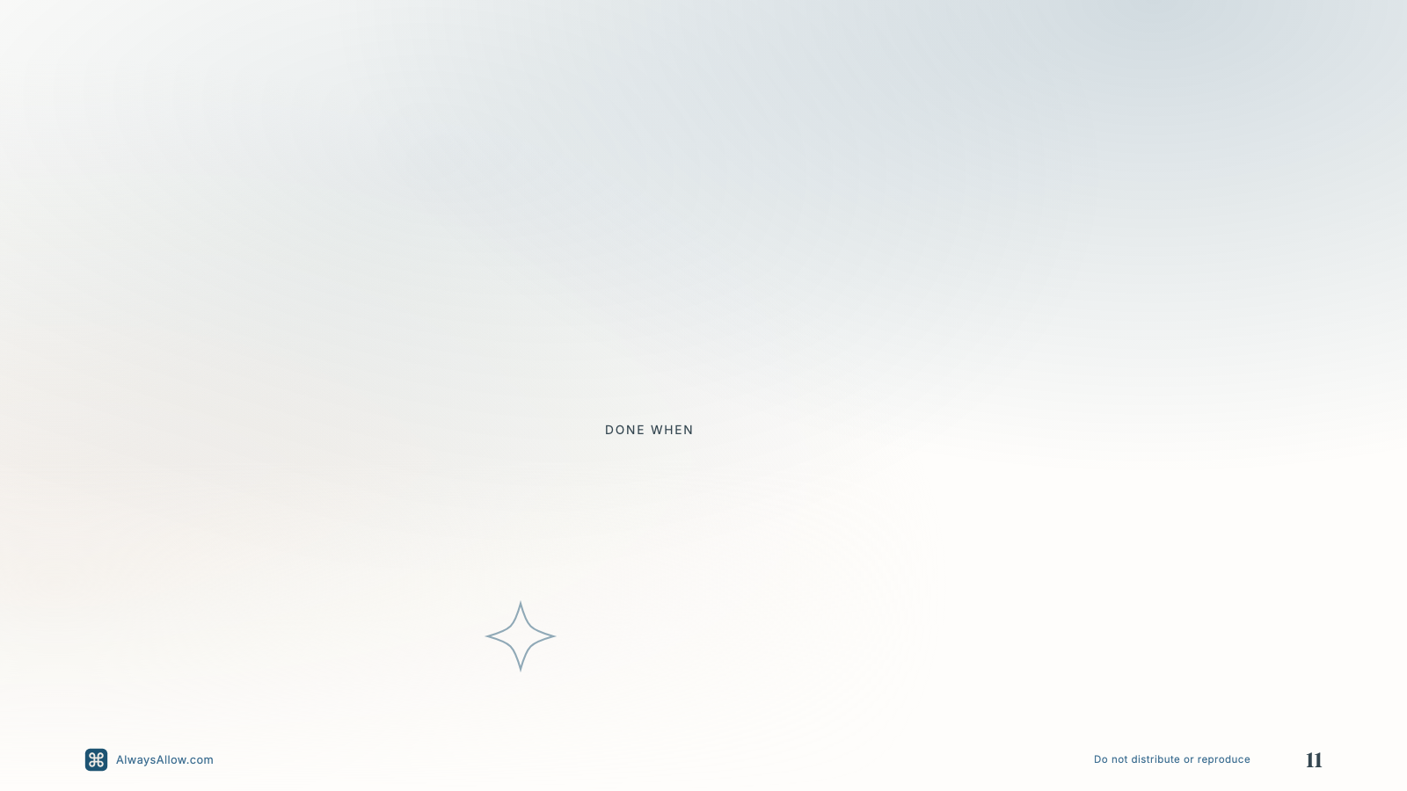
Build the instruction
12
you wish you had.
Choose one repeated handoff. Name the input, judgement, output, and stop condition.
MINUTES
Someone else can run the first pass without asking what you meant.
Notes:
Slide 11 of 17. Editable text overlays on the approved visual system.

Slide 12
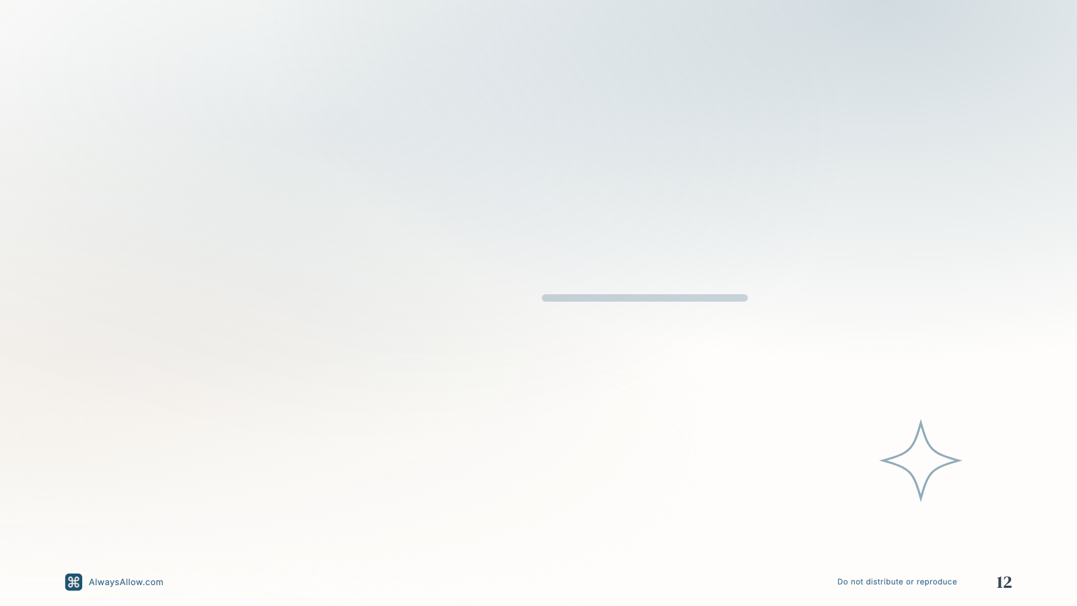
Leave with
something that
works.
AlwaysAllow.com/engagements
Notes:
Slide 12 of 17. Editable text overlays on the approved visual system.

Slide 13
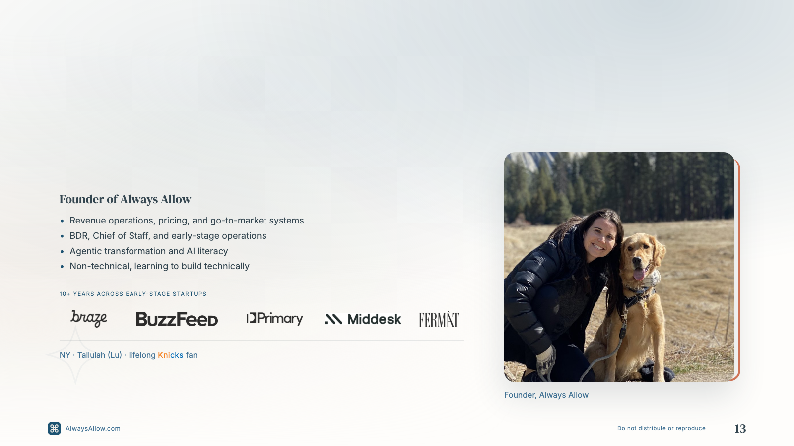
I’m Sarah Madden, but everyone calls me Smadds.
Notes:
Slide 13 of 17. Editable text overlays on the approved visual system.

Slide 14
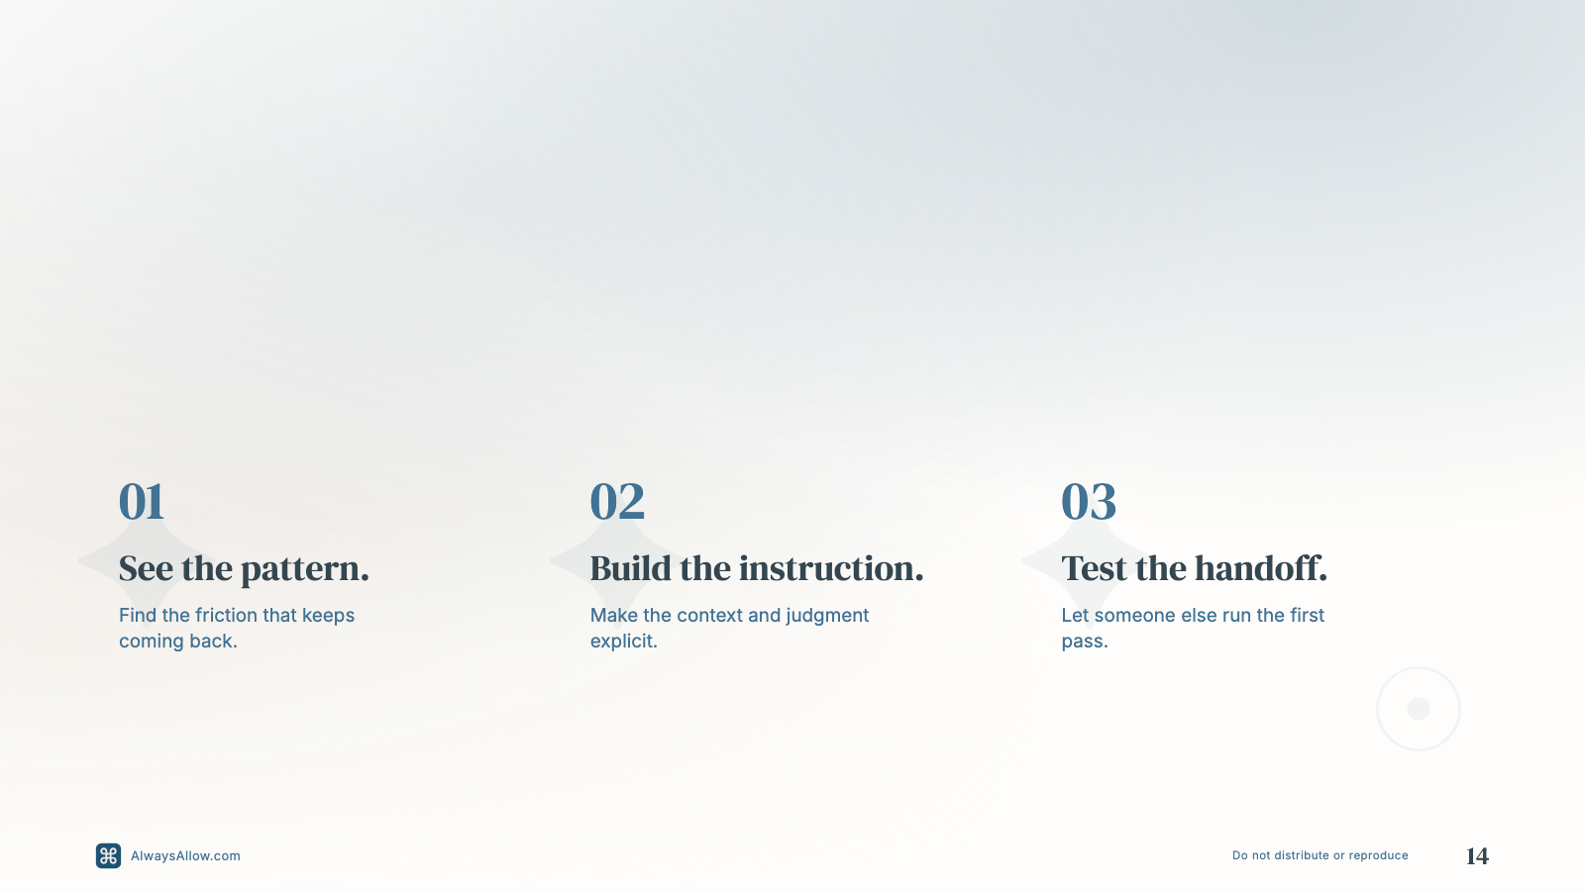
Today, we’ll turn one repeated task into a system someone else can run.
Notes:
Slide 14 of 17. Editable text overlays on the approved visual system.

Slide 15

A system is the judgment you no longer have to repeat.
A repeatable way of working carries enough context and judgment for someone else, or an AI system, to run the first pass.
It knows what to read.
It knows what to decide.
It knows when to stop.
Notes:
Slide 15 of 17. Editable text overlays on the approved visual system.

Slide 16
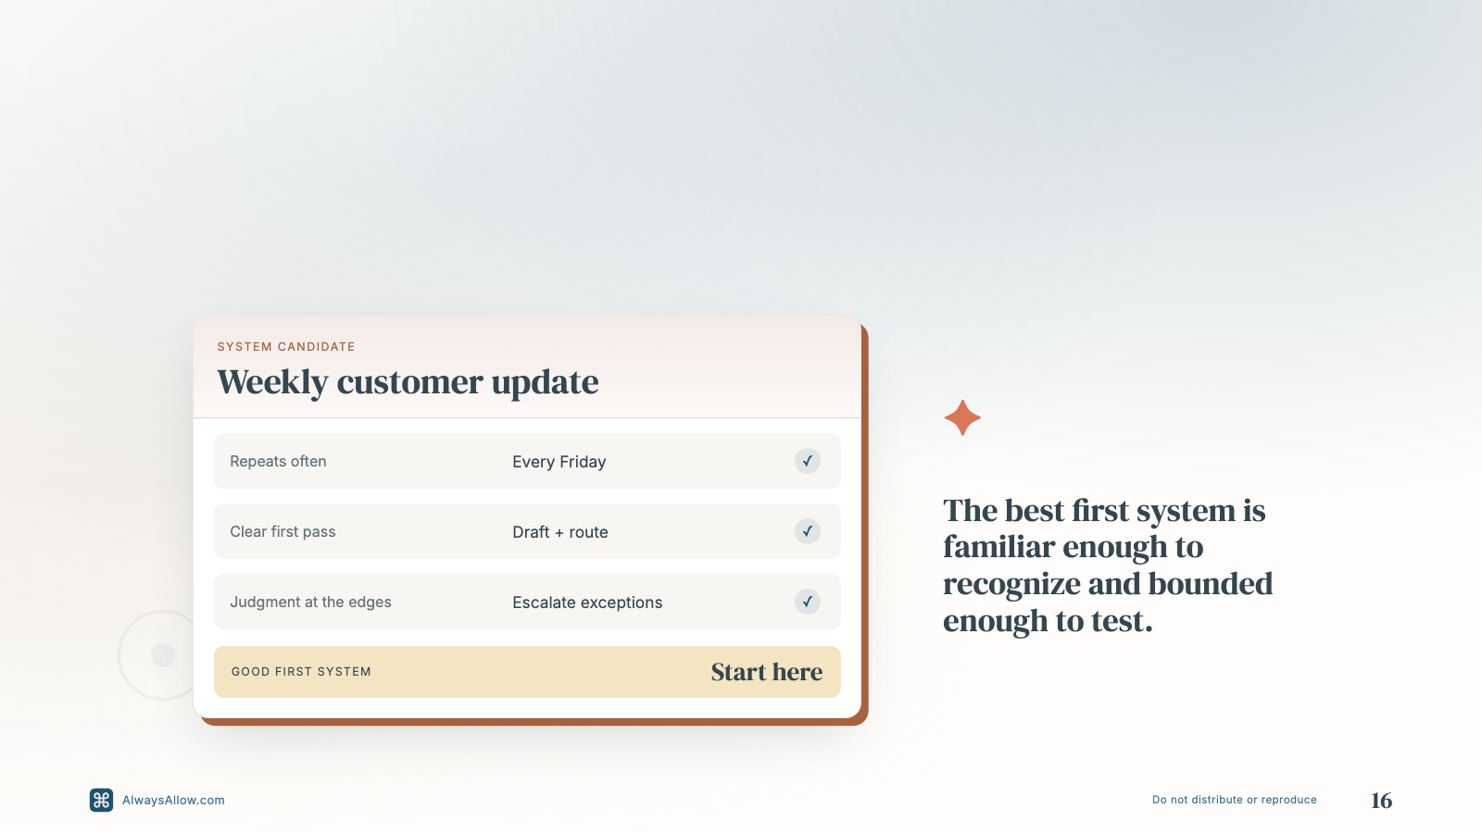
Choose work that repeats, has a clear first pass, and still needs judgment.
Notes:
Slide 16 of 17. Editable text overlays on the approved visual system.

Slide 17

If you remember three things, remember these.
03
01
02
A handoff is real when someone else can run it.
Context changes the output.
Criteria make judgment visible.
TOOLS USED
Notes:
Slide 17 of 17. Editable text overlays on the approved visual system. The tool icons are separate, replaceable image objects for a client-specific stack.

