Slide 1
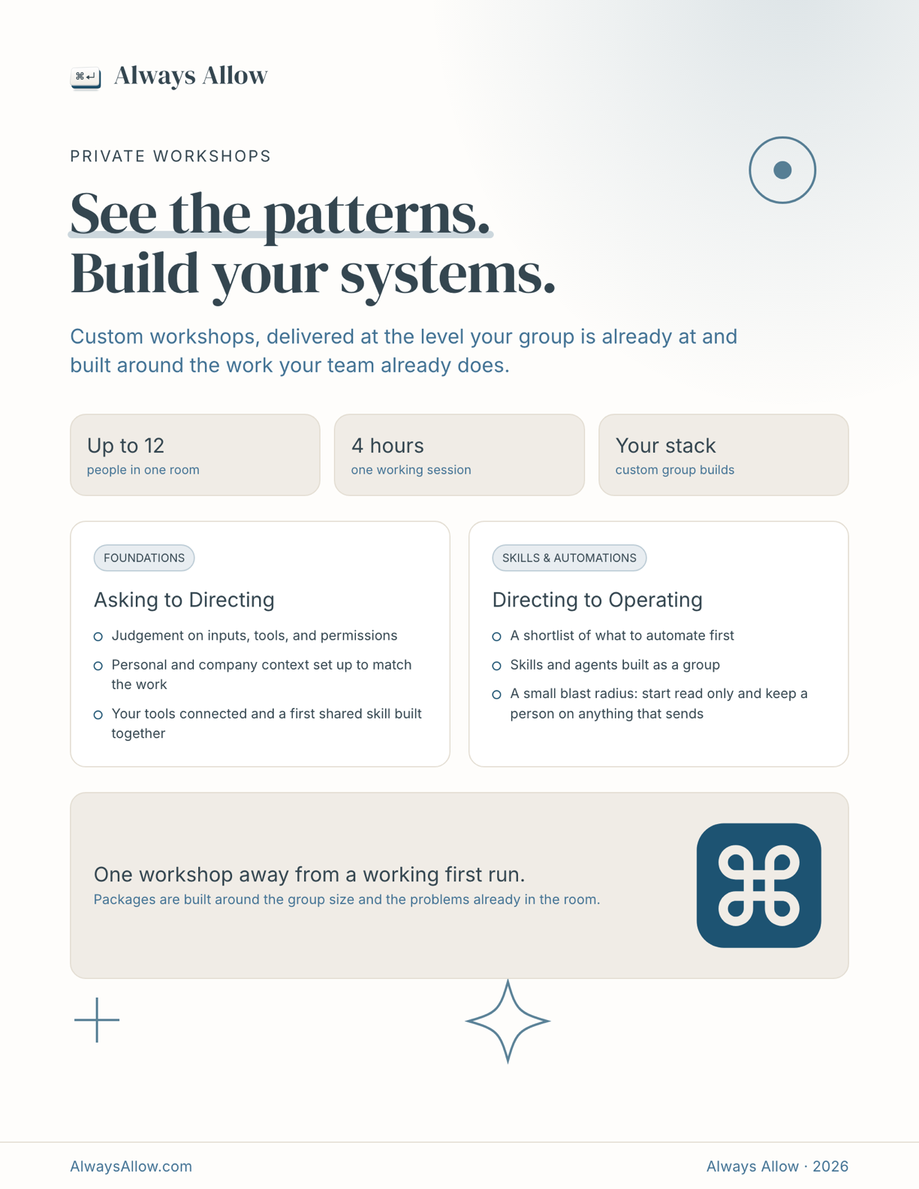




PRIVATE WORKSHOPS
See the patterns.
Build your systems.
Your stack
custom tools and access
Custom workshops, built around the work your team already does and the systems you want to run.
○ Judgement on inputs, tools, and permissions
○ Personal and company context matched to the work
○ Your tools connected and a first shared skill built
Up to 12
people in one room
4 hours
one working session
○ A shortlist of what to automate first
○ Skills and agents built as a group
○ Start read only, then expand with clear permission boundaries
SKILLS & AUTOMATIONS
FOUNDATIONS
Asking to Directing
Directing to Operating
CUSTOMIZE YOUR STACK
One workshop away from a working first run.
Replace the sample icons with the tools your team uses.
Do not distribute or reproduce · 01
Notes:
Template guide: Edit the workshop promise, format, modules, and stack icons. Keep the logo, footer, palette, and spacing consistent.
[Sources]
- Always Allow Visual Identity Guide, internal brand source.
- Always Allow workshop one-pager source, internal.
[/Sources]

Slide 2
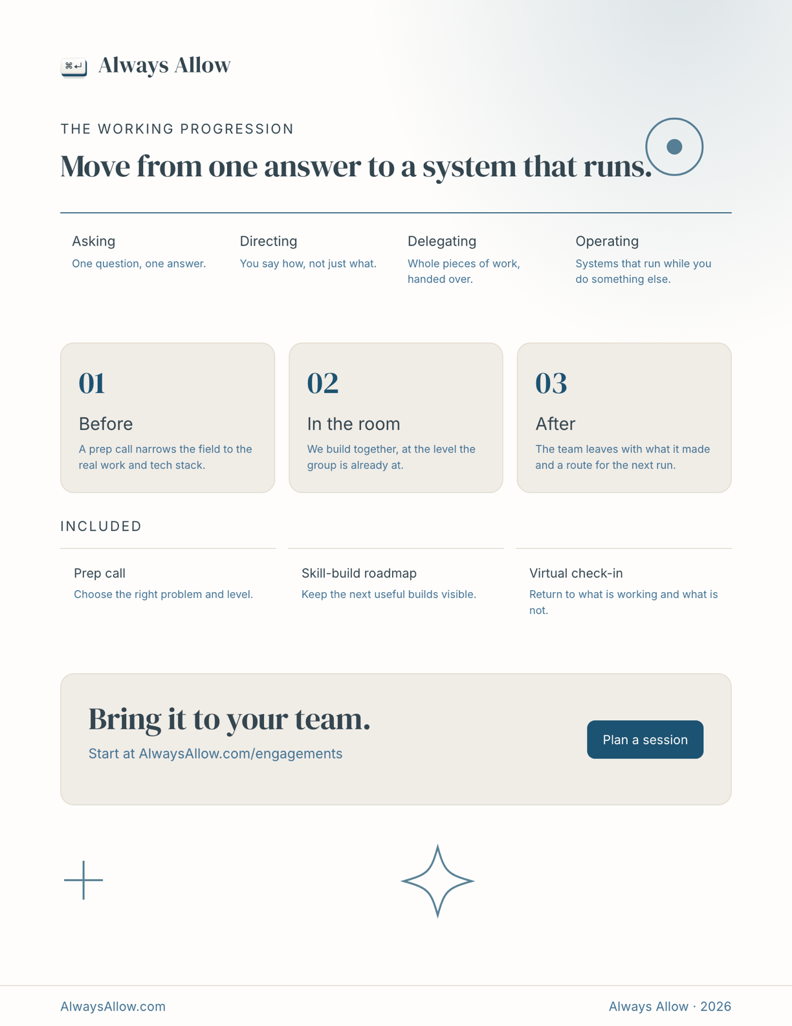
Operating
Systems that run while you do something else.
Delegating
Whole pieces of work, handed over.
THE WORKING PROGRESSION
Asking
One question, one answer.
Directing
You say how, not just what.
Move from one answer to a system that runs.
The team has what it made, a skill-build roadmap, and the next useful run.
A prep call narrows the field to the real work, audience, and tech stack.
The group builds at the level it is already at, using real work.
01
02
03
Skill-build roadmap
Keep the next useful builds visible.
In the room
Before
After
Virtual check-in
Return to what is working and what is not.
Prep call
Choose the right problem and level.
INCLUDED
Start at AlwaysAllow.com/engagements
Bring it to your team.
Do not distribute or reproduce · 02
Notes:
Template guide: Edit the progression, engagement stages, included deliverables, and call to action. Keep the page structure stable so future workshop handouts remain consistent.
[Sources]
- Always Allow Visual Identity Guide, internal brand source.
- Always Allow workshop one-pager source, internal.
[/Sources]

