Slide 1
CompTIA Network+ (N10-009) Learning Summary
Presented by: Ibrahim Khan
Under the program of TISS Winter Internship Program 2025-26

Slide 2
Who is CompTIA (Computing Technology Industry Association)?
The largest provider of IT certifications, worldwide reach and certifications offered in many different languages.

Slide 3
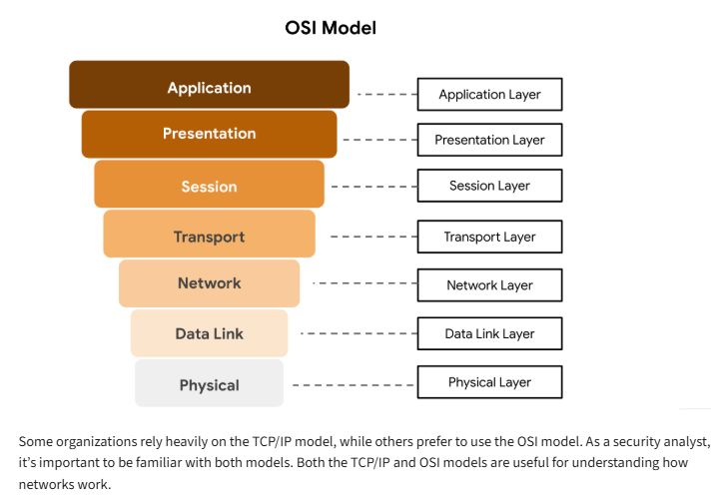
Understanding the OSI Model
Physical Layer
(cables, signaling, connectors).
Data Link Layer
(MAC addresses, switch).
Network Layer
(IP addresses, routing, packets).
Transport Layer
(TCP/UDP).
Session Layer
(Managing sessions start/end).
Presentation Layer
(encrypts/decrypts,compresses/decompress, apps).
Application Layer
(HTTPS, FTP, DNS).

Slide 4
Network Devices
A router is a network device that connects multiple networks together, routers operates at layer 3 of the OSI model.
A switch makes connections between specific devices on a network, switch operates at the layer of 2 of the OSI model.
A firewall is a network security device that monitors traffic to or from your network.
An intrusion detection system (IDS) is an application that monitors system activity and alerts on possible intrusions.
An intrusion prevention system (IPS) is an application that monitors system activity for intrusive activity and takes action to stop the activity
A load balancer distributes incoming network traffic across multiple servers to ensure no single server is overwhelmed.

Slide 5
Common Protocols and their Ports
Protocol | Port | Description
SSH | 22 | A secure way to control a computers remotley.
SFTP | 22 | Securely moves files between computers using the same method as SSH.
Telnet | 23 | An outdated and unsafe way to control a computer remotely.
SMTP | 25 | The standard method for sending emails from one server to another.
NTP | 123 | Keeps all the clocks on a network perfectly in sync.
SNMP | 161 | Helps network administrators watch over and manage network equipment like routers, switches etc.
LDAPS | 636 | LDAPS (Lightweight Directory Access Protocol Secure) is used to access and manage information in a central database.
SMB | 445 | The service that lets you share files and printers across Windows computers.
RDP | 3389 | A service that lets you remotely view and use another computer's full desktop screen.

Slide 6
Basics of binary math
A bit (0 or 1) A byte = 8 bits often called octet
A binary conversion chart to decimal
128 64 32 16 8 4 2 1
0 0 0 0 0 0 0 0
What is binary 00000010 in decimal?
128 64 32 16 8 4 2 1
0 0 0 0 0 0 1 0
0 + 0 + 0 + 0 + 0 + 0 + 2 + 0 = 2 decimal
What is decimal 154 in binary?
128 64 32 16 8 4 2 1
1 0 0 1 1 0 1 0 = 10011010 in binary
128 + 0 + 0 +16 +8 + 0 + 2 + 0 = 154 decimal1

Slide 7
What is subnetting?
Subnetting is the process of splitting larger network into smaller networks.
Calculation of the IPv4 class C address: IP(192.168.4.77) Subnet Mask(255.255.255.0)
 | Network | Host
 | 192.168.4. | 77
Network address (set all host bits to 0) | 192.168.4. | 0
First host address (add one) | 192.168.4. | 1
Broadcast address (set all host bits to | 192.168.4. | 255
Last host address (subtract one) | 192.168.4. | 254
Calculating subnets and hosts in 127.16.55.0/21
11111111.11111111.11111000.00000000
Total subnets = 5 bits = 2⁵ = 32
Host per subnet = 11 bits = 2¹¹-2 = 2,048 =2,046
Network = 16 bits
Sub= 5
Host = 11

Slide 8
Zero Trust
Zero Trust in networking is always verify, constantly authenticating users, devices, and applications, regardless of location.
Authentication: who they claim to be before granting access to a network or resources.
Authorization: is the security process that decides what an authenticated user can do.
Least Privilege Access: Grant only the minimum permissions needed to perform their job.

Slide 9
Infrastructure as code (IaC) is the ability to provision and support your computing infrastructure using code instead of manual processes and settings.
Static routing involves manually configured, fixed routes suitable for small, stable networks.
dynamic routing uses automated protocols to discover and update routes, making it ideal for larger, more complex networks.
VLANs (Virtual LANs) logically segment a single physical network into multiple separate broadcast addresses (like different LANs)
Trunk is the port (like a switch-to-switch cable) that carries traffic for multiple VLANs.
port bonding connecting multiple interfaces to make the network stable and fast.
STP (Spanning Tree Protocol) is a Layer 2 network protocol that creates a loop-free logical topology for an Ethernet network.

Slide 10
Network Solutions
Network discovery is the process of automatically identifying devices and connections within a network
Traffic analysis examining network data to understand usage patterns, detect issues, and optimize performance
Performance monitoring continuously tracking network and device metrics to ensure systems operate efficiently and reliably
Network redundancy adding extra or backup network paths, devices so the network keeps running even if one part fails
NTP (Network Time Protocol) a protocol used to synchronize the clocks of computers and network devices to a precise, common time source.

Slide 11
Virtual Private Network (VPN)
A VPN creates a secure, encrypted tunnel over a public network so users can safely access private network resources.
Client-to-Site VPN: A type of VPN where a user installs a VPN client on their device to securely connect to a company’s internal network from a remote location.
Clientless VPN: A VPN that does not require installing any software; users access internal resources securely through a web browser, usually over SSL.

Slide 12
Remote Access
Remote access allows us to connect to and manage network device from a different location.
SSH A secure, encrypted command-line remote access protocol used mainly for managing servers and network devices.
Telnet An older command-line remote access protocol that sends data unencrypted, making it insecure for modern networks.
RDP lets you access a Windows computer with a GUI interface.
VNC A GUI remote control over the system and its cross platform.
TeamViewer/AnyDesk Third-party tools for graphical remote control.
Console Connection A direct (using a console port) to a network device like a router or switch, mainly for initial setup.

Slide 13
Security Concepts
PKI (Public Key Infrastructure) is a framework of policies, processes, and technologies that uses digital certificates and public-key cryptography
Digital Certificates are electronic credentials issued by a certificate authority (CA) that verify the identity of users, devices, or servers
Role-Based Access Control (RBAC) An access model where permissions are assigned to roles
AAA Framework (Authentication, Authorization, Accounting) A security model that verifies identity, grants appropriate access, and logs user activities
Compliance Adhering to laws, standards, and regulations governing security
PCI-DSS (Payment Card Industry Data Security Standard) A security standard designed to protect payment card data across systems and transactions.
DDoS (Distributed Denial of Service) An attack where many compromised devices overwhelm a target server or network with traffic, causing it to slow down or crash
IP Spoofing faking the source IP address in packets

Slide 14
Social Engineering is the act of influencing someone to take an action that may not be in their best interest. Such as Phishing, smshing, vishing and etc.
Malware is malicious software designed to disrupt, damage, or steal data. Common types include worms, Trojans, ransomware and spyware.
Security rules are guidelines or settings that control who can access what in a network helping protect data from unauthorized use.

Slide 15
Network Issues
Cable physical damage or loose connections causing unstable network such as broken cable causing disconnects to fix ensure connectors are tight, and test using cable testers
Interface Monitoring errors like collisions, or flapping ports such as router port going up/down repeatedly to fix check port configuration, replace faulty transceivers, update firmware, and verify speed/duplex settings
Wireless Weak Wi-Fi signal, interference, or misconfigured access points such as slow Wi-Fi due to interference from nearby networks to fix change channel, reposition access points and strengthen security
Hardware failure of switches, routers, or access points such as overheated switch causing devices to drop, to fix ensure proper cooling, restart or reset the device, or replace faulty hardware.

Slide 16
CLI Tools and commands for Networks
Ping > Checks basic connectivity to a host by sending ICMP echo requests
traceroute > Shows the path and hops packets of the packet
nslookup > Queries DNS to find the IP address of a domain
dig > Provides detailed DNS record information
tcpdump > Captures and analyzes network packets
netstat > Displays active connections, ports, and routing information
arp –a > Shows IP-to-MAC address mappings used in local networks
show mac-address-table > Displays MAC addresses learned by the switch
show route > Shows the device’s routing table
show arp > Lists IP-to-MAC address mappings stored in the ARP cache
show vlan > Displays all VLANs configured on the switch and their status.
show power > Shows the device’s power status

Slide 17
Thank you for your time!

