Slide 1
CompTIA Security+ (SY0-701) Learning Summary
Presented by: Ibrahim Khan
Under the program of TISS Winter Internship Program 2025-26

Slide 2
What is CompTIA Security+
CompTIA Security+ is the best global certification that establishes the essential skills required for core security and a career in IT security.
It showcases professionals' capabilities in securing networks, applications, and devices, ensuring data integrity, confidentiality, and availability.
As the most widely recognized credential, it is best for advancing in the dynamic field of cybersecurity.

Slide 3
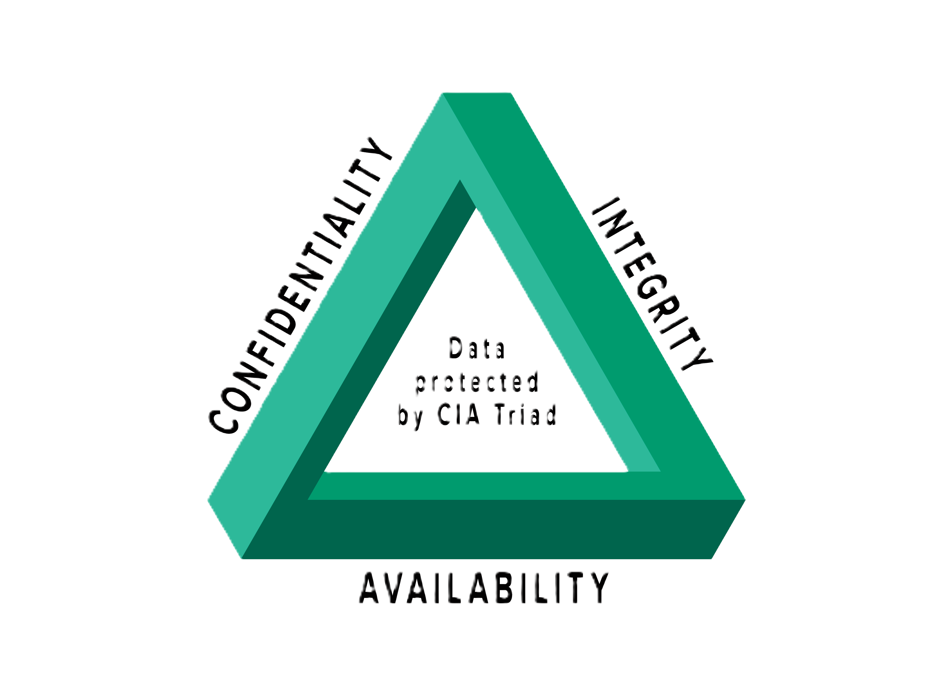
CIA triad
The CIA triad is a fundamental model in information security, guiding the protection of data by focusing on three core principles: Confidentiality, Integrity and Availability. It forms the bedrock for designing security systems, policies, and controls, balancing access with protection to maintain secure and reliable digital assets.
Confidentiality means the data is kept private and secret from unauthorized users. To maintain confidentiality, we use authentication methods such as usernames, passwords, and biometrics, along with encryption to ensure that only authorized users can access the data.
Integrity means the data is correct and authentic. To maintain integrity, we use encryption to protect data from unauthorized tampering and hashing to verify that the data has not been altered.
Availability means the data and systems are accessible to authorized users whenever needed. To maintain availability, we use backups, disaster recovery plans, and protection against attacks like ransomware and DDOS to keep services running.

Slide 4
AAA framework stands for Authentication, Authorization, and Accounting a security model used to control access to systems.
  Authentication: Verifying who you are (e.g., logging in with a password or fingerprint).
  Authorization: Determining what you’re allowed to do after you’re authenticated.
  Accounting: Tracking what you did—logging usage, actions, or resource consumption.
  Vulnerability scanning is the automated process of identifying, analyzing, and reporting security weaknesses
  Threat intelligence in cybersecurity is the collection, analysis, and application of data about cyber threats

Slide 5
Encryption
Encryption is the process of turning readable data (plaintext) into unreadable data (ciphertext) so only authorized people can read it.
AES (Advanced Encryption Standard) is a very fast and secure symmetric (same key to encrypt and decrypt) encryption algorithm. Used for Wi-Fi, disk encryption, messaging apps, games, phones and common key sizes: 128, 192, 256 bits.
RSA is an asymmetric (Public/Private key) encryption algorithm. Data encrypted with the public key can only be decrypted with the private key. Used for exchanging AES keys
, Digital signatures and HTTPS connections.
A TPM is a hardware security chip built into motherboards. Used for Stores encryption keys, Protects against malware stealing keys and etc.

Slide 6
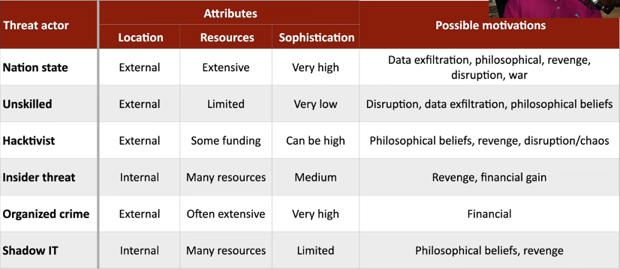
What is a threat actor?
A threat actor is any person or group that intentionally harms organizations, networks, or data. They exploit weaknesses to carry out cyberattacks like phishing, malware, or ransomware.

Slide 7
What is social engineering?
Social Engineering is the act of influencing someone to take an action that may not be in their best interest.
Common social engineering attacks:
Phishing is when attackers send fake messages (email, text, DMs, or websites) pretending to be a trusted organization or person to trick you into giving up information (like passwords) or clicking malicious links.
Impersonation is when someone pretends to be a specific person or authority (like a teacher, friend, company employee, or tech support) to gain trust and manipulate you.
A watering hole attack targets a specific group by infecting a website that the group commonly visits. Instead of tricking you directly, attackers wait for you to come to them.

Slide 8
What is Vulnerabilities?
Weaknesses in systems, software, or processes. Attackers can exploit them to gain access or cause damage.
Type | Description
OS Vulnerabilities | Flaws in an operating system’s design or code. They can allow unauthorized access or system control.
SQL Injection | Malicious SQL code is inserted into input fields. This lets attackers access or manipulate databases.
Cross-Site Scripting (XSS) | Attackers inject harmful scripts into web pages. These scripts run in users’ browsers and steal data.
Hardware Vulnerabilities | Weaknesses in physical components like CPUs or chips. They can be exploited to bypass software security.
Virtualization Vulnerabilities | Flaws in virtual machines or hypervisors. They may allow one VM to affect others or the host.
Misconfiguration Vulnerabilities | Security settings are incorrectly set or left default. This exposes systems to easy attacks.
Cloud Vulnerabilities | Security risks unique to cloud environments. Often caused by shared resources or poor access controls.

Slide 9
What is malware?
Any harmful software designed to damage, disrupt, or gain unauthorized access to a system.
Type | Description
Virus | Malware that attaches itself to files and spreads when the infected file is opened.
Worm | Malware that spreads automatically across networks without user action.
Ransomware | Malware that locks or encrypts data and demands money to restore access.
Trojan Horse | Malware disguised as legitimate software to trick users into installing it.
Keylogger | Malware that secretly records keystrokes to steal passwords or data.
Spyware | Malware that secretly monitors and collects user activity and information.
Logic Bomb | Malicious code that activates when a specific condition or time is met.
Rootkit | Malware that hides itself to gain long-term, privileged access to a system.

Slide 10
Common attacks in cybersecurity
Type | Description
Physical attacks | Gaining physical access to systems or devices to steal, damage, or manipulate hardware and data.
DDoS attacks | Flooding a server or network with excessive traffic to make services unavailable.
DNS attacks | Exploiting the Domain Name System to redirect users or disrupt network services.
Wireless attacks | Targeting wireless networks to intercept data, spoof access points, or break encryption.
On-path attacks | Intercepting and possibly altering communication between two parties without their knowledge.
Replay attacks | Capturing legitimate transmissions and replaying them to gain unauthorized access.
Application attacks | Exploiting software or web application vulnerabilities to access or manipulate data.
Cryptographic attacks | Attacking encryption algorithms to reveal or tamper with protected information.
Password attacks | Attempting to obtain passwords through guessing, phishing, or automated attacks.

Slide 11
Data protection, States, Classification, DLP and backup
Data protection safeguards organizational data from unauthorized access, alteration, and loss while supporting confidentiality, integrity, and availability.
Data states exists as data at rest, data in transit, and data in use. Each state requires specific protections such as encryption, secure communication protocols, and endpoint security.
Data classification assigns sensitivity levels such as public, internal, confidential, and restricted to ensure appropriate security controls are applied.
DLP monitors and controls data to prevent unauthorized disclosure by enforcing security policies across all data states.
Backups are copies of data created to protect against data loss caused by attacks.

Slide 12
Security hardening
Security hardening is the process of reducing cyber attacks as much as possible.
Patch Management: Regularly update software and operating systems to fix vulnerabilities.
Disable Unnecessary Services: Turn off unused applications, ports, or features to reduce attack surfaces.
Remove Default Accounts and Passwords: Eliminate default credentials that attackers can exploit.
Antivirus/Antimalware Protection: Install and update endpoint protection to detect threats.
Encryption: Encrypt sensitive data at rest and in transit.
User Account Management: Apply least privilege, strong passwords, and role-based access controls.

Slide 13
What Is Penetration Testing?
Penetration testing or pen testing is a controlled and authorized attempt to find and exploit security weaknesses in a computer system, network, website, or an application.
Penetration Testing Steps
Planning & Scope
Define what systems can be tested and how
Reconnaissance
Gather information about the target (e.g., IPs, domains)
Scanning
Look for open ports, weak services, or misconfigurations
Exploitation
Try to exploit vulnerabilities safely
Reporting
Document findings and recommend fixes

Slide 14
Monitoring
Monitoring is the continuous process of observing, collecting, and analyzing activities across systems and networks.
IDS/IPS: Detect and block malicious network activity using Snort and Suricata.
SIEM: Collect, correlate, and analyze security logs using IBM Qradar and Splunk.
EDR: Monitor endpoint behavior and respond to threats using Kaspersky EDR and CrowdStrike.
Cloud Security Monitoring: Monitor cloud resources and activities using AWS CloudWatch and Azure Monitor.
Security Orchestration, Automation and Response (SOAR): Automate alert handling and incident response using Splunk SOAR and IBM Resilient.

Slide 15
Firewall
A firewall is a network security device or software that monitors and controls incoming and outgoing network traffic based on predefined security rules.
Types of Firewalls
Stateless: Does not remember previous packets and filters traffic based only on rules (IP, port, protocol).
Stateful: Remembers previous packets in a session and allows only packets that are part of a legitimate, established connection.
Next-Generation Firewall (NGFW): Combines traditional firewall with IDS/IPS, application awareness, and threat intelligence and used in modern networks.

Slide 16
Identity and Access Management or IAM
IAM is a cybersecurity framework that ensures the right person has the right access to the right resources.
Key Functions of IAM
Identify users (who you are)
Authenticate users (verify identity)
Authorize access (what you can access)
Manage user accounts and permissions
Monitor access activities

Slide 17
Scripting and Automation
Scripting and Automation in cybersecurity involve using scripts and automated tools to perform security tasks automatically, reducing manual work, saving time, and minimizing human errors.
Importance of Scripting & Automation
Automate repetitive security tasks
Speed up threat detection and response
Improve accuracy and consistency
Reduce workload on security teams

Slide 18
Digital forensics
Digital forensics is the practice of identifying, preserving, analyzing, and presenting digital evidence in a manner that is technically sound and legally defensible. In cybersecurity operations, it plays a critical role in understanding what happened after a security incident.
Importance of digital forensics.
To ensure digital evidence is admissible in court.
Digital evidence is critical for investigating cyberattacks like data breaches.
Proper digital forensic practices prevent evidence from being lost.

Slide 19
Security Policies
A security policy is a document that spells out the rules, expectations, and overall approach that an organization uses to maintain the CIA triad of its data. Security policies exist at many different levels, from high-level constructs that describe an enterprise’s general security goals and principles to documents addressing specific issues, such as remote access or ransomware attack.
Importance of Security Policies
Guides the implementation of technical tools and controls
Sets clear expectations
Improves organizational efficiency and helps meet business objectives

Slide 20
compliance
compliance is the process of verifying whether the organization follows certain rules standards, and regulations for data privacy such as GDPR. This involves building certain guidelines in which the data should be collected stored and used.
Benefits of compliance
Reduces the likelihood of data breaches and cyberattacks.
Helps avoid legal consequences and penalties.
Builds and maintains trust by protecting sensitive information.
Safeguards data through encryption and regular security assessments.
Improves the ability to identify and respond to security incidents.
Demonstrates commitment to compliance and may open up new opportunities.

Slide 21
Thank you for your time!

