Slide 1
Understanding DLP and its Deployment/Configuration
KEY OBJECTIVES:
What is Data Loss Prevention or DLP?
What is Forcepoint DLP?
Forcepoint DLP Basic Architecture.
Forcepoint DLP Basic Components.
Forcepoint DLP Deployment/Configuration

Slide 2
WHAT IS DLP?
DLP, or Data Loss Prevention, is a cybersecurity solution that detects and prevents data breaches. Since it blocks extraction of sensitive data, organizations use it for internal security and regulatory compliance.
DLP allows businesses to:
Prevent accidental or unauthorized data sharing
Monitor, control, and protect important information
Alert security teams to potential data risks
Reduce the risk of data breaches and data leaks

Slide 3
What is Forcepoint DLP?
Forcepoint DLP is an advanced data protection platform that discovers, monitors, and secures sensitive information across an organization’s IT environment. It provides a centralized console for consistently defining and enforcing security policies, whether data is at rest, in motion, or in use.
Forcepoint DLP features:
Machine learning-based classification
Allows organizations to create own rules for specific data types
Continuously scans endpoints/servers for sensitive data.

Slide 4
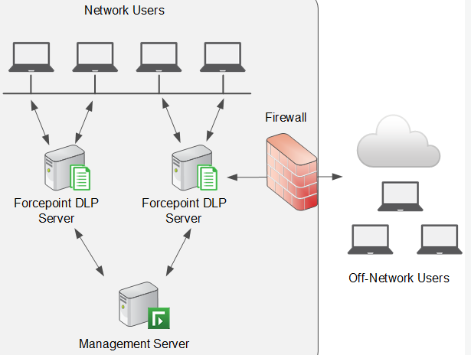
FORCEPOINT DLP BASIC ARCHITECTURE

Slide 5
FORCEPOINT DLP BASIC COMPONENTS
CMC: Single interface for administrators to configure policies, manage incidents, view alerts, and generate reports and controls all DLP components.
Policy Engine: Evaluates data against defined DLP rules and decides actions such as allow, block, encrypt, or alert.
Data Discovery & Classification: Scans and identifies sensitive data across environment.
Endpoint Agent: Monitors and enforces DLP policies on user devices for data in use and data transfers.
Analytics & Reporting: Collects logs and incidents to provide visibility, alerts, and compliance reports.

Slide 6
Forcepoint DLP Deployment/Configuration
Forcepoint DLP Prerequisites:
Install SQL server express edition
Install the .NET Framework 3.5
Microsoft Visual C++ Redistributable 2022

Slide 7
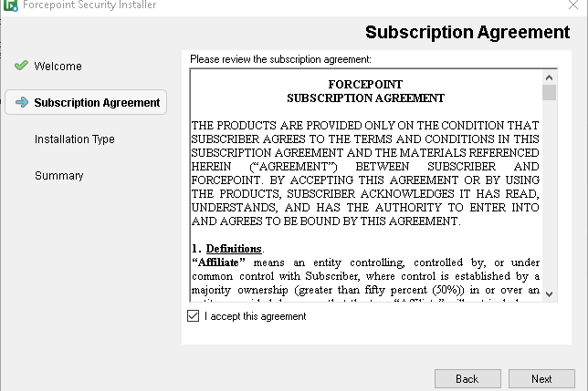
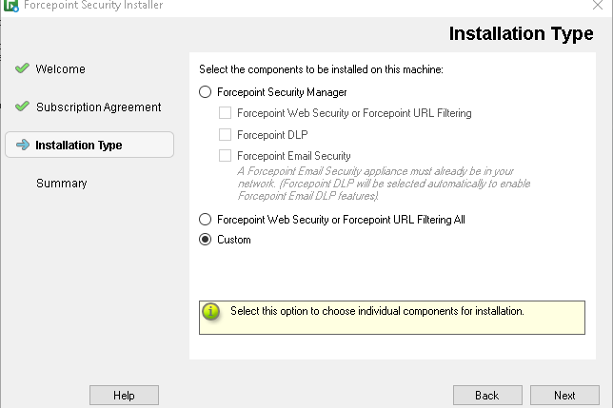
1. Launch the installer of Forcepoint DLP
Double-click ForcepointDLPSetup.exe and click Start.
Accept terms and check custom then click next.

Slide 8
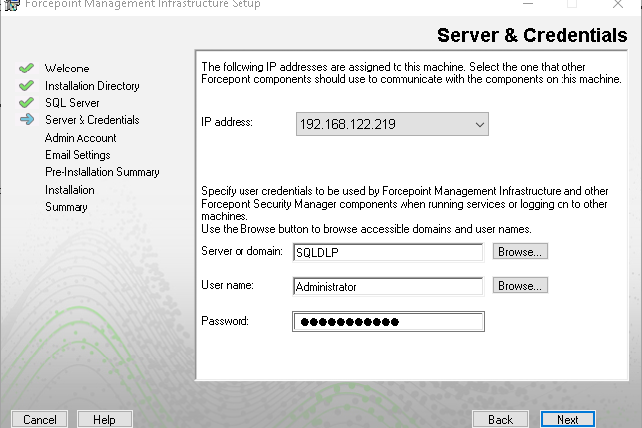
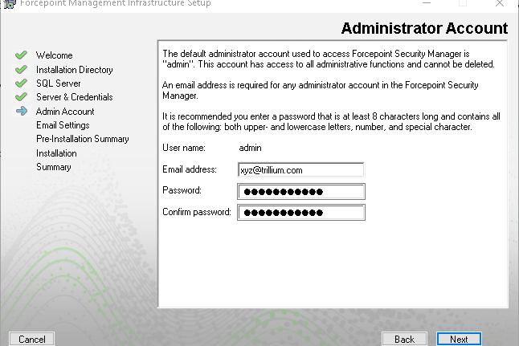
2. Install the Forcepoint Infrastructure
On the Forcepoint Infrastructure Setup Welcome screen, click Next
Enter the User Name or Account and its Password.
Continue with default settings

Slide 9
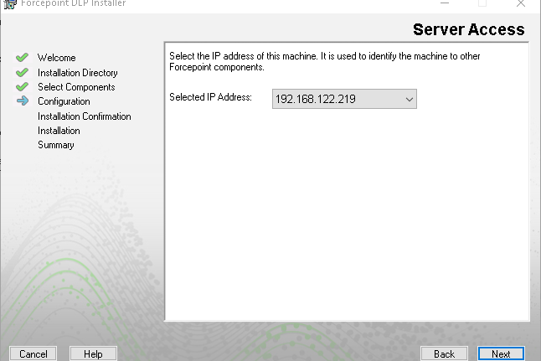
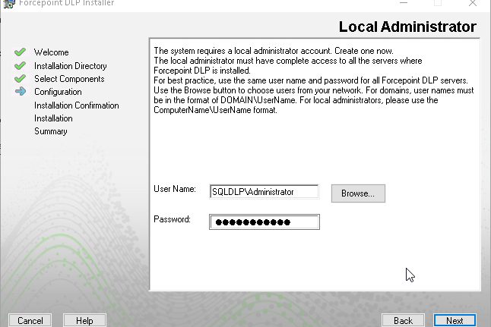
3. Install Forcepoint DLP
Continue with default options
On the Local Administrator screen, specify the User Name and Password for a local administrator account

Slide 10
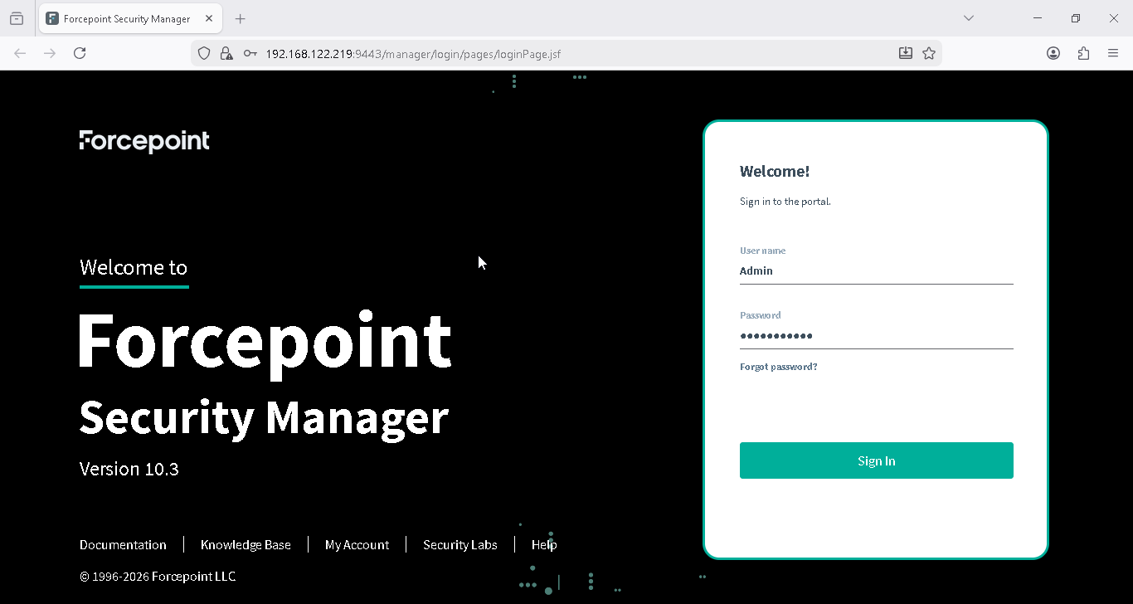
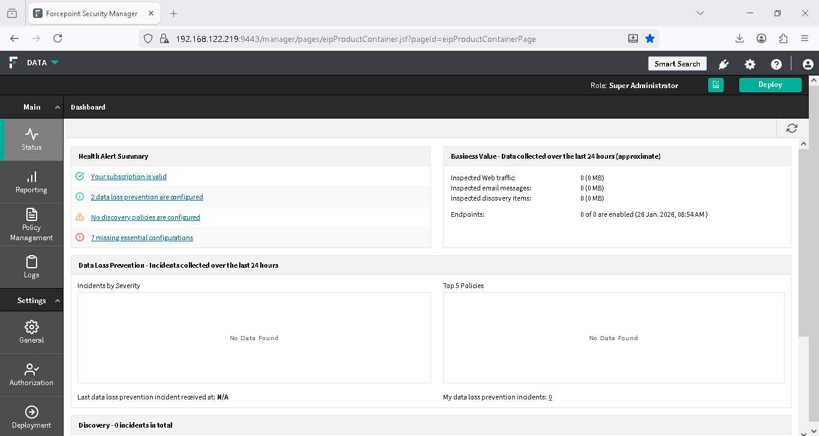
Put your previous created credentials and login to dashboard

