Slide 1
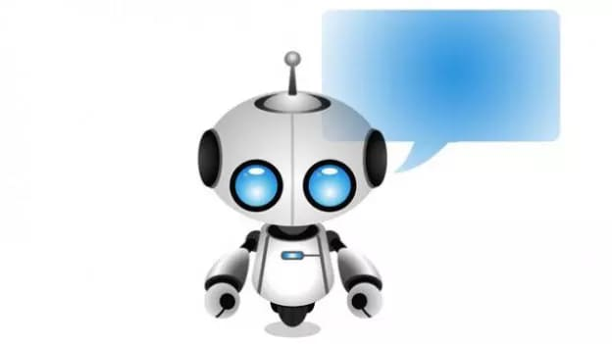
CHATBOT :
NAME AS
JARVIS

Slide 2
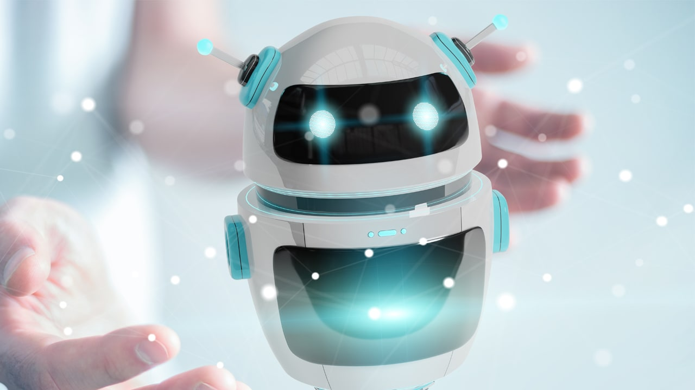
OVERVIEW
Introduction Types of Chatbot Ruled-Based Chatbot AI-Based chatbot Need of Chatbot How does it response Requirements

Slide 3
INTRODUCTION
What is a ChatBot????
From time to time humans have been trying to gain more and more ways to make lives easier using technology.
A Chatbot (sometimes referred to as chatterbot )is a programming that simulates the conversation between a human being through text or voice interaction.
Although it is a new concept it has been gaining popularity due to its features that makes all the work convenint for the users.

Slide 4
A chatbot is a conversational agent that interacts with users using natural language.
Numerous application of chatbots such as customer service, call centers , etc.

Slide 5
Types Of Chatbot
There are two types of chatbot:
Rule Based Chatbots
AI Chatbots

Slide 6
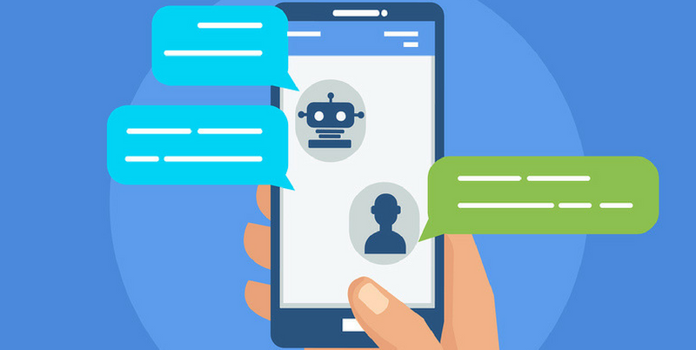
Ruled Based Chatbot
● These essentially work as an interactive FAQ.
● They're programmed to recogine certain terms and patterns from which they can respond with pre-set answers.
● This type of chatbot lacks of adaptability and analytics capabilities of a human being to well understand a person's expectations and intertions.This bot is very limited, it can response to only very specific commands. If you say the wrong this,it do not know what you said.
● A ruled-based chatbot will never be able to compete with his AI cousin.

Slide 7
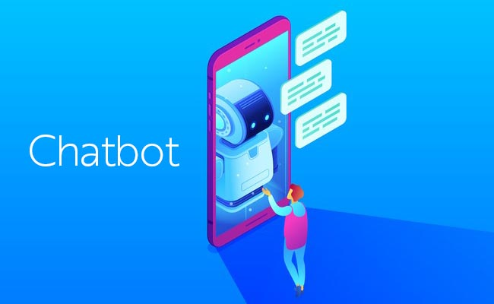
AI-Based Chatbot
● This bot has an artifical brain also konw as artifical intelligence. You don't have to be ridiculously specific when you are talking to it. It understands language, not just commands.
● This bot continuously gets smarter as it learns from conversations it has with people.
● We are seeing the first in the market from the really big players : Alexa, Google home and Apple's Siri are fantastic examples.

Slide 8
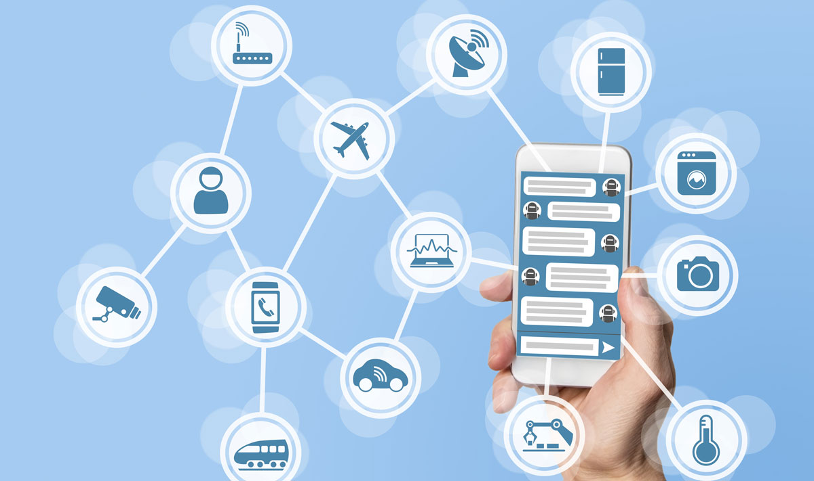
Need of CHATBOT
Better human computer interaction.
Available 24/7.
It is not possible to tackel a
huge amount of peoples queries
at a time by a human.
Save human resources for
qulaitative task.
Chatbot-easy-to-use.
Chatbot develpoment
requires less time.
Cost-effective and time-efficient.

Slide 9
HOW DOES IT RESPONSE
Looks for certain patterns of words in the user's input.
Replies with pre-determined output, if the pattern is matched.
Needs to have an idea of what the user will chat.

Slide 10
REQUIREMENTS
Hardware
Window 10
Microphone
camera
Software
Python 3.7
Pip
IDE(pycharm)

Slide 11
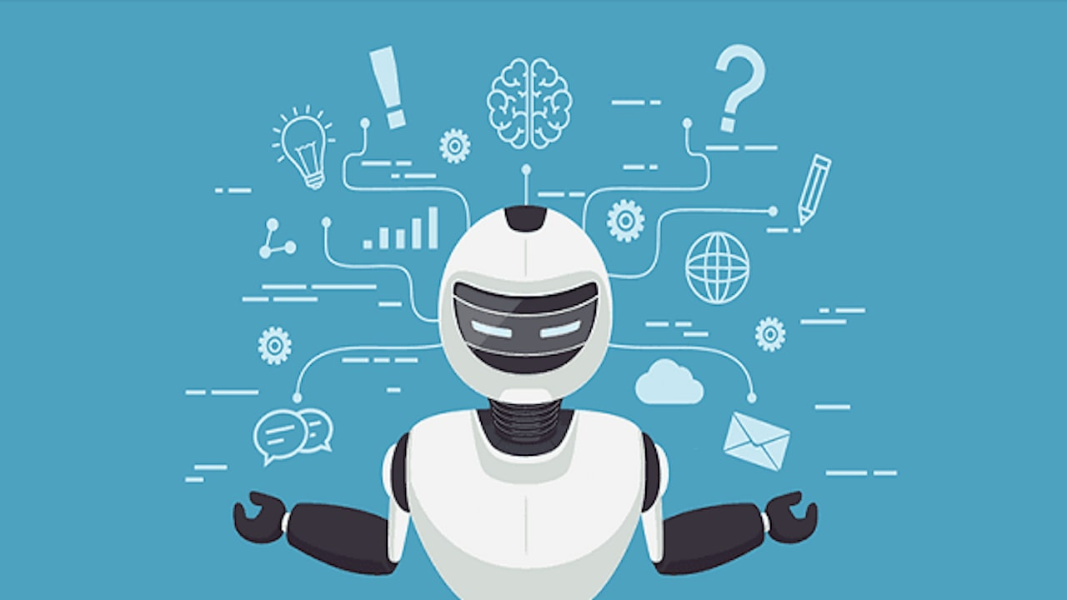
Let’s see our chatbot….

Slide 12


