Slide 1
CS-112 Object Oriented Programming (3+1) Prerequisites: Programming Fundamentals
Syed Muhammad Rafi Lecturer, Department of Software Engineering Faculty of Engineering Science and Technology, Ziauddin University

Slide 2
Basic Concepts of C++ Lecture # 02

Slide 3
Increment Operator
The increment operator is used to increase the value of a variable by 1.
It is denoted by the symbol ++.
It is unary operator and work with single variable.
The increment operator can be used in two forms.
Prefix Form
In prefix form, the increment operator is written before the variable as follows:
++y;
The above line increment the value of variable y by 1.
Postfix Form
In postfix form, the increment operator is written after the variable as follows:
y++;
The above line also increment the value by 1.

Slide 4
Difference between Postfix & prefix Increment
When increment operator is used independently postfix and prefix form work similarly. For example the result of A++ and ++A is same.
But when increment operator is used in larger expression with other operators the postfix and prefix forms work differently. The result of two expressions A=++B and A=B++ are different.
In prefix form the statement A=++B works in following order.
It increments the value of B by 1.
It assigns the value.
The above statement is equivalent to following two statements.
++B;
A=B;

Slide 5
In postfix form the statement A=B++ works in following order.
It assign the value of B to A.
It increment the value of B by 1.
The above statement is equivalent to following two statements.
A=B;
B++;

Slide 6
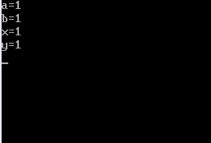
Write a program that explains the difference of postfix increment operator and prefix increment operator used as independent expression.
#include <iostream>
using namespace std;
int main()
{
int a,b,x,y ;
clrscr() ;
a=b=x=y=0;
a++ ;
b=a ;
++x ;
y=x ;
cout<<"a="<<a<<endl<<"b="<<b<<endl ;
cout<<"x="<<x<<endl<<"y="<<y<<endl ;
return 0;
}

Slide 7
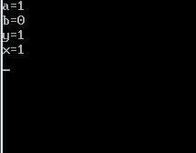
Write a program which explains the difference of postfix increment operator and prefix increment operator used as apart of larger expression.
#include <iostream.h>
using namespace std;
int main()
{
int a,b,x,y;
clrscr();
a=b=x=y=0;
b=a++;
y=++x;
cout<<"a="<<a<<endl<<"b="<<b<<endl;
cout<<"y="<<y<<endl<<"x="<<x<<endl;
return 0;
}

Slide 8
Decrement Operator
The decrement operator is used to decrease the variable by 1.
It is denoted by symbol --.
It is a unary operator and works with single variable.
The decrement operator can be used in two forms.
Prefix Form
In prefix form the decrement operator is written before the variable as follows:
--y;
The above line decrements the value of variable by 1.
Postfix Form
In postfix form the decrement operator is written after the variable as follows:
Y--;
The above line decrements the value of variable by 1.

Slide 9
Difference between Postfix & prefix Decrement
When decrement operator is used independently postfix and prefix form work similarly. For example the result of A-- and --A is same.
But when decrement operator is used in larger expression with other operators the postfix and prefix forms work differently. The result of two expressions A=--B and A=B-- are different.
In prefix form the statement A=--B works in following order.
It decrement the value of B by 1.
It assigns the value.
The above statement is equivalent to following two statements.
--B;
A=B;

Slide 10
In postfix form the statement A=B-- works in following order.
It assign the value of B to A.
It decrement the value of B by 1.
The above statement is equivalent to following two statements.
A=B;
B--;

Slide 11
Data Types
A data type defines the set of values and set of operations on those values.
The computer manipulates various types of data.
The data is given to program as input.
The data is processed according to program instructions and output is returned.
The data and its types are defined before designing the actual program used to process the data.
The type each data type value is identified at the beginning of program design.

Slide 12
Data Types
Every problem involves some sort of data in it.
The data can be:
Numbers
Integers (e.g. 24, 5874, -547)
Floating (e.g. 45.214, 0.2547, -658.748)
Characters (e.g. ‘a’, ‘f’, ‘#’, ‘?’, ‘!’, ‘w’)
String (e.g. “ZUFEST”, “SE”, “ZUFEST SE”)
Logical (e.g. True and False, Yes and No, 0 and 1)
The type of data is known as data type of that data item.

Slide 13
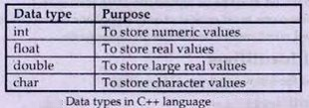
A C++ program may need to process different types of data. Each data types requires different amount of memory. C++ provides the following data type

Slide 14
Data Types
Data Item | Example Value | Data Type
Age of a person | 35 | Integer
Current year | 2014 | Integer
Radius of circle | 27.58 | Floating
Value of PI | 3.14159 | Floating
A vowel | e | Character
A key on keyboard | ? | Character
Person’s name | mohsin | String
Address of an office | Department of SE-ZUFEST | String
Is 1st number greater than 2nd ? | True or T or Yes or 1 | Logical
Is 7 less than 5 ? | False or F or No or 0 | Logical

Slide 15
Do it yourself
Data Types
Data Item | Example Value | Data Type
Number of students | 7 | Integer
Brand name of smartphone | Samsung | String
Is 5 an even number? | False | Logical/Boolean
Count of cars in parking | 4 | Integer
Speed of a car | 35.6 | Float
Your grade in result | A | Character
Is 13 a prime number ?
Title of book chapter
Percentage of marks
Option in MCQ

Slide 16
Integer Data Type
Integer data type is numeric value with no decimal point or fraction .
It includes both positive and negative value
If no sign is used the value is positive by default.
Example
Some integers values are 10, 520, -20 etc

Slide 17
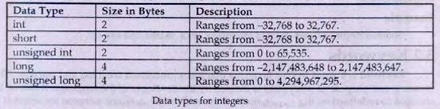
Types of Integers
C++ provides different types of integer data as follows.(in turbo C compiler)
# The size varies with type of compiler.. Different in Turbo C and Code Block etc.

Slide 18
int Data Type
Integer data type is used to store integer values.
It takes two four bytes in memory depending on the computer and compiler being used.
In MS-DOS it takes two bytes and it ranges from -32,768 to 32,768 .
short int Data Type
Short int data is store integer values .
It takes two bytes in memory.
It ranges from -32,768 to 32,768 .

Slide 19
unsigned int Data Type
unsigned int data type is used to store only positive integer values.
It takes two bytes in memory.
It ranges from 0 to 65,535.
long int Data Type
long int data type is used to store large integer values.
It takes four bytes in memory.
It ranges from -2,147,483,648 to 2,147,483,647.

Slide 20
Real Data type
Real data type is numeric values with decimal point or fraction .
It is also called floating point number.
It includes both positive and negative values.
the minus sign is used to indicate negative value.
It no sign is used the value is positive by default.

Slide 21

Types of Real
C++ provides different types of real data.

Slide 22
float Data Type
float data types is used to store real values.
It takes four bytes in memory.
It s ranges is from 3.4x10⁻³⁸ to 3.4x10³⁸ .
It provides accuracy of 6 decimal places.
double Data Type
double data type is used to store large real values.
It takes four bytes in memory.
Its ranges is from 1.7x 10⁻³⁰⁸ to 1.7x 10⁺³⁰⁸ .
It provides accuracy of 15 decimal places.

Slide 23
long double Data Type
Long double data type is used to store very large real values
It takes 10 bytes in memory.
It ranges is form 1.7x10⁻⁴⁹³² to 1.7x10⁴⁹³²
It provides accuracy of 19 decimal places.

Slide 24
Character Data Type
Char data type is used to store character values.
It takes 1 byte in memory.
It is used to represent a letter, number or punctuation marks and a few other symbols.
Character values are normally given in single quotes.

Slide 25
Data Types in C++
Data Type | Memory | Range Start | Range End
char | 1 Byte | -128 | 127
unsigned char | 1 Byte | 0 | 255
short | 2 Bytes | -32,768 | 32,767
unsigned short | 2 Bytes | 0 | 65,535
int | 4 Bytes | -2,147,483,648 | 2,147,483,647
unsigned int | 4 Bytes | 0 | 4,294,967,295
long | 8 Bytes | -9,223,372,036,854,775,807 | 9,223,372,036,854,775,807
unsigned long | 8 Bytes | 0 | 18,446,744,073,709,551,615
float | 4 Bytes | 3.4 × 10⁻³⁸ | 3.4 × 10³⁸
double | 8 Bytes | 1.7 × 10⁻³⁰⁸ | 1.7 × 10³⁰⁸
bool | 1 Byte | true and false

Slide 26
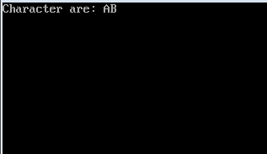
Write a program that print character
#include<iostream>
using namespace std;
int main()
{
clrscr();
char ch1,ch2,sum;
ch1='A';
ch2='B';
cout<<"Character are: "<<ch1<<ch2;
return 0;
}

Slide 27
Integer Overflow and Underflow
Integer overflow occurs when the value assigned to an integer variable is more than maximum possible value.
Integer underflow occurs when the value assigned to an integer variable
Is less than possible minimum value.
An integer variable can stored values from -32768 to 32767.
If assigned value is greater than 32767, it is known as integer overflow .
If assigned value is less than -32768, it is called integer underflow
Integer overflow and underflow is not detected by compiler.
But the result may become wrong.

Slide 28
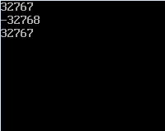
Write a program that explains the concept of overflow and underflow.
# include <iostream>
using namespace std;
int main()
{
short testVar=32767;
cout<<testVar <<endl;
testVar=testVar+1;
cout<<testVar<<endl;
testVar=testVar-1;
cout<<testVar<<endl;
return0;
}

Slide 29
Scientific or Exponential Notation
The real numbers can also be written in exponential or scientific notation.
This notation represent large real number in a short way.
The exponential notation consist of two parts.
Mantissa
Exponent
The general form of writing real values in exponential notation is as follows
±m e ±n OR ±m E ±n
The value before e is known as mantissa and the value after e is known as exponent.

Slide 30
Some important points about exponential notation is as follows.
Mantissa and exponent may be positive or negative value.
Exponent is always a integer value. It cannot be areal value.
The absolute value must be greater or equal to 1 and less than 10.
Example
Suppose we have a real number 1000.0 .It can be represented in scientific notation as 1.0 x10³.
It can also be written in exponential form as 1.0e3.
In this example 1.0 is the mantissa and 3 is the value of exponent.

Slide 31

Some examples of real numbers with scientific and exponential notations are as follows.

Slide 32
Range and Precision
The possible value that a floating type variable can store are describe in the term of range .
Precision: The number of digits after the decimal point.
Range: Range is the exponential power of 10.
A float variable has a precision of 6 digits and a range of 10⁻³⁸ to 10⁺³⁸
Suppose we have a value 0.12345x10³ . The precision of this value is 5 and range is 3. Similarly, a value 0.123456x 10⁻³ has a precision of 6 digits and a range of-3.
A double variable has a precision of 15 digits and a range of 10⁻³⁰⁸ to 10⁺³⁰⁸
A large precision provides more accuracy .
If the value to be stored requires more precision ,double data type is more suitable than float.

Slide 33
Variables
In programming, a variable is the memory (RAM) location that can store the data temporary.
The variable is a named memory location or cell.
It is used to store programs input data and computational results during execution.
The value of variable may change during the execution of program. However the name of variable cannot be changed.
The variables are created in RAM. RAM is a temporary memory. That is why the data stored in variable is also temporary.
It can only be used and proceed during the execution of program. The data stored in variable is automatically remove when program ends.

Slide 34


Variables
radius
The name of the variable is called as the identifier.
25.5
Consider two of the examples.
In first example, we have a variable whose name is radius, its data types is floating and its value is 25.5.
option
b
In second example, we have a variable whose name is
option, its data type is character and its value is b.

Slide 35
Variable Declaration
The process of specifying the variable name and its type is called variable declaration.
A variable is declared when we do not know the value to be stored in it.
A program can have as many variables as needed.
All variables can be declared anywhere in the program before its use.
Syntax
The syntax of declaring variable is as follows
data_type variable_ name
where,
data_type It indicates type of data that can be stored in variable
variable_ name It refers to memory location of the variable
Example
int a;
Char grade;

Slide 36

Variable Declaration
float radius;
radius

Slide 37
Variable Declaration
char v1 ; long v7 ;
unsigned char v2 ; unsigned
long v8 ;
short v3 ; float v9 ; unsigned short v4 ; double v10 ; int v5 ; bool v11 ;
unsigned int v6 ;

Slide 38
Rules of Declaring Variable
Following are the rules for naming variables in C++ language.
Variable may include letters ,numbers and underscore(_).
The first character of variable must be a letter or underscore_. The use of underscore is not recommended. The variable 9minutes,#home are invalid.
Blank spaces are not allowed in variable names. The variable my var and your car are invalid.
Both upper and lower cases are allowed. A user defined variable is conventionally written in lower case. The constants are conventionally written in upper case.

Slide 39
Special symbols cannot be used as variable names.
Reserved words cannot be used as variable names. The names int, void and while are invalid variables.
A variable can be up to 31 characters long for many compilers. If a variable consists of more than 31 characters, only first 31 character will be used. The remaining character will be ignored.
A variable can be declared for only one data type.

Slide 40
Variable Initialization
The process of assigning a value to a variable at the time of declaration is known as variable initialization.
The equal sign is used to initialize a variable.
Variable name is given on the left side and value is given on the right side of equal sign.
The C++ compiler automatically sets aside some memory for the variable when it is declared.
The memory location may contain meaning less data known as garbage value.
It may produce some unexpected results in some computations.
All variables should be initialized to avoid this problem.

Slide 41
Syntax
The syntax of initializing a variable is as follows:
type_name variable =value;
Where,
type_name It indicates the data type of variable to be initialized.
Variable It is the name of variable to be initialized.
= It is the assignment operator used to initialize a variable.
Value It is the value to initialize a variable.

Slide 42
Variable Definition/Initialization
A variable is defined when we know the exact value to be stored in it.
To define the variable, we need to specify three things: name, data type and
value.
data_type variable_name = value;

Slide 43
Variable Definition/Initialization
char v1 = ‘w’ ; unsigned char short v3 = -24 ; unsigned short int v5 = 5847 ;
unsigned int v6 = 8552U ;
long v7 = 25486655L ;
unsigned long v8 = 58622455UL ; float v9 = 25.4856F ;
double v10 = 5685.2154785 ;
bool v11 = true ;
v2 = ‘w’ ;
v4 = 64 ;

Slide 44
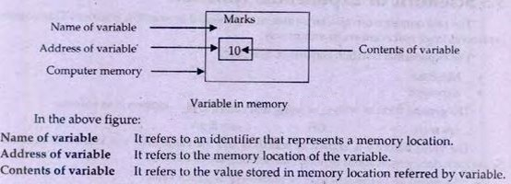

Slide 45
Constants
A constant is a variable whose value can not be altered during the execution of the program.
A constant is given a single value at the time of creation and it will hold that value
till the entire execution of the program.
In C++, a variable is declared as constant by just prefixing the variable definition statement with the keyword const.
const data_type variable_name = constant_value; const float PI = 3.1415F ;
const int MAX = 100 ;

Slide 46
Variables as Memory Locations
A variable is defined as a named piece of memory
location.
int num = 26 ;
MEMORY
num |  | 2000H
 |  | 2001H
 | 26 | 2002H
 |  | 2003H
 |  | 2004H
 |  | 2005H
 |  | 2006H
When we create a variable, some bytes of memory are reserved according to the data type, and are given a name of the variable.
Entire memory is divided in to pieces of 1 byte and each of the byte has address defined in hexadecimal number.

Slide 47
Variables as Memory Locations
Consider following empty memory map:
Execute the following variable
definition statements:
short V1 = 69 ; char V2 = ‘w’ ; int V3 = 5478 ;
float V4 = 87.245F ;
MEMORY
 | 2000H
 | 2001H
 | 2002H
 | 2003H
 | 2004H
 | 2005H
 | 2006H
 | 2007H
 | 2008H
 | 2009H
 | 200AH
 | 200BH
 | 200CH
 | 200DH
 | 200EH
 | 200FH
 | 2010H
 | 2011H

Slide 48
Variables as Memory Locations
MEMORY
V1 | 69 | 2000H
 |  | 2001H
 |  | 2002H
 |  | 2003H
 |  | 2004H
 |  | 2005H
 |  | 2006H
 |  | 2007H
 |  | 2008H
 |  | 2009H
 |  | 200AH
 |  | 200BH
 |  | 200CH
 |  | 200DH
 |  | 200EH
 |  | 200FH
 |  | 2010H
 |  | 2011H
short
V1 = 69 ;

Slide 49
Variables as Memory Locations
MEMORY
V1 | 69 | 2000H
 |  | 2001H
V2 | w | 2002H
 |  | 2003H
 |  | 2004H
 |  | 2005H
 |  | 2006H
 |  | 2007H
 |  | 2008H
 |  | 2009H
 |  | 200AH
 |  | 200BH
 |  | 200CH
 |  | 200DH
 |  | 200EH
 |  | 200FH
 |  | 2010H
 |  | 2011H
char
V2 = ‘w’ ;

Slide 50
Variables as Memory Locations
MEMORY
V1 | 69 | 2000H
 |  | 2001H
V2 | w | 2002H
V3 | 5478 | 2003H
 |  | 2004H
 |  | 2005H
 |  | 2006H
 |  | 2007H
 |  | 2008H
 |  | 2009H
 |  | 200AH
 |  | 200BH
 |  | 200CH
 |  | 200DH
 |  | 200EH
 |  | 200FH
 |  | 2010H
 |  | 2011H
int V3 = 5478 ;

Slide 51
Variables as Memory Locations
MEMORY
V1 | 69 | 2000H
 |  | 2001H
V2 | w | 2002H
V3 | 5478 | 2003H
 |  | 2004H
 |  | 2005H
 |  | 2006H
V4 | 87.245 | 2007H
 |  | 2008H
 |  | 2009H
 |  | 200AH
 |  | 200BH
 |  | 200CH
 |  | 200DH
 |  | 200EH
 |  | 200FH
 |  | 2010H
 |  | 2011H
float
V4 = 87.245F ;

Slide 52
Variables as Memory Locations
Consider following memory map:
Write down the variable definition statements for the variables created in the memory.
MEMORY
 |  | 2000H
V1 | 69.258 | 2001H
 |  | 2002H
 |  | 2003H
 |  | 2004H
 |  | 2005H
 |  | 2006H
V2 | 658 | 2007H
 |  | 2008H
 |  | 2009H
 |  | 200AH
V3 | 1453 | 200BH
 |  | 200CH
 |  | 200DH
 |  | 200EH
V4 | b | 200FH
 |  | 2010H
 |  | 2011H

Slide 53
Variables as Memory Locations
Consider following memory map:
Write down the variable definition statements for the variables created in memory.
float V1 = 69.258F ; short V2 = 658 ;
int V3 = 1453 ;
char V4 = ‘b’ ;
MEMORY
 |  | 2000H
V1 | 69.258 | 2001H
 |  | 2002H
 |  | 2003H
 |  | 2004H
 |  | 2005H
 |  | 2006H
V2 | 658 | 2007H
 |  | 2008H
 |  | 2009H
 |  | 200AH
V3 | 1453 | 200BH
 |  | 200CH
 |  | 200DH
 |  | 200EH
V4 | b | 200FH
 |  | 2010H
 |  | 2011H

Slide 54
Variables as Memory Locations
MEMORY
 |  | 2000H
V1 | 69.258 | 2001H
 |  | 2002H
 |  | 2003H
 |  | 2004H
 |  | 2005H
 |  | 2006H
V2 | 658 | 2007H
 |  | 2008H
 |  | 2009H
 |  | 200AH
V3 | 1453 | 200BH
 |  | 200CH
 |  | 200DH
 |  | 200EH
V4 | b | 200FH
 |  | 2010H
 |  | 2011H
Execute the following variables definition statements in the same memory map:
short char short
V5 = 985 ; V6 = ‘r’ ; V7 = 74 ;

Slide 55
Variables as Memory Locations
MEMORY
 |  | 2000H
V1 | 69.258 | 2001H
 |  | 2002H
 |  | 2003H
 |  | 2004H
V5 | 985 | 2005H
 |  | 2006H
V2 | 658 | 2007H
 |  | 2008H
 |  | 2009H
 |  | 200AH
V3 | 1453 | 200BH
 |  | 200CH
 |  | 200DH
 |  | 200EH
V4 | b | 200FH
 |  | 2010H
 |  | 2011H
short
V5 = 985 ;

Slide 56
Variables as Memory Locations
MEMORY
V6 | r | 2000H
V1 | 69.258 | 2001H
 |  | 2002H
 |  | 2003H
 |  | 2004H
V5 | 985 | 2005H
 |  | 2006H
V2 | 658 | 2007H
 |  | 2008H
 |  | 2009H
 |  | 200AH
V3 | 1453 | 200BH
 |  | 200CH
 |  | 200DH
 |  | 200EH
V4 | b | 200FH
 |  | 2010H
 |  | 2011H
char
V6 = ‘r’ ;

Slide 57
Variables as Memory Locations
MEMORY
V6 | r | 2000H
V1 | 69.258 | 2001H
 |  | 2002H
 |  | 2003H
 |  | 2004H
V5 | 985 | 2005H
 |  | 2006H
V2 | 658 | 2007H
 |  | 2008H
V7 | 74 | 2009H
 |  | 200AH
V3 | 1453 | 200BH
 |  | 200CH
 |  | 200DH
 |  | 200EH
V4 | b | 200FH
 |  | 2010H
 |  | 2011H
short
V7 = 74 ;

Slide 58
Inputting with cin
In C++, cin statement is used to get input from the keyboard.
Cin is the Standard Console Input, which is the keyboard.
Cin is used in conjunction with the extraction operator ( >> ).
Anything inputted from keyboard will go to the variable to the right side of
>> extraction operator.

Slide 59




Inputting with cin
cin
>>
radius;

Slide 60
Expression
The statement that evaluates to a values is called an expression
An expression gives a single value.
An expression consist of operators and operands.
An operator is a symbol that performs some operation.
Operand can be constant variable or function
An expression may consist of any number of operator or operands.
Some examples of expressions are as follows.
A+B;
m/n

Slide 61
Operator Precedence
The order in which different types of operator is an expression are evaluated is known as operator precedence. In is also known as hierarchy of operators.
Each operator has its own precedence level.
If an expression contains different types of operators. The operators with higher precedence are evaluated before the operator with lower precedence.

Slide 62
The order of precedence in C++ language is as follows.
Any expression in parenthesis is evaluated first.
The multiplication * and division / operators are evaluated.
Then plus+ and – operators are evaluated.
In case of parenthesis under parenthesis, the expression of the inner parenthesis will be evaluated first.
Example
The expression 10*(24/(5-2)+13 is evaluated in the following order.
First of all the expression 5-2 is evaluated .It gives 3.
Secondly, 24 will be divided by the result of last line i.e. 24/3 giving value 8.
Thirdly, 10 will be multiplied by 8 i.e. giving a result 80.
Finally, 80 will be added in 13 and the last result will be 93.

Slide 63
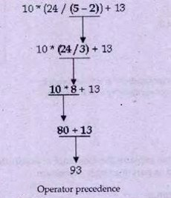

Slide 64
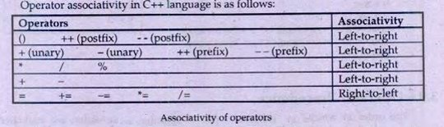
Operator Associativity
The order in which operator of same precedence are evaluated is known as operator associativity.
If an expression contains some operator that have same precedence level , the either from left –to- right or right-to-left.

Slide 65
Example
The expression 10*24/5-2+13 contains four operators.
Two operators *and / have equal precedence.
These expression can be evaluated from left to right.
Similarly, two operators + and – also have equal precedence.
The expression will be evaluated as follows.
First of all, the expression 10*24 is evaluated. It gives a value 240.
Secondly, 240 will be divided by 5 i.e. 240/5 giving a value 48.
Thirdly,2 will be subtracted from 48 i.e.48-2 giving a result 46.
Finally, 46 will be added in 13 and the last result will be 59.

Slide 66
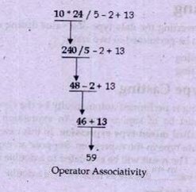

Slide 67
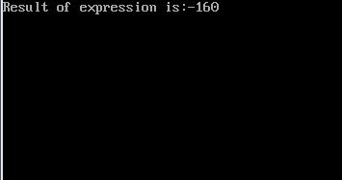
Write a program to solve the following expression a*b/(-c*31%13)*d.
Assuming the values of variables are as follows.
a=10,b=20,c=15,d=8,e=40
#include <iostream.h>
using namespace std;
int main()
{
int a,b,c,d,r;
clrscr();
a=10;
b=20;
c=15;
d=8;
e=40;
r=a*b/(-c*31%13)*d;
cout<<"Result of expression is:"<<r<<endl;
return 0;
}

Slide 68
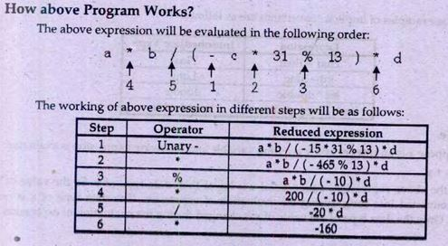
How Above Program Works

Slide 69
Program Examples Variables and constants in C++

Slide 70
Program Example 01
Problem Statement:
Write a computer program in C++ that accepts the base and height of a right angle triangle from the user and displays the area of the triangle.

Slide 71
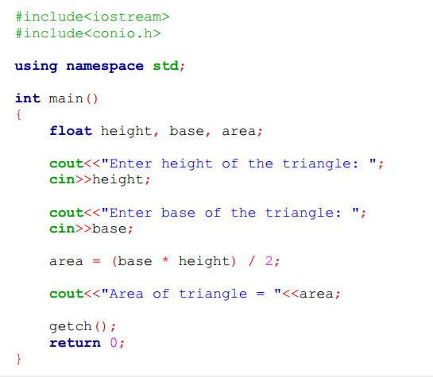
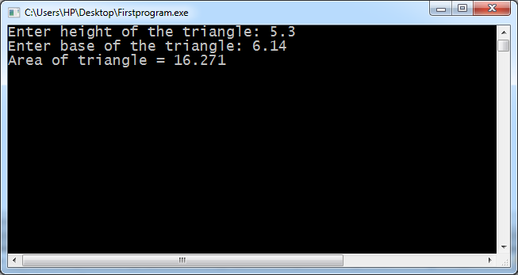
Program Example 01

Slide 72
Program Example 02
Problem Statement:
A person is running in a circular ground. Write a program in C++ that asks the user to input the radius of the ground in meters and the number of rounds the person completes. The program should display the amount of distance travelled by the person in meters.

Slide 73
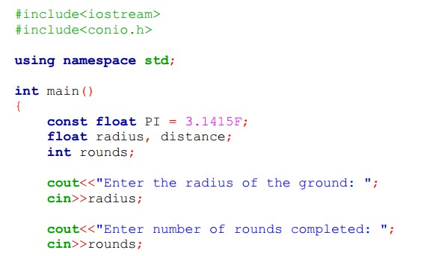
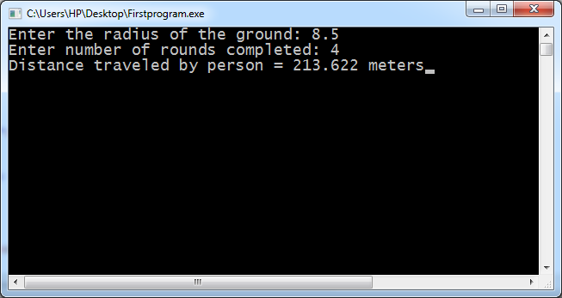
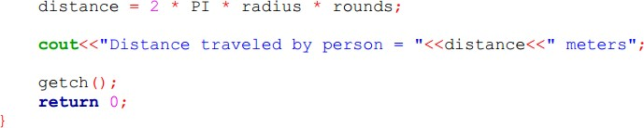
Program Example 02

Slide 74
Program Example 03
Problem Statement:
Write a program in C++ that asks the user to enter two integer numbers, stores them in variables num1 and num2 respectively. The program swaps the values of two variables with each other without using a third variable and displays the values of both the variables after swapping.
Sample output: Input:
num1 = 45
num2 = 94
Output: num1 = 94
num2 = 45

Slide 75

End of lecture

