Slide 1
CS-112 Object Oriented Programming (3+1) Prerequisites: Programming Fundamentals
Syed Muhammad Rafi Lecturer, Department of Software Engineering Faculty of Engineering Science and Technology, Ziauddin University

Slide 2
Type Casting and Size of Lecture # 3

Slide 3
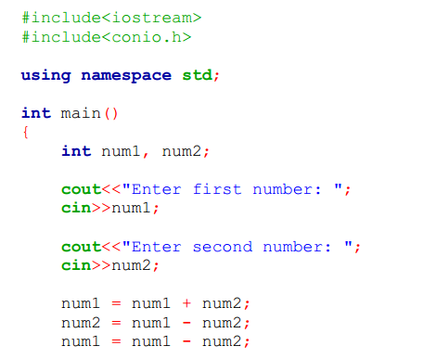
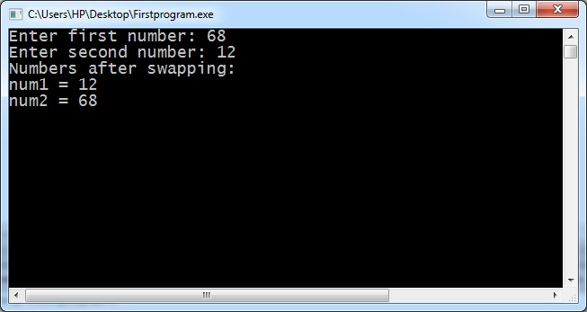
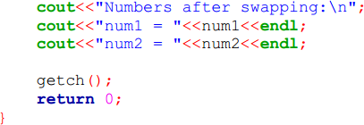
Program Example 03

Slide 4
Type Casting
The process of converting the data type of value during execution is known as type casting.
The casting can be performed in two ways.
Implicit Type Casting
Implicit type casting is performed automatically by the C++ compiler.
The operand in arithmetic operations must be of similar types.
An expression in which operands are of different data types is called mixed-type expression.
In this case, result of an expression is evaluated to larger data type in the expression.
Suppose an expression contains an integer and double as operands.
The result will be evaluated to double data type.

Slide 5
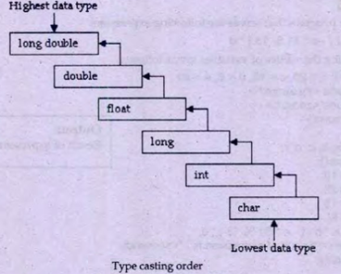
Different Types of variables are as follows.

Slide 6
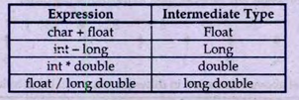
Some examples of implicit conversions are as follows.

Slide 7
Example
Suppose x is an integer variable and y is a long variable.
following expression is evaluated
x+y
In the above expression, data type of x is lower than data type of y.
So the value of x will be converted into long during the evaluation of expression.
The data type of x is not change.
Only the data type of value of x is change during the evaluation of expression.

Slide 8
Explicit Casting
Explicit casting is performed by programmer.
It is performed by using cast operator.
The cast operator tells the computer to convert the data type of a value.
Syntax
The syntax of the cast operator is as follows.
(type) expression;
Type It indicates the data type to which operand is to be converted.
Expression It indicates the constant, variable or expression whose data type is to be converted

Slide 9
Example
Suppose x and y are two float variables.
x contains 10.3 and y contains 5.2 and the following expression is evaluated.
x%y
The above expression will generate an error because data type of x and y is float.
The modulus operator cannot work with float variable.
It only works with integers.
So the expression can be written as follows.
(int)x % (int)y
The above expression converts the values of x and y into integer and evaluates the expression.
The value of x will be converted to 10 and value of y will be converted to 5.
so the result of expression will be zero.

Slide 10
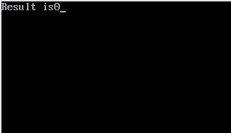
Write a program that divides two float variable and find the remainder by using explicit casting.
#include <iostream>
using namespace std;
void main()
{
float a,b;
int c;
a=10.3;
b=5.2;
c= (int)a%(int)b;
cout<<“Result is”<<c;
return 0;
}

Slide 11
The“sizeof”Operator
The sizeof operator is used to find the size of any data value.
It gives the number of bytes occupied by that value.
Syntax
The syntax of using this operator is:
sizeof(operand);
Example
The following are some examples of using sizeof operator.
sizeof(n);
sizeof(pakistan);
sizeof(10);

Slide 12
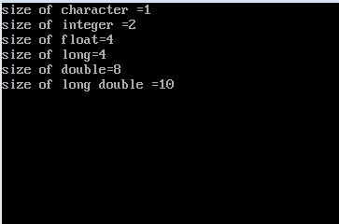
Write a program that displays size of different data types
#include <iostream.h>
using namespace std;
void main()
{
cout<<"size of character ="<<sizeof(char)<<endl;
cout<<"size of integer ="<<sizeof(int)<<endl;
cout<<"size of float="<<sizeof(float)<<endl;
cout<<"size of long="<<sizeof(long)<<endl;
cout<<"size of double="<<sizeof(double)<<endl;
cout<<"size of long double ="<<sizeof(long double)<<endl;
return 0;
}

Slide 13
Comments
Comments are lines of program that are not executed.
The compiler ignores comments and does not include them in executable program.
That’s why the comment does not effect the size of executable program.
Comments are used to increase the readability of program.
Comments are notes about different lines of code that explain the purpose of the code.
The user can insert information notes in the code.
It help in debugging and modifying the program later.

Slide 14
Comments can be used any where in program in two ways.
Single line comments
Comment on single line are added by using double slash “//”.
Any thing written on the right side of double slash is consider as comments and is ignored during execution.
Multi-line comments
Multi-level comments are inserted to the code by placing /* at the begning of the comments.
The character */ is used to end multi-line comments.
Examples
// object oriented programming.
*/These lines are for the purpose of
writing comments*/

Slide 15
Input and Output
The Process of giving something to computer is known as input.
The input is mostly given by keyboard.
A program may need certain inputs from the user for working properly.
The term standard input refers to input via keyboard.
The process of getting something from computer is known as output.
The output is mostly displayed on monitor.
The term standard output refers to the output displayed on monitor.
The result of a program is the output of that program.

Slide 16
Standard Output
The term standard output refers to the output displayed on monitor .
C++ uses the cout stream object to display standard output.
The word ‘cout’ stands for console output.
The cout is used with insertion operator (<<).
The message or the value of variable followed by the insertion operator is displayed on screen.
Syntax
The syntax of using cout object is as follows.
cout<<Variable/Constant/Expression;

Slide 17
Where,
cout | It is the name of the object to display standard output.
<< | It is known as insertion operator or put to operator. It sends the output to cout object. The cout object then sends the output to screen. The left side of << operator must be an output stream like cout. The right side of << operator must be an expression or manipulator. One statement can be used multiple variables or constants .
Variable/constant /expression | It is variable constant or expression whose value is displayed on screen.

Slide 18
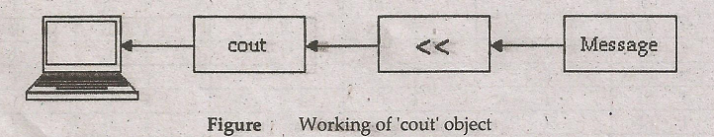

Slide 19
Standard Input
Term standard output refers to the input given by keyboard.
C++used cin stream object to get standard input.
The word ‘cin’ stands for console input.
C++handles console input by applying the extraction operator (>>) with cin stream.
The operator must be followed by a variable.
The variable is used to store the input data.
Syntax
The syntax of using cin object is as follows:
cin >> var;

Slide 20
Where,
Cin | It is the name of the object used to get standard input.
>> | It is known as extraction operator or get from operator. It gets the output from cin object. The cin object then stores the input in the variable. The left side of >> operator must be an input stream like cin. The right side of >> operator must be a variable of simple data type. One statement can use multiple extraction operators to get multiple values.
var | It is the variable in which the input values are stored .

Slide 21
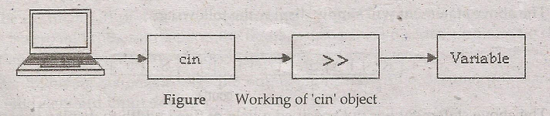

Slide 22
C++ Manipulator
C++ manipulators are used to format the output in different styles.
The manipulators are the most common way to control output formatting.
Some important manipulators in C++ are as follows.
‘endl’ Manipulator
The word ‘endl’ stands for end of line.
The ‘endl’ manipulator is used to move cursor to the beginning of next line.

Slide 23
Example
cout<<“hello “<<endl<<“world”;
The above line will display the following output.
hello
world
The endl manipulator is not used as apart of string.
It is written with separate insertion operator.

Slide 24
‘setw’ Manipulator
The word ‘setw’ stands for set width.
The ‘setw’ manipulator is used to display the value of expression in a specified columns.
The value of expression can be string or numbers.
If values of expression is less than the specified columns, the additional columns are left blank from left side.
The output automatically uses the required columns if output is larger than the specified column.
The use of ‘setw’ has no effect on output in this case.

Slide 25
Syntax
The syntax of ‘setw’ manipulator is as follows
setw(n)
The n indicates the number of column in which the value is to be displayed, it can be an unsigned positive integer constant, variable or expression.

Slide 26
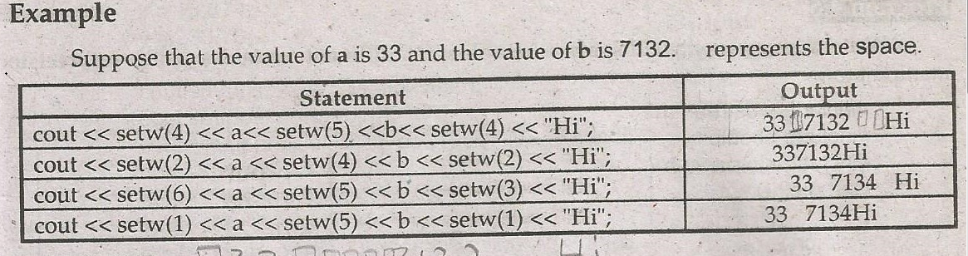

Slide 27
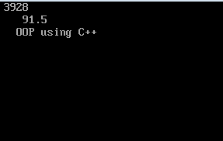
Write a program that explain the use of setw manipulator.
#include <iostream>
#include <iomanip>
using namespace std;
int main()
{
int n=3928;
double d=91.5;
char str[ ]="OOP using C++";
cout<<setw(5)<<n<<endl;
cout<<setw(8)<<d<<endl;
cout<<setw(16)<<str<<endl;
return 0;
}

Slide 28
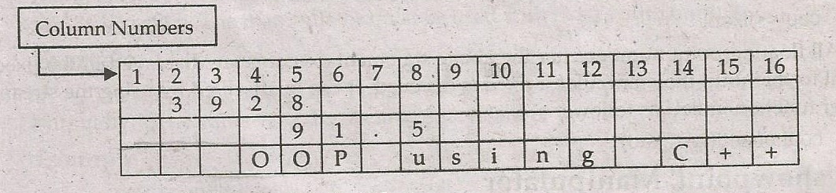

Slide 29
‘setprecision’ Manipulator
The ‘setprecision’ manipulator is used to set the number of digits to be displayed after decimal point .
It is applied to all subsequent floating point numbers written to that output stream.
The value is rounded with the use of this manipulator
Syntax
The syntax of set precision manipulator is as follows:
setprecision(n);
The n indicates the number of digits displayed after the decimal point.
It can be an unsigned positive integer constant, variable or expression.

Slide 30
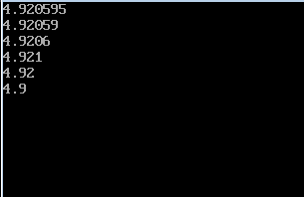
Write a program that displays the values of different variables using set precision manipulator
#include <iostream>
#include <iomanip>
using namespace std;
int main()
{
double r, n1=132.364, n2=26.9;
r=n1/n2;
cout<<r<<endl;
cout<<setprecision(5)<<r<<endl;
cout<<setprecision(4)<<r<<endl;
cout<<setprecision(3)<<r<<endl;
cout<<setprecision(2)<<r<<endl;
cout<<setprecision(1)<<r<<endl;
return 0;
}

Slide 31
‘setfill’ Manipulator
The setfill manipulator is used to replace the leading or trailing blank in the output by the specified character.
It requires one parameter to specify the fill character.
The parameter can be a character constant ,character variable or an integer that represents the fill character in ASCII system.
The manipulator must be used with fixed width output.
Example
The manipulator setfill(*)will replace the leading or trailing blank in the output by *.
The value 42 is the decimal equivalent of character(*) in ASCII.

Slide 32
Example
Cout<<endl<<setfill(‘*’)<<“RESULT:”;
The above statement will simply display the following:
The above statement has not specified a field of fixed width to display string.
It will appear in the field of minimum width.
It takes exactly eight fields to display the value.
That is why, the setfill(‘*’) has not effect.
R | E | S | U | L | T | :

Slide 33
Example
cout<<endl<<setw(15)<<setfill(‘*’)<<“RESULTS:”;
The above statement will display the following.
The above statement will defines a field width of 15.
It is more than the length of the values to be displayed.
* | * | * | * | * | * | * | R | E | S | U | L | T | S | :

Slide 34
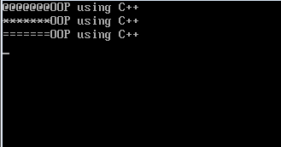
Write a program to display the values of different variables using setfill manipulator
#include <iostream>
#include <iomanip>
using namespace std;
int main()
{
char str[ ]="OOP using C++";
cout<<setw(20)<<setfill('@')<<str<<endl;
cout<<setw(20)<<setfill('*')<<str<<endl;
cout<<setw(20)<<setfill('=')<<str<<endl;
return 0;
}

Slide 35
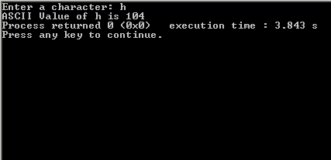
Write a program that prints values of ASCII
#include <iostream>
using namespace std;
int main()
{
char c;
cout << "Enter a character: ";
cin >> c;
cout << "ASCII Value of " << c << " is " << int(c);
return 0;
}

Slide 36
Explanation
A character variable holds ASCII value (an integer number between 0 and 127) rather than that character itself in C programming. That value is known as ASCII value.
For example, ASCII value of 'A' is 65.
What this means is that, if you assign 'A' to a character variable, 65 is stored in that variable rather than 'A' itself.

Slide 37
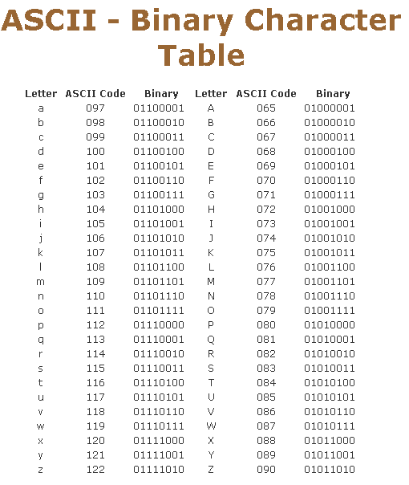

Slide 38

End of lecture

