Slide 1
CS-112 Object Oriented Programming (3+1) Prerequisites: Programming Fundamentals
Syed Muhammad Rafi Lecturer, Department of Software Engineering Faculty of Engineering Science and Technology, Ziauddin University

Slide 2
Object and Class Lecture # 04

Slide 3
Features of Object Oriented Programming
Following are the features of object oriented programming.
Objects
OOPs provides the facility of programming based on objects.
Object is an entity that consist of data and functions.
Classes
Classes are designed for creating objects.
OOPs provide the facility to design classes for creating different objects.
All properties and functions of an objects are specified in classes.

Slide 4
Real-world Modeling
OOP is based on real world modeling.
As in real world, things have properties and working capabilities.
Similarly objects have data and functions.
Data represent properties and function represent working of objects.
Reusability
OOP provides ways of reusing the data and code.
Inheritance is a technique that allows a programmer to use the code of existing program to create new programs.

Slide 5
Information Hiding
OOP allow the programmer to hide important data from the user.
It is performed by encapsulation.
Polymorphism
Polymorphism is an ability of an object to behave in different ways.
7. Dynamic Binding

Slide 6
Objects
An object represent an entity in the real world. Such as a person thing or concept etc.
Object is simply a collection of data and functions that act on those data.
An object is identified by its name.
An object consists of following two things:
Properties: Properties are characteristic of an object .
Functions: Functions are the actions that can be performed by an object.

Slide 7
Example
Some examples of objects of different types are as follows:
Physical Objects
Vehicle such as car, bus, truck etc.
Electrical components
Elements of Computer-User Environment
Windows
Menus
Graphics Objects
Mouse and Keyboard
User-defined Data Types
Time
Angles

Slide 8
Properties of an Object
The characteristic of an object are known as its properties or attributes.
Each object has its own properties.
These properties can be used to describe the object.
For example the properties of an object Person can be as follows.
Name
Age
Weight

Slide 9
The properties of an object Car can be as follows:
Model
Color
Price
Engine Power

Slide 10
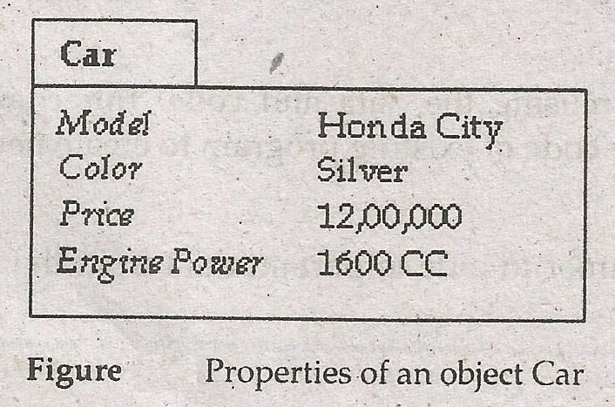
The set values of the attributes of a particular objects is called its state.
It is means that the state of an object can be determined by the values of its attributes.
The following figure shows the values of the attributes of an object Car.

Slide 11
Functions of Object
An Object Can perform different tasks and actions.
The actions that can be performed by an object are known as functions or methods.
For example the object Car can perform the following functions:
Start
Stop
Accelerate
Reverse

Slide 12
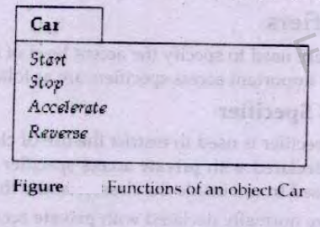
The set of functions of an object represents the behavior of the object.
It means that the overall behavior of an object can be defined by the list of functions of that objects.

Slide 13
Classes
The collection of objects with same properties is known as class.
A class is used to define the characteristic of objects.
It is used as a model for creating different objects of same type.
For example, a class Person can be used to define the characteristic and functions of a person.
It can be used to create many objects of type Person such as ali, salman, usman.

Slide 14
All objects of Person class will have same characteristic and functions.
However the values of each object can be different.
The values of the objects are assigned after creating an object.
Each object of a class is known as the instance of the class.
For example ali, salman, usman are three instances of a class Person.
Similarly myBook, yourBook are the two instances of class Book.

Slide 15
Declaring a Class
A class is declared in same way as a structure is declared.
The keyword class is used to declare a class.
A class declaration specifies the variables and functions that are common to all objects of that class.
The variables declared in a class are known as member variable or data members.
The functions declared in a class are called member function.

Slide 16
Syntax
The syntax for declaring a class is as follows.
class identifier
{
body of class(some data /some functions)
};
Where,
class It is a keyword that is used to declare a class.
identifier It is a name of the class. The rules for class name are
same as the rule for declaring a variable.
The class declaration always ends with a semicolon.
All data members and member functions are declared with in the braces known as body of the class.

Slide 17
Example
Class test
{
int n;
char c;
float x;
};
The above class only contain data members in it.

Slide 18
Example
class Test
{
private:
int data1;
float data2;
public:
void function1()
{ data1 = 2; }
float function2()
{
data2 = 3.5;
return data2;
}
};
The above class only contain data members and member function in it.

Slide 19
Access Specifiers
The commands that are used to specify the access level of class members are known as access Specifiers.
Two most important access Specifiers are as follows.
The private Access Specifiers
The private access specifier is used to restrict the use of class member with in the class.
Any member of class declared with private access specifier can only be accessed within the class.
I cannot be accessed from outside the class.
It is also the default access specifier.

Slide 20
Explanation
The data members are normally declared with private access specifier.
It is because the data of object is more sensitive.
The private access specifier is used to protects the data member from direct access from outside the class.
These data members can only use the functions with in the class.
Public Access Specifier
The public access specifier is used to allow the user to access a class with in the class as well as outside the class.
Any member of class declared with public access specifier can be accessed from anywhere in the program.

Slide 21
Explanation
The member functions are normally declared with public access specifier.
It is because the user access functions of an object from outside the class.
The class cannot be used directly if both data members and member functions are declared as private.

Slide 22
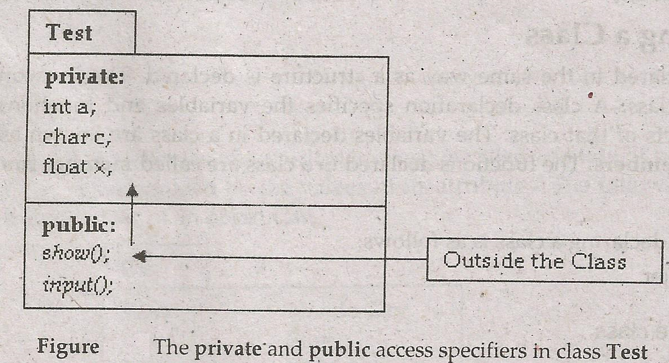

Slide 23
The above figure shows that data members a,c and x of class Test cannot be accessed from outside the class because they are declared with private access specifier.
The member functions show() and input() are accessible from outside the class because they are declared with public access specifier.
The data members are accessed and manipulated indirectly through member function.

Slide 24
Creating Objects
A class is simply a model or prototype for creating objects.
It is like a new data type that contains both data and functions.
An object is created in the same way as other variables are created.
When an object of a class is created, the space for all data members defined in the class is allocated in the memory according to their data types.
An object is also known as instance.
The process of creating an object of a class is also called instantiation.

Slide 25
Syntax
The syntax of creating an object of a class is as follows:
class_name object_name;
Where,
class_name: It is name of the class whose type of object is to be created.
Object_name It is name of the object to be created. The rules for object
name are same as the rule for variable declaring.
Example
Test obj;
The above example declares an object obj of type Test.

Slide 26
Executing Member Function
An object of a particular class contains all data members as well as member functions defined in that class.
The data member contains the value related to the object.
The member functions are used to manipulate data members.
The member functions can be executed only after creating an object.

Slide 27
Syntax
The syntax of executing member function is as follows:
object_name.function();
Where,
object_name: It is the name of object whose member function
is to be executed.
Function: It is the name of member function to be executed.
Any required parameter are also passed to the
member functions in parenthesis.
The object name and member functions are separated by dot operator
Example
Obj.input();

Slide 28
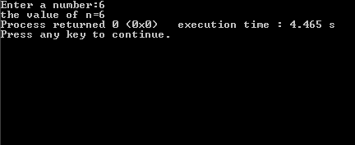
Write a program that declares a class with one integer data member and two member functions in() and out() to input data in data member
# include<iostream>
using namespace std;
class test
{
private:
int n;
public:
void in()
{
cout<<"Enter a number:";
cin>>n;
}
void out()
{
cout<<"the value of n="<<n;
}
};
int main()
{
test obj;
obj.in();
obj.out();
return 0;
}

Slide 29

End of lecture

