Slide 1
Jump Rope City: Testing
Kamin Fay, Celine Fucci, Kevin Ho,
Ethan McGowan, Jalen Pestillo

Slide 2
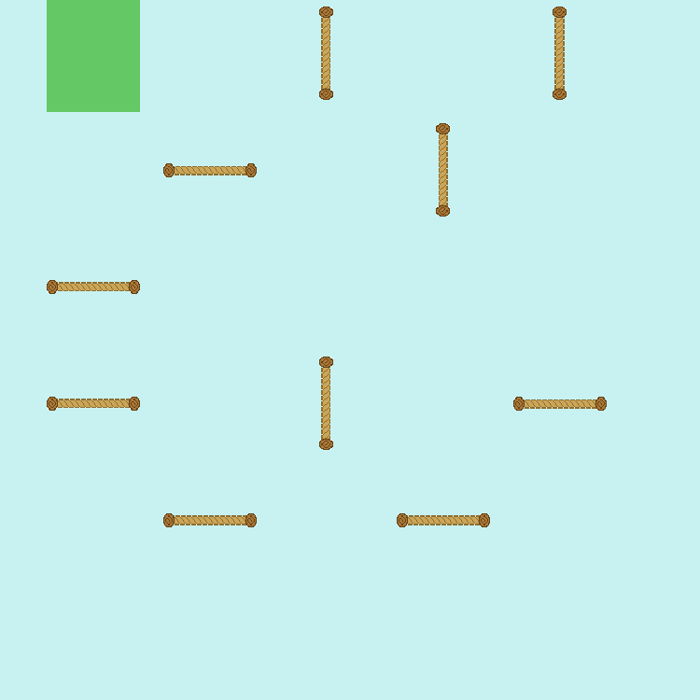

Boundaries of Map Grid
Entering 10 into the console will allow 10 ropes to be spawned.
Notes:
Ethan

Slide 3
Boundaries of Map Grid
The current maximum size we can allow is 24. Therefore, trying to spawn 420 ropes will cause an error.
We prevented the user from placing more than 24 ropes.
Notes:
Ethan

Slide 4
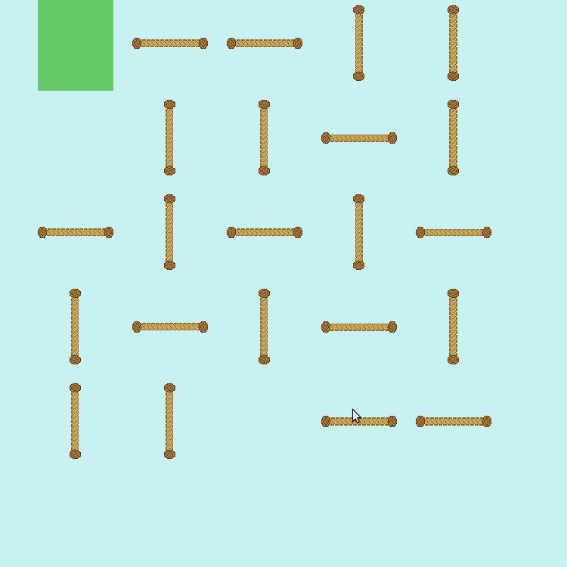
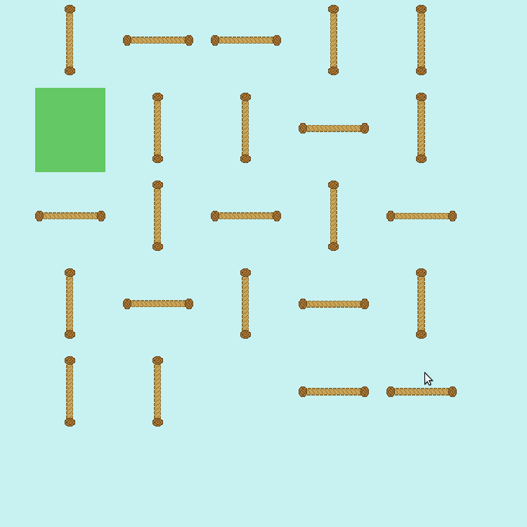
Bugs in the Map Grid
Notes:
Jay
Player spawns on top of rope - not good
Ran program, found error. This will be a testing feature we are working on in the future.

Slide 5
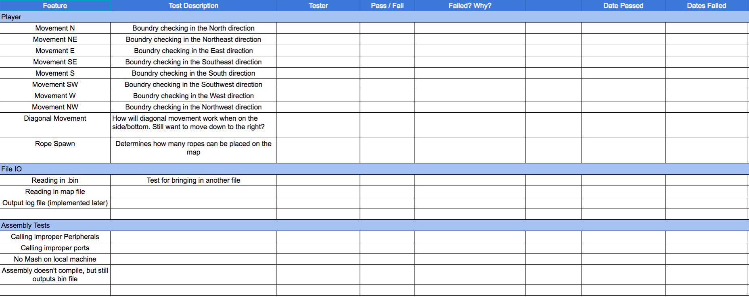
Testing Document
Notes:
Celine
This is an example of our testing document that we’re currently using to track our tests. Using this document helps us to prioritize our tests. We’ve been using this document to determine what features we’ve implemented and need to continue testing.

Slide 6
Jump Rope City: Status
Notes:
Kamin

Slide 7
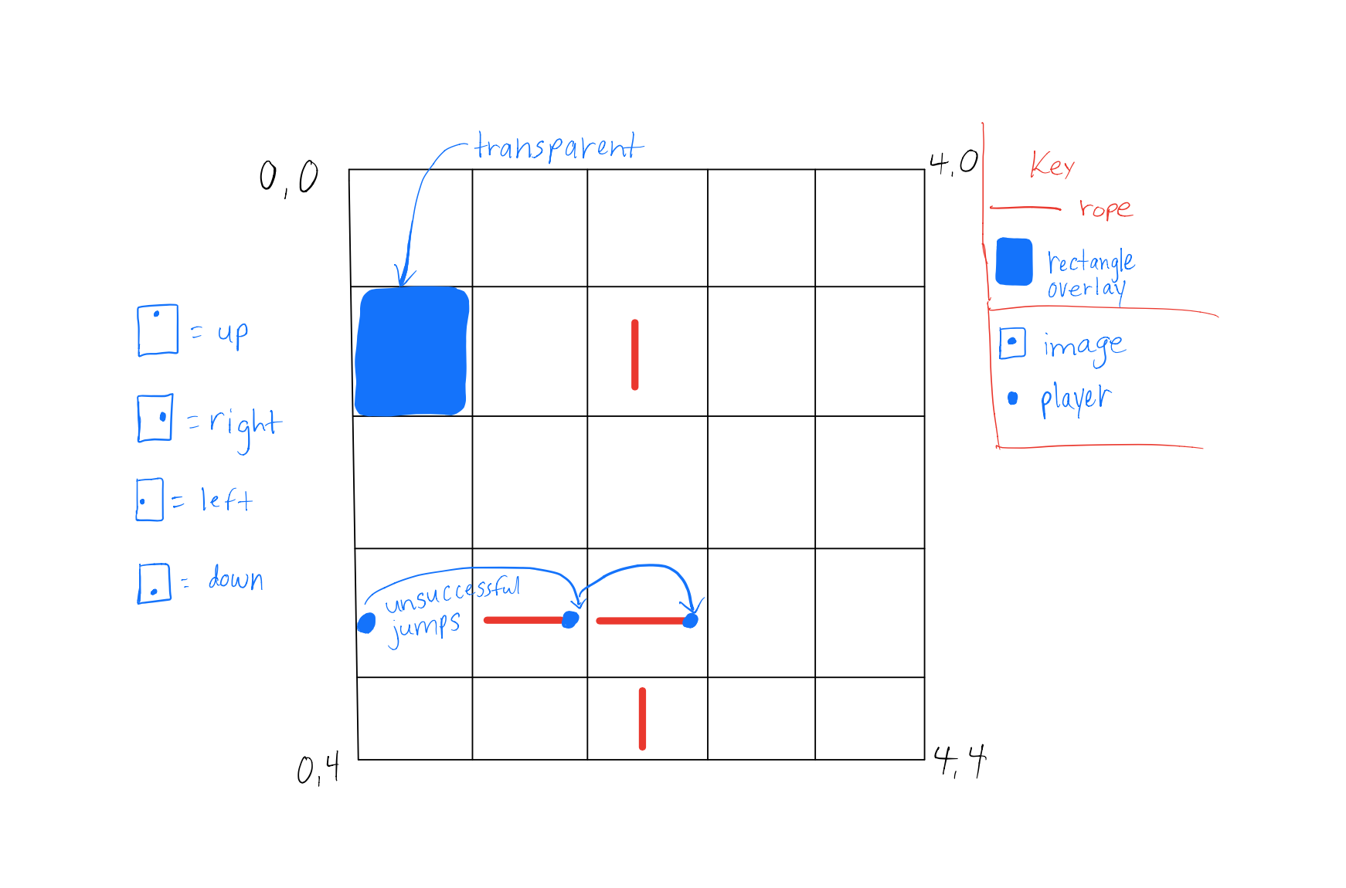
Game Structure
Notes:
Kamin
After discussing things with Confer we’ve decided to reevaluate the current game structure to possibly move the player around the map grid differently. This change will be determined once the player motion is tested with a proper cycle speed.

Slide 8
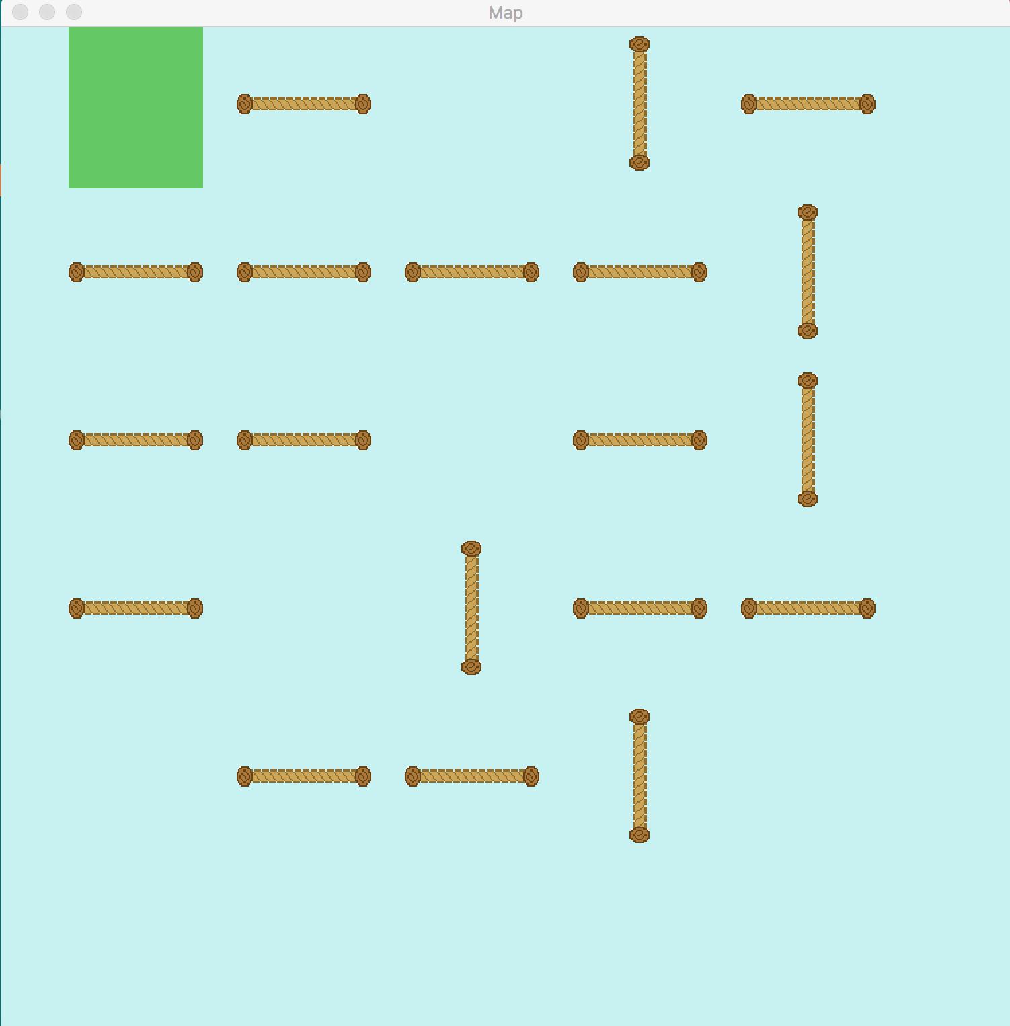
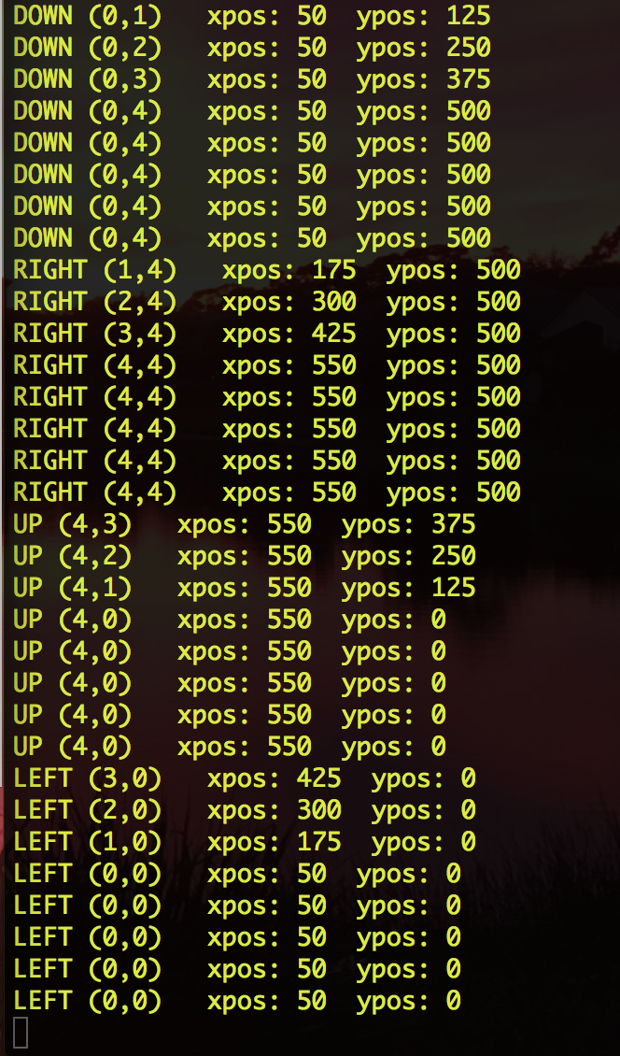
Boundaries of Player Grid
Notes:
Kevin

Slide 9
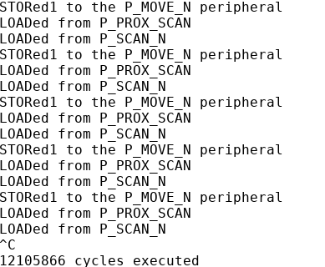
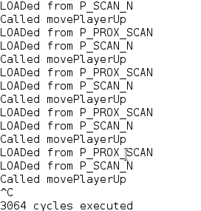
Clock Cycles Reduced
Notes:
Jay
SDL_Delay(1000/60);

Slide 10
Live Demo
Notes:
Kevin

Slide 11
Future Plans
Adding movement animations
Full MiniAT integration
Rope removal
Producing a viable game for the customer
Notes:
Celine

