Slide 1
Biotech Industry - MVE vs Age
Jacob Willson
October 7, 2026
Notes:
Title slide. Question: is a biotech firm's market value of equity related to how long it has been a public filer?

Slide 2




Business Context & Question
Economic rationale: why we expect a positive correlation
RESEARCH QUESTION
Is the Market Value of Equity correlated with company age? If so, does it increase or decrease over time for Biotech companies?
Industry expansion
Biotech is an expanding industry, so firms that persist should grow in value alongside it.
Pipeline de-risking
Survivors turn R&D into approved, revenue-generating products; resolved clinical risk lifts expected cash flows and lowers required returns.
Measurable outcomes
Accounting: R&D is expensed
US GAAP expenses most R&D, so book equity understates accumulated know-how; market value capitalizes it as the pipeline matures.
Rank (Spearman ρ) and linear (Pearson r) correlation of MVE with post-IPO age; H1: ρ > 0
Effect size: change in median MVE across age bands and per decade of age
Direction: does MVE rise, stay flat or fall as firms age?
Survival and scale
Failures delist; long-lived public biotechs have raised more capital and reached commercial scale.
Counter-view: patent cliffs and maturing franchises could flatten or lower older firms' value, which is why this is an empirical question.
Notes:
The 'why': industry expansion is the headline expectation. The accounting angle is that R&D is expensed, so the value created by successful R&D shows up in market value rather than book value. De-risking and survival reinforce this. We state a directional hypothesis (rho > 0) before looking at the data.

Slide 3
Data & Cleaning Choices
833
201
2010–2024
≥ $100M
company-years after cleaning
unique biotech firms
fiscal years covered
revenue floor on every row
The data
Cleaning steps
What: annual firm-level financial ratios from the provided file ValuesFSARatios.xlsx (MVE, R&D / revenue, debt / equity, FCF / net income, revenue)
Age: days since the firm's first filed 10-K (post-IPO age)
When: fiscal years 2010–2024; 1 to 15 years per firm (median 3)
Industry: biotech as provided; the file has no industry code, so membership is taken as given
Revenue floor: only firm-years with revenue ≥ $100M (applied upstream) so ratios are not distorted by tiny denominators
Missing data: none in the columns used; no imputation, and this analysis dropped no rows. Upstream filters on the full source table: Appendix A1
Outliers: none removed and no winsorizing; 1% / 99% and 5% / 95% tests left the results unchanged (Appendix A2). Log axes handle the skew
Units: MVE converted from $ millions to $; age from days to years
Notes:
Final sample is 833 company-years for 201 firms. The $100M revenue floor was applied in the data file and matters a lot: without it the correlation is much weaker (Appendix A2). We deliberately did not winsorize; the appendix shows why.

Slide 4
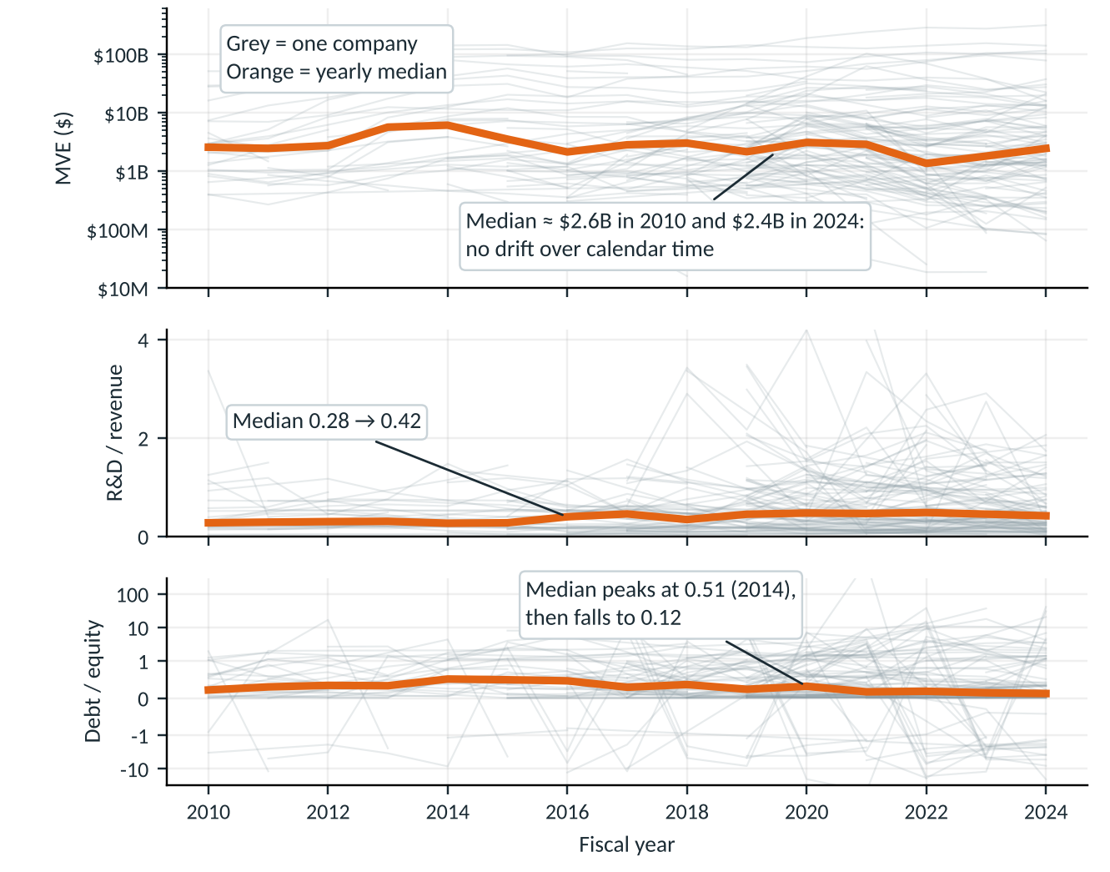
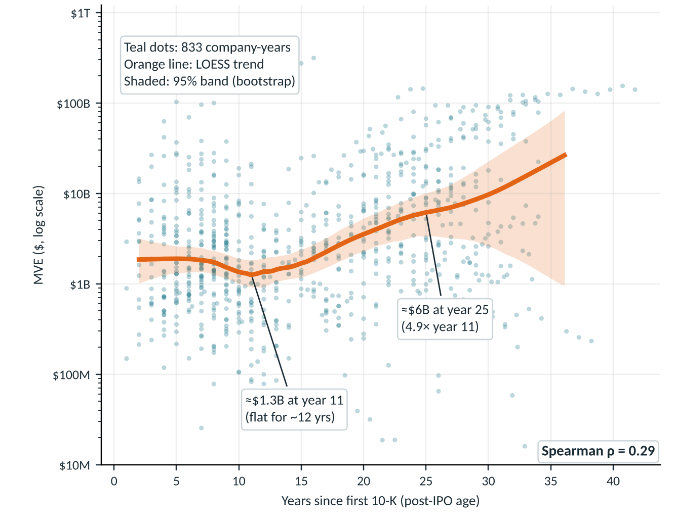
Age, not calendar time, is where MVE grows
Line graphs: yearly medians are stable, so MVE, R&D intensity and leverage show no strong time trend.
Dot plot: MVE is flat for ~12 years of filing history, then rises about 5× by year 25, with huge spread around the trend.
Notes:
Left: each grey line is one company; the orange line is the yearly median. Right: each dot is a company-year; the orange line is a LOESS trend with a bootstrap 95% band (resampling whole companies). The median MVE by calendar year does not trend up, so the age pattern is not just a rising tide.

Slide 5
Older firms are worth ~4× more, but age explains only ~11%
Size of the correlation
0.29
0.33
Spearman ρ (rank correlation)
Pearson r, log MVE vs age
11%
×1.8
share of log-MVE variation explained (R²)
MVE per extra decade of age (95% CI ×1.3–2.6)
Economic significance: firms with 20+ years of filings have a median MVE about 4× that of younger firms ($6.5B–$13.7B vs $1.5B–$1.7B; 95% CI 1.8–8.7×, resampling firms). But the ranges overlap heavily: age shifts the typical level, yet on its own it is a weak predictor of any one firm's value.
Notes:
rho = 0.29 is a moderate positive rank correlation. Under 20 years the median MVE is flat at roughly $1.5-1.7B; after 20 years it jumps. The 95% interval for the ratio of medians comes from resampling whole firms because each firm appears in several years.

Slide 6



Conclusion & Implications
What we found
Limitations
Further analysis
Yes: MVE is positively correlated with post-IPO age (ρ = 0.29), so it rises rather than falls with age
Not steadily: flat (or slightly down) for ~12 years, then ~5× higher by year 25
Median MVE by calendar year does not drift up, so this looks like maturity and de-risking, not just a rising tide
Age explains only ~11% of the variation: a real but modest factor
Survivorship: failed biotechs delist, so older firms are the winners
The $100M revenue floor excludes pre-revenue biotechs; without it ρ falls to 0.11
Firms repeat across years; firm-level ρ is only 0.15–0.18
Correlation, not causation: scale and year effects are not controlled; industry label taken as given
Control for revenue, fiscal-year and firm effects to isolate age
Add pre-revenue and delisted biotechs to test selection and survivorship
Test the mechanism directly with pipeline stage or FDA approvals
Compare IPO cohorts: ρ was 0.50 in 2010–16 vs 0.24 in 2017–24
Notes:
Answer to the question: positive, moderate, and non-linear. Limitations matter: survivorship and the revenue floor are the big ones. Next steps are about separating age from scale and from calendar-time effects.

Slide 7
Appendix A1: Source data and upstream filters
Original source table
Filters applied before this analysis
Extract provided for this analysis
100,000+
Removed rows with zero total debt
Removed rows with blank capex
Kept revenue ≥ $100M
833
lines of data, all available columns (CompustatData.xlsx)
company-years (201 firms), simplified to the columns needed
Why it matters
Zero total debt removed: debt-free firm-years are excluded, which may tilt the sample toward firms that carry debt
Blank capex removed: only firm-years that report capital expenditure remain, which may leave out some early-stage or sparse filers
These filters were applied before the file reached this analysis, so their effect on the MVE–age correlation has not been measured here; Appendix A2 isolates only the revenue floor (ρ 0.11 → 0.29)
To test them, rebuild the charts from the full table with and without each filter
Code, data extract and README: https://github.com/AlwaysOverachieve/Project1 | Full source table: CompustatData.xlsx (in the repository)
Notes:
The data used here is a simplified extract of a table with over 100,000 lines. Before extraction, rows with zero total debt and rows with blank capex were removed, and the $100M revenue floor was applied. We have not measured how the first two filters affect the result.

Slide 8
Appendix A2: Data cleaning choices and their effects
Version | n | Spearman ρ | Pearson r | R² (log MVE) | MVE per decade
Final: no winsorizing | 833 | 0.29 | 0.29 | 0.11 | ×1.84
MVE winsorized 1% / 99% | 833 | 0.29 | 0.34 | 0.11 | ×1.85
MVE and age winsorized 1% / 99% | 833 | 0.29 | 0.33 | 0.11 | ×1.85
MVE and age winsorized 5% / 95% | 833 | 0.30 | 0.35 | 0.11 | ×1.85
Earlier data, no $100M revenue floor | 3,448 | 0.11 | 0.14* | – | –
* Pearson r on log MVE; this earlier file (3,448 company-years, 730 firms) has no revenue column.
Winsorizing pulls extreme values to the cutoff. It lifts raw Pearson r (0.29 → 0.33–0.35) because a few giant firms stop dominating, but leaves rank correlation and the fitted slope unchanged, so no hidden stronger relationship
Bias from winsorizing: it shrinks the tails toward the middle and understates true dispersion. Rank statistics and log axes handle outliers without changing values, so the final analysis uses unmodified data
The $100M revenue floor is the biggest data choice: it removes small and pre-revenue firms and raises ρ from 0.11 to 0.29. Results describe commercial-stage biotechs
No firms were dropped for missing data in this analysis (no missing values in the columns used); upstream filters are in Appendix A1
Notes:
Why winsorizing was not used: it changes Pearson but not the rank-based result or the slope.

Slide 9
Appendix A3: Robustness checks
Cut of the data | n | Correlation of MVE with age
Full sample (Spearman ρ) | 833 | 0.29
One observation per firm (latest year) | 201 | ρ = 0.18
Firm medians (one point per firm) | 201 | ρ = 0.15
Within-firm only (firm means removed), log MVE | 833 | r = 0.15
Fiscal years 2010-2016 | 201 | ρ = 0.50
Fiscal years 2017-2024 | 632 | ρ = 0.24
Excluding MVE above $100B | 805 | ρ = 0.26
Reading the table
Positive in every cut, but weaker once each firm counts once (ρ ≈ 0.15–0.18)
Strongest in 2010–16 (ρ = 0.50) and weaker in 2017–24 (0.24), a period when many young IPOs entered: 29 firms in 2010 vs 96 in 2024
Not driven by the largest firms: dropping MVE above $100B leaves ρ = 0.26
Scale matters more than age: revenue has ρ = 0.76 with MVE (and 0.37 with age)
Notes:
Within-firm only means each firm's average is removed, so it measures whether a firm's MVE rises as it ages; it is positive but small, and it also reflects calendar time.

Slide 10
Appendix A4: Summary statistics and methods
Variable | Min | Median | Mean | Max
MVE ($ millions) | 16 | 2,560 | 13,583 | 313,686
Age (years since first 10-K) | 1.0 | 15.0 | 16.2 | 41.8
Revenue ($ millions) | 100 | 317 | 2,469 | 58,054
Method notes
Trend line: LOESS of log(MVE) on age, span 0.4, drawn over the 1st–99th percentile of age
95% band: 300 resamples of whole firms, refitting each time
Axes: MVE log scale; R&D / revenue linear; debt / equity symmetric-log (it has negative values)
Reproduce: Python and Node scripts, data extract and README at github.com/AlwaysOverachieve/Project1
n = 833 company-years (201 firms). MVE is strongly right-skewed (mean about 5× the median), which is why the charts use a log axis.
Notes:
Summary statistics are for the final sample. The mean MVE is far above the median because of a few very large firms.

