Slide 1
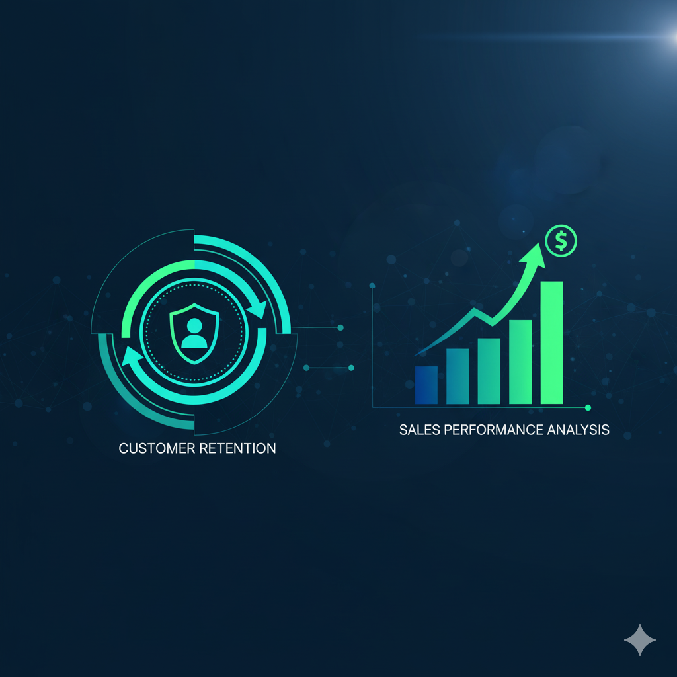
CUSTOMER RETENTION
AND
SALES PERFORMANCE ANALYSIS
Online Retail II Dataset

Slide 2

Reason for PROJECT Selection
To explore how data visualization can reveal sales patterns and customer behavior in an online retail business.
The goal is to transform raw transaction data into actionable insights that help improve performance and decision-making.
Relevance to Real-World Scenarios
Online businesses rely on data-driven insights to monitor sales trends and customer loyalty.
This project demonstrates how Power BI dashboards can help track revenue, identify best-selling products, and understand country-wise performance.

Slide 3
Dataset Description
Attribute | Description
Source | Online Retail II Dataset (UCI Machine Learning Repository)
Time Period | 01 December 2009 – 09 December 2011
Records | 1 million transaction records
Business Domain | Non-store UK-based online retailer
Attributes | InvoiceNo, StockCode, Description, Quantity, InvoiceDate, UnitPrice, CustomerID, Country
Currency | All transactions in Euro (£)

Slide 4
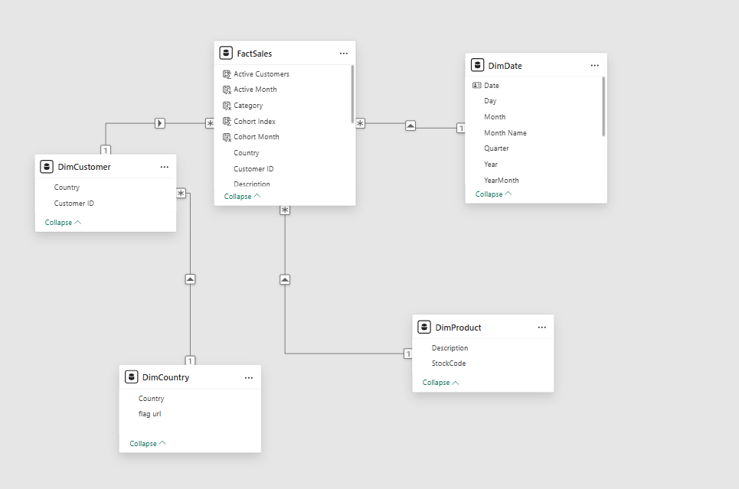
Data Model and Relationships

Slide 5
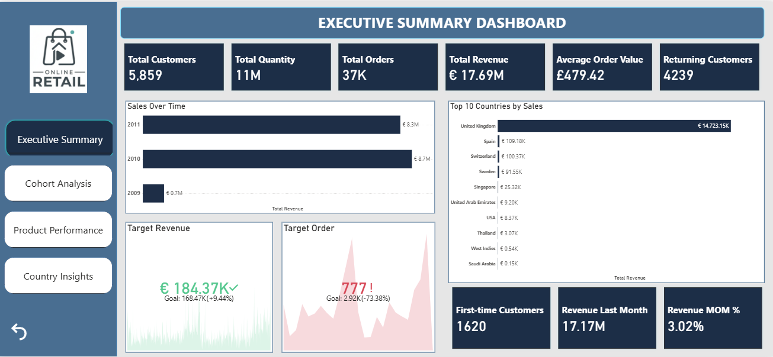
Key Insights and Business Findings

Slide 6
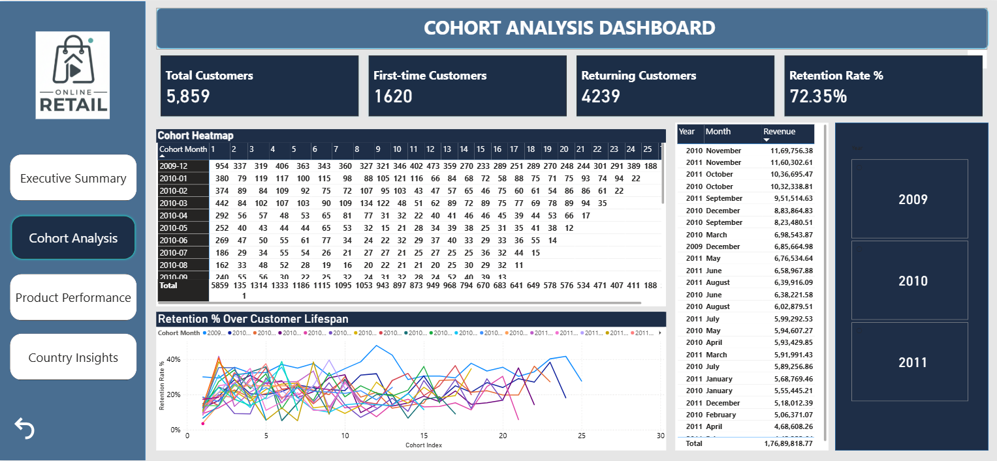
Key Insights and Business Findings

Slide 7
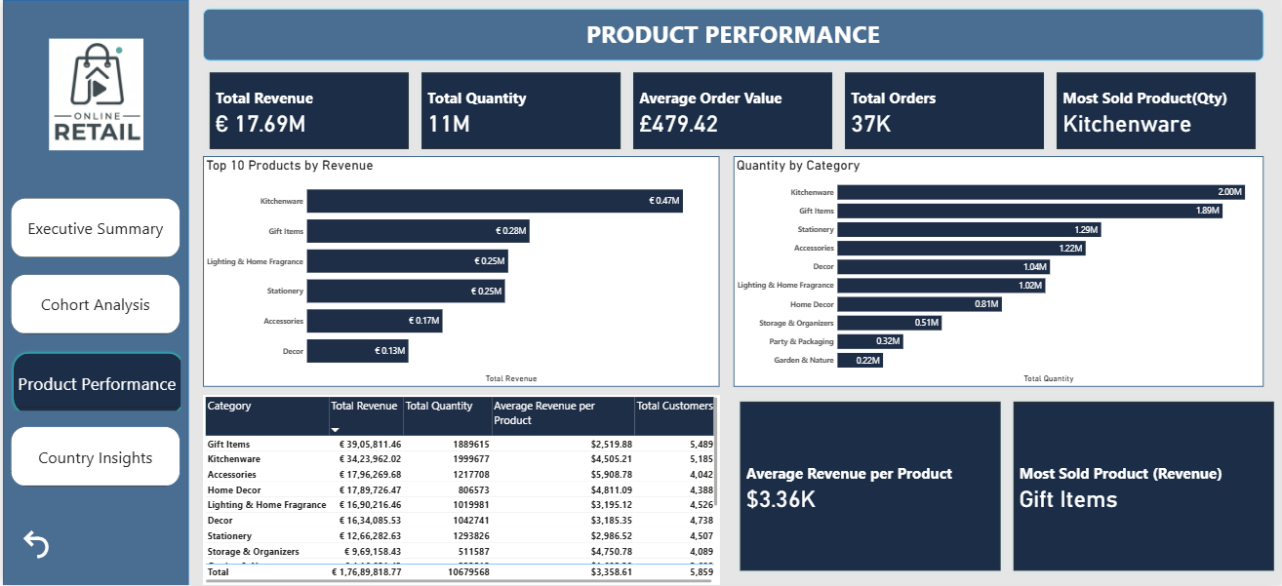
Key Insights and Business Findings

Slide 8
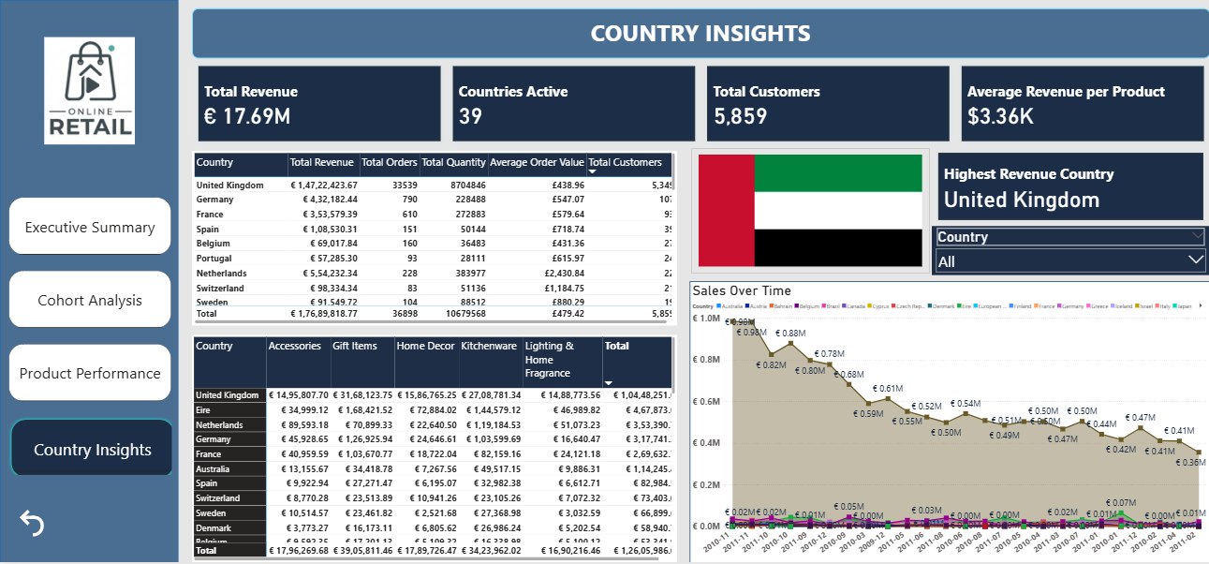
Key Insights and Business Findings

Slide 9
Key Insights and Business Findings
Insight | Recommendation
High revenue concentration in the UK | Diversify marketing efforts in other countries
Declining revenue trend in 2011 | Launch reactivation campaigns for lost customers
72% retention rate | Introduce loyalty programs for long-term retention
Product classification issues | Improve product catalog and metadata consistency

Slide 10
Conclusion
This Power BI project transformed over 1 million retail transactions into actionable insights on sales performance, customer retention, and product trends.
The analysis revealed that the UK drives 80% of revenue, while improving international marketing, customer loyalty, and product categorization can further boost growth.
Future enhancements include adding profit and forecasting models to strengthen decision-making and enable real-time business intelligence.

Slide 11
THANK YOU

