Slide 1
CSEQUITY AI · COMPETITIVE PROGRAMMING TRACK
Week 8 — Ship &
Stress-Test Your Pipeline
Putting your agentic LLM solver on held-out competitive programming problems — and seeing where it cracks.
AC
WA
TLE
RE
Final session · live evaluation + project presentations

Slide 2




RECAP
What you built: an agentic solver
The model never sees the test cases. It gets a problem statement, writes a full program, runs it, reads the verdict, and tries again.
1
2
3
4
→
→
→
Read problem
Generate
Run vs tests
Read verdict → retry
Statement only — no I/O examples leaked into the prompt.
Model emits a complete Python program inside a code fence.
Execute against hidden stdin/stdout cases.
AC stops the loop; WA/RE/TLE feeds back for another attempt.
The retry arrow is the whole point — your grade is about how well the loop recovers, not first-try luck.

Slide 3


TODAY
Two jobs this session
1 · Evaluate
2 · Stress-test
Run every team's pipeline on the same held-out set.
A problem counts only if all hidden cases pass.
Report solve rate + average attempts to first AC.
Hand out a hard problem live, in class.
Watch the loop work — where does it stall?
Probe failure modes before the presentation.
= 1 same cases for everyone
all-or-nothing every case must pass
≤ N retries capped, efficiency counts

Slide 4




THE HARNESS
How grading works
We use LiveBench's coding_generation tasks. Each problem ships with hidden test cases the model never sees.
Your program
Feed each case's stdin
AC only if every case matches
→
→
extracted from the ```python fence
compare stdout, line by line
trailing whitespace normalized
Two things will bite you
Trailing spaces & blank lines — the checker normalizes per line, but verify yours does too. Multiple valid answers — exact-match grading can reject a correct-but-different output.

Slide 5
INSTRUMENTING THE PIPELINE
Make the loop talk
A verbose pipeline is a teachable pipeline — you and your students can see exactly what changed and why.
Plan
solver.log
one line: the approach + rough complexity
iter 1 plan binary-search the answer · O(n log n)
Diff
iter 1 run WA on case 3 (exp 14, got 13)
what changed since the last attempt
iter 2 diff fix off-by-one in hi bound
Verdict
iter 2 run AC (12/12 cases)
AC / WA / RE / TLE + which case failed
Keep code extraction strict — parse only the ```python fence so the chatty prose can't corrupt what gets compiled.

Slide 6

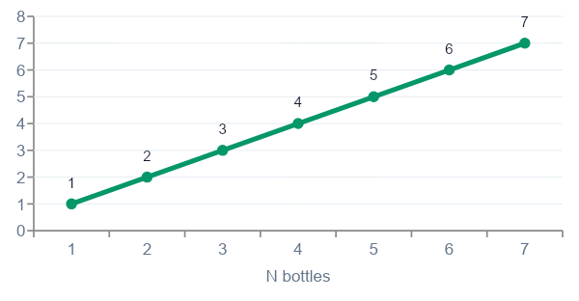
WHY WE FILTERED SOME PROBLEMS
The “Bad Juice” lesson
One sample problem in the set is interactive — and interactive problems quietly break static stdin/stdout grading.
Needs a live judge
What the problem is really about
Read N → print groups → flush → read the verdict S → answer. A fixed input string can't play that back.
Many right answers
Any valid labeling of bottles is optimal; exact-match marks the “wrong” correct answer as WA.
The stored cases didn’t even agree
Decoding the hidden tests showed answers that don’t match the problem’s own logic.
M = ⌈log₂ N⌉ — elegant and provably minimal, but unobservable from a static I/O pair.

Slide 7

THE FIX
One-line filter, applied
We drop interactive problems before week 8. It’s a tiny slice of the set and removes the only landmine.
problems = [p for p in dataset if "interactive problem" not in p.statement.lower()]
Stays in
Filtered out
Standard stdin/stdout problems
Single fixed expected output
Math, greedy, DP, graphs, strings
Interactive judges (“Bad Juice” et al.)
Problems with adaptive responses
Anything needing a live two-way protocol

Slide 8




THE LIVE SESSION
Stress-test run of show
Cases are handed out in class. Teams have time to make the loop work before presenting.
Hand out the case
Let the loop run
Probe the cracks
Present
Same held-out problem for every team.
Teams watch the verbose log, debug live.
Where does it stall — parsing, edge cases, timeouts?
Each team walks through one AC and one failure.
Heads up: handing out the exact cases + a retry loop means a pipeline can learn to print the expected bytes. Hold back one case if you want the score to mean “solved,” not “memorized.”

Slide 9



READING THE RESULTS
What a score actually means
Solve rate
Attempts to AC
Held-out gap
Share of held-out problems that reach AC. The headline number — but only honest on unseen cases.
How fast the loop converges. Fewer iterations = a sharper feedback signal, not just a bigger model.
If visible-case AC ≫ hidden-case AC, the pipeline is memorizing the trace, not solving.
The takeaway for students: a good pipeline isn’t the one that passes the most cases you showed it — it’s the one that recovers on a problem it has never seen.

Slide 10
GRADING THE PRESENTATIONS
Presentation rubric
Criterion | What we look for | Weight
Correctness | Held-out solve rate; honest reporting of failures | 30%
Loop design | Sensible retry strategy; uses the verdict to improve | 25%
Transparency | Verbose log makes each iteration legible | 20%
Failure analysis | Explains one case it couldn’t crack and why | 15%
Communication | Clear, honest, well-paced walkthrough | 10%
Weights are a starting point — tune them to what you emphasized across the eight weeks.

Slide 11






WHAT TO WATCH FOR
Common failure modes
Output formatting
Timeouts (TLE)
Silent crashes (RE)
Trailing spaces, missing newline, wrong separator — a correct answer marked WA.
Right idea, wrong complexity. The loop must read TLE as “go faster,” not “try again.”
Edge cases: empty input, N=1, integer overflow assumptions.
Retry stalls
Extraction errors
Overfitting
Same fix re-proposed every round. Feed the actual diff + failing case back in.
Prose leaking into the code block; multiple fences; non-Python output.
Memorizing shown cases instead of solving — caught by held-out gap.

Slide 12



WRAP-UP
You shipped a solver.
Now you can measure it honestly.
Today
If you keep going
Stretch
Run the held-out eval, present one AC and one failure.
Add a real interactor and bring interactive problems back.
Compare two models on the same loop — what does the gap show?
CSEquity AI · Competitive Programming Track · Week 8

