Slide 1
Edu.Inv
Inspiring Education Through Investment
GUIDE : SUKRITH LAL
ALWIN K G

Slide 2
INTRODUCTION
Source of Income: By lending money at an average interest rate, investors can earn a steady income.
The project is an educational loan platform developed using Python Django, aimed at supporting highly talented, financially underprivileged, and well-deserving candidates. This platform not only connects students in need of financial assistance with potential sources of funding but also incorporates a unique feature: the Investor Page.
The Investor Page allows individuals to invest in the education of registered candidates, providing them with the necessary funds to pursue their studies. Investors benefit in several ways:
Source of Income : By lending money at an average interest rate, investors can earn a steady income.
Positive Public Exposure : Participation in this program enhances the investor's public image as a benefactor of education and
supporter of future leaders
Charity : Investors contribute to a noble cause, supporting the education of deserving students who might otherwise lack the means
to achieve their academic goals.
Overall, this project bridges the gap between financially challenged students and philanthropic investors, fostering an environment of mutual benefit and societal growth. The educational loan platform not only alleviates the financial burden of students but also provides investors with an opportunity to make a meaningful impact while receiving a return on their investment.

Slide 3
Existence System
Prodigy Finance : Prodigy Finance offers loans to international postgraduate students attending top universities. The funds for these loans come from a community of alumni and institutional investors who earn financial returns while supporting education.
Kiva: Kiva is a micro-lending platform that allows individuals to lend money to low-income entrepreneurs and students around the world. While not solely focused on education, it does include educational loans as part of its offerings.
Funding Circle: Although not specifically for education, Funding Circle connects small businesses with investors who provide loans in exchange for interest. The concept is similar in that it connects those in need of funds with those looking to invest.

Slide 4
Proposed System
The proposed system is a web-based educational loan platform developed using Python Django, designed to support highly talented, financially underprivileged, and deserving candidates. The platform stands out by integrating an Investor Page, where individuals can invest in students' education, thereby providing them with the necessary funds to pursue their studies.
Benefits
For Students: Access to necessary funds for education, alleviation of financial burdens, and the ability to pursue academic and career goals.
For Investors: Opportunity to earn a steady income through interest, positive public exposure as a benefactor of education, and the satisfaction of contributing to a noble cause.
For Society: Promotion of education, support for financially disadvantaged students, and fostering a culture of mutual benefit and societal growth.

Slide 5
Comparison
Existence System
Edu.inv
Target Audience: Vary from international students, low-income individuals, to small businesses.
Investment Model: Mix of community funding, crowdfunding, and institutional investments.
Interest Rate: Varies from low/no interest (Kiva) to competitive rates (Prodigy Finance, Funding Circle).
Technology: Proprietary platforms with advanced data analytics and AI (Upstart).
Target Audience: Specifically targets talented, financially underprivileged students.
Investment Model: Direct individual investments in student loans.
Interest Rate: Average market rate for balance.
Technology: Modern stack with Python Django, and typical web technologies.

Slide 6
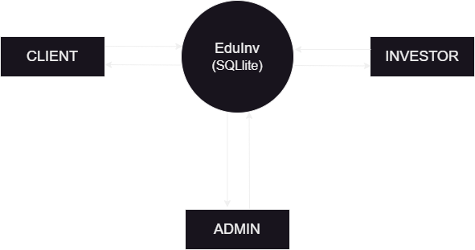
DFD 0

Slide 7
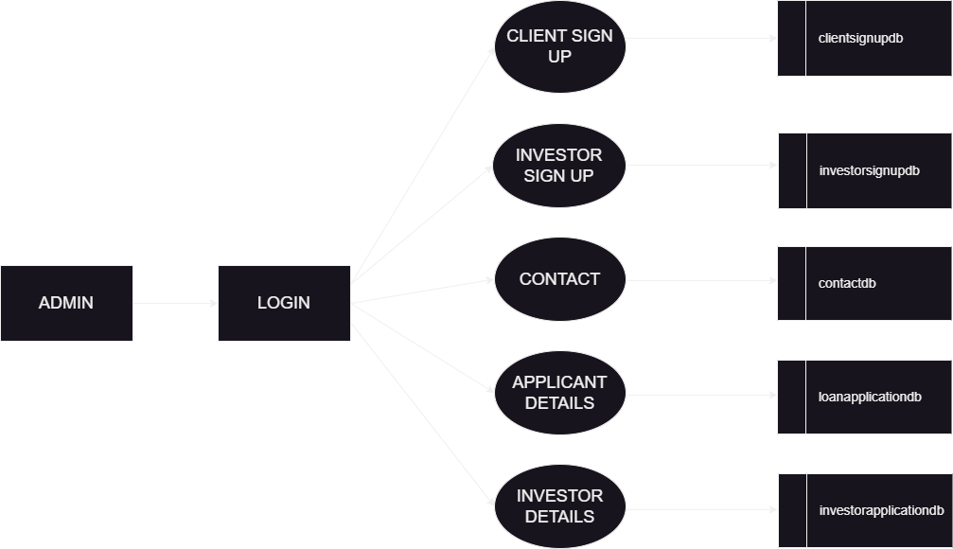
DFD 1 (Admin)

Slide 8
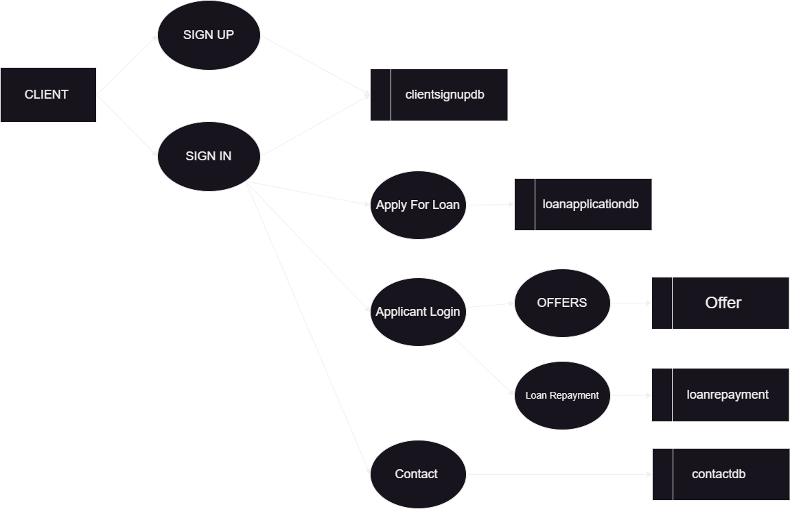
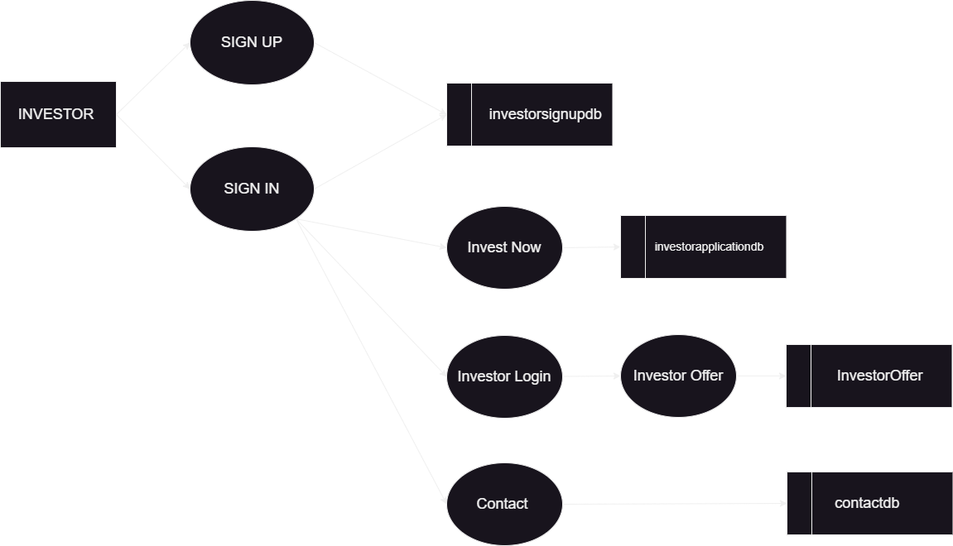
DFD 11

Slide 9
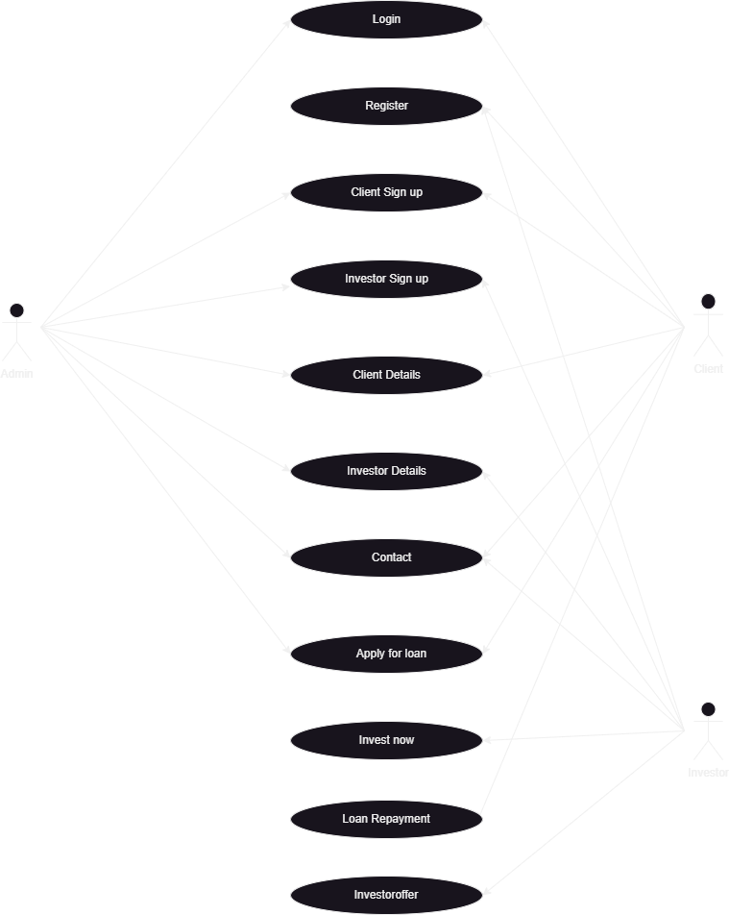
USECASE

Slide 10
PLATFORM: Full-Stack (Python Django)
Backend : Python Django
Frontend:
HTML/CSS
JavaScript
Templates
Database:
SQLite
Hosting:
AWS

Slide 11
REFERENCES
Django Official Documentation:
URL: https://docs.djangoproject.com/
Description: Comprehensive guide and reference for Django features, modules, and best practices.
Prodigy Finance:
URL: https://prodigyfinance.com/
Description: An international loan provider for postgraduate students, funded by a community of alumni and institutional investors.
Kiva:
URL: https://www.kiva.org/
Description: A micro-lending platform connecting low-income entrepreneurs and students with individual lenders worldwide.
Funding Circle:
URL: https://www.fundingcircle.com/
Description: A peer-to-peer lending marketplace where investors lend directly to small businesses.
Upstart:
URL: https://www.upstart.com/
Description: A lending platform using AI to assess creditworthiness and offer personal loans, including for education.
CommonBond:
URL: https://www.commonbond.co/
Description: Provides student loans and refinancing options, focusing on community and social impact.
AWS Hosting for Django:
URL: https://aws.amazon.com/django/
Description: AWS services and best practices for deploying and managing Django applications.
Django Packages:
URL: https://djangopackages.org/
Description: A directory of reusable Django applications, integrations, and tools contributed by the Django community.

Slide 12
Thank You

