Slide 1




Project V: Multi-Dimensional Scaling, Isometric Mapping, and Kernal Principal Component Analysis
Saif Al-Wahaibi
Ph.D. Candidate
Tyreek Alexander
Ph.D. Student
Saturday, May 4th, 2024, 2023

Slide 2
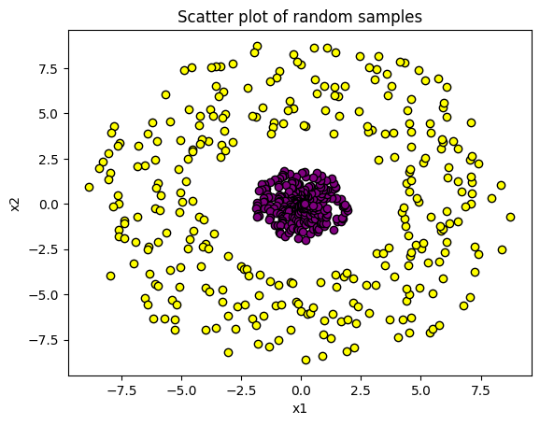
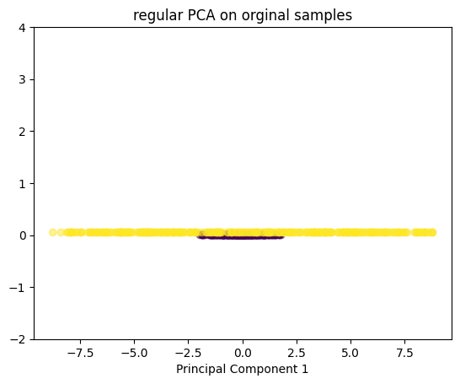
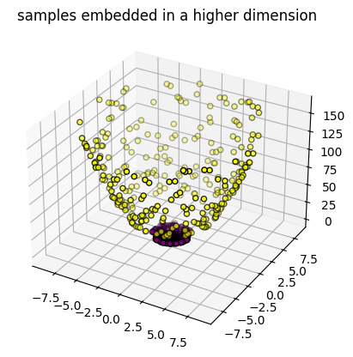
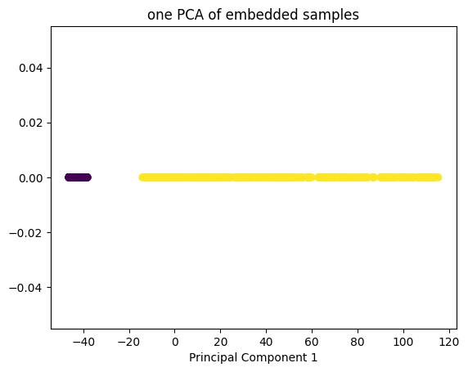
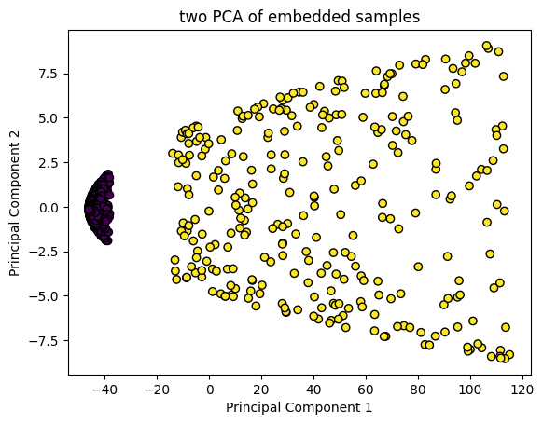
Kernel PCA
Definition:
Given a set of samples in the original space, we project each sample onto a new embedding of higher dimensionality. We perform PCA in this higher dimension. The result is a non-linear projection of samples in the dimension of required principal components.
1

Slide 3
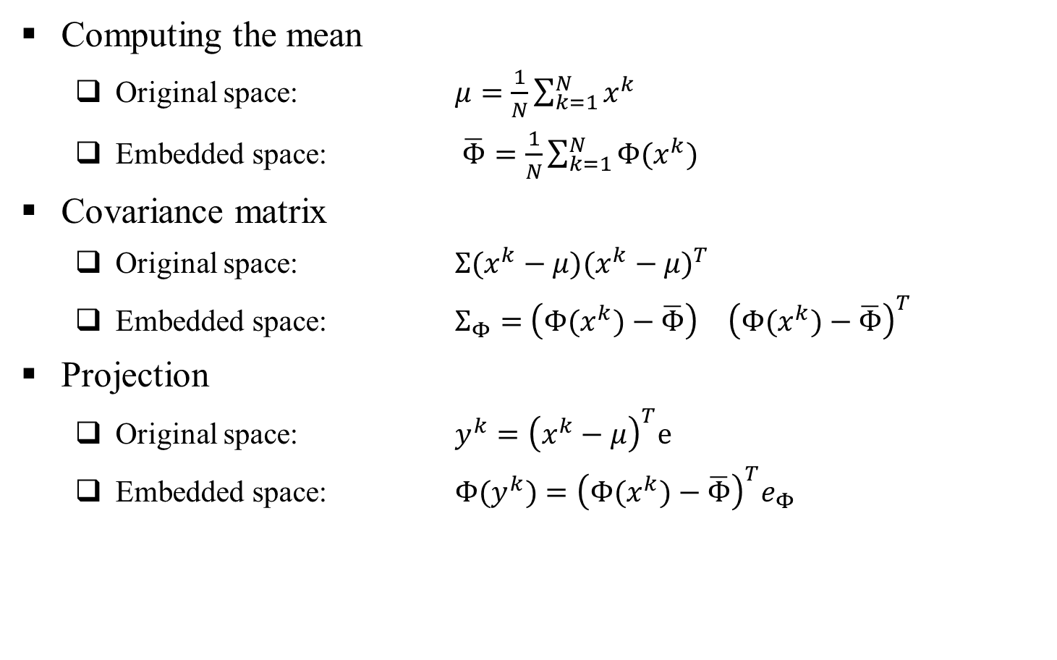
Kernel PCA Basics
Computing the mean
Original space: $μ=\frac{1}{N}\sum_{k=1}^{N}{x^{k}}$
Embedded space: $\overline{Φ}=\frac{1}{N}\sum_{k=1}^{N}{{Φ(x}^{k})}$
Covariance matrix
Original space: $Σ(x^{k}−μ){(x^{k}−μ)}^{T}$
Embedded space: $Σ_{Φ}=$ ${\left(Φ(x^{k})−\overline{Φ}\right)}^{}$ ${\left(Φ(x^{k})−\overline{Φ}\right)}^{T}$
Projection
Original space: $y^{k}={\left(x^{k}−μ\right)}^{T}e$
Embedded space: $Φ(y^{k})={\left(Φ(x^{k})−\overline{Φ}\right)}^{T}e_{Φ}$
2

Slide 4
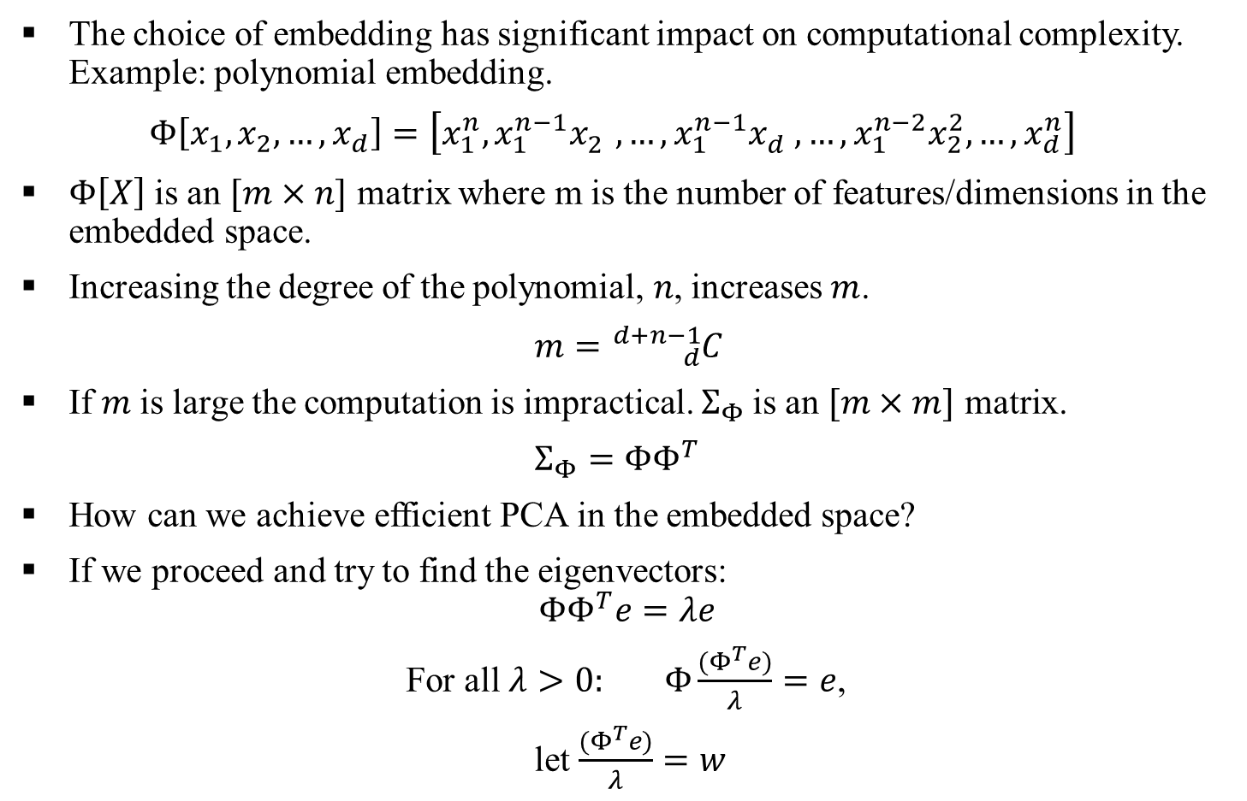
Kernel PCA Mathematical Foundation
The choice of embedding has significant impact on computational complexity. Example: polynomial embedding.
$Φ\left[x_{1},x_{2},…,x_{d}\right]=\left[x_{1}^{n},x_{1}^{n−1}x_{2}^{},…,x_{1}^{n−1}x_{d}^{},…,x_{1}^{n−2}x_{2}^{2},…,x_{d}^{n}\right]$
$Φ\left[X\right]$ is an $[m×n]$ matrix where m is the number of features/dimensions in the embedded space.
Increasing the degree of the polynomial, 𝑛, increases $m$.
$m={}_{d}^{d+n−1}C$
If $m$is large the computation is impractical. $Σ_{Φ}$is an $[m×m]$ matrix.
$Σ_{Φ}=ΦΦ^{T}$
How can we achieve efficient PCA in the embedded space?
If we proceed and try to find the eigenvectors:
$$ΦΦ^{T}e=λe$$
For all $λ>0: Φ\frac{{(Φ}^{T}e)}{λ}=e$,
let $\frac{{(Φ}^{T}e)}{λ}=w$
3

Slide 5
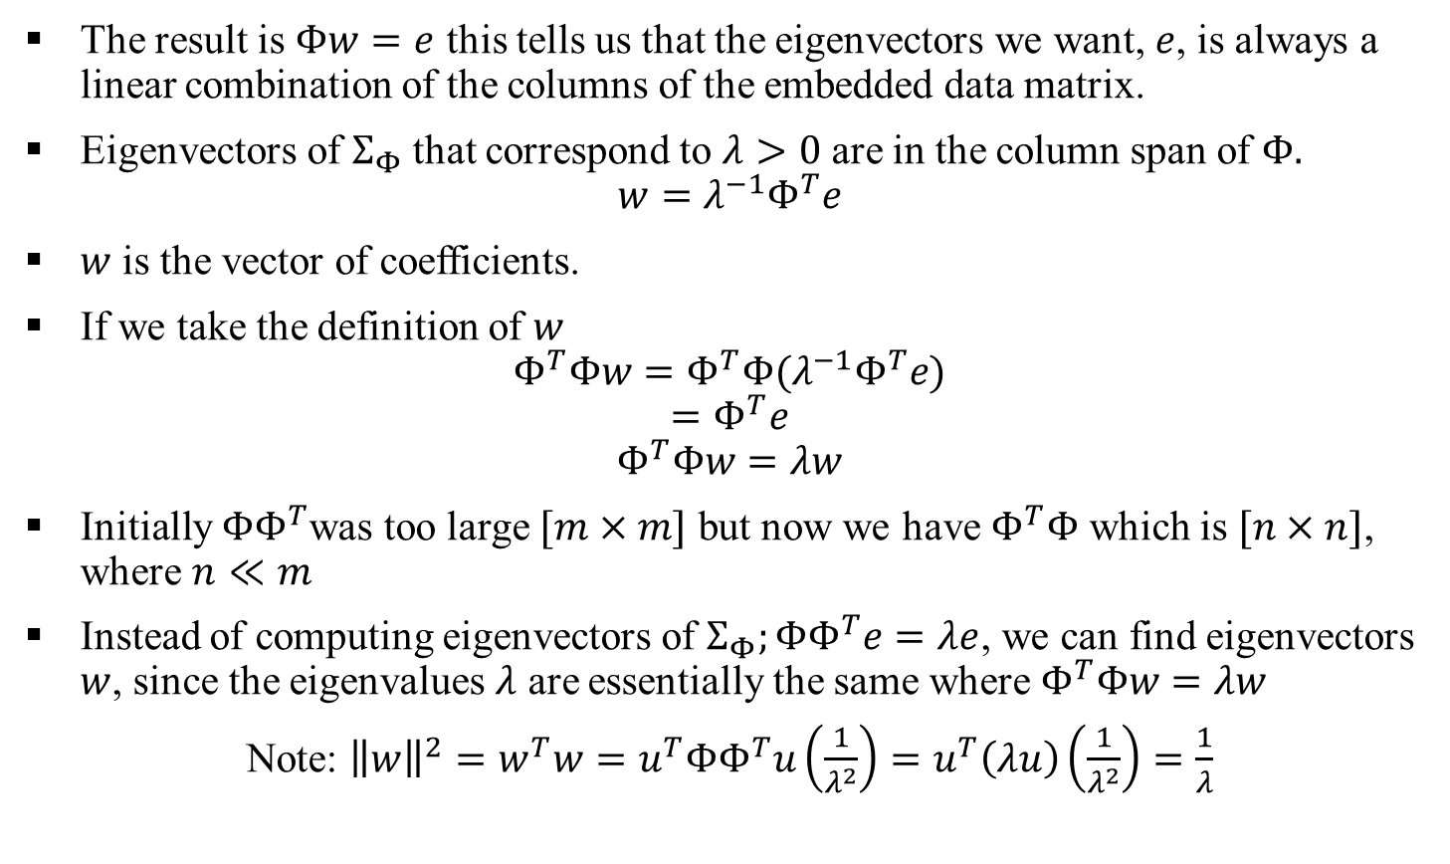
Kernel PCA Mathematical Foundation
The result is $Φw=e$ this tells us that the eigenvectors we want, $e$, is always a linear combination of the columns of the embedded data matrix.
Eigenvectors of $Σ_{Φ}$ that correspond to $λ>0$ are in the column span of $Φ.$
$$w=λ^{−1}Φ^{T}e$$
$w$ is the vector of coefficients.
If we take the definition of $w$
$$Φ^{T}Φw=Φ^{T}Φ(λ^{−1}Φ^{T}e)$$
$$=Φ^{T}e$$
$$Φ^{T}Φw=λw$$
Initially $ΦΦ^{T}$was too large $[m×m]$ but now we have $Φ^{T}Φ$ which is $[n×n]$, where $n≪m$
Instead of computing eigenvectors of $Σ_{Φ};ΦΦ^{T}e=λe$, we can find eigenvectors $w$, since the eigenvalues $λ$ are essentially the same where $Φ^{T}Φw=λw$
Note: ${\left\|w\right\|}^{2}=w^{T}w=u^{T}ΦΦ^{T}u\left(\frac{1}{λ^{2}}\right)=u^{T}\left(λu\right)\left(\frac{1}{λ^{2}}\right)=\frac{1}{λ}$
4

Slide 6
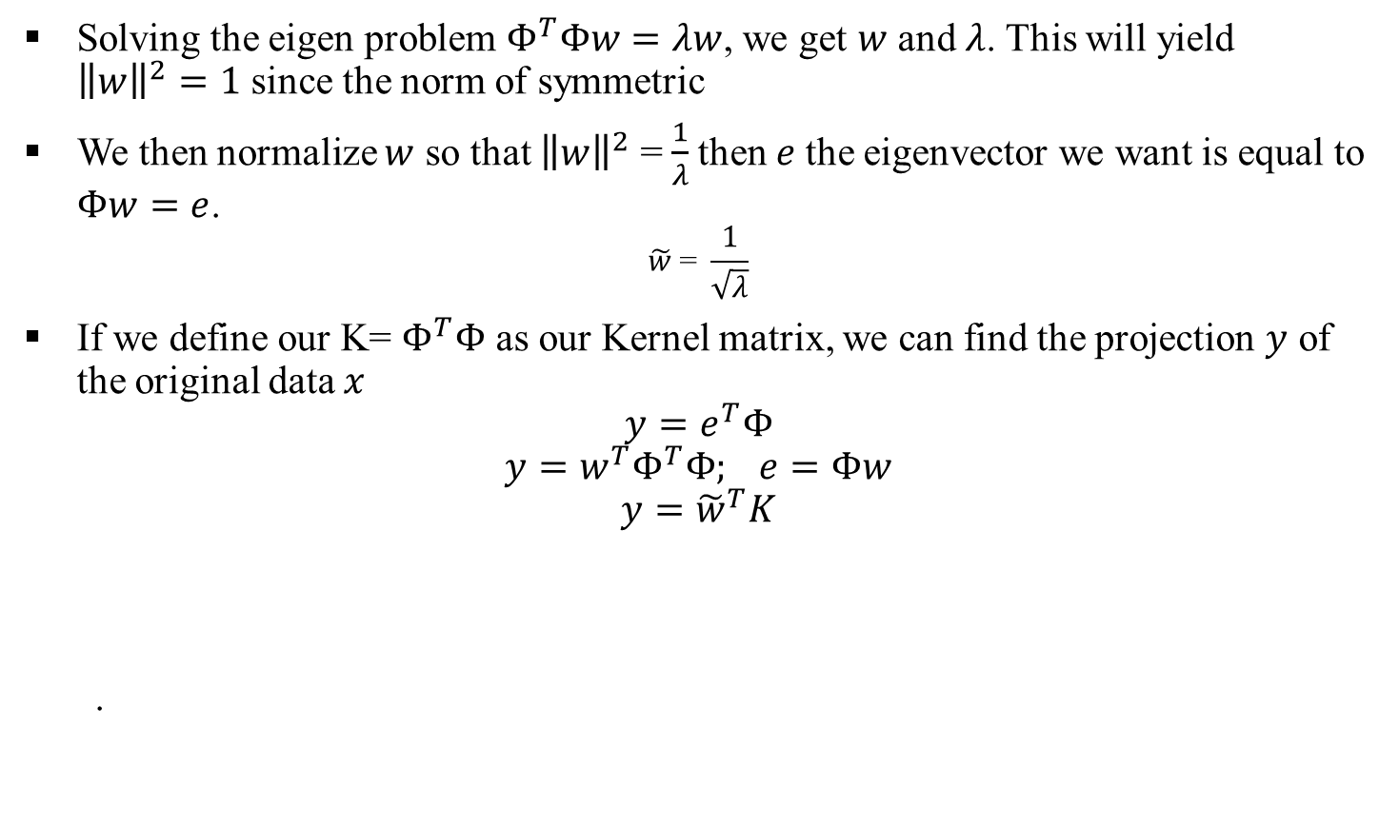
Kernel PCA Mathematical Foundation
Solving the eigen problem $Φ^{T}Φw=λw$, we get $w$ and $λ$. This will yield ${\left\|w\right\|}^{2}=1$ since the norm of symmetric
We then normalize $w$ so that ${\left\|w\right\|}^{2}$ = $\frac{1}{λ}$then $e$the eigenvector we want is equal to $Φw=e$.
$$\tilde{w}\text{ = }\frac{1}{\sqrt{λ}}$$
If we define our K= $Φ^{T}Φ$ as our Kernel matrix, we can find the projection $y$ of the original data $x$
$$y=e^{T}Φ$$
$$y=w^{T}Φ^{T}Φ; e=Φw$$
$$y={\tilde{w}}^{T}K$$
.
5

Slide 7

Kernel PCA Algorithm
Given samples $\left[x_{1},x_{2},…,x_{n}\right]$, a Kernel function $K(x,y)$, and number of principal components $d$.
Calculate $K_{ij}=K\left(x_{i},x_{j}\right), \tilde{K}=JKJ^{T}$ :
Perform an Eigen Decomposition of$\tilde{K}≈WΛW^{−1}$ for the top $d$ eigenvectors.
$Y= {\tilde{W}}^{T}K$
6

Slide 8
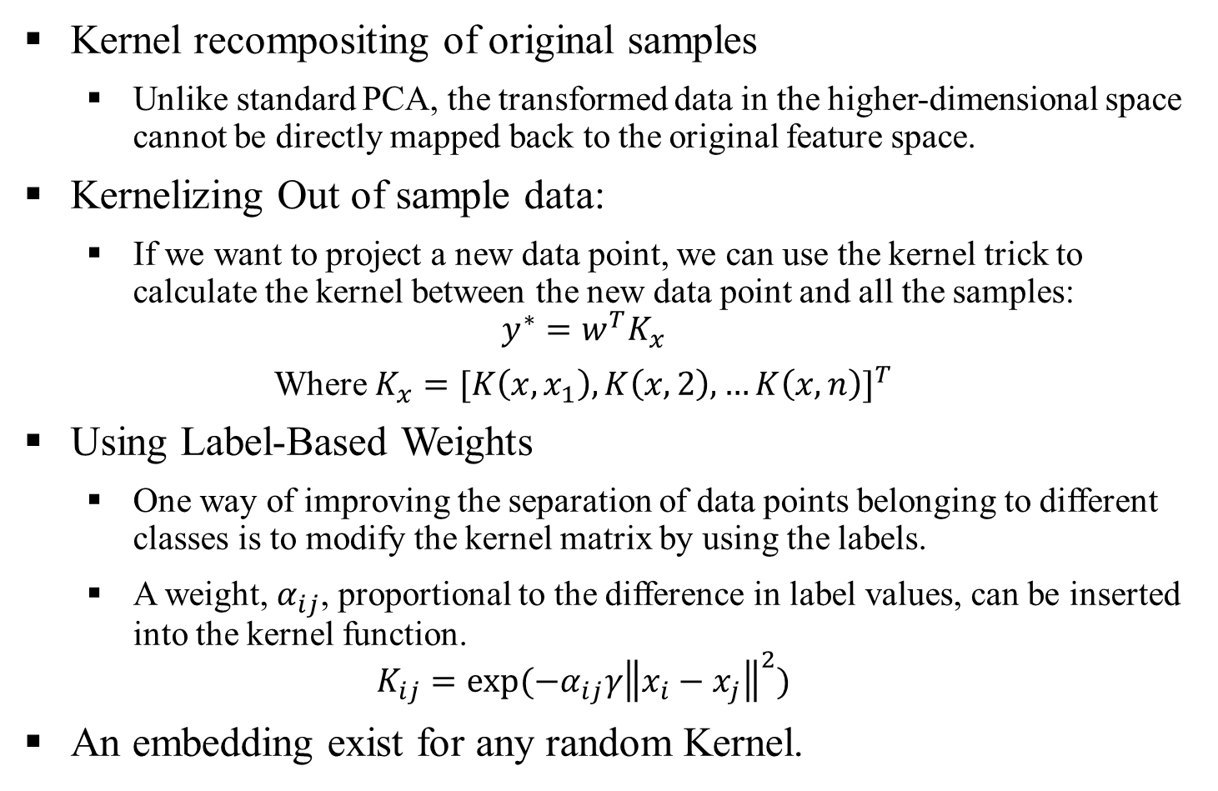
Kernel PCA extensions
Kernel recompositing of original samples
Unlike standard PCA, the transformed data in the higher-dimensional space cannot be directly mapped back to the original feature space.
Kernelizing Out of sample data:
If we want to project a new data point, we can use the kernel trick to calculate the kernel between the new data point and all the samples:
$$y^{∗}=w^{T}K_{x}$$
Where $K_{x}={[K\left(x,x_{1}\right),K\left(x,2\right),…K\left(x,n\right)]}^{T}$
Using Label-Based Weights
One way of improving the separation of data points belonging to different classes is to modify the kernel matrix by using the labels.
A weight, $α_{ij}$, proportional to the difference in label values, can be inserted into the kernel function.
$$K_{ij}=exp⁡(−α_{ij}γ{\left\|x_{i}−x_{j}\right\|}^{2})$$
An embedding exist for any random Kernel.
7

