Slide 1
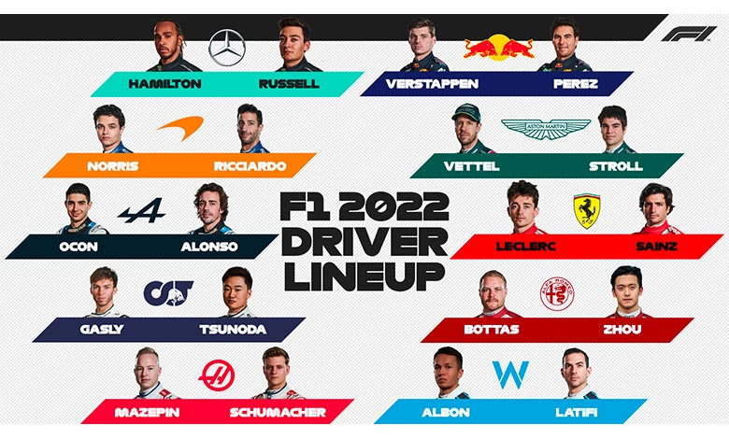
F1Visuaization
Team 8
Juan Cano, Frida Delgado, Alejandro Donjuán
Esta foto de Autor desconocido está bajo licencia CC BY-NC-ND

Slide 2
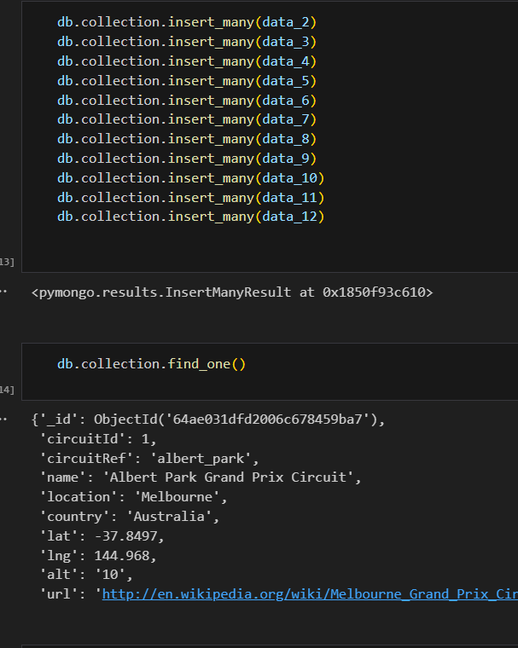
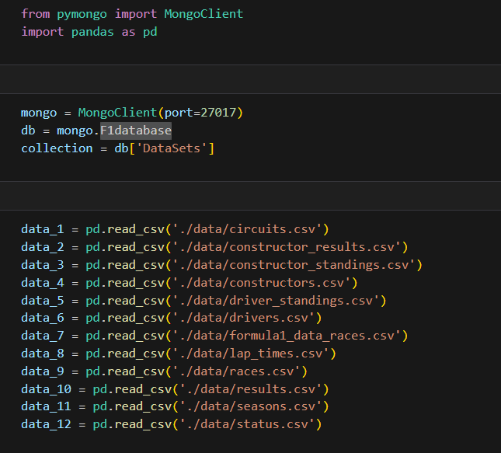
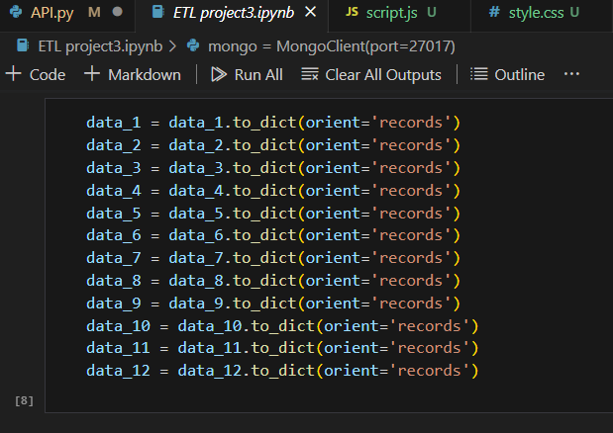
ETL
URL: https://www.kaggle.com/datasets/rohanrao/formula-1-world-championship-1950-2020?resource=download

Slide 3
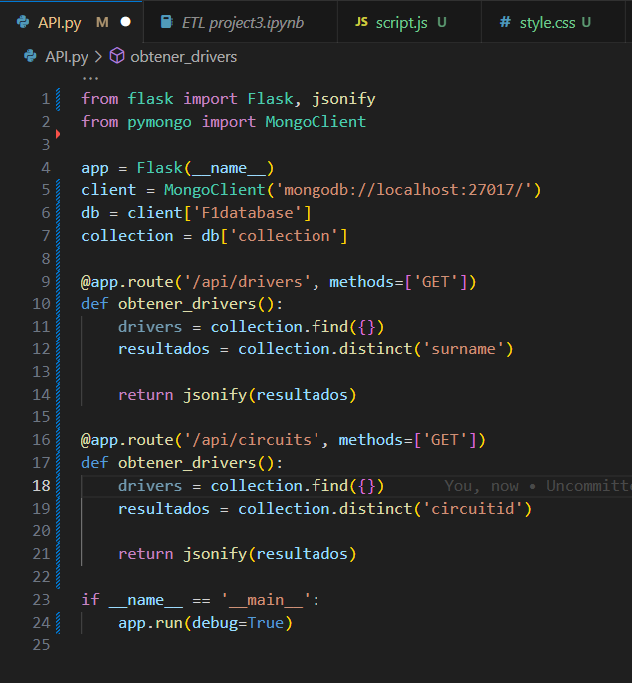
API.py
Dependencies: Flask, pyMongo.
We create routes for each field of information that we would use for our visualization

Slide 4
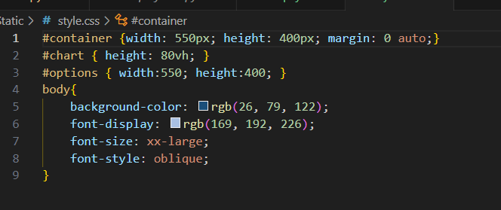
CSS

Slide 5
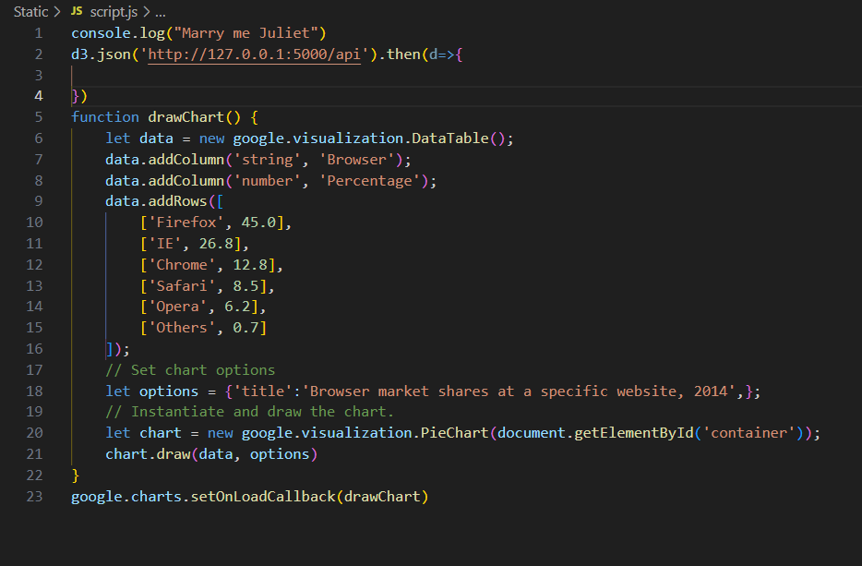
JavaScript

Slide 6
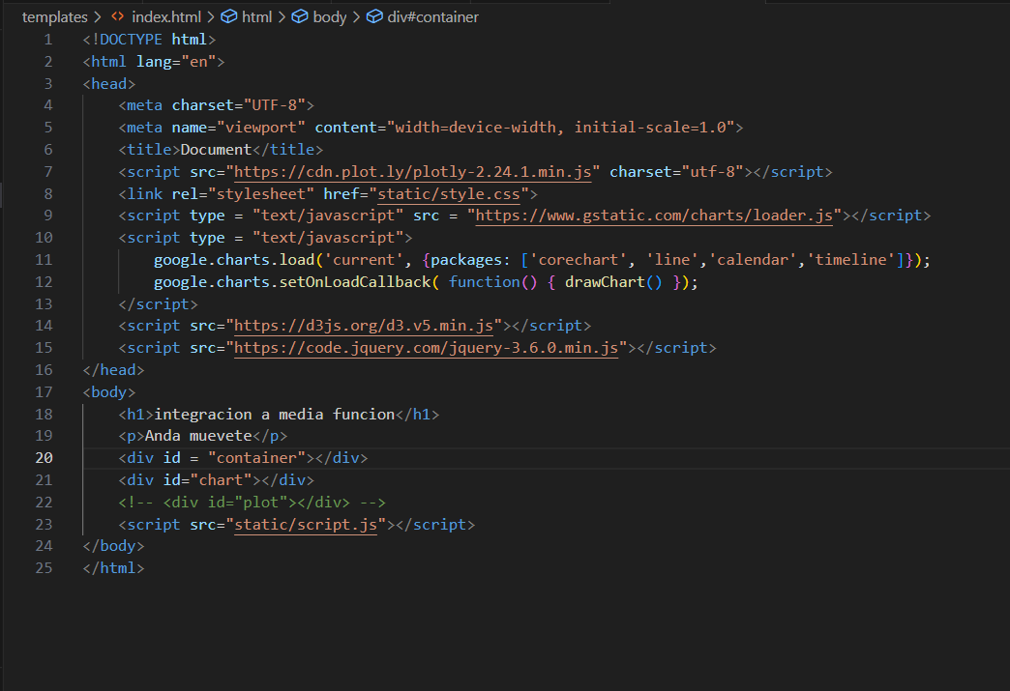
HTML

Slide 7
Thank you

