Slide 1
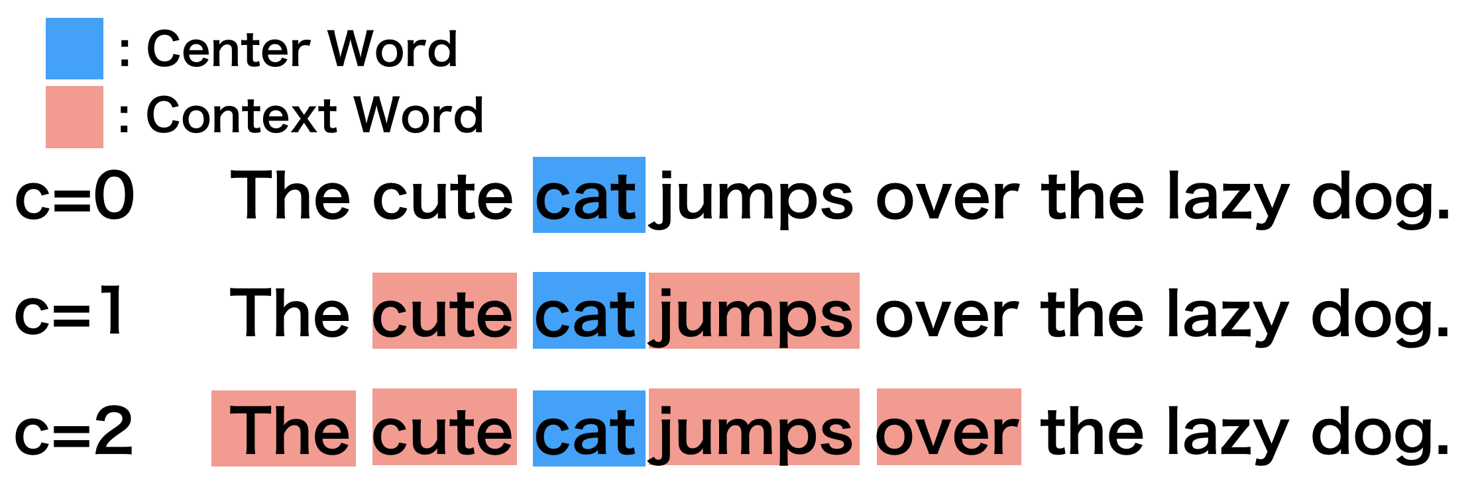
Word2vec (1)
Pretrained NLP network as startpoint for specialization.
Has learned concepts (comparable to CNN for images)

Slide 2
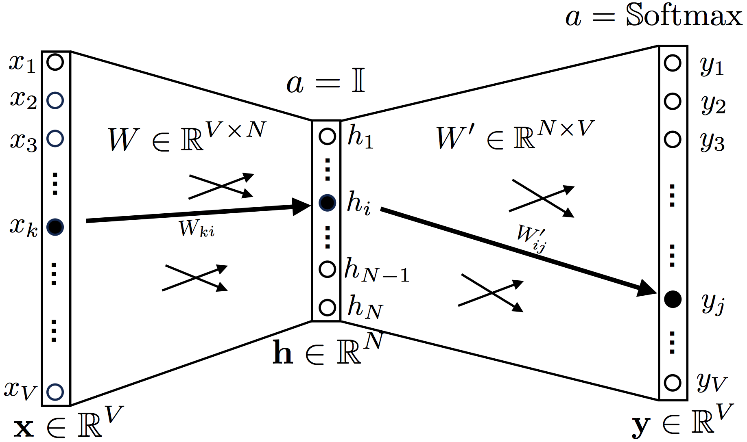
word2vec (2)
context
similar context => similar meaning
word
Dimension reduction:
Similar contexts should produce synonyms, hence be reduced to similar vectors by efficient coding in the hidden layer.
CBOW (Continuous Bag Of Words)
Inverse: Skip-gram
Zellig S Harris: Distributional Structure (1956)

Slide 3
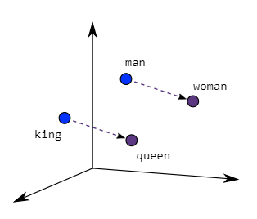
word2vec (3)
woman - man
king – man + woman = queen

Slide 4
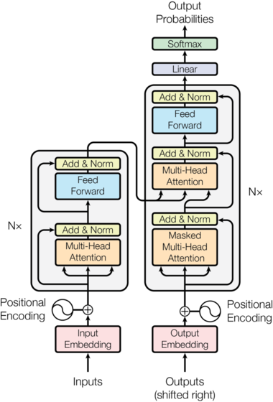
Bert (Google)
Trouble with word2vec:
house (to live in)
house (music)
Solution: Bert takes bi-directional
context into account.
Bidirectional
Encoder
Representations from
Transformers

