Slide 1
ROS Intro/Tutorial
Contents
Motivation
ROS
  Basic Structure, Commands etc.
Installation
Basic Workflow (incl. simple example project)
Simulator: Stage
Visualization: rViz
Demos (Wavefront, Tangent bug, Potential)
Debugging rospy in PyCharm

Slide 2

ROS (Robot Operating System) provides libraries and tools to help software developers create robot applications. It provides hardware abstraction, device drivers, libraries, visualizers, message-passing, package management, and more.

Slide 4
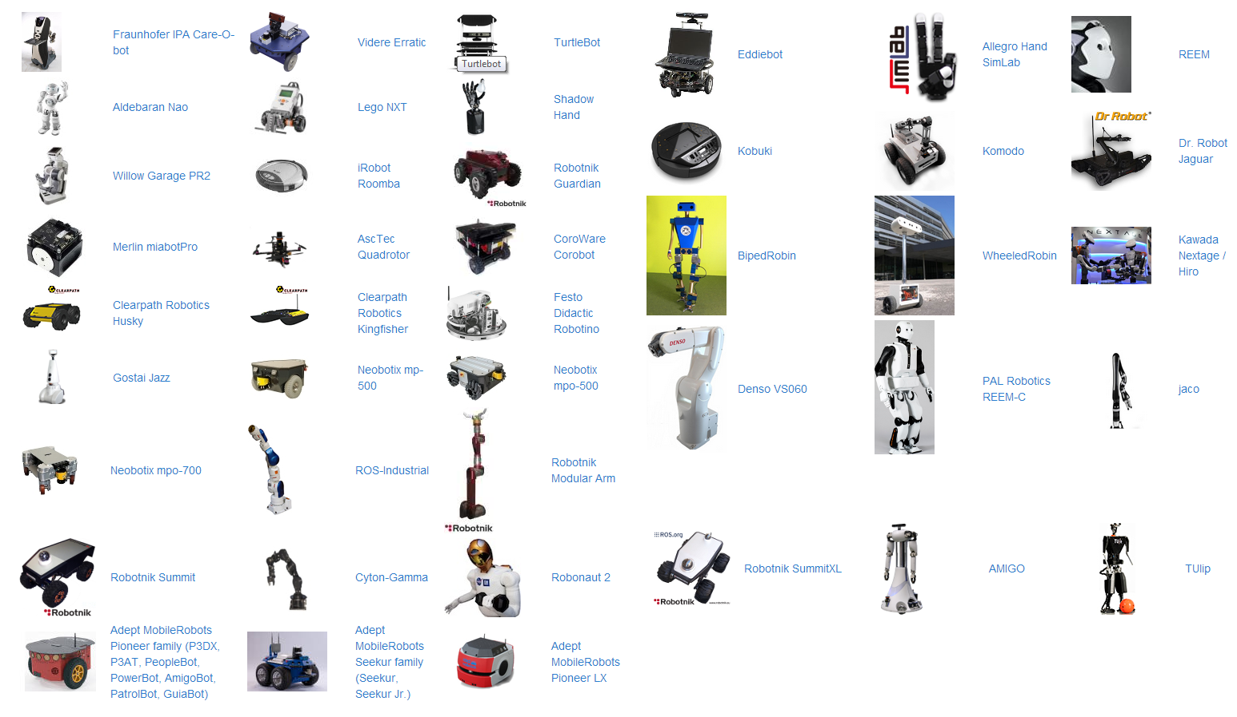
Supported Robots

Slide 5
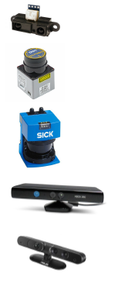
Supported Sensors
Sharp IR range
Hokuyo laser scanners
Sick lasers
Microsoft Kinect
Asus Xtion
Cameras
  monocular and stereo
  USB (uvc) and rewire
  video streaming (gstreamer)

Slide 6
Structure of the ROS Framework
Related to Filesystem (resources that you encounter on disk)
  Packages
    Main unit for organizing software in ROS
    A folder (e.g. in ~/catkin_ws/src) that contains your code, build files, launch files, etc.
    Can contain any number of nodes
    Should only contain code that is related
    You will create a package to hand in the assignment
  Package Manifests
    Manifests (package.xml) provide metadata about a package, including its name, version, description, license information, dependencies.
    You have to adjust this file eventually
  See http://wiki.ros.org/ROS/Concepts for more details

Slide 7
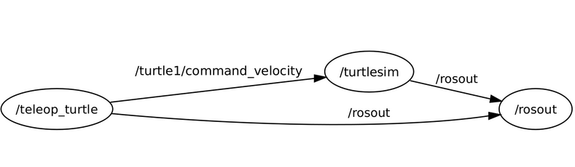
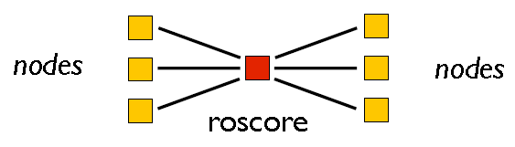
Structure of the ROS Framework
Computation Graph Level
  Nodes
    Nodes are processes that perform computation
    robot control system usually comprises many nodes
    You will program nodes (in c++ or python)
  Master
    To start: $ roscore
    Central unit
    You always start working by starting the ROS Master

Slide 8
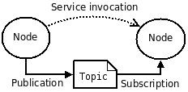

Structure of the ROS Framework
Computation Graph Level (continued)
  Messages
    Nodes communicate with each other by passing messages
    You have to deal with the different kinds of these
  Topics
    Messages are routed via a transport system with publish / subscribe semantics
    You have to deal with this

Slide 9
Tutorials
Installation (jade)
Understanding Nodes
Understanding Topics
Basic Workflow
  Creating workspace with catkin
  Create a package (one for each exercise)
  Add/Edit source files of a package
  Build the workspace
  Load this workspace
  Run your package
  Create a launcher (to start multiple packages at once)
Using the Stage Simulator
Using rViz visualisation

Slide 10
ROS Installation (Jade)
Get Ubuntu (14.04 or newer): http://www.ubuntu.com/download/desktop
Windows → Oracle VM VirtualBox: http://www.virtualbox.org
Follow Guide: http://wiki.ros.org/jade/Installation/Ubuntu
Linux Terminal Code:
sudo apt-get install ros-jade-desktop-full
sudo rosdep init
rosdep update
echo "source /opt/ros/jade/setup.bash" >> ~/.bashrc
source ~/.bashrc
sudo apt-get install python-rosinstall
sudo apt-get install ros-jade-map-server
ros-jade-map-server is optional
For kinetic (newest ros): http://wiki.ros.org/kinetic/Installation/Ubuntu
Restart the terminal after installation

Slide 11
Understanding Nodes
Prerequisities:
sudo apt-get install ros-jade-ros-tutorials
Enter in terminal 1:
roscore
Enter in terminal 2:
rosnode list
Enter in terminal 3:
rosrun turtlesim turtlesim_node
Enter in terminal 2:
rosnode list

Slide 12
Understanding Topics
Prerequisities:
sudo apt-get install ros-jade-ros-tutorials
Enter in terminal 1:
roscore
Enter in terminal 2:
rosrun turtlesim turtlesim_node
Enter in terminal 3:
rosrun turtlesim turtle_teleop_key
Enter in terminal 4:
rosrun rqt_graph rqt_graph
Enter in terminal 5:
rostopic pub -1 /turtle1/cmd_vel geometry_msgs/Twist -- '[2.0, 0.0, 0.0]' '[0.0, 0.0, 1.8]'

Slide 13
Basic Workflow
Create a workspace (once)
Create a package (one for each exercise)
Add/Edit source files of a package (to solve the exercises)
Build the workspace (after you changed something)
Load the workspace (each time you restart the pc or something changes in the workspace)
Run your package (to see results)
Create a launcher (more convenient way to run your package)

Slide 14
Creating a Workspace with catkin
Creating a workspace using catkin (you do this once)
mkdir -p ~/catkin_ws/src
cd ~/catkin_ws/src
catkin_init_workspace

Slide 15
Create a package
Prerequisite: Valid catkin workspace
Create one for each exercise
Go to the src folder of your catkin workspace
Create new packages (this generates the manifest and CmakeList):
cd ~/catkin_ws/src
catkin_create_pkg tarefa1 std_msgs rospy roscpp
catkin_create_pkg wavefront std_msgs rospy roscpp
catkin_create_pkg tarefa3 std_msgs rospy roscpp

Slide 16
Add/Edit source files of a package
Prerequisites: Valid catkin workspace and one or more generated packages
Your work directory is located inside the package, e.g. ~/catkin_ws/src/tarefa1/src
Here you add code files like “Stopper.cpp” or “run_stopper.cpp” and header files like “Stopper.h”
Edit respective lines in ~/catkin_ws/src/tarefa1/CmakeLists.txt
  For the example add this two lines
...
add_executable(stopper src/Stopper.cpp src/run_stopper.cpp)
target_link_libraries(stopper ${catkin_LIBRARIES})

Slide 17
Building a Workspace with catkin
If you program in C++
Build the workspace (you do this every time you change the code)
  This builds your package(s) in ~/catkin_ws/src to ~/catkin_ws/build
cd ~/catkin_ws/
catkin_make

Slide 18
Load the Workspace
Each time you restart the pc
Once before you start the ROS core/nodes
source ~/catkin_ws/devel/setup.bash
Check if the path variable is set correctly now
echo $ROS_PACKAGE_PATH
Should output
/home/youruser/catkin_ws/src:/opt/ros/jade/share:/opt/ros/jade/stacks

Slide 19
Run your package (to see results)
To run your compiled code
Prerequisites: Workspace, package + code, compiled, nothing ROS related is running
Terminal 1:
roscore
Terminal 2:
cd ~/catkin_ws
source ./devel/setup.bash
rosrun tarefa1 stopper
alex:catkin_ws$ rosrun tarefa1 stopper
[ INFO] [1490198512.526653851]: Start moving
The simulator is missing,
but the node works!

Slide 20
Create a launcher
Launch file for launching both the Stage simulator and the stopper node
  example for ~/catkin_ws/src/tarefa1/launch/my_launcher.launch
<launch>
<node name="stage" pkg="stage_ros" type="stageros" args="$(find stage_ros)/world/willow-erratic.world"/>
<node name="stopper" pkg="tarefa1" type="stopper" output="screen"/>
</launch>
To execute in a free terminal:
source ~/catkin_ws/devel/setup.bash
roslaunch tarefa1 my_launcher.launch

Slide 21
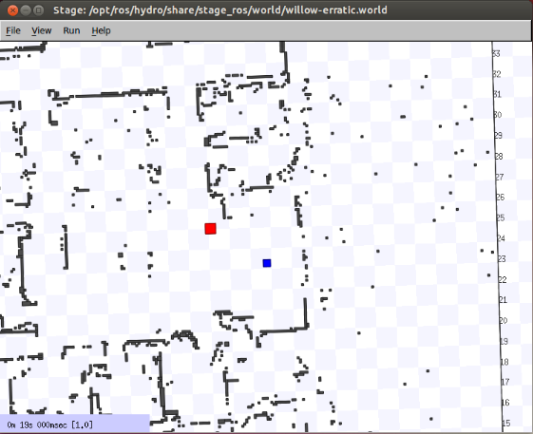
Stage Simulator
http://wiki.ros.org/stage
A 2D simulator that provides a virtual world populated by mobile robots, along with various objects for the robots to sense and manipulate

Slide 22
Stage Simulator
Is installed with ROS jade
To run Stage with an existing world file:
Stage World Files:
  nameofworld.pgm contains occupancy grid (image)
  myworld.world contains description of entities
Good class on the stage simulator
rosrun stage_ros stageros $(rospack find stage_ros)/world/willow-erratic.world
http://u.cs.biu.ac.il/~yehoshr1/89-685/ROS_Lesson4.pdf

Slide 23
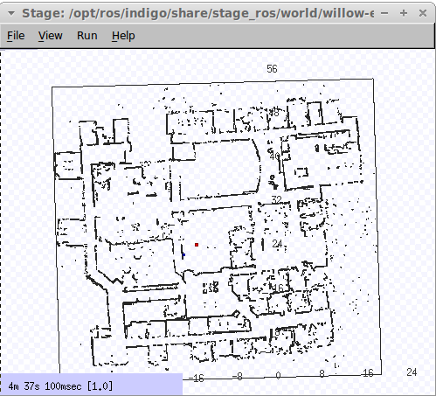
.world File Example
You need to create your own, more simple world
See an example in the folder /opt/ros/jade/share/stage_ros/world/
  willow-full.pgm
  willow-erratic.world

Slide 24
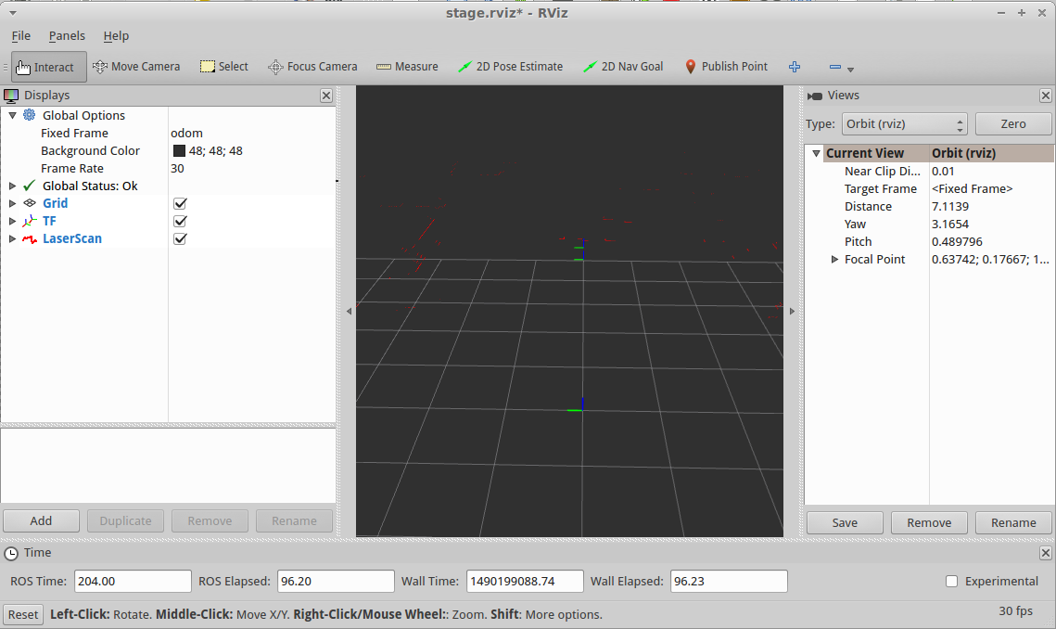
rViz Visualisation
To see what the robot 'sees'
rosrun rviz rviz -d `rospack find stage_ros`/rviz/stage.rviz

Slide 25
Demo of Excercises
Wavefront
Tangent Bug
Potential

Slide 26
Useful Links
ROS wiki http://wiki.ros.org/
Search the ROS wiki for: "concepts", "command line tools", …
ROS Q&A Forum http://answers.ros.org/questions/
ROS code repositories at github https://github.com/ros

