Slide 1

NYC Taxi Trip Duration Predictor
By Aly Osama & Aya Sayed

Slide 2
Dataset
NYC Taxi Trip Dataset (2016-2017).
Includes pickup/dropoff time and location, vendor ID, passenger count.

Slide 3
Problem Statement
NYC taxi durations vary due to traffic, time, and distance.
Goal: Predict trip duration to aid planning and satisfaction.

Slide 4
Problems and Fixes
Outliers in location → Filtered invalid coordinates.
UI freeze with map → Optimized folium rendering.
Large model size → Used joblib with streamlit cache.

Slide 5
Data Preprocessing
Extracted hour and day of week from datetime.
Calculated Haversine distance.
Handled missing values and outliers.

Slide 6
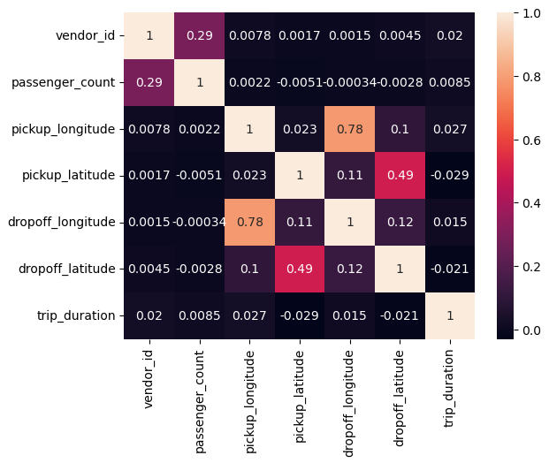
collection of numerical columns

Slide 7
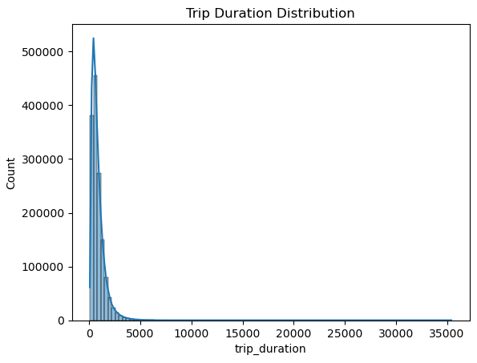
Trip Duration Distribution

Slide 8
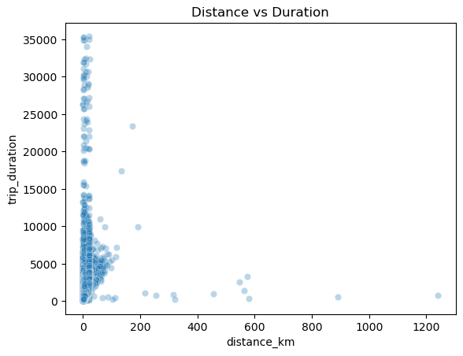
Distance vs Duration

Slide 9
Model Building
Used a trained regression model (e.g., RandomForest).
Input features: passenger count, vendor ID, hour, day, distance.
Evaluated with MAE, RMSE.

Slide 10
Streamlit Web App
Interactive map for pickup/dropoff.
User inputs: Date, Time, Passenger Count.
Predict button shows trip duration in readable format.
Deploying the model using streamlit community cloud

Slide 11
Example Prediction
Pickup: Times Square, Dropoff: Central Park.
Time: 5 PM Friday → Predicted: 14 min 30 sec.

Slide 12
Conclusion
Effective ML prediction of taxi duration.
Useful for passengers and dispatchers.
Can integrate traffic or weather data in future.

Slide 13
Team Members
Aly Osama Aya Sayed

Slide 14


