Slide 1
3D_Sub-Volume_BPadding_Registration
OCT Huber

Slide 2
Agenda
Litrature
Motivation
Aproach
OCT scans characteristics
Stage settings
Software Guide
Software Parameters
Registration results
Cross correlation matrix
Software accuracy
Limitations
Plausible findings
References

Slide 3
Litrature
2D SubPixel DFT matrix multiplication ‘‘Paper‘‘
Elastixs (based on optimizing mutual information) ‘‘Manual‘‘

Slide 4
Motivation
In laboratory work, experiments always contain some shifts from the human operators errors, or even the unconditional movements of the objects(patients) during the scanning time. Therefore, registering these scans will be beneficial before further operations using them.
CNN 3D registration requires a huge amount of the task specific datasets for a better training process. This takes a lot of time and extra preperations for the datasets, and even the results will not be that much accurate.
Optimization tehniques by estimating the best shifts based on maximizing the mutual information between the reference and the moved volumes are also time complex.

Slide 5
Approach
3D registration based on Sub-Pixel DFT matrix multiplication using black borders padding Sub-Volumes stiching function.
SubPixel DFT matrix multiplication: Use upsampling factor to enable half pixel shift values for upsfac=2, or more accurate tiny shift values using DFT matrix mutiplication within a predefined neighboring window size using the first shift estimate from usfac=2 step.
Black borders Padding: By padding the moved volume in x, y, and z with a padding size equal to half of the sub-volume size to avoid the negative shift values and maintain the registration process being as accurate as possible.
Sub-Volumes stching: After the registration is done, the subvolumes are needed to be stiched together to form the main registered volume with the size of the original reference volume.

Slide 6
Oct-scans charachterisitics
PVAPhantom
1312CWL
101BW
100nblank
40phase
50offset
Nopumpedtable
1000x75
shaking_100µm
XYZ Movement
Fingertip
1312CWL
101BW
200nblank
30phase
90offset
Nopumpedtable
2048x35

Slide 7
Stage Settings
XYZ movement speed: 100 µm/s (25 Hz in x and 1. z, and 14 Hz in y)
Laser spot(spekle) size: 30 µm

Slide 8
Software guide
Resource | Direcory
Main: Sub-Volume Stiching | ‘‘SubVolumes_DFT_Subpixel_ 3DRegistration_Stiching‘‘
Function: Sub-Volume Registration with Bb (black borders) Padding | ‘‘SubVolume_Registration_Bb_padding‘‘
Function: 3D registration based on subpixel cross correlation | ‘‘dftregistration3D‘‘
DataSet: Realsitic Scans with 100μm/s as the stage speed | X:\3D_Registration\20231213_3DRegistration_RealisticMotionSpeed
Function: Accuracy Test | ‘‘Accuracy_Test‘‘
Experiments: Registered samples | Y:\Mitarbeiter\Aly\00_Lab_Book\Registration Results
Experments: CC matrices | Y:\Mitarbeiter\Aly\00_Lab_Book\CCPlot

Slide 9
Software Parameters
Usfac: For more accurate registration results, upsampling factor need to be greater than 2 for smaller Sub-Volumes, however in the case that the hardware system is doing upsampling. Then software upsampling is no longer required.
Cut-off sub-volume: The minimum Cut-Off should be at least 50, 200, 200 in Y, X, and Z for better features retaining in the registered Sub-Volumes.
X = 200; % pixels in X-axis / number of A-scans
Y = 200; % pixels in Y-axis / A-scan length
Z = 75; % pixels in Z-axis / number of B-scans (Higher frame size leads to better accuracies)
neighbor_window_size: The size of the window beyond which the first estimate shift values are updated in case of DFT matrix multiplication.
1.5 in 2D → 15 pixels window
0.3737 in 3D → 4 pixels window which is much smaller than in 2D to avoid the multible optimal points in larger window sizes.
Subpixel_Zshift: Supixels in Z axis lead to to blurry images.

Slide 10
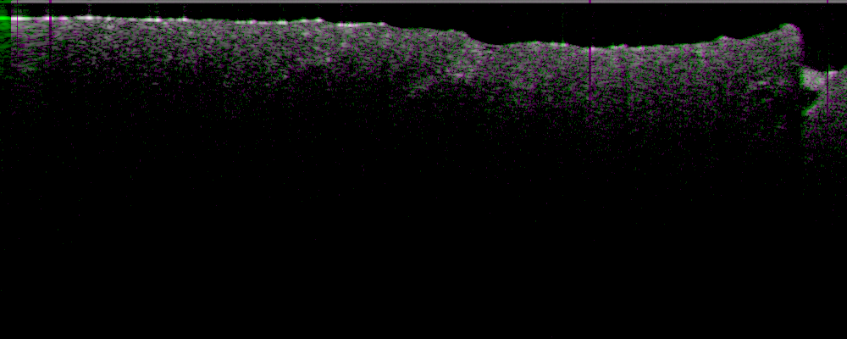
Registration Results
XYZ Movement_ realistic scans 75 frames ‘‘Video‘‘

Slide 11
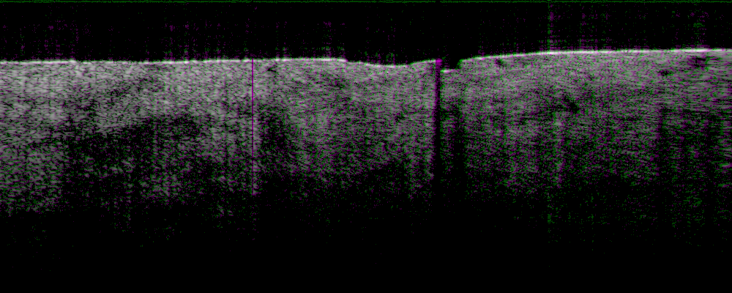
Registration results
XYZ Movements 1000 frames ‘‘Video‘‘

Slide 12
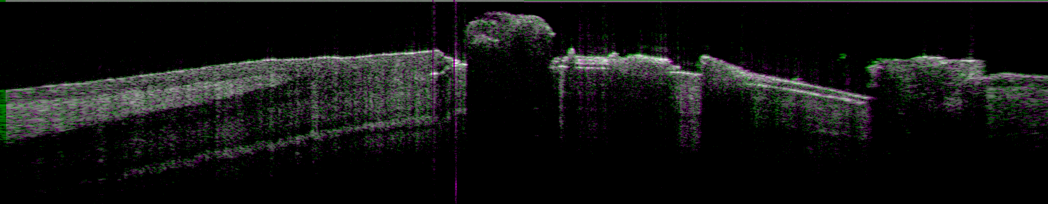
Registration results
Fingertip ‘‘Video‘‘

Slide 13
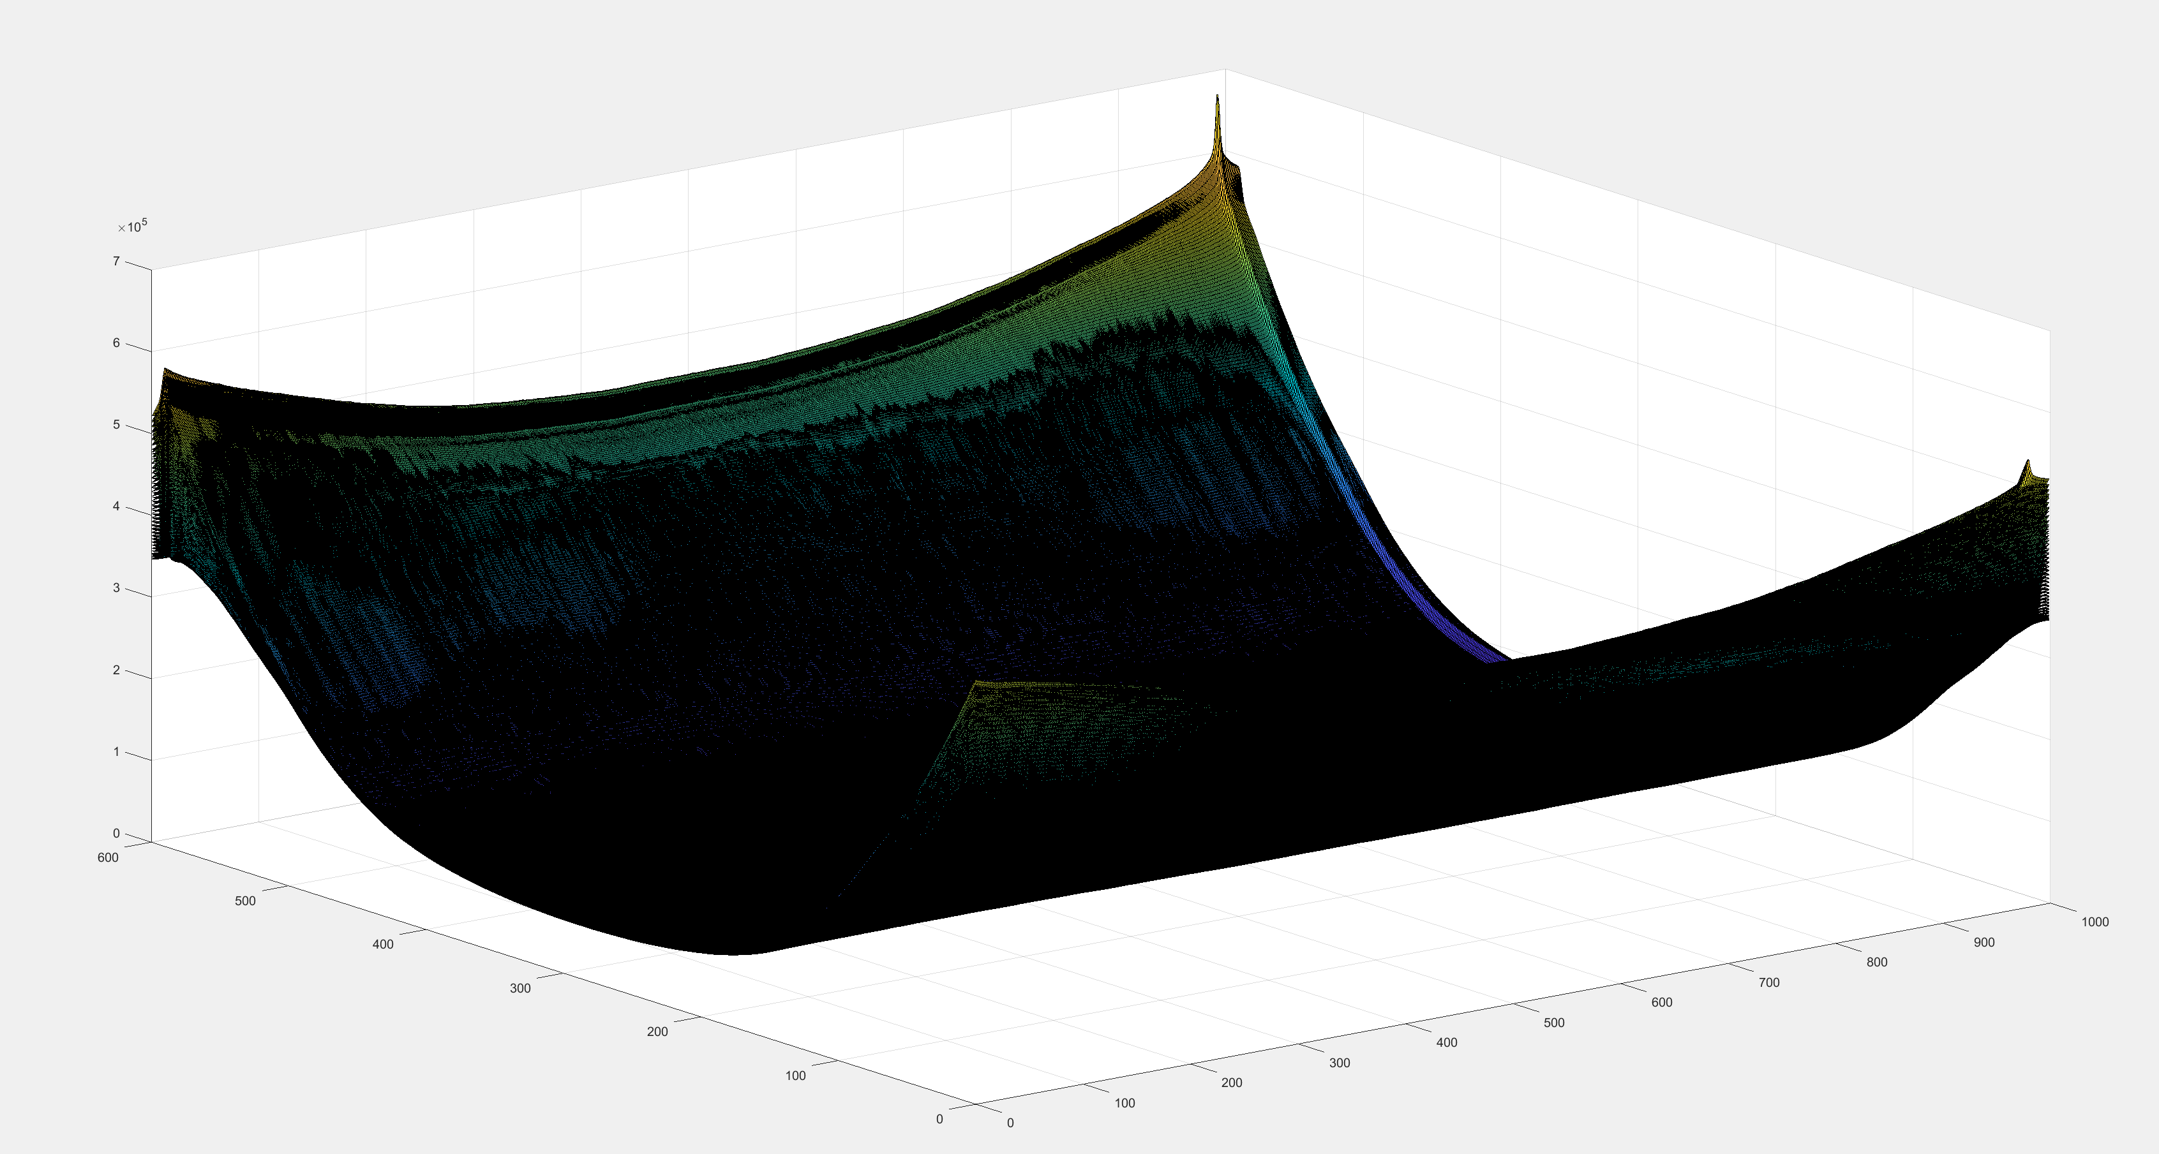
Cross correlation matrix
Volume size 600X1000X75_upsfac=1

Slide 14
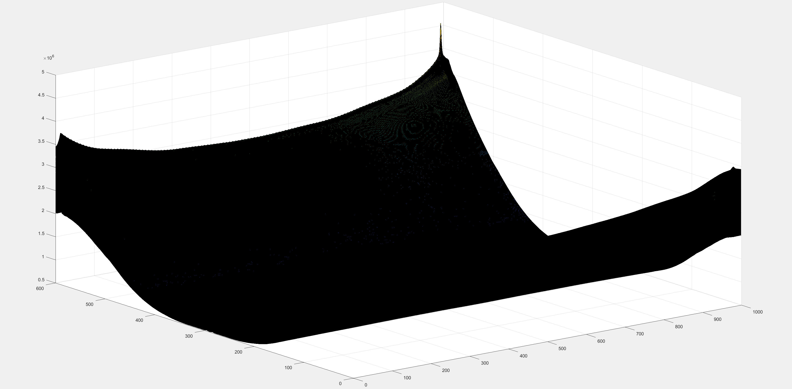
Cross correlation matrix
Volume size 600X1000X1000_upsfac=1

Slide 15
Software ACCURACY
Applying random manual shifts to the ref volume and calculating the mean error within iterations number = 10 for four different scans:
When using usfac= 1 with subpixel shift values (integer shifts gives 0 error)
When using usfac = 10 with a neighbor_window_size = 0.3737.
Scans/shift axis | XYZ 1000 | XYZ 75 | BSFingertip | AlyFingertip
X | 0.25 | 0.27 | 0.23 | 0.17
Y | 0.29 | 0.33 | 0.24 | 0.24
Z | 0 | 0 | 0 | 0
total | 0.54 | 0.6 | 0.47 | 0.41
Scans/shift axis | XYZ 1000 | XYZ 75 | BSFingertip | AlyFingertip
X | 0.220 | 0.17 | 0.19 | 0.19
Y | 0.1 | 0.03 | 0.07 | 0.07
Z | 0 | 0 | 0 | 0
total | 0.32 | 0.2 | 0.26 | 0.26

Slide 16
Limitations
X movement has a problem from the scanner as it is more blurry at the edges.
Upsampling factor need to be greater than 2 with smaller Sub-Volumes for better accuracies.
We still have mismatching in the registration of the first and the last few frames only with the more complex shifts.
The algorithm has only been tested for linear deformation in XYZ axes.
The Registration time [Elapsed time is 103.574402 seconds so far, and it will be 91.601146 seconds when using the GPU in case of (600x1000x1000) scans and less than 10 seconds for (600,1000,75) scans].
Minimum Cut-off Sub-Volumes should be (100, 200, 200) to obtain good accuracies.
The accuracy is slightly bad when it comes to registering the entire information in the OCT scans.
50 frames are the minimum number of frames which are sufficient to give fair registration accuracies.

Slide 17
Plausible findings
Capability of registering more complex structures.
Ability of registering various scans like phantom and fingertip.
Max computation time is less than 10s for 75 frame size for the whole registration process.

Slide 18
Thanks!

