Slide 1
Praktikum: Cloud Data Bases (IN0012, IN2106, IN4163)
by Aly Kamel, Iremur Kidil, Ricardo Kraft
28.01.2020

Slide 2
Summary
Use case scenario
Motivation
Approach
Implementation
Perfomance test
Experimental setup
Diagramms
Conclusion
Pros and Cons
Recommendation of the extension
References
Questions
Discussion

Slide 3
I. The use case scenario (problem)
Client 1
Client 2
DATA BASE
„Clients want to communicate with each other about the data,
while not having to use 3rd party software“

Slide 4
II. Motivation
Our solution: The Chatroom
Bot: Ricardo has joined the chat.
Ricardo: Hey guys, what‘s up?
Aly: Hi hi, everything‘s fine here!
Irem: Helloooo, ... nothing, just working.
Ricardo: Nice, btw. Where can I find ... ?
Aly: You have to check the keys ...
Irem: And if its not there, check ...
Ricardo: Thx a lot :)!!!

Slide 5
III. Approach
Client 1
SERVER 1
Client 2
Client 3

Slide 6
IV. Implementation (just the highlights)
serverMain
ChatroomHandler
clientsCoordinator

Slide 7
V. Performance
I. Experimental setup
Our goal was to compare different levels of chat frequencies
Variables:
M = Number of chatmessages
D = Number of database operations e.g. put, get, delete
M/D = chatmessage per database operation

Slide 8
V. Performance
II. Graph 1
0 M/D
1 M/D
10 M/D
100 M/D
1000 M/D

Slide 9
VI. Conclusion
I. Pros and Cons
Pros
Good for short msg
Acces to database in chat
Arg 3
Cons
Many people need better overview
Arg2
Arg3
No pictures etc., just words

Slide 10
VI. Conclusion
II. Recommendation of the extension
The extension should or shouldn‘t be used for chat heavy systems because its holds/loses performance after a critical amount of messages/database operation
Then the client should consider to use a third party software
for the communication

Slide 11
VII. References
[1] Keshav, S. (2007). How to read a paper. ACM SIGCOMM Computer Communication Review, 37(3), 83.
[2] Levin et al. (2012). Logically centralized?: state distribution trade-offs in software defined networks. In Proceedings of the first workshop on Hot topics in software defined networks - HotSDN ’12 (p. 1). Workshop/conference venue

Slide 12
THANK YOU FOR YOU ATTENTION
VIII. Questions
ARE THERE ANY QUESTION?

Slide 13
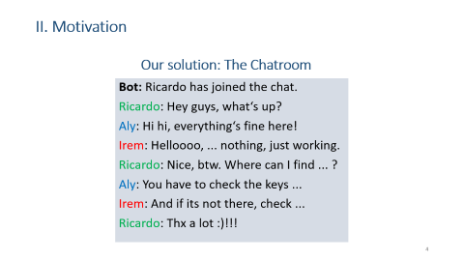
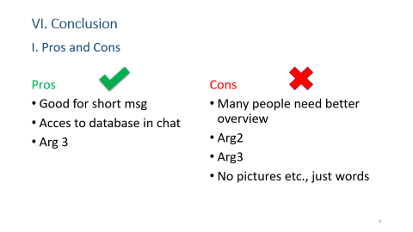
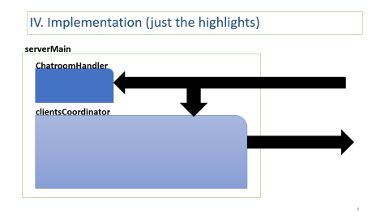
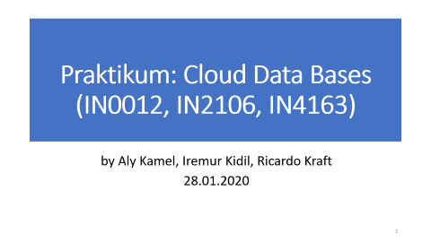
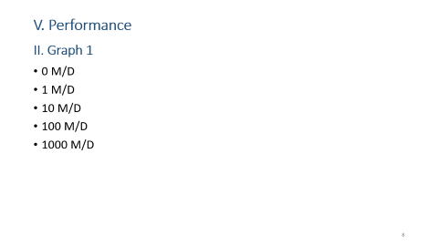
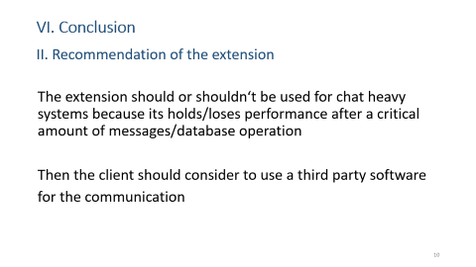
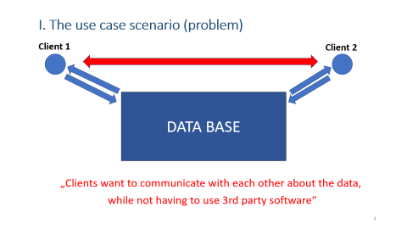
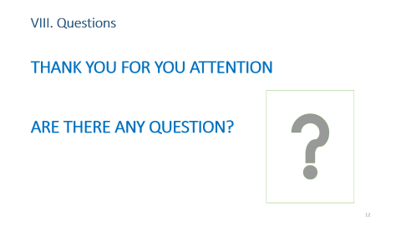
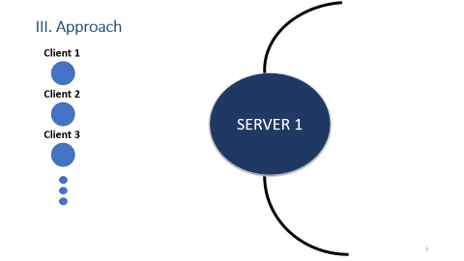
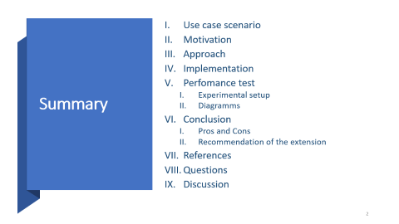
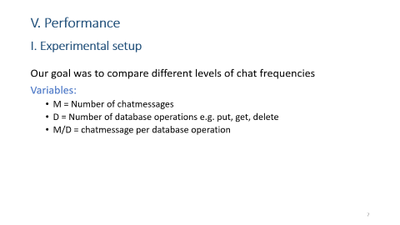
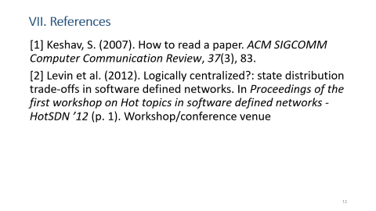
IX. Discussion

