Slide 1

Instructor Kick-off
Analyze A/B Test Results
© 2019 Udacity. All rights reserved.

Slide 2
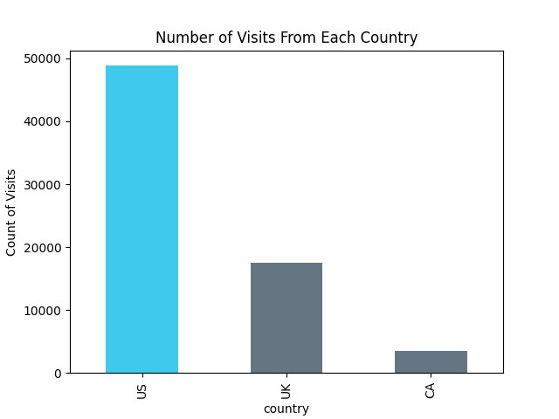
How Was The Experiment Implemented?​
Total Variant Visitors: 35211
Total Control Participants:​ 34678

Slide 3
Conversion Rates
 | U.S. | U.K. | CA
Control | 10.7% | 10.2% | 9.4%
Treatment | 15.8% | 14.9% | 15.4%
Executive Summary: This suggests that “Treatment” increases conversion by around 5%, but the “Country” doesn’t significantly affect the results.

Slide 4
Experiment Results
Treatment Conversion Rate: 15.5%
Control Conversion Rate:​ 10.5%
Delta in Treatment vs. Control Conversion Rate:​ 0.050
p-value:​ 0
Conclusion:​ In this case, the p-value is 0, so we reject the null hypothesis. The Treatment/Variant page is better in converting users than the control page. This may be due to users loving a new design, or that the new design makes the click easier to access and more visually appealing.

Slide 5
Country Results
Conclusion:​ Differences are super low and statistically insignificant.

