Slide 1
DALIA
a containerized launcher with a GUI for multi-agent-systems written
in DALI
with advanced example: Emergency Filtering/Evacuation/Response
MAS
By: Aly Shmahell
Presented as a final project for the course of “Agent Architectures, Languages and Systems” as a requirement for the AIConDa Master’s Degree in Computer Science at University of L’Aquila.

Slide 2
What it is
a containerized launcher with a GUI for multi-agent-systems written in DALI
Runs entirely inside a docker container
Independent from the DALI and Sicstus folder which are provided as parameters to be mounted internally within docker, in a completely automated fashion
Provides a GUI written in Python using NiceGUI.

Slide 3
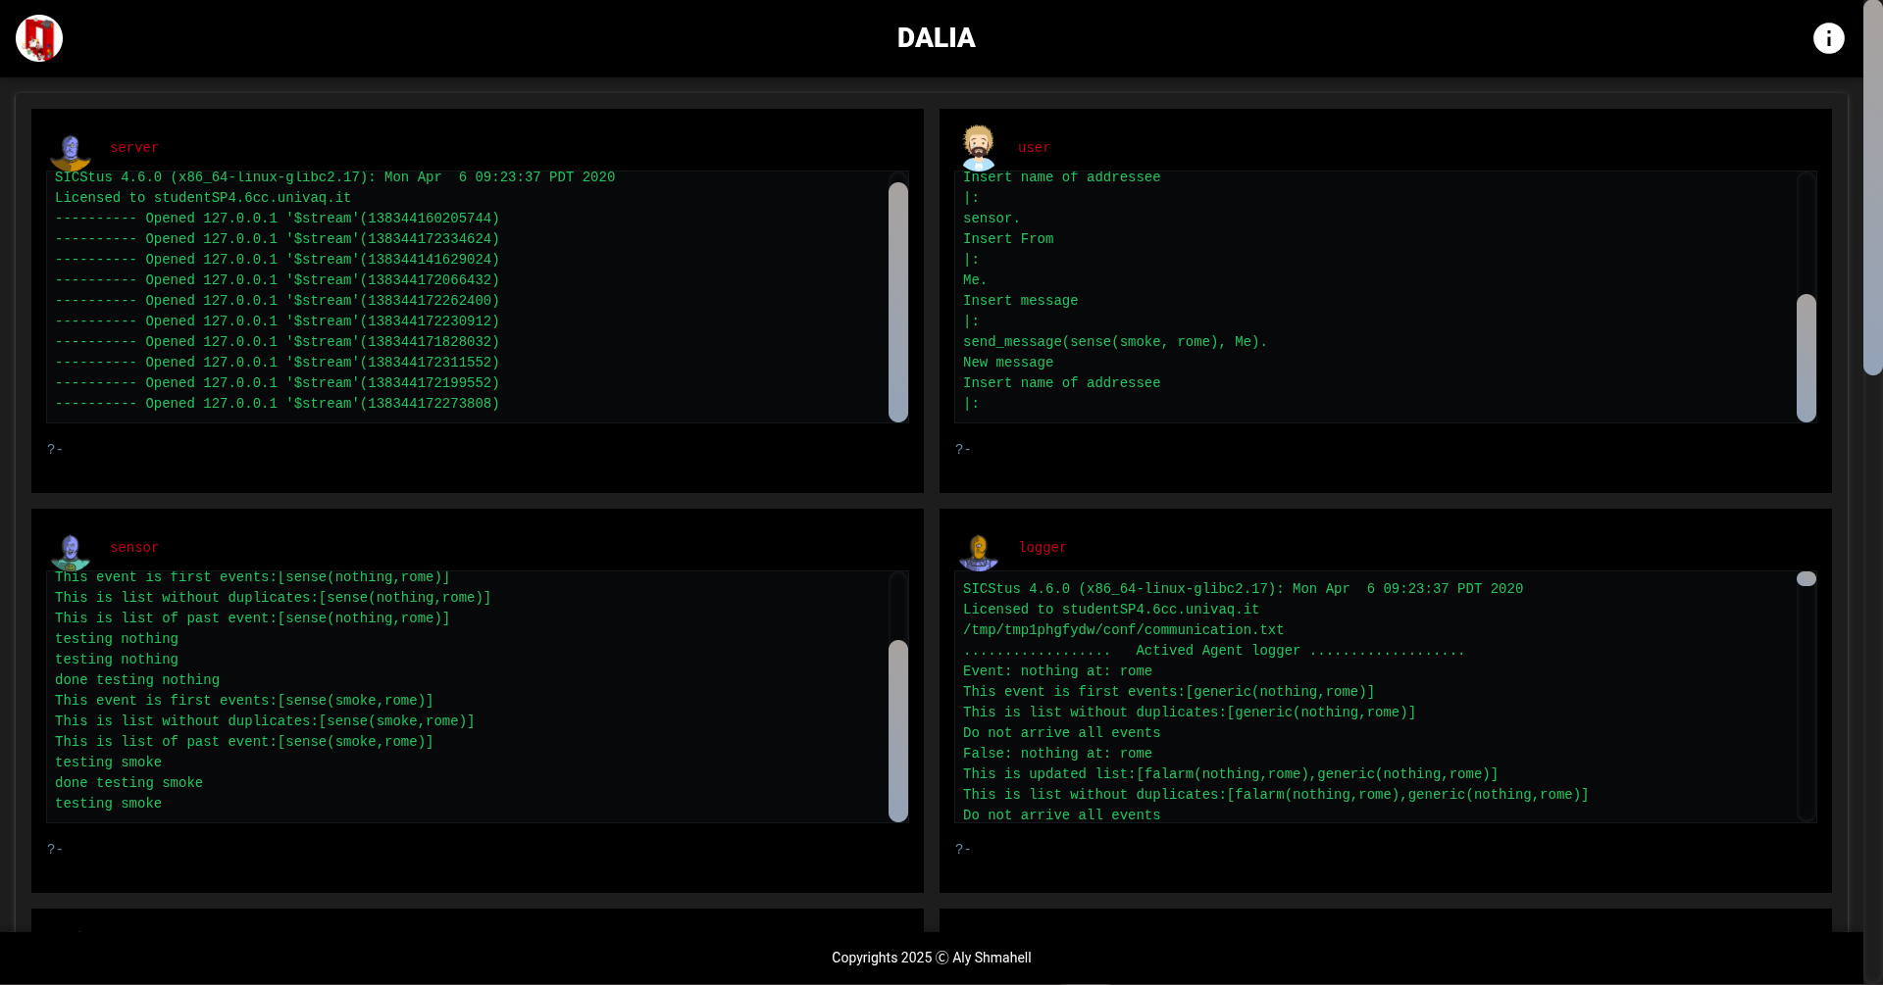

Slide 4
Why it is
To provide a modern interface as a replacement to termux CLIs.
To provide infinite agent windows instead of being limited to a few in some older implementations.
To provide a more self container launcher that is modular and loosely coupled with DALI and Sicstus, meaning the separation of Framework (DALI) from compiler (Sicstus) from source (the MAS code).
To provide a better way to create agent instances.
To provide a 2D graphic agent representation as appropriate icons attached to each agent window, for example a user window has a human icon, while and agent window is a robot.

Slide 5
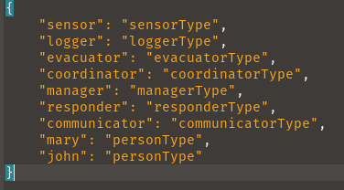
Agent Instance Definition
Using a singular json file, for example:

Slide 6
It comes with a more Advanced Example
Emergency Filtering/Evacuation/Response MAS.
Implements the Gaia methodology for agent-oriented analysis and design.
Implements FIPA primitives beyond the default, in this case the Inform primitive.
Distributed between multiple agents
Non-Deterministic as agent goals have multiple solutions (for example emergencies sensed with senseE(X, L) could be fire, smoke, earthquake) ...etc.
Proactive as it updates internal states based on input and acts upon it.
Autonomous via the launcher DALIA.
Asynchronous as inter-agent communication is conducted as events arrive without wait (without a universal clock).

Slide 7
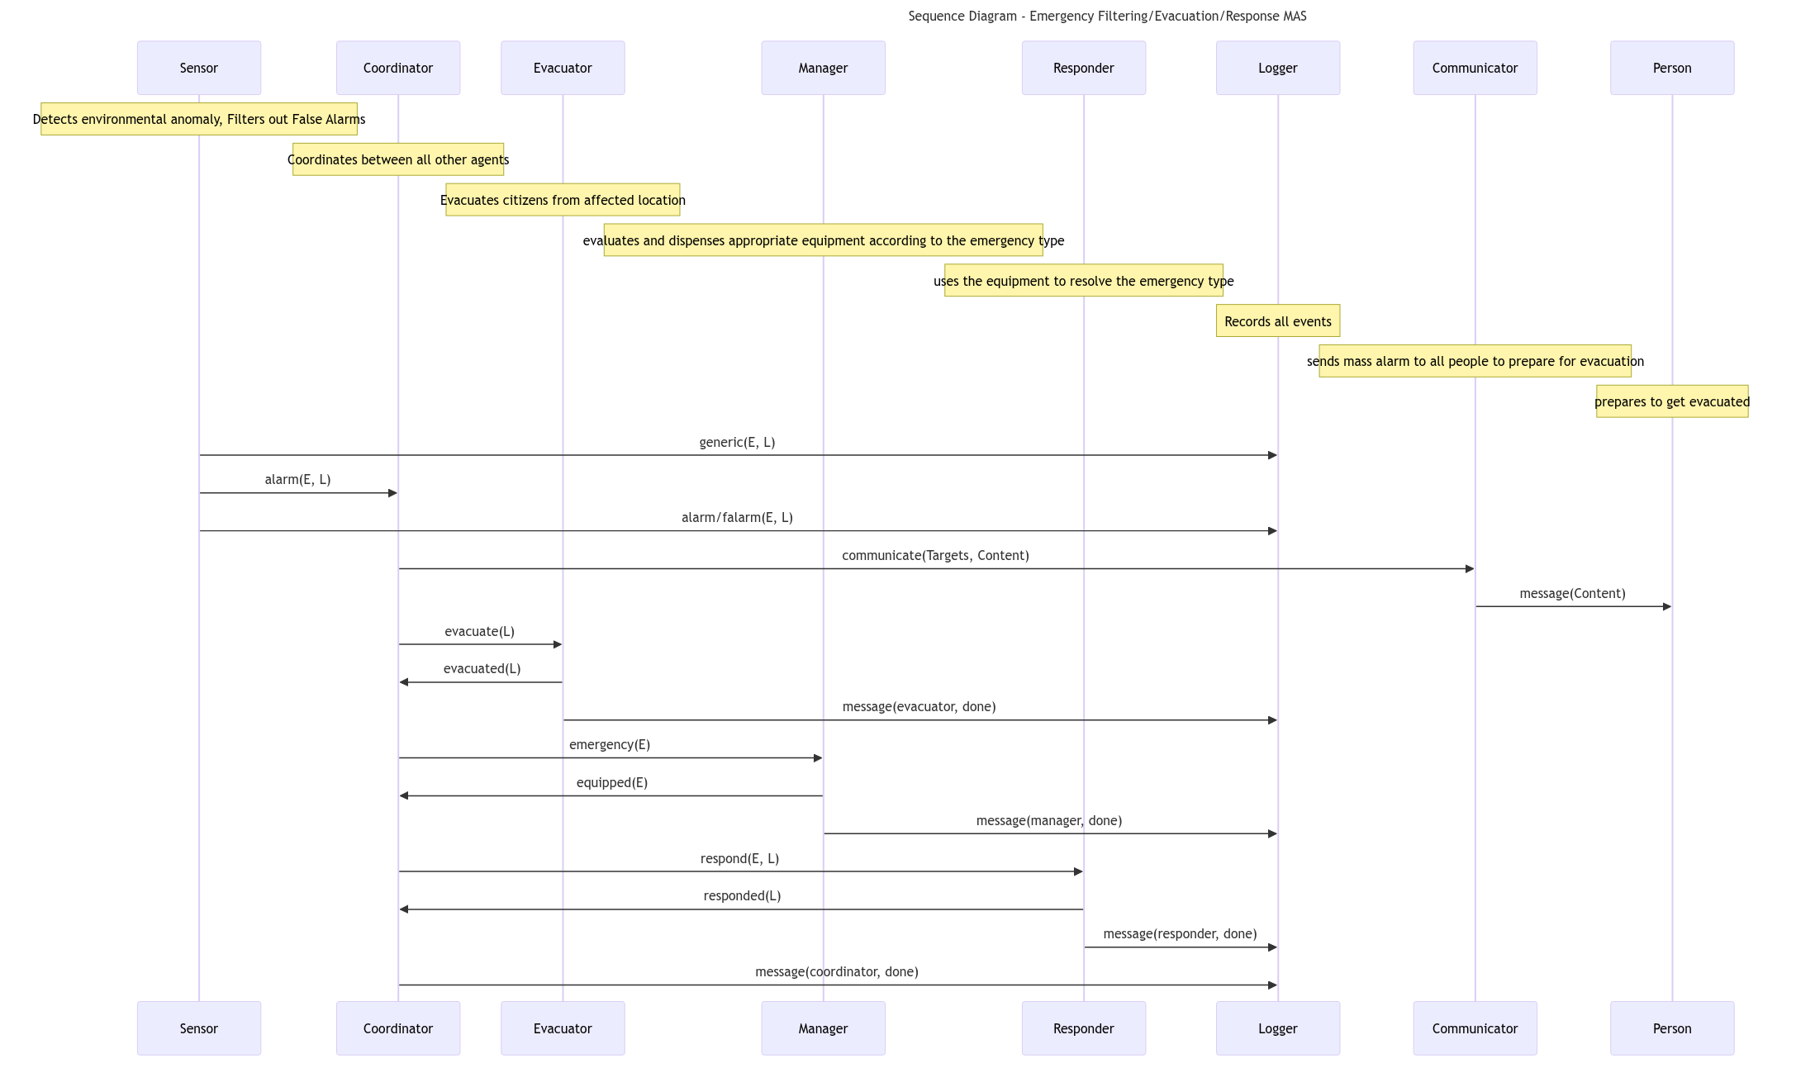
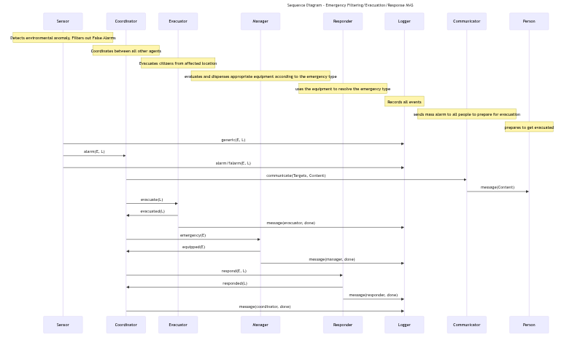
Sequence Diagram of the MAS

Slide 8
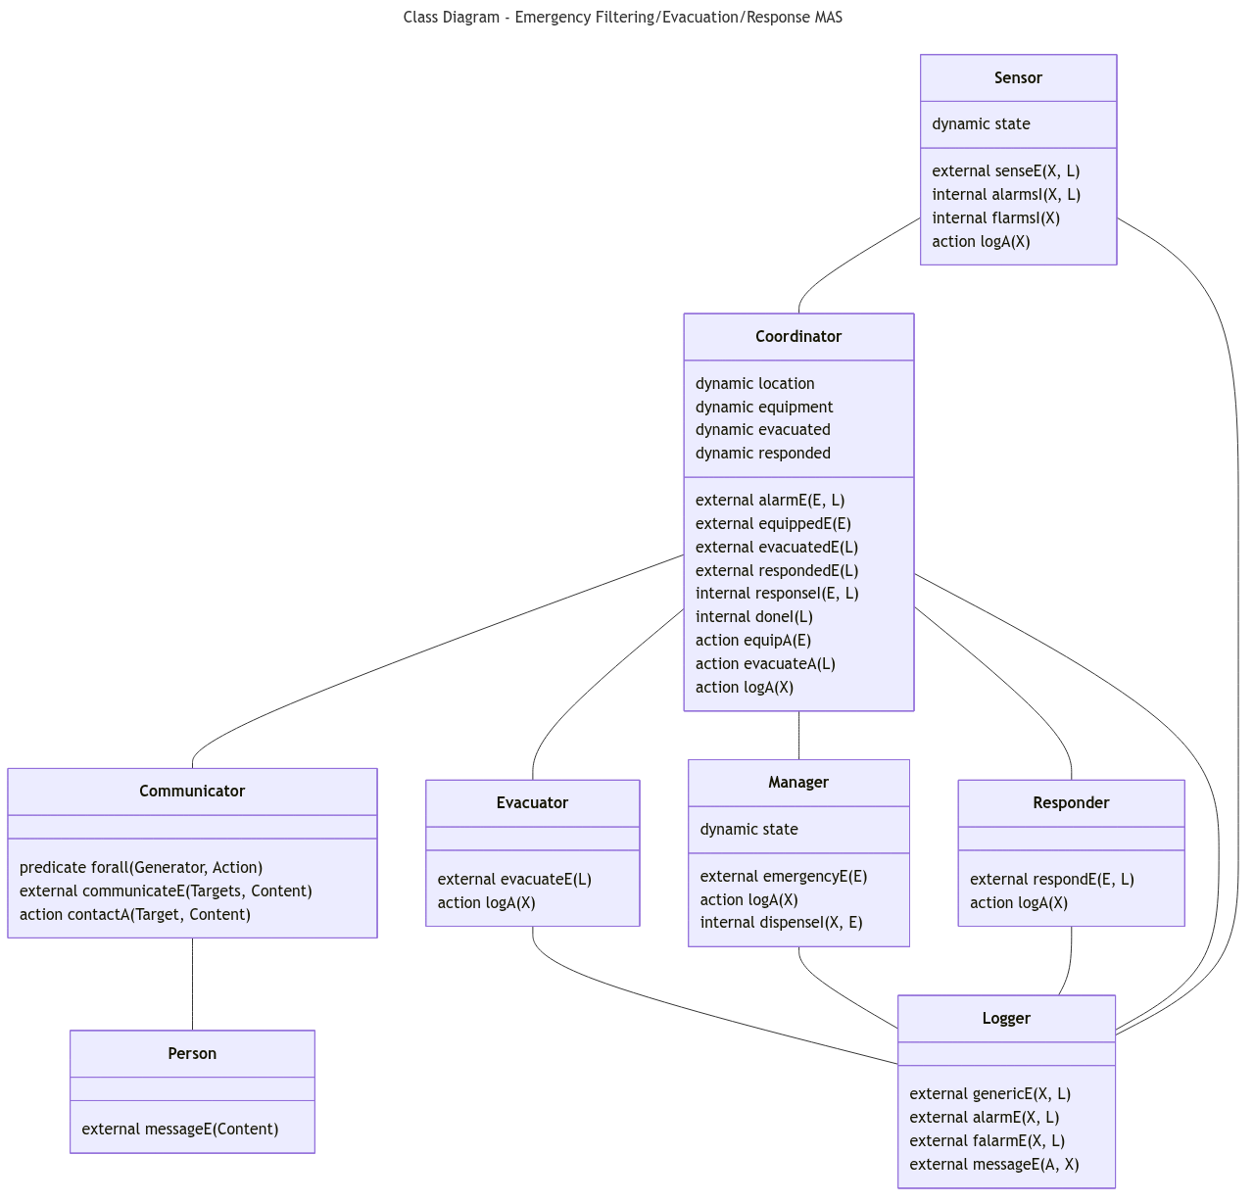
Class Diagram of the MAS

Slide 9
Repository
https://github.com/AlyShmahell/dalia.git

