Slide 1

NOV 2021
Recipients of Social Protection Schemes in
Ierland
EXPLORATORY DATA ANALYSIS (EDA)
prepared by : Alya Almanqour

Slide 2


WHAT IS AN EDA ?
It is an exhaustive look at existing data . It is used by data scientists to analyze and investigate data sets and summarize their main characteristics, often employing data visualization methods. It helps determine how best to manipulate data sources to get the answers you need, making it easier for data scientists to discover patterns, spot anomalies, test a hypothesis, or check assumptions.
WHY EDA IMPORTANT?
Exploratory Data Analysis, or EDA, is an important step in any Data Analysis or Data Science project. EDA is the process of investigating the dataset to discover patterns, and anomalies (outliers), and form hypotheses based on our understanding of the dataset.
PAGE 1
DATASET DESCRIPTION

Slide 3
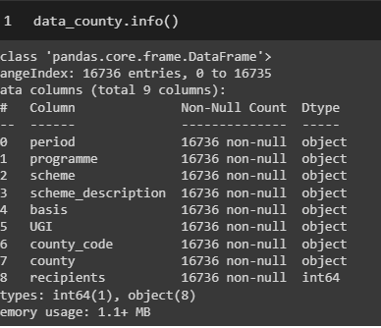
DATASET DESCRIPTION
The data in my project show Quarterly data of recipients on selected social protection schemes by county from Ireland.
This data was provided by Department of Social Protection of Welfare by virtue of the Central Statistical Office in Ireland.
Period of time covered between 2014-01-01 and 2021-09-30.
The dataset has more than 16,000 records (rows), which are divided into 9 description (columns).
Each record contains a 9 columns which describing data. often , first column show Period of data, it start from first Quarter of 2014 .
See the chart below for more details .

Slide 4


IN CODING
We do things the right way, and we never take no for an answer.

Slide 5

STEPS OF THE EDA PROCESS:
Loading dataset into pandas, NumPy or another similar tool.
2.Visualizing the distributions
3. Cleaning Dataset and missing values
4. Graphical representation and communicate findings
5. Conclusion

Slide 6

WHERE
We're Headed
IMPORTING LIBRARIES
timport numpy as np
import pandas as pd
import matplotlib.pyplot as plt
import seaborn as sns
READING DATA
data_county = pd.read_csv("county.csv")
DESCRIPTIVE STATISTICS
data_county.describe(include='all')
data_county.shape
data_county.columns
data_county.groupby(['county']).sum()
MISSING VALUE IMPUTATION
data_county.isnull().sum()
sum(data_county.duplicated())
GRAPHICAL REPRESENTATION
. sns.distplot(data_county['recipients'])
.plt.scatter(data_county.recipients,data_co unty.scheme_description);
. data_county.plot(x='period', y='recipients', kind='line')
. plt.show()
. data_county[['period', 'recipients']][data_county['recipients']> 22000].groupby('period').count().plot()

Slide 7
GOALS
1. Which county have the largest number of recipients?
2. Is there any relationship between the total number of recipients in some county with the type of service provided (scheme).
3. Which county have the largest number of recipients?
4. Is the service make differences over the year?
CONCLUSION
Through my analysis of recipients number of protection schemes , it's been proven that Dublin county is recived the most large number of recipients during 2020, the scheme was Pandemic Unemployment Claim.While Wicklow County received the largest number during the study period.
As can be seen from the graphical the number of recipients decrease over years, Except COVID-19 pandemic period, In our case of study the decreasing is a positve mark for econmic and all business relatied with.

Slide 8
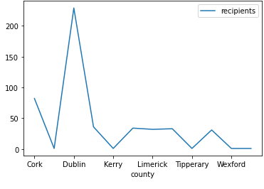
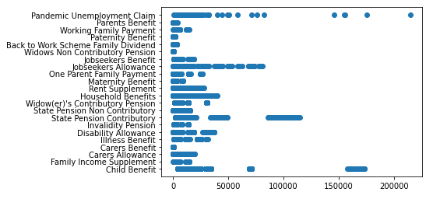
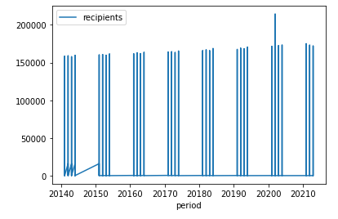
RESULTE

Slide 9
THANK YOU
AND FEEL FREE TO SEND US YOUR QUESTIONS!
ALYA ALMANQOUR
alyamanqour@gmail.com
Refrences
data.gov.ie

