Slide 1
WELLCOME TO
HOSPITAL MANAGEMENT SYSTEM
USER:
PASSWORD:
Register?
Log In

Slide 2
CREATE
NEW ACCOUNT
Username:
Department…
Profession:
Password:
* You should use uppercase letters, numbers (0 – 9) and low case letters.
Security Question:
Choose question for required password.
What school did you attend for sixth grade?
In what city or town did your mother and father meet?
Which is your favorite web browser?
Who is your favorite actor, musician, or artist?
Answer:
Sign Up

Slide 3
Hospital
Pharmacy
Log Out

Slide 4
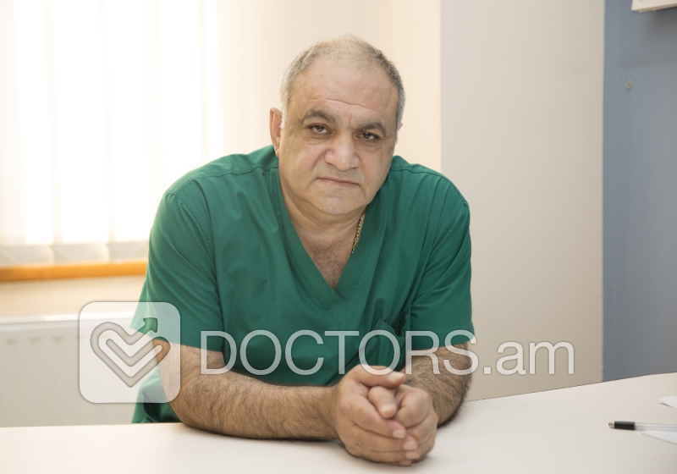
Search…
DEPARTAMENTS
Consultative and Diagnostic Department
Urology
Orthoepy and Traumatology
ENT
Coloproctology
General Proctology
Surgery
PATIENTS
NURSES
Ara A. Torozyan
Surgeoun(general)
Endrocrin Department
REGISTER
NEW PATIENT

Slide 5
DOCTORS
Search…
Ani
Gevorgi
Hovhannisyan
Adress: Yerevan,str.
Poxos
Armeni
Poxosyan
Adress: Ararat,str.
Birth: 30/09/1970
Birth: 26/07/1963
ID: 145673457
ID: 78959800
PATIENTS
NURSES
REGISTER
NEW PATIENT

Slide 6
Ani Gevorgi Hovhannisyan
Personal Information
Insurance
Disease
Notes
Vaccination
Laborator tvyalner
First Name:
Ani
Last Name:
Hovhannisyan
Gevorgi
Birth Date:
30/09/1975
Gender:
Female
Citizen:
Armenian
3487572o2984
Passport/ID:
Address Line:
Armenia, Yerevan
Date of Register:
10/11/2016
Region/Zip:
Avan, 0057

Slide 7
Ani Gevorgi Hovhannisyan
Personal Information
Insurance
Disease
Notes
Vaccination
Laborator tvyalner
Working Place:
YSU
Profession:
Lecturer
Phone Number:
+374-95-67-46-39
+374-95-67-46-39
Registration ID:
6758030475
OK

Slide 8
Ani Gevorgi Hovhannisyan
Personal Information
Insurance
Objective Data
Notes
Vaccination
Laborator tvyalner
Insurance Name:
Phone Number:
Insurance Card ID:
OK

Slide 9
Ani Gevorgi Hovhannisyan
Personal Information
Insurance
Jizneni anamnez
Objective data
Vaccination
Laborator tvyalner
Hereditary disease
Algeria
Surgery
Chronical disease
Hashmandamutyun
Riski faktorner
Mankakan infekcion hivandutyunner

Slide 10
Hereditary disease
V
OK

Slide 11
Alergia
OK

Slide 12
Surgery
Type | Date
OK

Slide 13
Chronical Disease
OK

Slide 14
Mankakan Infekcion hivandutyunner
OK

Slide 15
Hashmandamutyun
I
II
III
V
OK

Slide 16
Ani Gevorgi Hovhannisyan
Personal Information
Insurance
Jiznenei anamnez
Objective data
Vaccination
Laborator tvyalner
Vaccination Name:
Vaccination Date:
OK

Slide 17
Ani Gevorgi Hovhannisyan
Personal Information
Insurance
Jizneni anamnez
Objective data
Vaccination
Laborator tvyalner
Gangatner
Height:
Weight:
Blood Group:
Blood pressure:
Jnshum,pulys
Last Visit:
12/05/2016
OK

Slide 18
Ani Gevorgi Hovhannisyan
Personal Information
Insurance
Jizneni anamnez
Objective data
Vaccination
Laborator tvyalner
Gangatner
Uxegrum

Slide 19
Gangatner
Ani Gevorgi Hovhannisyan
Personal Information
Insurance
Jizneni anamnez
Objective data
Vaccination
Laborator tvyalner
Gangatner
OK

Slide 20
Uxegrum
Ani Gevorgi Hovhannisyan
Search…
DEPARTAMENTS
Consultative and Diagnostic Department
Urology
Orthoepy and Traumatology
ENT
Coloproctology
General Proctology
Surgery
Ara A. Torozyan
Anna M. Karapetyan

Slide 21
Uxegrum
Ani Gevorgi Hovhannisyan
Ara A. Torozyan
Surgeoun(general)
Endrocrin Department
Message
OK

Slide 22
Ani Gevorgi Hovhannisyan
Personal Information
Insurance
Jizneni anamnez
Objective data
Vaccination
Laborator tvyalner
Gangatner
Uxegrum

Slide 23
Laborator Tvyalner
Analizi anun | Date | Result
OK

