Slide 1

React JS & Hooks
MA003
ALYANI MAMAD B.

Slide 2
Agenda
01. Introduction
02. Features Of React
Basic
Open Source
Who Uses React
Responsive Design
Component Based
Reusable code
03. Installation & Run
04. React App Structure
05. Why React?

Slide 3

Introduction
React is an open source, JavaScript library for developing user interface (UI) in web application.
React is developed and released by Meta.
I assume that the you have the basic knowledge in HTML, CSS and JavaScript ES6 concepts.
React work on component based approach.
React is flexible and can be used in variety projects.
React Office Website : https://reactjs.org/

Slide 4
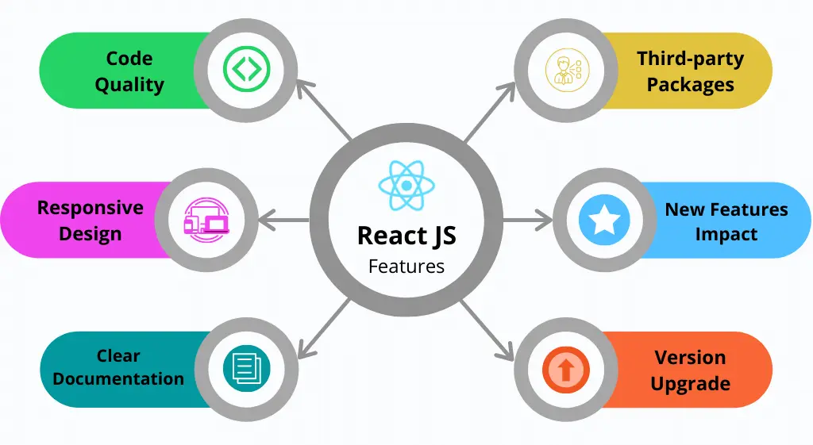
Features React Js

Slide 5
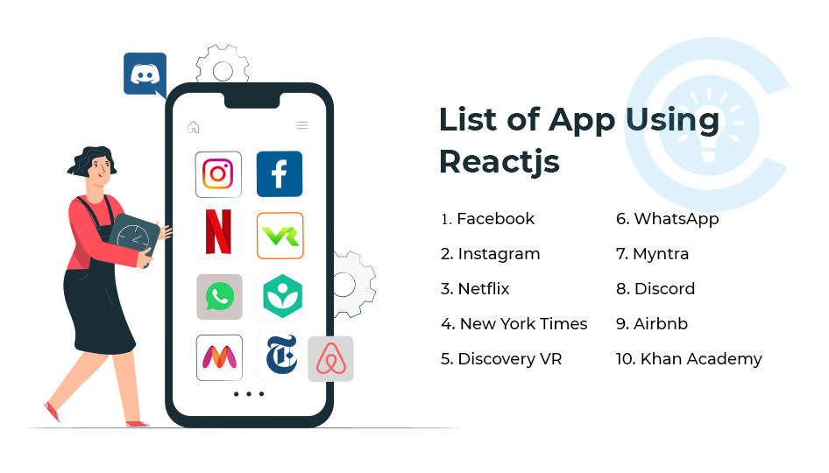

Slide 6
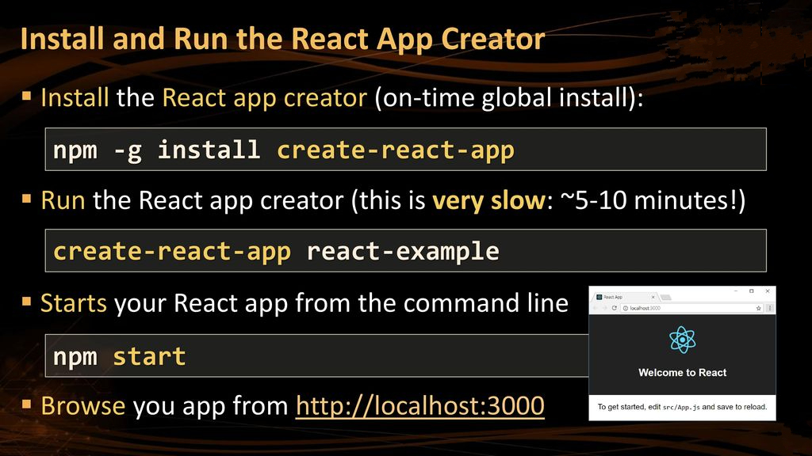
Installation & Run App

Slide 7
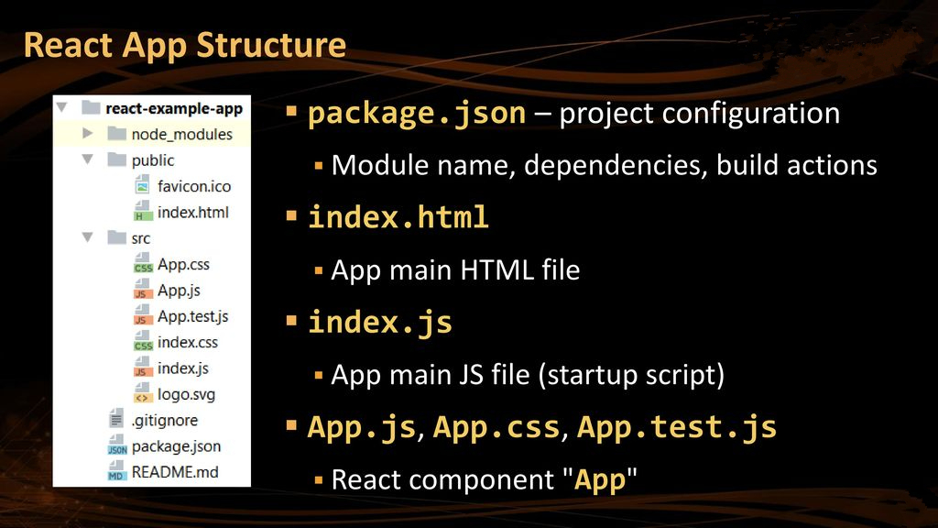
React App Structure

Slide 8

Why React?
Reuse of components.
It is quite easy to create interactive UI’s.
It has huge community.
Component Based Architecture.
Efficient update and render.
Excellent cross-platform support(Multiple OS).
Provides amazing developer tools.
Makes JavaScript coding easier.

Slide 9

Thank you

