Slide 1

React JS & Hooks
MA003
ALYANI MAMAD B.

Slide 2






Agenda
Installation Of React
Introduction to JSX
Why We Learn EcmaScript Concept
Arrow Function VS Regular Function
“Hello World” Program

Slide 3
Installation
Install JS Runtime Enviroment
cd Hello-world
NodeJS is the platform needed for the ReactJS development.
https://nodejs.org/en/
Move inside the same folder using the above command.
npm install –g create-react app
npm start or Yarn start
Everything went well run the command.
To start your app run the above command .
create-react-app Hello-world
It will take some time to install the required dependencies.

Slide 4
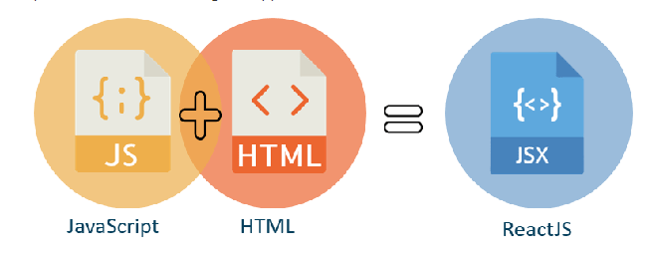
Introduction To JSX
React is often considered developer-friendly and the major reason for it is JSX.
JSX stands for JavaScript XML.
JSX allows us to write HTML in React.
JSX converts HTML tags into react elements.
Example :
let name = “Alyani";
let heading = <h1> Hi, my name is {name} </h1>

Slide 5


Why We Learn EcmaScript ?
By using ES6 features, we write less and do more, so the term 'Write less, do more' suits ES6.
ES6 introduces you many great features such as scope variable, arrow functions, template strings,etc..
The Main Reason is to Learn React JS.

Slide 6
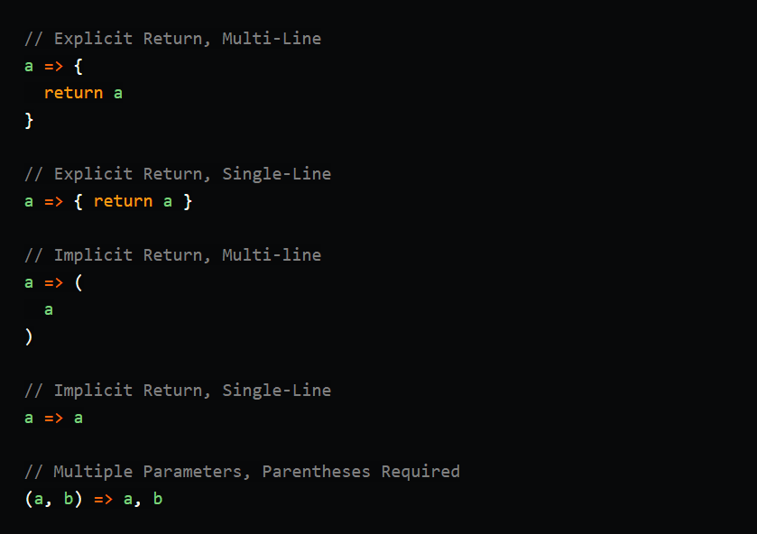
Arrow Function VS Regular Function
Syntax
Prototype Checking
This Keyword
Multiple Argument

Slide 7
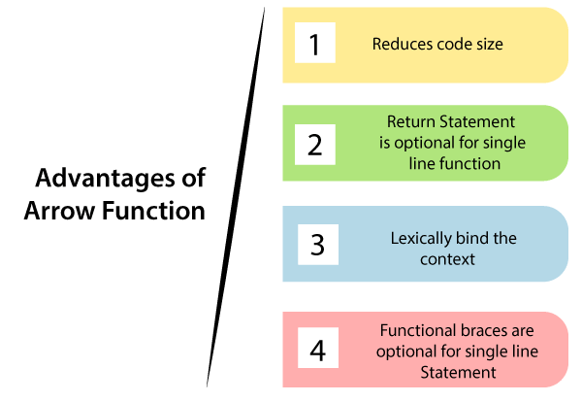

Slide 8
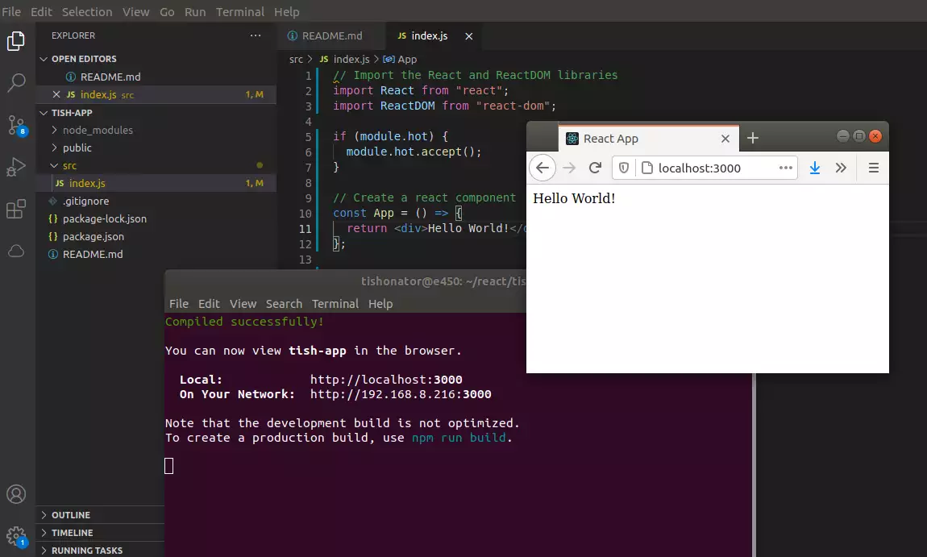
“Hello World” Program

Slide 9

Thank you

