Slide 1

React JS & Hooks
MA003
ALYANI MAMAD B.

Slide 2






Agenda-(Hooks🦄)
Introduction (Hooks)
Hooks Rules
Introduction to useState Hook
Importing & Initialize
useState
Examplee

Slide 3








Introduction
Hooks are a new addition in React 16.8.
Hooks are functions that let you “hook into” React state and lifecycle features from function components.
Why the need for Hooks?
Use of ‘this’ keyword.
Reusable stateful logics.
Simplifying complex scenarios.
Although Hooks generally replace class components.
It does not work inside classes.
Node version 6 or above &
NPM 5.2 or above

Slide 4

Hook Rules
There are 3 rules for hooks:
Hooks can only be called inside React function components.
Hooks can only be called at the top level
of a component.
Hooks cannot be conditional.
Note: Hooks will not work in React class components.

Slide 5
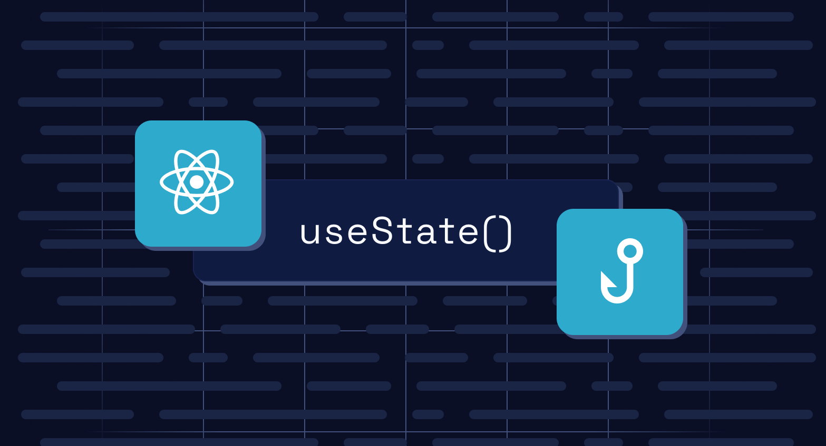

Introduction to useState Hook
Do you have data in your component which changes over time? And by using normal variables you are not able to reload your component.
This issue can be easily resolved by the useState hook.
This hook reloads the component whenever there are any changes in the state thereby updating your user interface with the latest value
useState is a react hook that allows you to create state variables

Slide 6
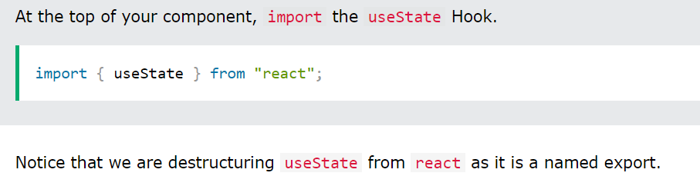
Importing useState
To use the useState Hook, we first need to import it into our component.

Slide 7
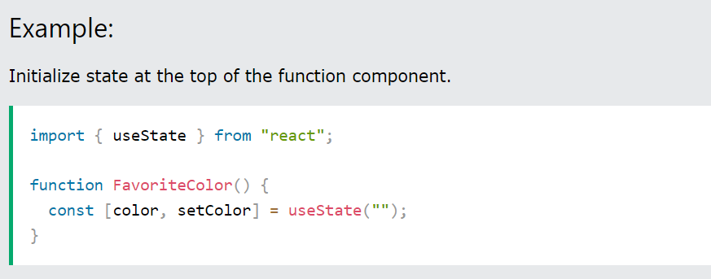
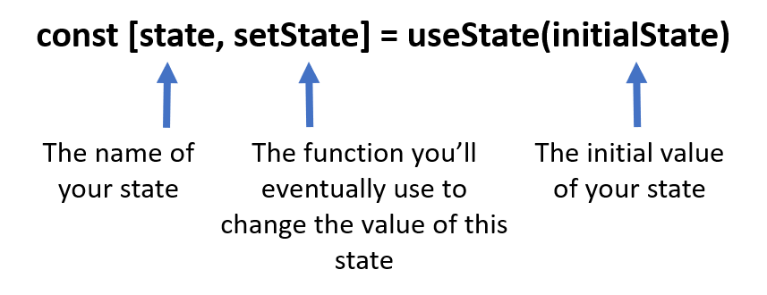
Initialize useState
We initialize our state by calling useState in our function component.
useState accepts an initial state and returns two values:
The current state.
A function that updates the state.

Slide 8
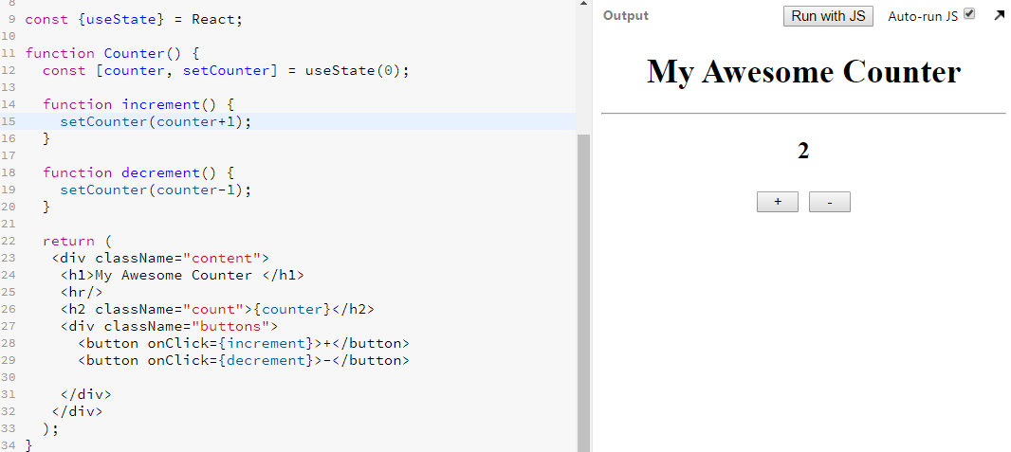
Example :

Slide 9
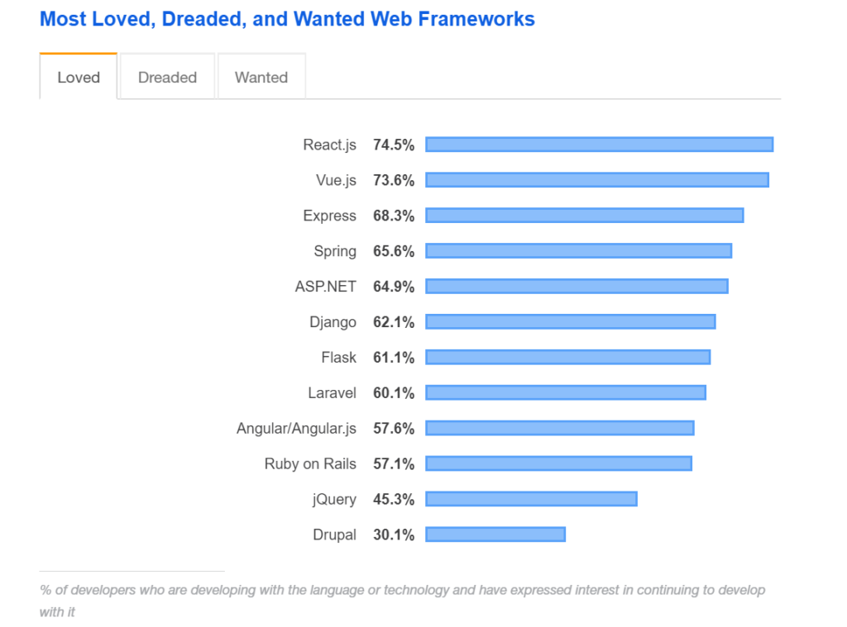

Slide 10

Thank you

