Slide 1

React JS & Hooks
MA003
ALYANI MAMAD B.

Slide 2






Agenda
What We Have Discussed Till Now?
Types Of Hooks
Introduction to useEffect 🦋
Effect Cleanup
Conclusion

Slide 3

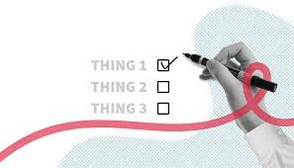
What We Have Discussed Till Now?
Basic Introduction Of React Js
Installation
Some Prerequisite
Introduction to Hooks 🦄 and some Rules
useState hook done

Slide 4
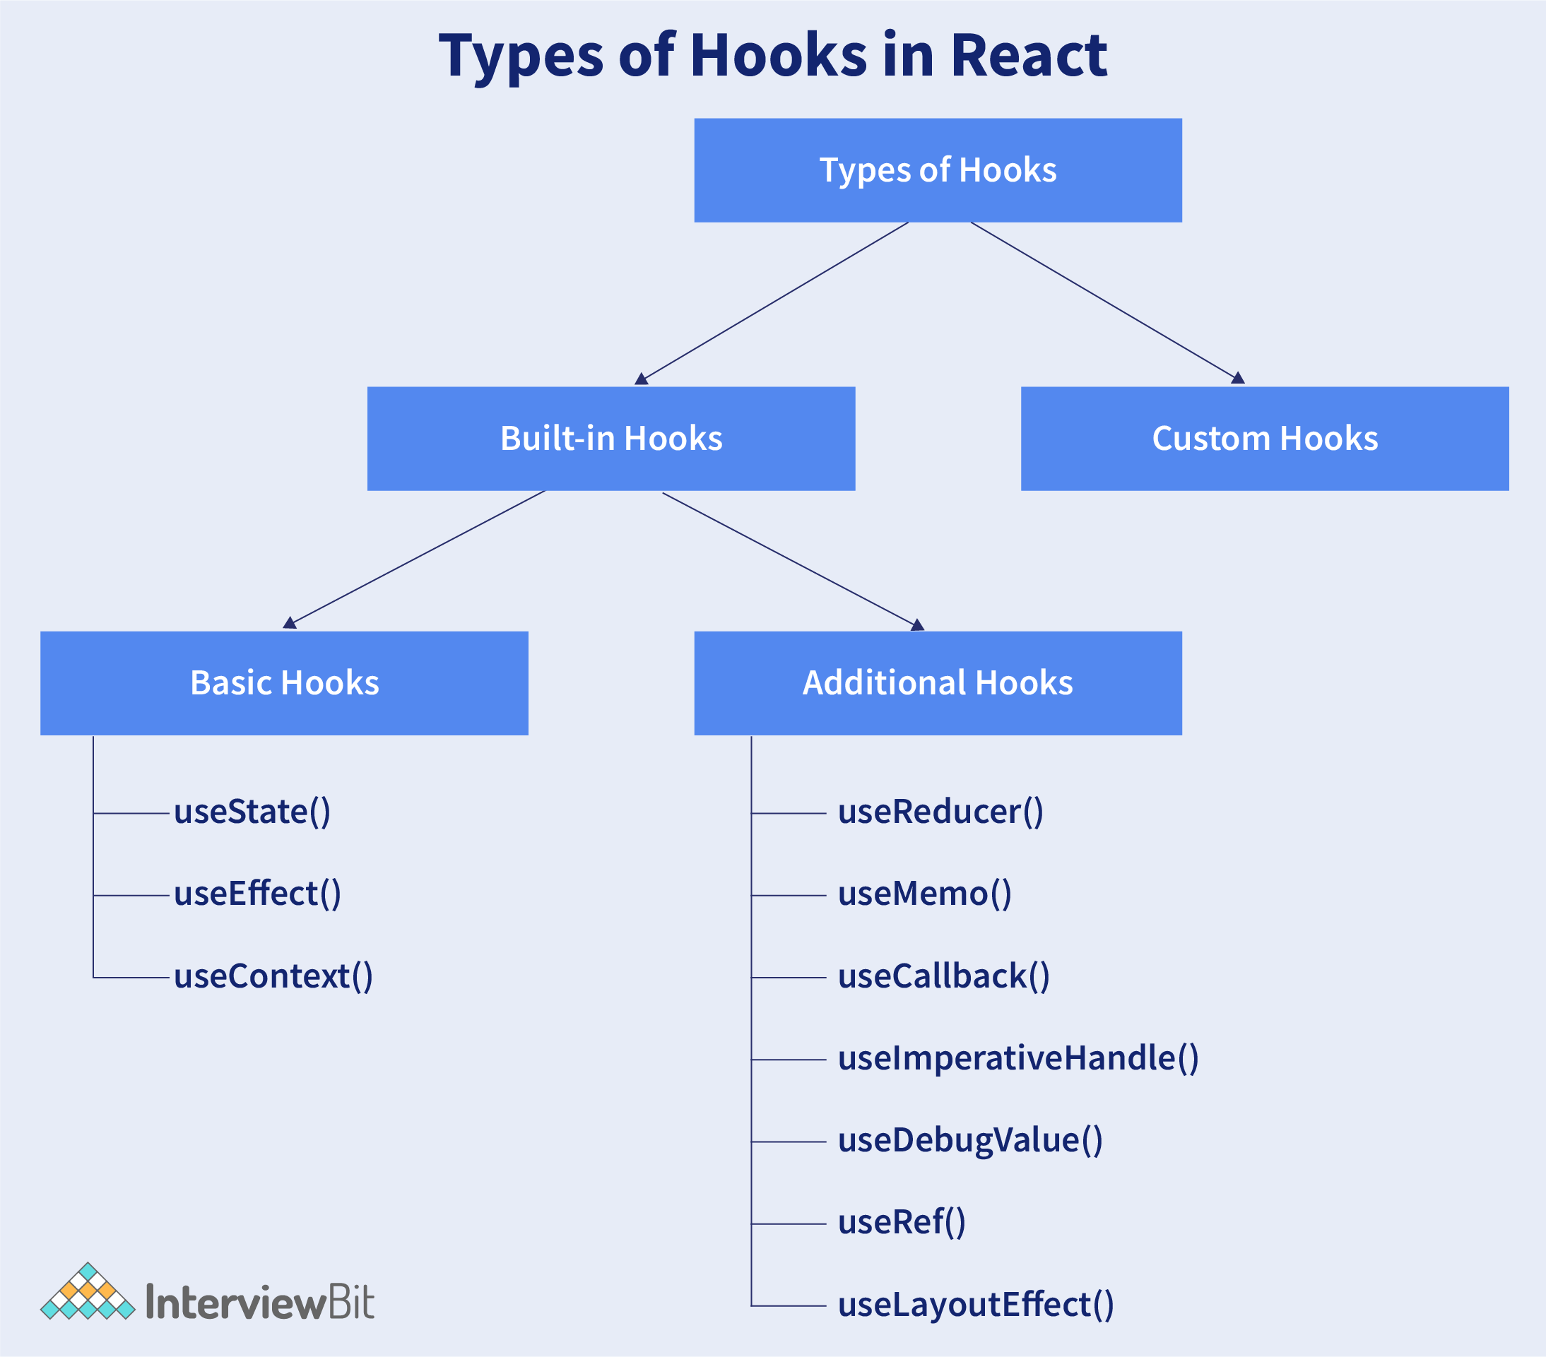
Types Of Hooks :

Slide 5


Introduction to useEffect 🦋
The useEffect helps to perform side-effects(Outside current scope) in functional components.
Automatically called when page LOADS.
Eg : WHATSAPP chat count(chats(5)), Error-tracking.
Used Outside the component to render data(API’s).
useEffect accepts two arguments. The second argument is optional.
Syntax : useEffect(<function>, <dependency>)

Slide 6
Example :

Slide 7
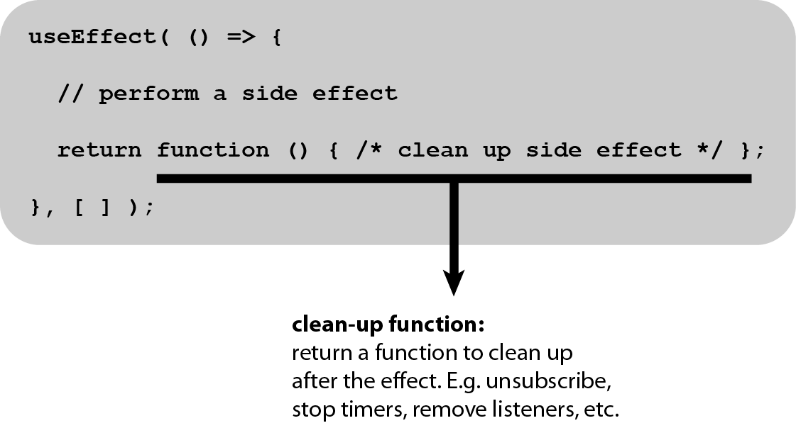
Effect Cleanup
Some effects require cleanup to reduce memory leaks.
Timeouts, subscriptions, event listeners, and other effects that are no longer needed should be disposed
We do this by including a return function at the end of the useEffect Hook.

Slide 8
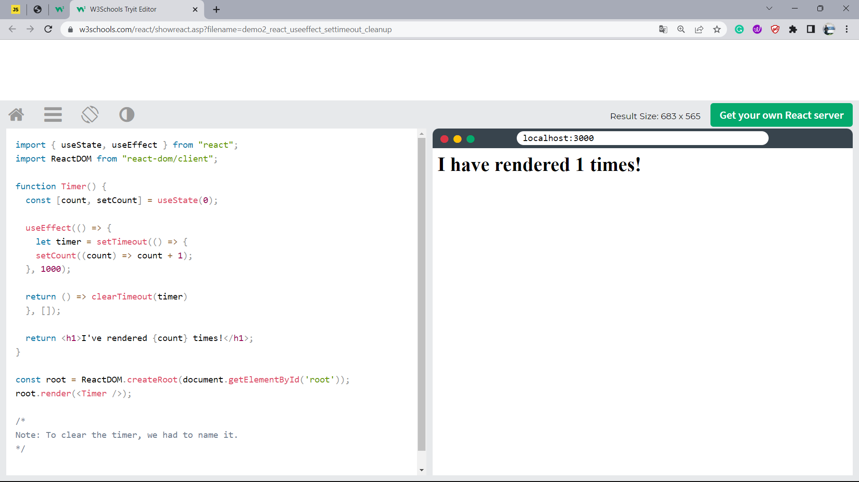

Slide 9

Thank you

