Slide 1
Charity pool
Charity pool Github repo

Slide 2
Dev team
Yassine Yadine
Alain Wackenheim
Andrinandrasana David Rasamoelina

Slide 3
Charity pool project
DApp built on the Solana blockchain,
Allows users to contribute funds to various causes and organizations.
Dapp aaply to each pool, a deadline,
VRF to select a winner among contributors,
All transactions and contributions are publicly visible

Slide 4
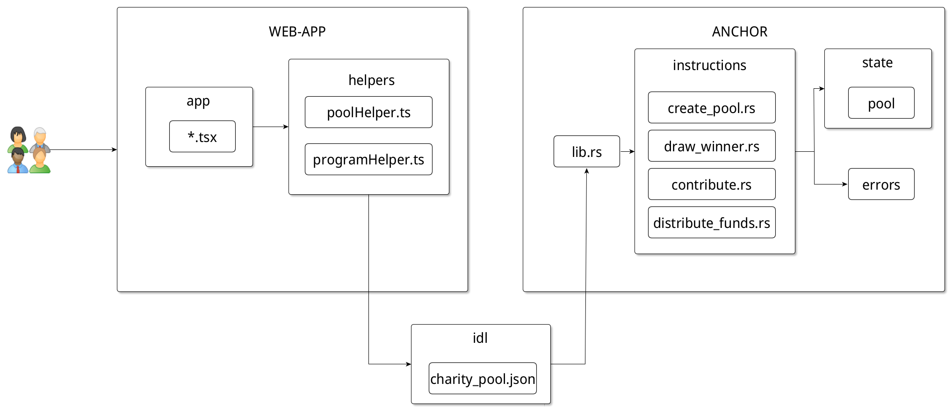
Architecture

Slide 5
Demo time
Limits of the demo
No deadline
VRF not implemented

Slide 6
Key parts
Smart contract

Slide 7
Tests
Let’s run `anchor test`

Slide 8
Questions

