Slide 1
Do you git it?
Basic introduction to git and GitHub
Deakin Coding Club
May 2021
Alys Young
aryo@deakin.edu.au

Slide 2
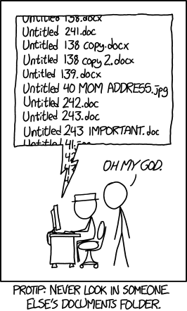
What is git?
Version control
GitHub, GitLab, and Bitbucket
Main benefits:
Backing up your work
Reverting back to past versions
Collaboration

Slide 3






Git version control:
New terminology: Repository or repo, push, pull
Code saved on git in a repository
Commit the new changes to your version multiple times a day at the end of mini sections
Push
Pull
Commit
Use a copy of it on your local computer

Slide 4

Git version control for collaboration:
Code saved on git in a repository
Clone
Push
Pull
Commit
Use a copy of it on your local computer

Slide 5
Git version control for collaboration:
Fork
Code saved on git in a repository
Pull
Push
Pull
Commit
Use a copy of it on your local computer

Slide 6



Git version control:
Another way of visualizing
Head
(what you’re currently up to)
Commit
Push
Main or Master branch
Other ideas that we wont talk about today:
Branch
Fork
Clone
Command line
Time
You can go back in time with git a retrieve the previous versions

Slide 7
How to get started:
download git (https://git-scm.com/downloads)
create a github account (https://github.com) or whatever program you want to use
Follow a tutorial on how to link git and R.
e.g. Jenny Bryan’s Happy Git with R book (https://happygitwithr.com/)

