Slide 1

Cory Gardner for Senate
Date of Analysis: 10/21/19
Notes:
Do you want to go through page by page or sit down and just talk about it?
We’re going to talk about giving you a leg up on the competition in developing winning messaging strategies. We will save you time, and we will save you money.
Google searches are more accurate, less expensive, and, more honest than survey polling. I’ll argue until my last breath that Google search alone could build you a winning message strategy. You should partner with us because we are at the forefront of the future.
The future of polling will certainly include Google search data. Google maintains an 88% market share of domestic internet search queries. Geographic search data is available through Google Trends; Google’s repository of search data made available for free, to the public, to encourage data journalism. It’s part of Google’s News Initiative.

Slide 2
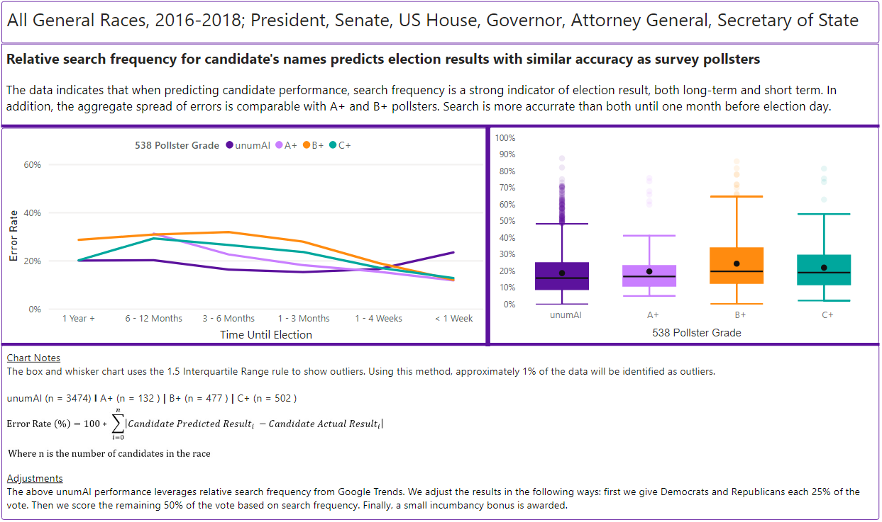
UnumAI leverages Google Trends Search data for polling predictions
Google Search indicates candidate support and confirmatory voting intent
Notes:
I assert that Search indicates support, and confirmatory voting intent and issue support. Yes, there are cases that celebrities, and common names, and Trump skew this assertion. Those are exceptions to the rule evidenced by the data. Looking at an encyclopedic history of every Federal election and every statewide election in the United States in the last two-cycles, including every public poll, and elections without polls, we see increased accuracy from this method, usually by significant margins.
Relative search frequency for candidate’s names predicts election results with similar accuracy as survey pollsters.
I want to define Error Rate, which is the left axis for both these charts, and the metric we use to compare ourselves to survey polling on…. Error Rate is each candidate’s predicted result’s difference from their actual election day vote shares summed for all the candidates in the races.
Looking at the box and whisker chart, it seems like the only thing you get by hiring a 538 rated A+ pollster is a narrower band of results, but not on average more accurate.
Looking at the Time until Election chart, we see UnumAI’s relative advantage up until 1 month before election day, which is when candidates go on TV and people start paying attention. However, if you thought that you knew what was going on early in the race because you hired an A+ pollster, you may have been flying blind.

Slide 3
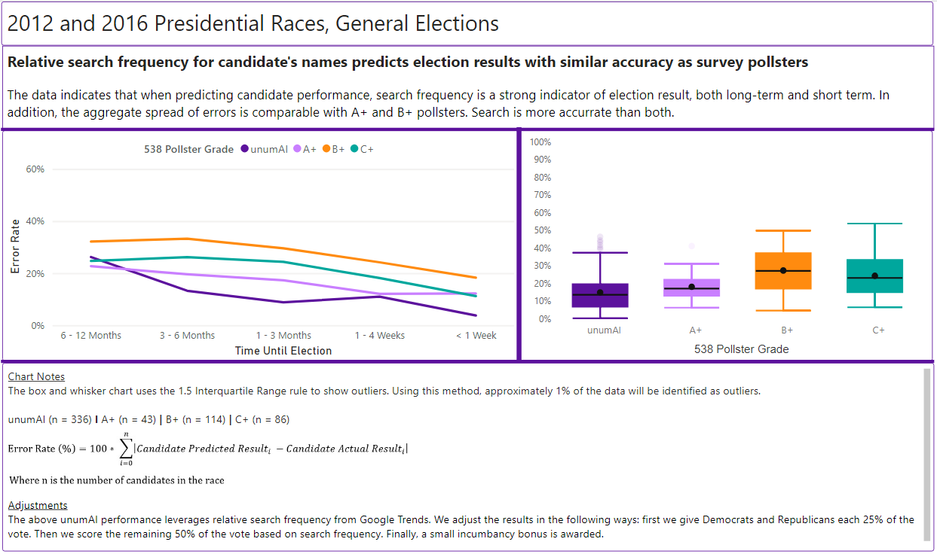
Google Search versus Survey: Presidential General Elections
Comparisons on all Federal and Statewide office levels in Appendix
Notes:
Just for Presidential General Races, we see that Search outperforms survey once the contestants are set. Unum outperforms all rankings of pollsters across all times. We have Search versus survey comparisons for each Federal and Statewide office level of the ballot in the appendix if you’re interested.

Slide 4
What Place Is Gardner In?
Unum predictions foreshadow survey results
Type /Method | Random Split | Chronological Split
Train Data | 0.715 | 0.701
Testing Data | 0.607 | -512.578
Notes:
So What Place Are You In? We see you as being in 8th… Unum predictions foreshadow survey results for a couple of reasons… Partially, search indicates the leanings of undecideds.
Everyone knows that Biden is crashing and burning. We see him here at 14%. Despite being implicated in impeachment, his search is still way down… Expect the survey results to follow. RCP still has him with a 7 point lead nationally.
Search spikes can be identified as being outside two standard deviations of their survey results… these are skews that occur to viral candidates. We can treat these as outliers and impute whatever the latest survey results are for their rank-order choice.

Slide 5
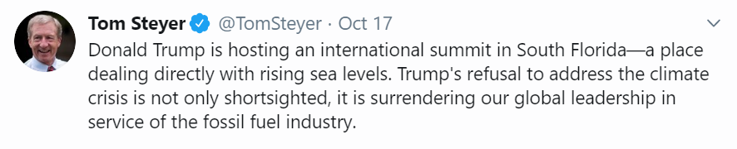
Search data is also used to build winning messaging strategies
The Process
Take each candidate’s Tweets
Parse them into Google-sized phrases
Gather Google Trends search data to measure public interest in the topics
Organize into issue categories
Build statistical models to analyze and form messaging mix shifts
“Donald Trump”
“international summit”
“South Florida”
“rising sea levels”
“climate crisis”
“global leadership”
“fossil fuel”

Slide 6
Search data is also used to build winning messaging strategies
The Philosophy
Your Tweets = Your supply on a given idea
Other Candidates’ Tweets = Their supply on a given idea
Everyone’s Tweets = The Marketplace of Ideas where you can go shopping for what the competition is talking about that resonates with your constituency, and that we know will help you
Our recommendations bring you to the optimal: Are you talking about what the public wants to hear you speak up on?
Demand
Tweets
Supply 1
Supply 2
Votes

Slide 7
Who Are You?
Tweet Breakdown by Candidate and Issue
Notes:
Donald Trump talks more about National Security, Veterans Affairs, and Foreign Policy more than anyone else.
Bernie talks more about healthcare and the economy than anyone else.
Steyer talks more about the environment than anyone else.

Slide 8
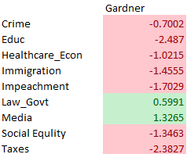
The Marketplace of Ideas - Alysia
How the ecosystem of ideas is working for and against Cory Gardner
Gardner has strong influence on Law and Government related event
Gardener is also strong on media
Taxes has the most negative impact on Gardner
Impeachment has negative impact on Gardner
Green = Relative advantage against other Dems amongst Dems; or positive for Trump’s approval rating
Red = as search interest increases, candidate’s polling decreases
Notes:
The Marketplace of Ideas represents how the overall conversation is effecting each candidate. How much is the public searching for each issue, and what is happening to each candidate’s polling numbers as that’s happening. So, if you talk about this more, or your opponent talks about this more, somebody related to one of these issues dies and people search for it, there’s a shooting or a natural disaster… this is how much it will effect your polling numbers. We focus on what’s green and red more than the magnitudes. Green is a relative advantage against other Democrats; or beneficial to Trump’s approval rating in his case. Red are issues that hurt you. Trump benefits from Trade...

Slide 9
Impeachment
# of Terms in Category: | 145
Average Daily Share: | 0.3%
Average Daily Rank: | 17
Term | Steyer | Biden | Sanders | Warren | Trump
impeachment | 0.04 | -0.23 | -0.16 | 0.44 | 0.16
impeached | 0.06 | -0.21 | -0.11 | 0.36 | 0.11
testimony | 0.05 | -0.02 | -0.05 | 0.05 | 0.15
impeach | 0.12 | -0.17 | -0.11 | 0.33 | 0.07
25th amendment | -0.13 | -0.15 | 0.04 | -0.06 | 0.00
transcript | 0.01 | -0.13 | 0.05 | 0.07 | -0.01
schiff | 0.00 | -0.18 | 0.03 | 0.17 | 0.11
to impeach | 0.07 | -0.20 | -0.11 | 0.34 | 0.09
obstruction of justice | -0.08 | 0.13 | 0.08 | -0.20 | 0.06
rudy | 0.16 | -0.22 | -0.07 | 0.35 | 0.04
impeach president | 0.04 | -0.19 | -0.08 | 0.29 | 0.12
sections | 0.02 | 0.02 | 0.00 | 0.02 | -0.12
impeachable | -0.01 | 0.17 | 0.05 | -0.03 | 0.52
collusion | 0.01 | 0.05 | 0.31 | -0.35 | -0.06
impeach trump | 0.12 | -0.20 | -0.15 | 0.34 | 0.10
white house staff | 0.13 | 0.04 | 0.00 | -0.10 | -0.10
to impeach president | 0.01 | -0.16 | -0.07 | 0.30 | 0.13
intelligence committee | 0.09 | -0.02 | -0.05 | 0.03 | 0.06
senate intelligence committee | 0.04 | 0.10 | -0.04 | -0.05 | 0.04
impeachment vote | 0.05 | -0.33 | -0.29 | 0.56 | 0.22
Impeachment is helping Warren and Trump and it is hurting Biden
Of the Democrats, Warren and Steyer have positive correlations
Biden has many negative correlations – maybe he is being impacted by his son’s potential involvement in Ukraine?

Slide 10
Takeaway: Messaging Mix
Take the messaging mix from this:
To this:
Media, Law & Government
More From Positive Categories
Continue to push on the Law and Government
week positioning on taxes, Impeachment
Test new messaging on issues not significant in the model
Take full advantage when an issue takes over the news cycle
The list goes on…
Crime, Education
Healthcare, Economy
Immigration,
Social Equity &
Taxes
Less From Negative Impact Categories
Notes:
So what’s next? We analyze the shifts that will get you the most return on vote share from, honing in on the messages that we know will help you. We organize a dictionary that tells you what to say and what not to say on each topic. We liaise with your public relations and communications teams to give them these tools, and we develop a reporting process to suit your desires.

Slide 11
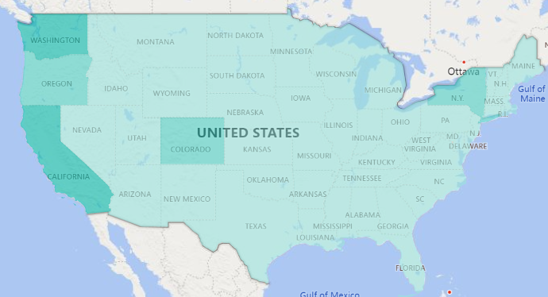
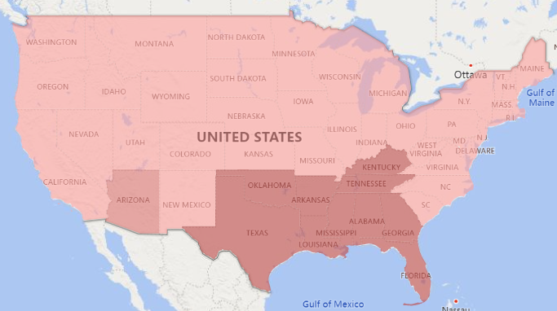
A preview of what’s next
Our next phase of this project will look to expand the national level analysis down to the state level
Will look for differences in what issues resonate in different states
Environmental issues may have a bigger impact in West Coast races…
..while gun issues may dominate the South
Notes:
Here’s a preview of what’s next…. Tailor your winning message to the geography that you happen to be in! I’m thinking this will be an interactive dashboard that you click on what state you’re in that day and a dictionary pops up of what to talk about, and what not to talk about there. It goes in your daily briefing book.

Slide 12
Conclusion and Thank You
Google Search polling and UnumAI are at the forefront of the future
More accurate
Less expensive
More honest, robust respondents and insights
Harness the relative advantages of both Search and Survey
Search: More accurate, less expensive, more honest
Survey: Better demographic crosstabulation
We believe in you, and we’d like to become your partner, today and tomorrow
Notes:
Google searches are more accurate, less expensive, and more honest than survey polling. I will argue until my last breath that search alone could build you winning messaging strategies. We want to partner with you, and you should partner with us because we are at the forefront of the future... In conjunction with your familiar survey pollsters, we offer a supplemental view of what’s going on; one that can be combined with surveys to harness the relative advantages of both: Improved accuracy from search, and better demographic crosstabulation from surveys.
I can recognize a divinely possessed individual on a crusade… we believe in your father. It’s a righteous mission and fight. What questions may you have?
Answer the question and only the question. Harness my emotions. Port in the storm is what people want out of a partner, not spirited.

Slide 13
Appendix

Slide 14
SWOT Against Trump’s Message
How Trump’s tweets alone effects each of the Democrats
 | Steyer | Biden | Sanders | Warren
Conspiracy & Mueller | -0.17 |  | 2.23 | -3.43
Corporate Regulation |  | -2.84 |  | 7.63
Economy & Healthcare |  |  |  | -0.23
Education | -0.05 | 0.74 | 0.48 | -1.40
Environment | -0.51
Ethics | 0.18
Immigration | -0.09 |  | 1.02 | -3.37
Impeachment |  | -1.18 | -0.87 | 2.34
Law & Gov't |  |  | 0.31
Media |  |  | -0.52
Social Equality | 0.70 |  |  | -2.97
Trade & Agriculture | -0.53 | 2.72 | -2.29 | 3.16
War & Foreign Policy | -0.04 | 0.34 |  | -0.53
Steyer performs better relative to other Dems on Social Equality
Biden appears to be stronger on Trade and Foreign Policy
Sanders’ advantages include Education and Immigration
Warren is strong on Impeachment, but weak on Immigration and Education
Green = Relative advantage against other Dems amongst Dems; or positive for Trump’s approval rating
Red = as search interest increases, candidate’s polling decreases
Notes:
Looking at Trump’s message and Democrats’ polling numbers, we see where Democrats are vulnerable in a general…

Slide 15
Conspiracy & Mueller
# of Terms in Category: | 557
Average Daily Share: | 1.4%
Average Daily Rank: | 12
Term | Category | Steyer | Biden | Sanders | Warren | Trump
fbi | Mueller/Russia | 0.07 | -0.10 | 0.07 | -0.05 | -0.08
mueller testimony | Mueller/Russia | 0.25 | 0.15 | -0.10 | -0.27 | 0.22
mueller | Mueller/Russia | 0.03 | 0.04 | -0.02 | -0.06 | 0.13
jared | Mueller/Russia | -0.06 | 0.07 | -0.11 | 0.04 | 0.02
investigation | Mueller/Russia | 0.02 | 0.01 | 0.36 | -0.38 | -0.17
secret | Conspiracy | -0.06 | 0.02 | -0.04 | -0.11 | 0.05
russian | Mueller/Russia | 0.15 | 0.07 | -0.09 | -0.21 | -0.09
attorney general | Conspiracy | 0.05 | 0.09 | 0.19 | -0.32 | -0.20
cohen | Mueller/Russia | -0.10 | -0.04 | 0.24 | -0.11 | 0.05
russia | Mueller/Russia | 0.12 | 0.04 | 0.09 | -0.24 | -0.16
testimony | Mueller/Russia | 0.05 | -0.02 | -0.05 | 0.05 | 0.15
state department | Conspiracy | 0.02 | -0.06 | -0.10 | 0.10 | -0.01
michelle obama | Conspiracy | 0.09 | -0.02 | 0.25 | -0.32 | -0.19
cohen testimony | Mueller/Russia | -0.24 | -0.07 | 0.32 | -0.19 | 0.21
Indictment | Mueller/Russia | 0.03 | 0.05 | 0.26 | -0.29 | -0.16
gatekeepers | Conspiracy | -0.41 | 0.54 | 0.24 | -0.74 | -0.03
Correlation of sub-categories
 | Biden | Sanders | Warren | Steyer | Trump
Conspiracy | -0.01 | 0.03 | -0.06 | 0.07 | 0.08
Mueller/Russia | 0.06 | 0.16 | -0.19 | -0.01 | 0.09
Warren has many negative associations with this category, especially terms related to Mueller and Russia
While there are some individual term correlations for others, the sub-categories lack any substantial correlations

Slide 16
Environment
# of Terms in Category: | 1,270
Average Daily Share: | 1.4%
Average Daily Rank: | 13
Term | Steyer | Biden | Sanders | Warren | Trump
river | -0.04 | 0.12 | -0.26 | 0.07 | 0.11
gas | -0.07 | -0.12 | -0.12 | 0.13 | 0.03
carbon | 0.17 | 0.07 | -0.07 | -0.16 | -0.24
energy | 0.09 | -0.11 | 0.13 | 0.00 | -0.11
oil | -0.14 | 0.17 | 0.11 | -0.24 | 0.01
disaster | -0.08 | 0.00 | -0.02 | 0.05 | -0.04
iron | -0.13 | 0.22 | 0.12 | -0.21 | 0.11
drinking | -0.10 | 0.01 | -0.08 | 0.03 | 0.22
urban | -0.10 | 0.10 | 0.07 | -0.06 | 0.09
habitat | 0.17 | -0.22 | -0.22 | 0.34 | -0.01
lakes | -0.08 | 0.03 | -0.19 | 0.02 | 0.09
storm | -0.09 | 0.13 | 0.06 | -0.13 | -0.05
grass | -0.32 | 0.25 | -0.24 | 0.02 | 0.38
ocean | -0.18 | 0.03 | -0.11 | 0.04 | 0.18
graph | 0.15 | -0.24 | -0.30 | 0.38 | -0.12
earth | -0.20 | 0.12 | 0.06 | -0.14 | 0.04
environmental | -0.03 | 0.04 | 0.09 | -0.05 | -0.07
research | 0.05 | -0.10 | 0.14 | -0.04 | -0.18
build | 0.15 | 0.05 | 0.05 | -0.22 | -0.27
tornado | -0.11 | 0.27 | 0.01 | -0.12 | -0.08
Environment is a very small category, ranking 13th in average daily search volume
Overall, the category favors Warren in relation to other democrats
Sanders is weakest here
This is not a significant category in Steyer’s model, because of lack of variability in his polling

Slide 17
Economy & Healthcare
# of Terms in Category: | 7,285
Average Daily Share: | 20%
Average Daily Rank: | 2
Term | Category | Steyer | Biden | Sanders | Warren | Trump
health | Healthcare | 0.06 | 0.00 | -0.13 | 0.10 | 0.03
unemployment | Economy | 0.14 | -0.08 | 0.00 | -0.09 | -0.08
jobs | Economy | 0.02 | -0.03 | -0.16 | 0.08 | 0.11
pay | Economy | 0.05 | -0.08 | -0.08 | 0.02 | 0.03
wage | Economy | 0.08 | -0.02 | -0.13 | -0.06 | 0.11
medical | Healthcare | 0.03 | -0.17 | -0.05 | 0.12 | 0.04
work | Economy | -0.07 | 0.05 | 0.02 | -0.06 | -0.01
union | Economy | 0.14 | -0.02 | 0.01 | -0.09 | -0.24
mental | Healthcare | -0.07 | -0.11 | -0.09 | 0.18 | 0.10
shutdown | Economy | 0.74 | 0.49 | -0.15 | -0.36 | -0.64
minimum wage | Economy | 0.03 | -0.05 | -0.11 | -0.04 | 0.15
mental health | Healthcare | -0.05 | -0.08 | -0.10 | 0.19 | 0.11
healthcare | Healthcare | 0.07 | -0.05 | 0.00 | 0.05 | 0.02
firm | Economy | 0.02 | 0.00 | -0.10 | 0.07 | 0.08
dr | Healthcare | -0.04 | 0.06 | -0.10 | -0.01 | 0.05
business | Economy | 0.03 | -0.02 | 0.02 | -0.01 | -0.03
credit | Economy | -0.06 | -0.14 | 0.12 | -0.09 | 0.03
benefits | Healthcare | 0.15 | -0.08 | -0.08 | 0.05 | 0.00
insurance | Economy | 0.00 | 0.03 | -0.06 | -0.02 | 0.11
bankruptcy | Economy | 0.09 | -0.23 | -0.11 | 0.21 | -0.01
Correlation of Sub-categories
 | Biden | Sanders | Warren | Steyer | Trump
Economy | -0.07 | -0.07 | -0.05 | 0.29 | -0.16
Healthcare | -0.09 | -0.09 | 0.18 | -0.04 | 0.09
Steyer has a positive correlation with Economy, unlike other candidates
Warren’s strength in this category is driven by a positive association to Healthcare
Notes:
Here’s an example issue anlysis. We have these for each issue in the appendix.

Slide 18
Reproductive Health
# of Terms in Category: | 185
Average Daily Share: | 0.5%
Average Daily Rank: | 16
Term | Steyer | Biden | Sanders | Warren | Trump
baby | -0.17 | 0.37 | -0.11 | -0.13 | 0.17
planned parenthood | -0.05 | 0.02 | 0.00 | -0.04 | 0.10
abortion | 0.09 | 0.37 | 0.00 | -0.27 | -0.30
parenthood | -0.08 | 0.07 | 0.01 | -0.03 | 0.11
pregnancy | -0.11 | 0.15 | -0.12 | -0.01 | 0.15
pregnant | -0.11 | 0.33 | -0.02 | -0.16 | 0.03
fathers | -0.11 | 0.06 | -0.13 | 0.05 | 0.12
abortion law | 0.13 | 0.38 | -0.05 | -0.30 | -0.22
adoption | -0.05 | -0.09 | 0.06 | -0.04 | -0.06
new child | 0.02 | 0.12 | -0.11 | -0.06 | 0.01
new abortion | 0.45 | 0.07 | -0.12 | -0.19 | -0.54
babies | -0.06 | 0.01 | -0.05 | -0.02 | 0.00
roe | 0.38 | -0.13 | -0.44 | 0.49 | -0.04
new abortion laws | 0.48 | 0.08 | -0.14 | -0.20 | -0.51
infant | -0.06 | 0.10 | 0.03 | -0.10 | 0.05
us child | -0.09 | -0.10 | -0.02 | 0.06 | 0.01
reproductive | 0.36 | 0.06 | -0.06 | -0.14 | -0.40
miscarriage | -0.10 | 0.30 | -0.09 | -0.04 | 0.10
adopt | 0.00 | -0.10 | -0.04 | 0.21 | 0.05
us children | -0.08 | -0.05 | -0.08 | 0.10 | -0.01
Reproductive health favors Biden against other democrats and works against Trump
Democrats should boost this in light of several states recently passing restrictive abortion laws
Steyer correlates positively to several abortion related terms, but negatively to pregnancy-type terms
Warren and Sanders are especially negative throughout

Slide 19
Social Equality
# of Terms in Category: | 2,793
Average Daily Share: | 4.6%
Average Daily Rank: | 6
Term | Steyer | Biden | Sanders | Warren | Trump
white | 0.09 | 0.02 | -0.04 | -0.05 | -0.13
Rights | -0.03 | 0.06 | 0.27 | -0.12 | -0.24
Divorce | -0.07 | -0.14 | -0.23 | 0.17 | 0.28
girl | -0.04 | 0.21 | 0.03 | -0.09 | 0.07
women | -0.10 | 0.22 | 0.08 | -0.24 | 0.00
woman | -0.12 | 0.17 | -0.10 | 0.00 | 0.01
wic | 0.14 | -0.33 | -0.12 | 0.28 | -0.22
disability | 0.06 | -0.19 | -0.14 | 0.18 | 0.12
food stamps | 0.51 | -0.03 | -0.18 | 0.05 | -0.19
lincoln | -0.16 | 0.15 | -0.09 | -0.06 | 0.20
mother | -0.10 | 0.24 | -0.05 | -0.21 | 0.01
female | -0.02 | 0.06 | 0.19 | -0.23 | -0.09
abuse | -0.15 | -0.07 | 0.13 | -0.03 | 0.06
girls | -0.18 | 0.12 | -0.10 | -0.04 | 0.19
homeless | 0.28 | -0.35 | -0.29 | 0.57 | -0.10
race | 0.03 | 0.04 | 0.07 | 0.02 | 0.09
gay | -0.18 | 0.12 | -0.04 | -0.10 | 0.15
mom | -0.18 | 0.14 | 0.16 | -0.25 | 0.07
salvation army | -0.01 | -0.07 | -0.24 | 0.22 | 0.17
color | -0.13 | 0.23 | 0.01 | -0.07 | 0.08
Social equality works in favor of Biden and Sanders, and against Warren and Trump
WIC – Special Supplemental Nutrition Program for Women, Infants, and Children
Steyer correlates well with the issues of “homelessness” and “food stamps”
He does not perform well with the top terms, especially womens issues
Biden performs well with terms related to women

Slide 20
Crime
# of Terms in Category: | 2,289
Average Daily Share: | 21%
Average Daily Rank: | 1
Term | Category | Steyer | Biden | Sanders | Warren | Trump
jail | Criminal Justice | -0.16 | -0.01 | -0.13 | 0.09 | 0.10
police | Public Safety | -0.13 | -0.03 | -0.17 | 0.10 | 0.21
law | Criminal Justice | -0.11 | -0.06 | 0.01 | 0.06 | 0.07
county jail | Criminal Justice | -0.03 | -0.08 | -0.12 | 0.14 | 0.04
shooting | Public Safety | 0.04 | 0.15 | -0.17 | 0.06 | 0.12
Murder | Public Safety | -0.06 | -0.12 | -0.06 | 0.03 | 0.10
prison | Criminal Justice | 0.01 | -0.08 | -0.12 | 0.06 | 0.10
police department | Public Safety | -0.15 | -0.04 | -0.20 | 0.15 | 0.26
officer | Criminal Justice | -0.04 | 0.04 | -0.18 | 0.05 | 0.11
safety | Public Safety | 0.02 | -0.22 | -0.12 | 0.23 | 0.07
crime | Public Safety | -0.05 | 0.03 | 0.08 | -0.12 | 0.01
sheriff | Public Safety | -0.18 | 0.00 | -0.08 | 0.02 | 0.18
legal | Criminal Justice | -0.12 | -0.13 | -0.11 | 0.12 | 0.21
laws | Criminal Justice | -0.02 | 0.09 | -0.07 | -0.05 | -0.02
lawyers | Criminal Justice | 0.00 | -0.09 | -0.11 | 0.12 | 0.13
inmates | Criminal Justice | -0.01 | -0.02 | -0.18 | 0.14 | 0.17
criminal | Criminal Justice | -0.04 | -0.19 | -0.01 | 0.15 | 0.03
arrest | Criminal Justice | -0.10 | -0.06 | -0.12 | 0.09 | 0.19
murders | Public Safety | -0.04 | -0.16 | -0.20 | 0.13 | 0.15
killer | Criminal Justice | 0.10 | 0.02 | -0.19 | 0.05 | -0.27
Correlation of sub-categories
 | Biden | Sanders | Warren | Steyer | Trump
Guns | 0.06 | -0.08 | 0.05 | 0.06 | 0.11
Criminal Justice | -0.12 | -0.17 | 0.14 | -0.22 | 0.16
Public Safety | 0.02 | -0.26 | 0.12 | -0.06 | 0.25
Trump and Warren perform best within these terms and across sub-categories
Steyer, Biden, & Sanders have only 1 positive correlation among them

Slide 21
Immigration
# of Terms in Category: | 1,009
Average Daily Share: | 3.5%
Average Daily Rank: | 8
Term | Steyer | Biden | Sanders | Warren | Trump
immigration | 0.01 | -0.09 | -0.14 | 0.07 | 0.20
mexico | 0.07 | -0.04 | 0.02 | -0.20 | -0.15
detention | -0.13 | -0.18 | -0.22 | 0.20 | 0.33
border | 0.28 | 0.02 | 0.11 | -0.32 | -0.34
green card | 0.02 | -0.10 | -0.24 | 0.22 | 0.17
citizenship | -0.07 | -0.25 | -0.23 | 0.22 | 0.17
ice | 0.07 | -0.18 | -0.25 | 0.17 | 0.22
wall | 0.42 | 0.02 | 0.16 | -0.31 | -0.51
immigrants | 0.15 | -0.16 | -0.04 | -0.08 | -0.01
Gang | -0.04 | -0.01 | 0.06 | -0.03 | 0.08
heritage | -0.07 | -0.05 | 0.02 | 0.00 | 0.07
ice raids | 0.09 | -0.07 | -0.25 | -0.14 | 0.22
citizens | -0.02 | -0.03 | 0.08 | -0.01 | 0.01
mexican | 0.02 | 0.07 | 0.07 | -0.26 | -0.10
immigrant | 0.00 | -0.18 | -0.13 | 0.13 | 0.18
illegal | 0.14 | -0.06 | 0.03 | -0.22 | -0.10
hordes | -0.31 | 0.44 | 0.21 | -0.70 | -0.08
homeland | -0.08 | 0.06 | 0.04 | 0.23 | 0.27
english | 0.07 | 0.00 | -0.08 | 0.11 | -0.10
us citizen | -0.01 | -0.18 | -0.20 | 0.16 | 0.13
Trump unsurprisingly correlates positively with many of the terms regarding immigration
Sanders performs poorly in this category inverse to Trump and Warren
Steyer performs well with the term “wall”, while Trump does not

Slide 22
Trade & Agriculture
# of Terms in Category: | 897
Average Daily Share: | 1.4%
Average Daily Rank: | 14
Term | Category | Steyer | Biden | Sanders | Warren | Trump
china | Trade | -0.16 | 0.20 | -0.24 | 0.23 | 0.16
trade | Trade | -0.12 | 0.08 | 0.01 | 0.07 | 0.00
ship | Trade | -0.16 | 0.15 | -0.17 | -0.02 | 0.12
farm | Agriculture | -0.06 | -0.08 | -0.33 | 0.46 | 0.26
chinese | Trade | 0.06 | -0.02 | -0.06 | 0.16 | -0.15
fish | Agriculture | -0.06 | -0.04 | 0.05 | 0.03 | 0.09
internet | Trade | -0.07 | -0.11 | -0.06 | 0.05 | 0.10
foods | Agriculture | -0.16 | 0.11 | 0.04 | -0.24 | 0.06
japanese | Trade | -0.17 | 0.30 | 0.05 | -0.24 | -0.01
garden | Agriculture | 0.39 | -0.33 | -0.51 | 0.70 | 0.21
puerto | Trade | 0.21 | -0.13 | -0.14 | 0.11 | 0.22
ships | Trade | -0.19 | 0.14 | -0.17 | 0.00 | 0.14
gardens | Agriculture | -0.25 | 0.31 | -0.06 | -0.12 | 0.17
nations | Trade | -0.16 | 0.09 | 0.19 | -0.10 | 0.03
horse | Agriculture | -0.09 | 0.22 | -0.15 | -0.01 | 0.16
conditions | Trade | 0.02 | -0.05 | 0.06 | -0.08 | -0.04
the process | Trade | 0.01 | -0.05 | 0.28 | -0.07 | -0.25
country to country | Trade | 0.00 | 0.01 | 0.04 | -0.02 | -0.04
duties | Trade | 0.02 | 0.03 | 0.21 | -0.10 | -0.13
Correlation of sub-categories
 | Biden | Sanders | Warren | Steyer | Trump
Trade | 0.26 | -0.12 | 0.15 | -0.23 | 0.10
Agriculture | 0.00 | -0.16 | 0.32 | -0.10 | 0.20
Warren and Trump perform well in both Trade and Agriculture while Sanders and Steyer do not.
Biden performs well in Trade only.

Slide 23
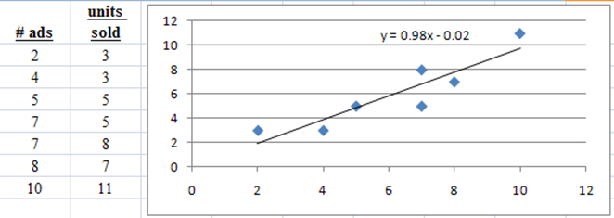
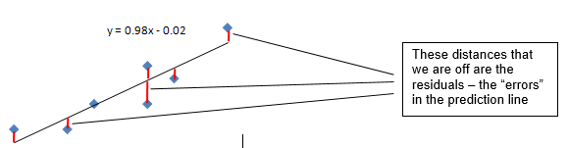

Linear Regression Explained
In Linear Regression models, a continuous target is predicted by continuous or categorical predictors.
Regression Equation: y = b0 + b1 x1 + b2 x2 + … + bn xn
b0 = Coefficient for Intercept
b1 = Coefficient for x1
b2 = Coefficient for x2
Ordinary Least Squares (OLS) is the algorithm used to fit the line minimizing error
Notes:
Stats textbook definition: Least Squares Principle: A mathematical procedure that uses that data to position a line with the objective of minimizing the sum of the squares of the vertical distances between the actual values and the predicted values of y.

Slide 24

Linear Regression Explained
ASSESSING FIT: Coefficient of Determination, R²
This measure finds our relative fit. It ranges from 0 to 1. The higher the R², the better the fit. It is interpreted as the % of variation explained. So if we have a fit of 74% in a model predicting sales, that means that we can explain 74% of the variation (how it changes) in sales with our model.
SS Model captures variation we CAN explain
SS Residual/Error captures variation we CAN NOT explain
SS Total captures all variation in target variable (sales)
Notes:
Stats book definition: Coefficient of multiple determination: The percent of variation in the dependent variable, y, explained by the set of independent variables, x1, x2, … xn.

Slide 25
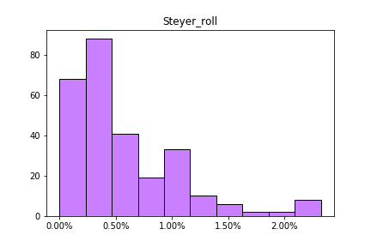
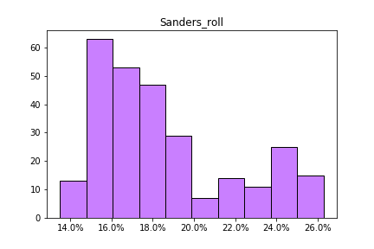
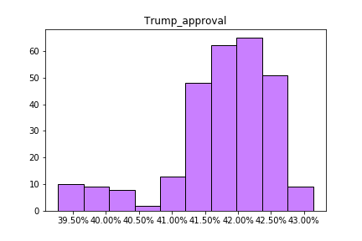
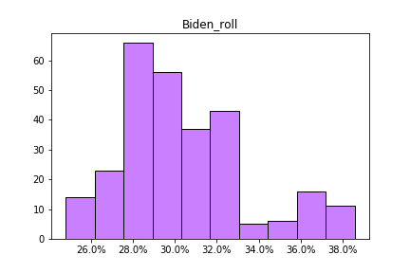
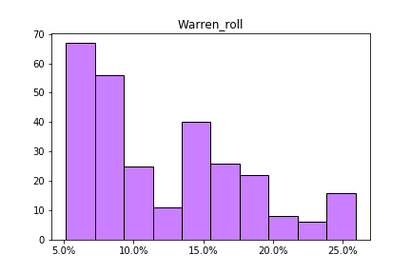
Variable Distributions

Slide 26
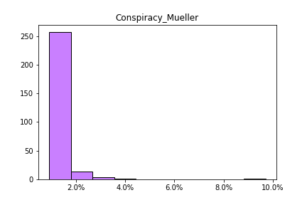
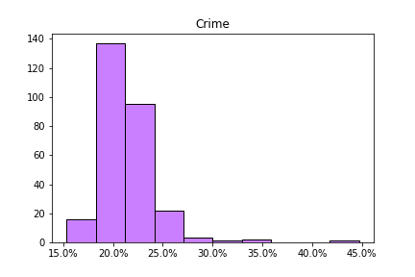
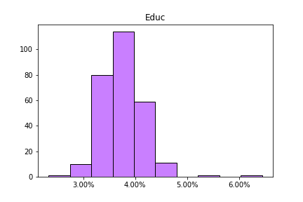
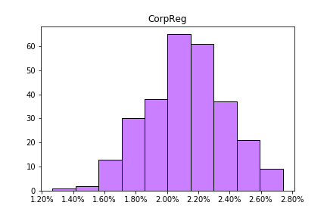
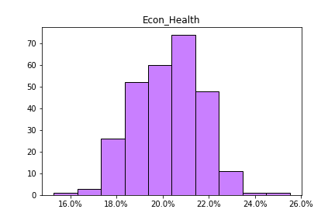
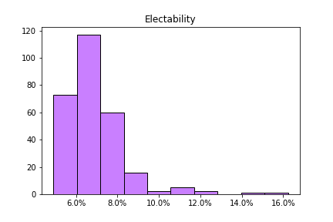
Variable Distributions

Slide 27
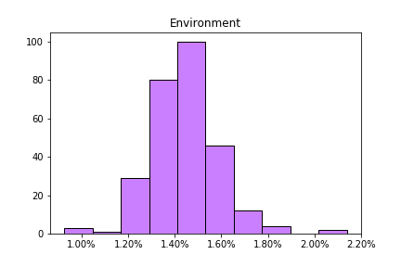
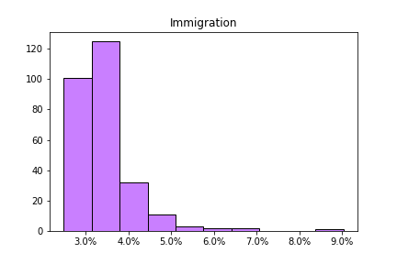
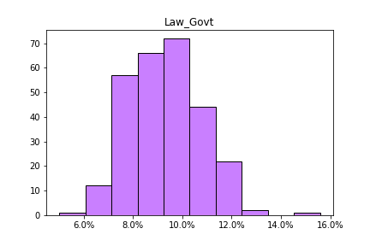
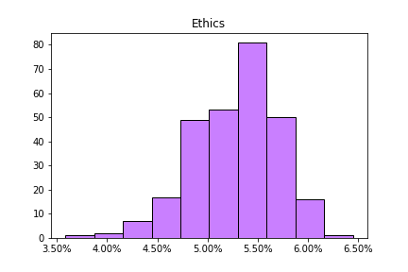
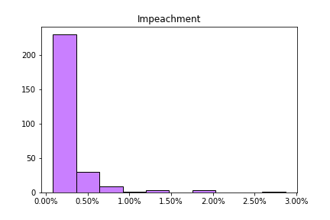
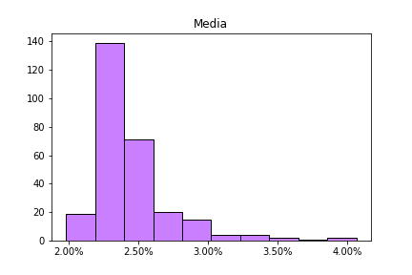
Variable Distributions

Slide 28
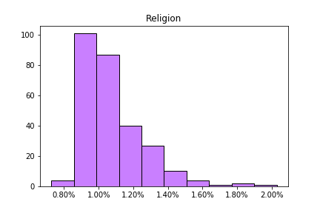
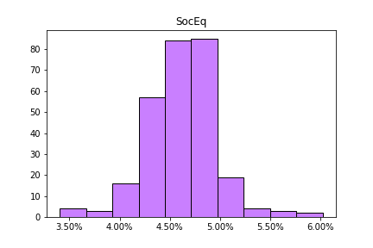
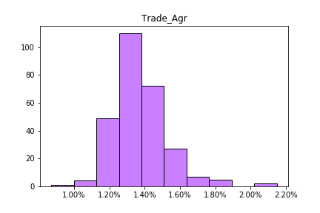
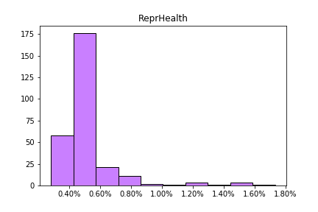
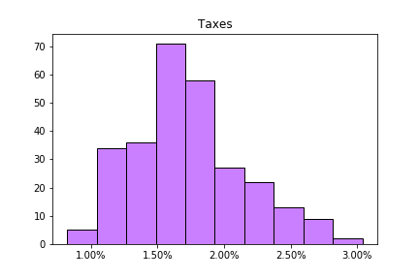
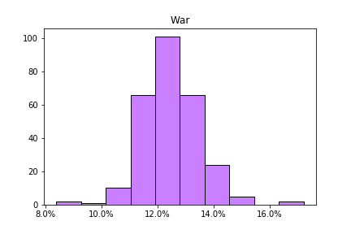
Variable Distributions

Slide 29
Variable Definitions
Education - Education/schools on all levels (Pre-K, Primary, Secondary, Higher education, charter schools, public schools, private schools). Issues include the cost of education and student loans, children are educated or should be educated
Electability – related to the chances of being elected. Issues include polls, crowds, size of campaign rally’s, chances/ability to win in specific states, republican/democratic convention information. Queries searching for a candidate’s ability to win in a specific district, state, or nationwide and solicitation for small donor funding
Election Security – the legitimacy of United States Elections. Is the process of United States elections, who votes when, how, and where, widely accepted as fair? Issues include voting rights, voter suppression, voter ID laws, vote rigging, election manipulation, voter fraud, accessibility of voting, voting age, and gerrymandering should be included, security of elections from foreign influence
Environmental – the protection of oceans, air, water, and all natural habitats as well as climate change. Issues renewable energy as well as other more traditional forms of energy such as oil, gas and coal, references to natural disasters

Slide 30
Variable Definitions
Ethics/Morals – moral or ethical questions in politics, corruption, government oversight, calls for governmental or criminal investigation, partisanship, divisiveness, patriotism, ideology, compassion, lying, or hatred.
General terms that cannot be interpreted politically are excluded (ex. “horror” or “inspiring”)
Guns – mass shootings, 2nd Amendment, protection of gun rights, gun safety, guns for hunting, and hunter safety.
Terms related to police officers are excluded and categorized as Public Safety.
Generic Policy Queries – information on political policies that are too general to categorize in a specific issue area, such as “public policy”, “platform”, “policy ideas”, “new policy idea”
Healthcare – Improvement of health through medical prevention, diagnosis, treatment. Issues include health professions, mental, physical, occupational, pharmaceutical, dental, cost of healthcare, health insurance companies, Obamacare, ACA, universal healthcare, and private and public and insurance.
Terms related to pharmaceutical companies and regulation are also categorized as Corporate Regulation.
Terms related to reproductive health are excluded and categorized as Reproductive Health

Slide 31
Variable Definitions
Immigration – Concerns the international movement of people to the U.S. and elsewhere. Issues include refugees, treatment of immigrants, paths to citizenship, immigration with the Americas, border protection and drug cartels.
Terms related to the opioid crisis are also categorized as Healthcare
Impeachment – Political process and proceedings of leveling charges against President Donald Trump. Includes any allegations of wrongdoings involved in the impeachment proceedings. This includes investigations into foreign relations between Ukraine and the Trump Administration as well as the facts and conspiracies about between Ukraine and Joe Biden and or his son Hunter Biden.
International Relations – foreign policy, treaties, country alliances, diplomatic meetings between heads of state. Includes regions of the world where the US tends to have more diplomatic relationships (as opposed to adversarial: see National Security) –Europe, Cuba, Venezuela, Israel
Judiciary Branch – courts systems, Supreme Court and all other levels, justices, cases, nominations, and court appointments.
Terms related to specific Supreme Court cases are also categorized in their specific issue area

Slide 32
Variable Definitions
Media – allegations of media bias, fact checking, media consumption, news organizations, reporters, anchors
Mueller/Russia – investigation, findings and conclusions of Special Counsel Robert Mueller's investigation into Russian efforts to interfere in the 2016 election, allegations of conspiracy or coordination between Donald Trump's campaign and Russia, allegations of obstruction of justice. Terms related to U.S. foreign relations with Russia and Putin
National Security – foreign threats to the US, military branches, weapons of war, foreign terrorism, military campaigns. Includes terms related to adversarial nations, including North Korea and the Middle East.
Public Safety – domestic safety of the public, Coast Guard, Police, Firefighters, EMTs, frequency of crime, domestic terrorism, explosions, and bombings.
Terms related to mass shootings are categorized as Guns
Terms related to police brutality towards minority groups are also categorized as Social Equality

Slide 33
Variable Definitions
Religion – all religions, practices, holidays, scriptures of these religions as well as terms inquiring about a specific person’s religion or religious beliefs, or religious freedom in general
This category will see overlap with the “Immigration” category especially regarding Muslim Americans and Syrians
This category will see overlap with the “Social Equality” with regards to Islamophobia, Anti-Semitism, or any form of anti-religious discrimination
Reproductive Health – reproductive health of both men and women, fertility, pregnancy, abortion, birth control, family planning, infant mortality, and infant health.
Social Equality – social equality (or lack thereof) among different social groups in the US. Terms related to equality/discrimination by race, sex, gender, sexual orientation, disability, language, religion, and age. Equality in civil rights, legal protections, freedom of speech, property rights, access to social goods and social services, equal treatment of majority groups
Terms related to economic equality or class equality are categorized as Economy
Space – space security and exploration, funding of space programs, space races, satellites, space missiles, space missile defense systems, space military forces, state exploration, space telescopes, NASA

Slide 34
Variable Definitions
Trade – international exchange of goods, international trade agreements such as NAFTA and TPP, outsourcing of jobs, isolationism. This category also includes all terms related to China
Taxes/Spending – government taxation, government spending, welfare, debt ceiling, government shutdowns, IRS, payroll taxes, tax refunds, and Social Security
Veterans – individuals who previously served in the US military, military medals, military honors, support for troops
Voter Turnout – voter engagement in the voting system, absentee ballot, voter registration, early voting, voting locations, boards of elections, voting machines
Exclude terms related to polls, presidential debates, candidate rallies – these are Electability

Slide 35
Patents Referencing ‘Google Trends’
76 U.S. patents that cite Google Trends (USPTO, 2017)
Applications: Information and Computer Science, Medicine and Bio Science, Economy and Business
Unum Provisional Patent ID: 1911.100.00US
Notes:
As mentioned in some of the examples, other fields are adopting Google search technology. Patent applications referencing Google Trends follow the traditional hype-cycle of adoption and have stabilized. There are none yet in politics… I know this because Unum’s is the only one.

Slide 36
Academic Literature Review
657 documents that reference Google Trends
Source: Scopus is Elsevier’s abstract and citation database launched in 2004. Scopus covers nearly 36,377 titles from approximately 11,678 publishers.
Notes:
The academic community is adopting much faster. 2011 is when big data began to receive a lot of media coverage and you can see a step there of people using Google Trends as data for academic articles.
There are other people studying the applications in politics. All of these papers in the political field are enormously helpful with our research.

Slide 37

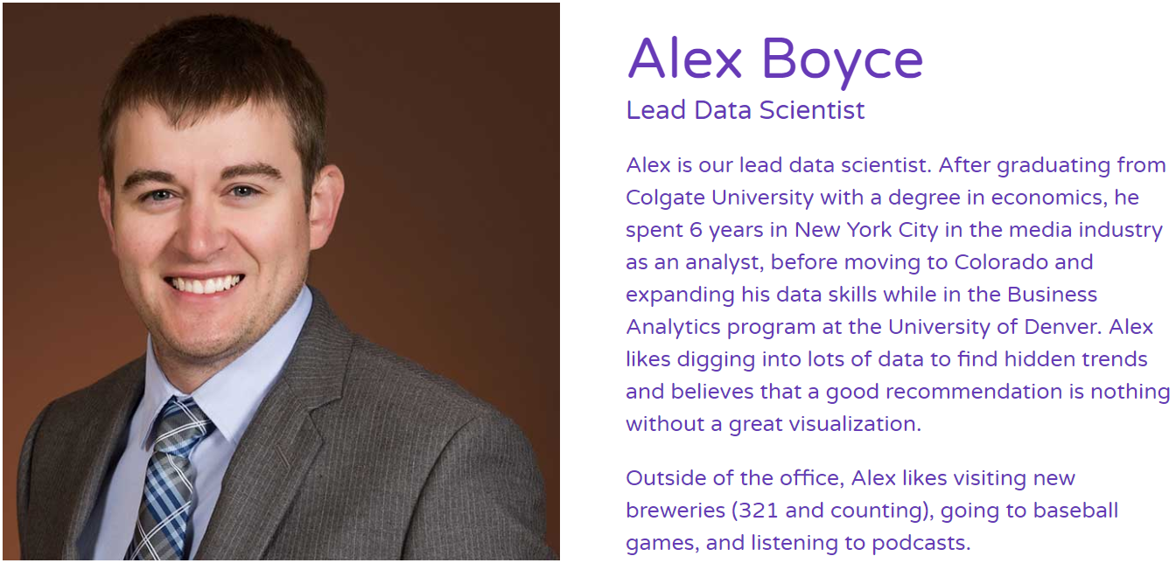
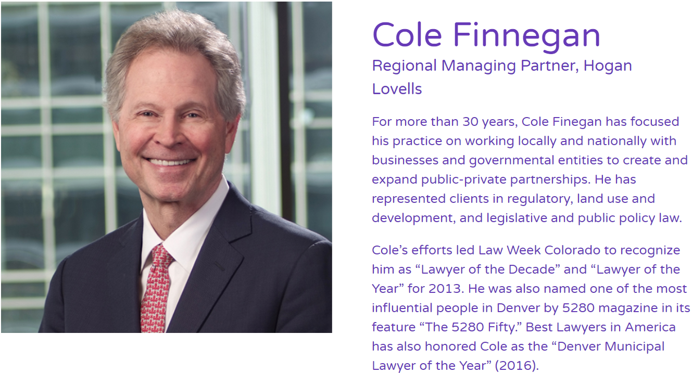

Team Members: Management and Board
Lauren Beaver
Lauren graduated from the University of Denver where she studied Finance and Business Analytics. She has experience working in the financial services industry as a big data and cloud developer. Lauren believes that data and analytics can provide value to any industry, and loves when a model returns a clean and elegant solution. She enjoys spending time on the beach with her family in Los Angeles.

Slide 38
Website
www.unumai.org

Slide 39
Google Search Versus Survey Results by Race Level

Slide 40
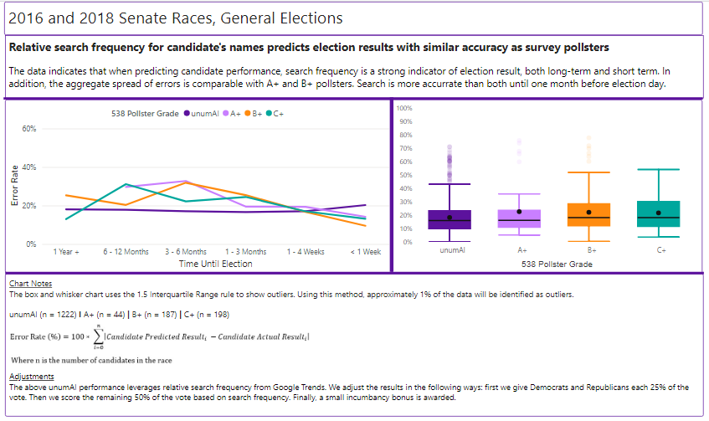
Google Search versus Survey: Senate General Elections
Notes:
Just for Presidential General Races, we see that Search outperforms survey once the contestants are set. Unum outperforms all rankings of pollsters across 336 polls.

Slide 41
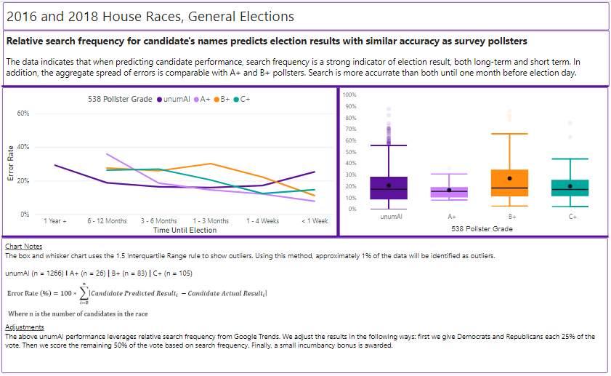
Google Search versus Survey: House General Elections
Notes:
Just for Presidential General Races, we see that Search outperforms survey once the contestants are set. Unum outperforms all rankings of pollsters across 336 polls.

Slide 42
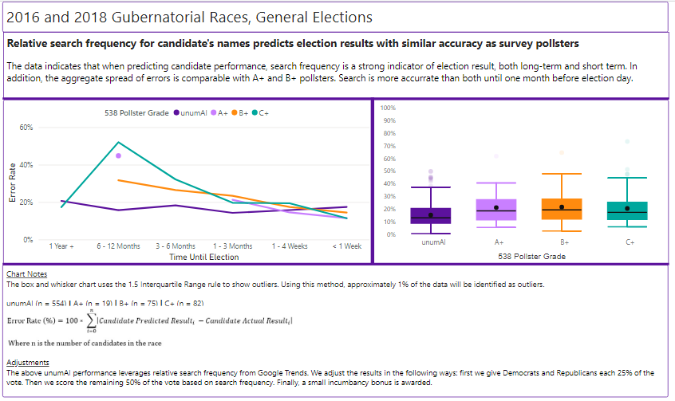
Google Search versus Survey: Gubernational General Elections
Notes:
Just for Presidential General Races, we see that Search outperforms survey once the contestants are set. Unum outperforms all rankings of pollsters across 336 polls.

Slide 43
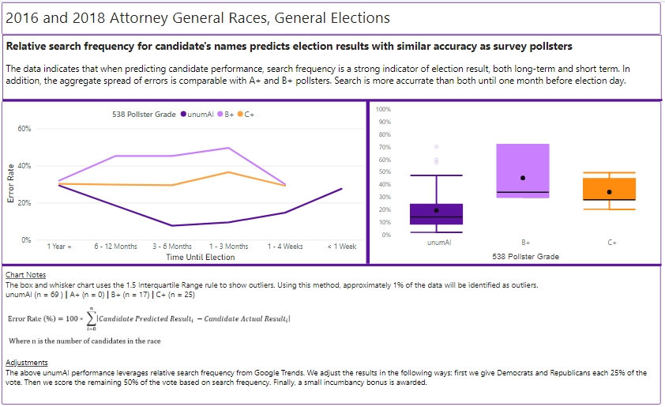
Google Search versus Survey: Attorney General General Elections
Notes:
Just for Presidential General Races, we see that Search outperforms survey once the contestants are set. Unum outperforms all rankings of pollsters across 336 polls.

Slide 44
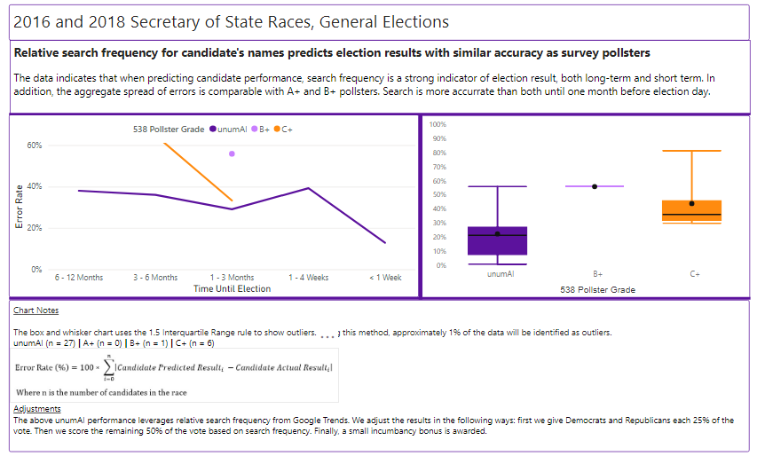
Google Search versus Survey: Secretary of State General Elections
Notes:
Just for Presidential General Races, we see that Search outperforms survey once the contestants are set. Unum outperforms all rankings of pollsters across 336 polls.

Slide 45
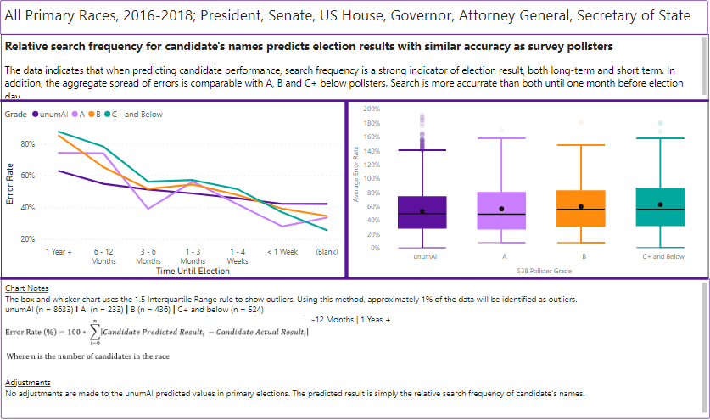
Primaries Aggregated
Notes:
I assert that Search indicates support, and confirmatory voting intent and issue support. Yes, there are cases that celebrities, and common names, and Trump skew this assertion. Those are exceptions to the rule evidenced by the data. Looking at an encyclopedic history of every Federal election and every statewide election in the United States in the last two-cycles, including every public poll, and elections without polls, we see increased accuracy from this method, usually by significant margins.

Slide 46
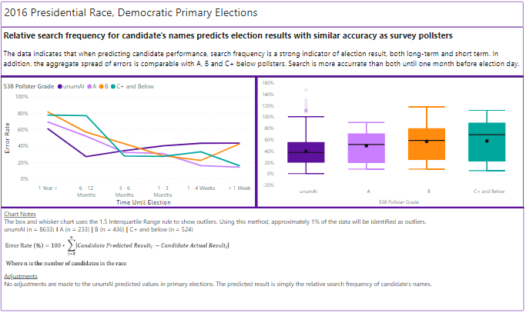
Google Search versus Survey: Presidential Democratic Primaries
Notes:
Just for Presidential General Races, we see that Search outperforms survey once the contestants are set. Unum outperforms all rankings of pollsters across 336 polls.

Slide 47
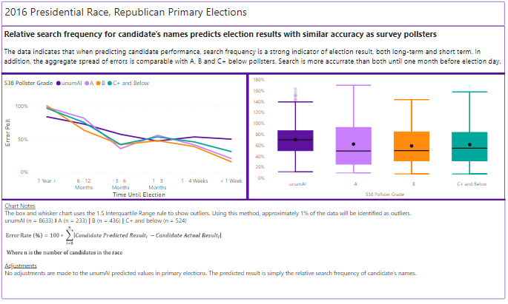
Google Search versus Survey: Presidential Republican Primaries
Notes:
Just for Presidential General Races, we see that Search outperforms survey once the contestants are set. Unum outperforms all rankings of pollsters across 336 polls.

Slide 48
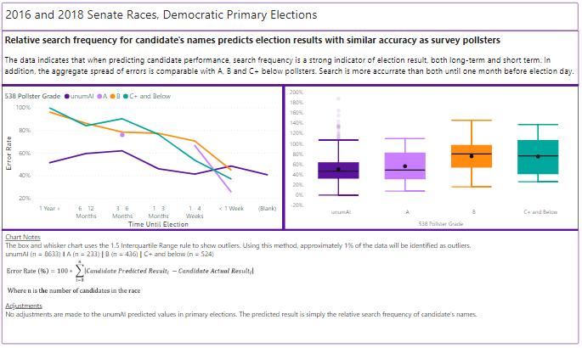
Google Search versus Survey: Senate Democratic Primaries
Notes:
Just for Presidential General Races, we see that Search outperforms survey once the contestants are set. Unum outperforms all rankings of pollsters across 336 polls.

Slide 49
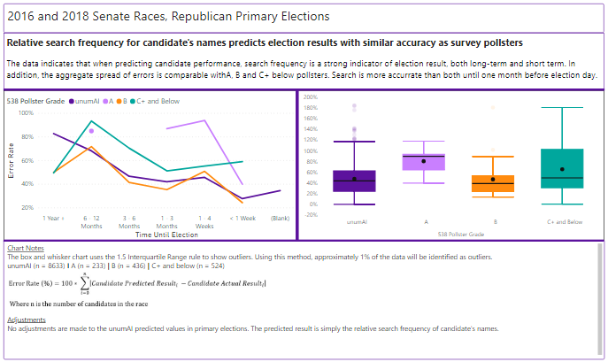
Google Search versus Survey: Senate Republican Primaries
Notes:
Just for Presidential General Races, we see that Search outperforms survey once the contestants are set. Unum outperforms all rankings of pollsters across 336 polls.

Slide 50
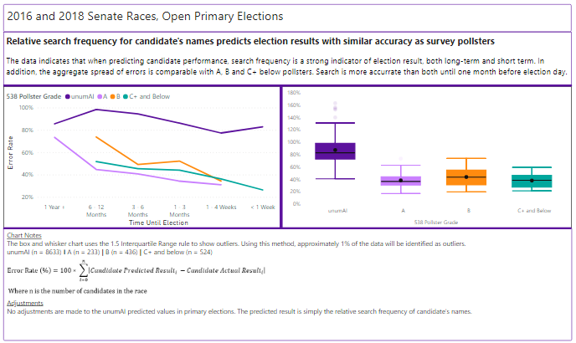
Google Search versus Survey: Senate Open Primaries
Notes:
Just for Presidential General Races, we see that Search outperforms survey once the contestants are set. Unum outperforms all rankings of pollsters across 336 polls.

Slide 51
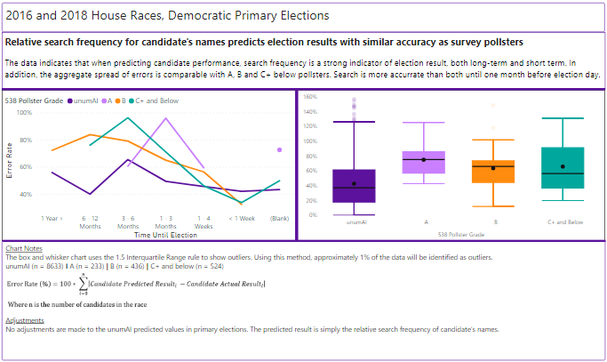
Google Search versus Survey: House Democratic Primaries
Notes:
Just for Presidential General Races, we see that Search outperforms survey once the contestants are set. Unum outperforms all rankings of pollsters across 336 polls.

Slide 52
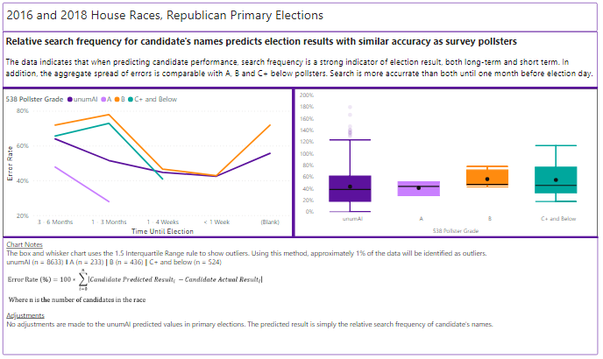
Google Search versus Survey: House Republican Primaries
Notes:
Just for Presidential General Races, we see that Search outperforms survey once the contestants are set. Unum outperforms all rankings of pollsters across 336 polls.

Slide 53
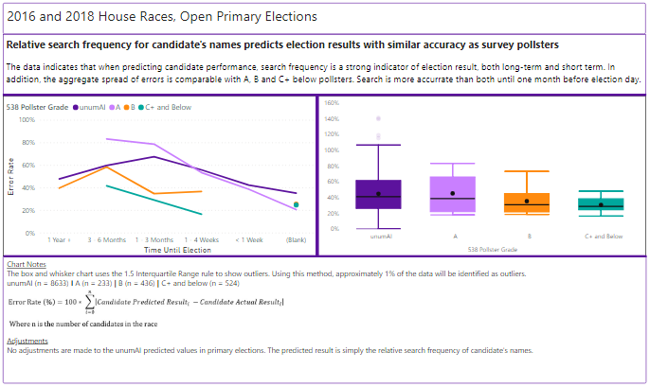
Google Search versus Survey: House Open Primaries
Notes:
Just for Presidential General Races, we see that Search outperforms survey once the contestants are set. Unum outperforms all rankings of pollsters across 336 polls.

Slide 54
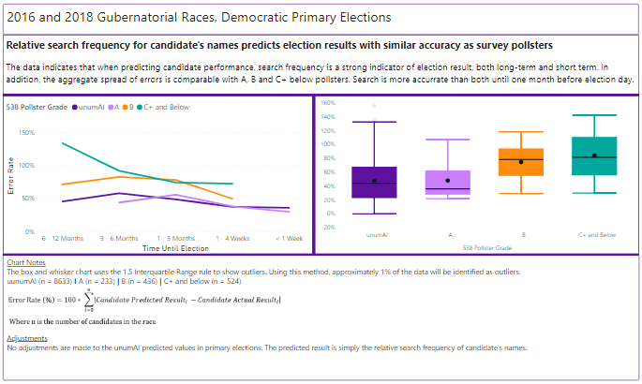
Google Search versus Survey: Gubernatorial Democratic Primaries
Notes:
Just for Presidential General Races, we see that Search outperforms survey once the contestants are set. Unum outperforms all rankings of pollsters across 336 polls.

Slide 55
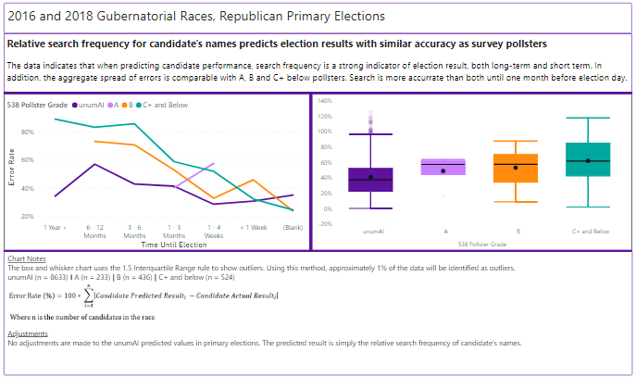
Google Search versus Survey: Gubernatorial Republican Primaries
Notes:
Just for Presidential General Races, we see that Search outperforms survey once the contestants are set. Unum outperforms all rankings of pollsters across 336 polls.

Slide 56
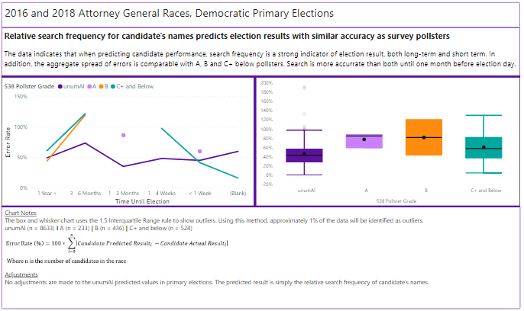
Google Search versus Survey: Attorney General Democratic Primaries
Notes:
Just for Presidential General Races, we see that Search outperforms survey once the contestants are set. Unum outperforms all rankings of pollsters across 336 polls.

Slide 57

Google Search versus Survey: Attorney General Republican Primaries
Notes:
Just for Presidential General Races, we see that Search outperforms survey once the contestants are set. Unum outperforms all rankings of pollsters across 336 polls.

Slide 58

Google Search versus Survey: Secretary of State Democratic Primaries
Notes:
Just for Presidential General Races, we see that Search outperforms survey once the contestants are set. Unum outperforms all rankings of pollsters across 336 polls.

Slide 59

Google Search versus Survey: Secretary of State Republican Primaries
Notes:
Just for Presidential General Races, we see that Search outperforms survey once the contestants are set. Unum outperforms all rankings of pollsters across 336 polls.

