Slide 1
JAMPABUS
RACING GAME
Computer Graphics Final Project
[1107190]
2015.1
Diogo Dantas
1103718
Computer Science Course
Federal University of Paraiba
Prof. PhD. Christian A. Pagot
Higor Anjos
1103767

Slide 2
3

Slide 3
Introduction

Slide 4
Development

Slide 5
Discussion

Slide 6
1

Slide 7
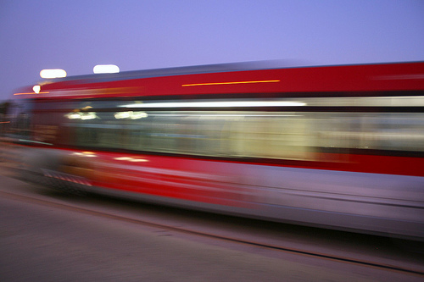
flickr.com

Slide 8
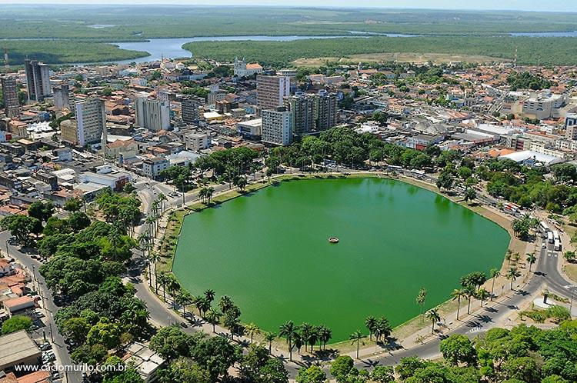

Slide 9
JAMPABUS
RACING GAME

Slide 10
SUN ILUMINATION

Slide 11
SUN ILUMINATION
STATIC TRACK

Slide 12
SUN ILUMINATION
STATIC TRACK
MOVING SKY

Slide 13
SUN ILUMINATION
STATIC TRACK
MOVING SKY
CAMERA FOLLOWS CAR

Slide 14
SUN ILUMINATION
STATIC TRACK
MOVING SKY
CAMERA FOLLOWS CAR
TEXT INFORMATION

Slide 15
SUN ILUMINATION
STATIC TRACK
MOVING SKY
CAMERA FOLLOWS CAR
TEXT INFORMATION
SIMPLE PHYSICS

Slide 16
SUN ILUMINATION
STATIC TRACK
MOVING SKY
CAMERA FOLLOWS CAR
TEXT INFORMATION
SIMPLE PHYSICS
CUSTOM TEXTURE

Slide 17
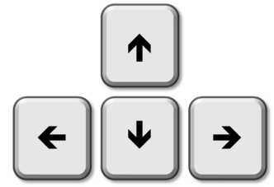
INTERACTION

Slide 18
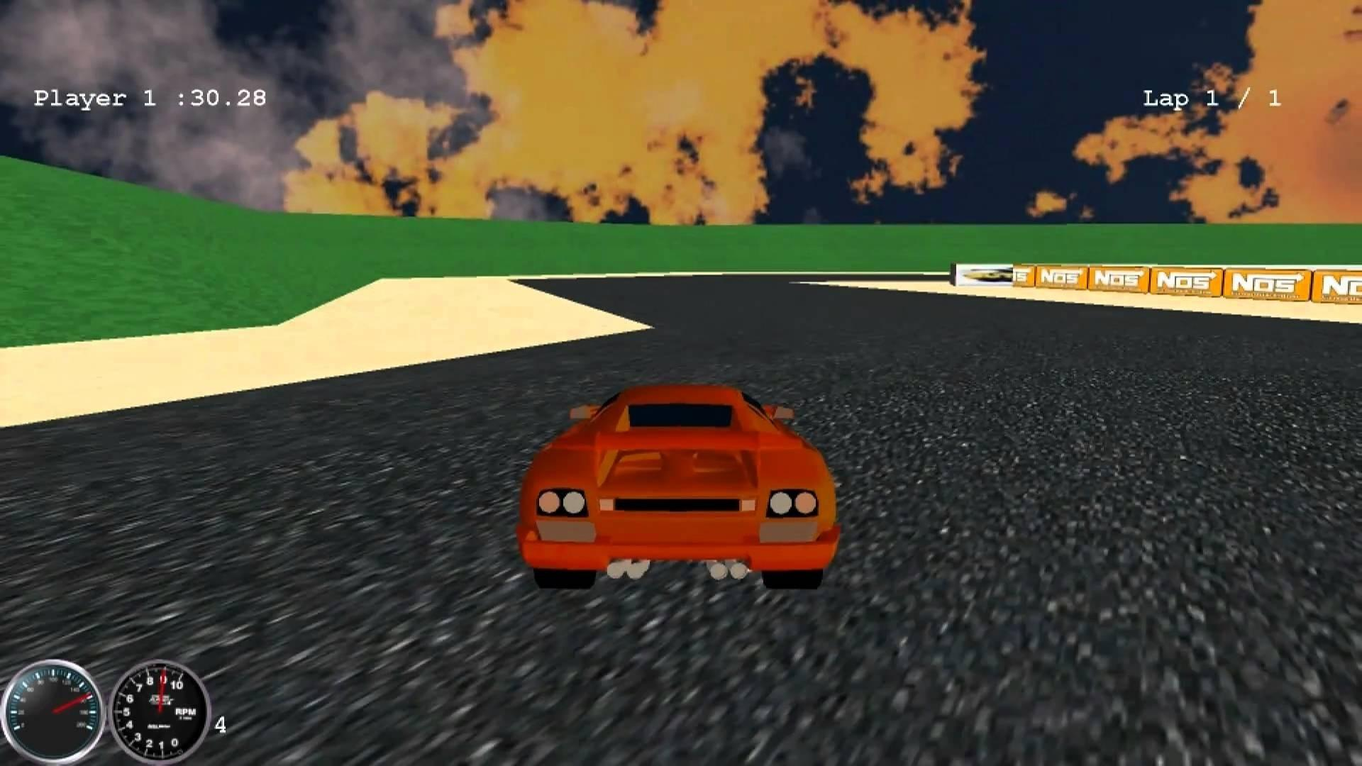
EXPECTATION
Youtube Channel - norc16

Slide 19
REALITY
?

Slide 20
2

Slide 21



Slide 22
Simple OpenGL Image Library
(SOIL)

Slide 23
Open Asset Import Library
(ASSIMP)

Slide 24
HOW
everything
HAPPENED?

Slide 25
FIRST
FIRST
things

Slide 26
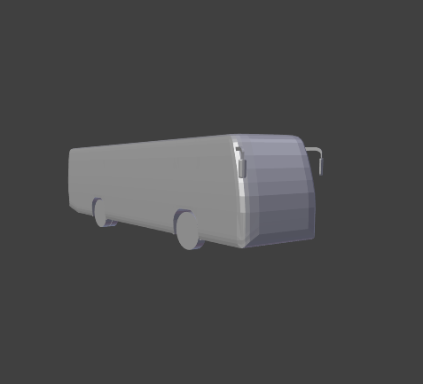
the bus
tf3dm.com

Slide 27

the track
tf3dm.com

Slide 28
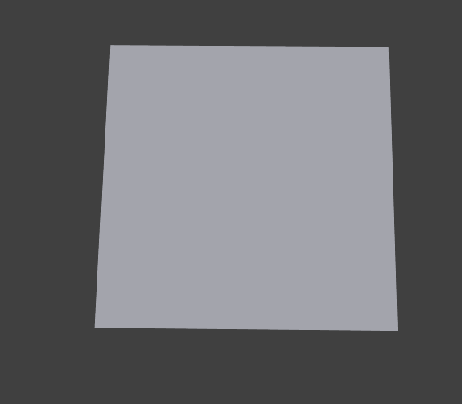
the ground

Slide 29
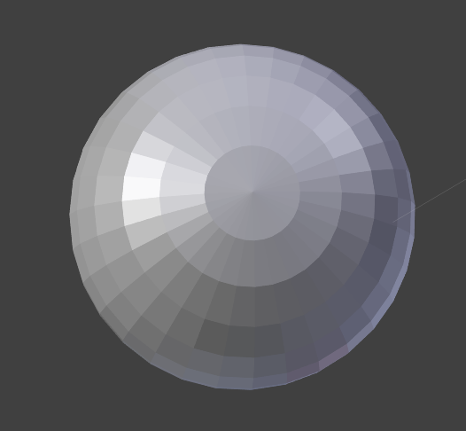
the “sky”

Slide 30
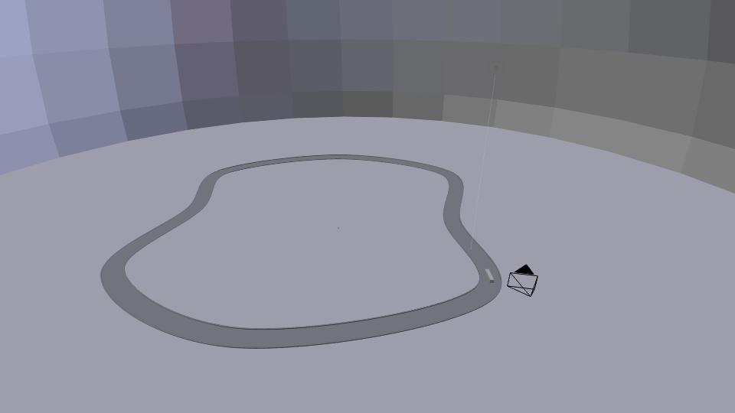
all together

Slide 31
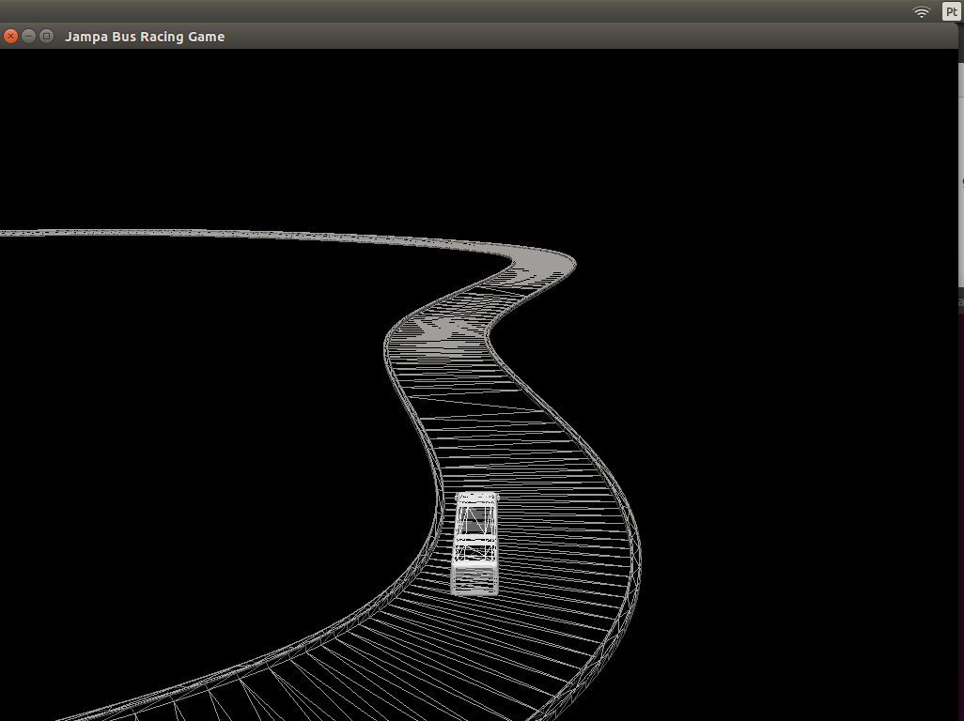
rasterization

Slide 32
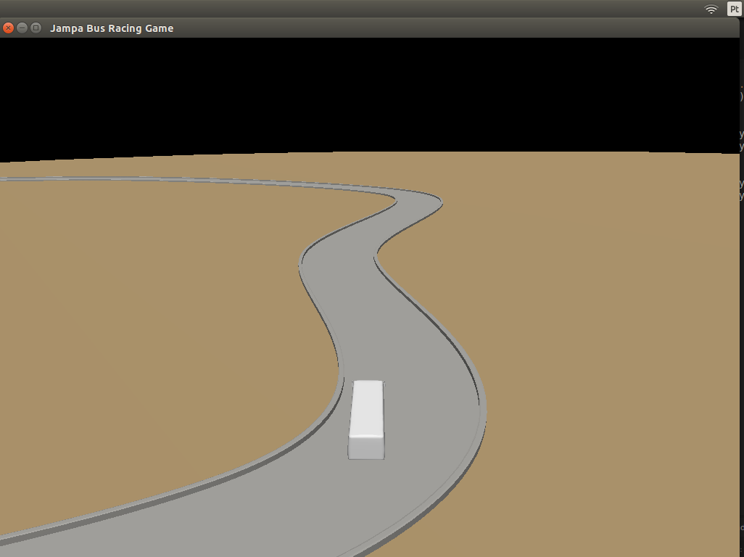
rasterization

Slide 33
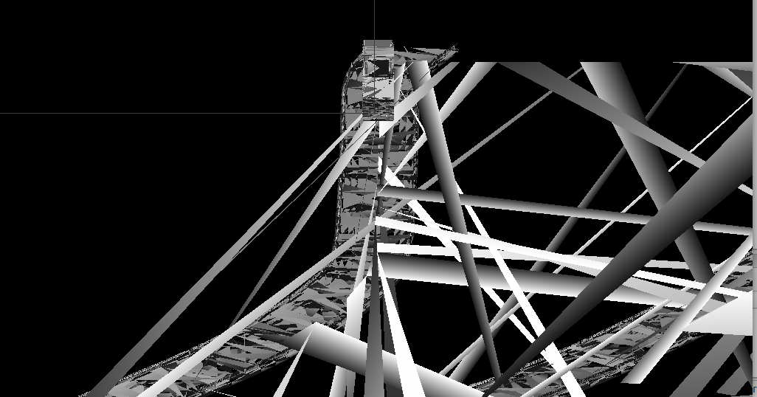
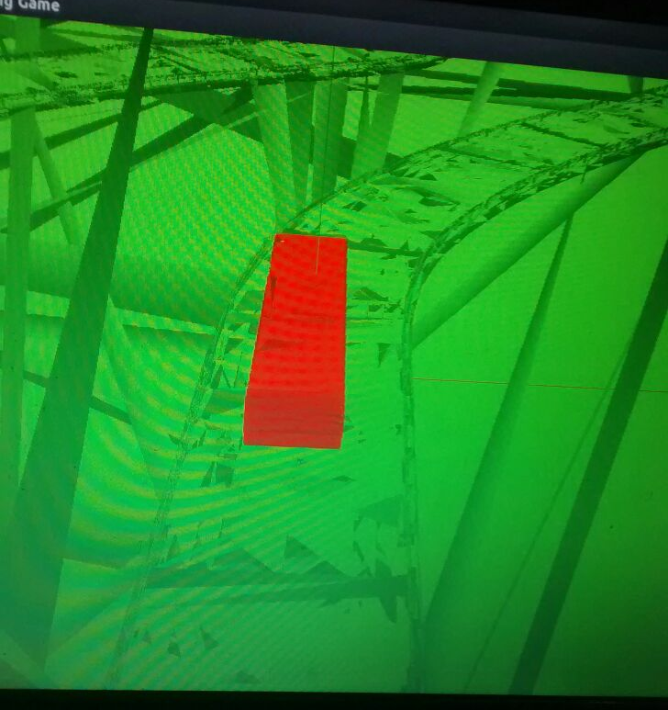
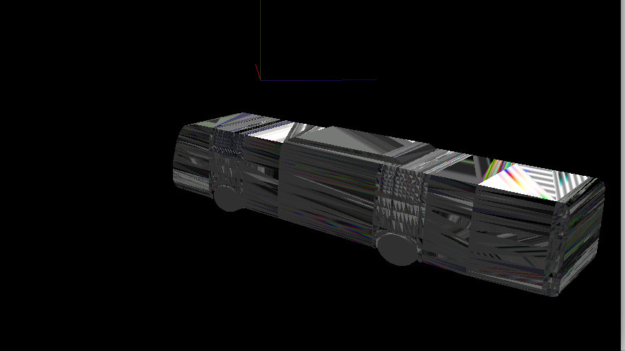
Some weird results

Slide 34
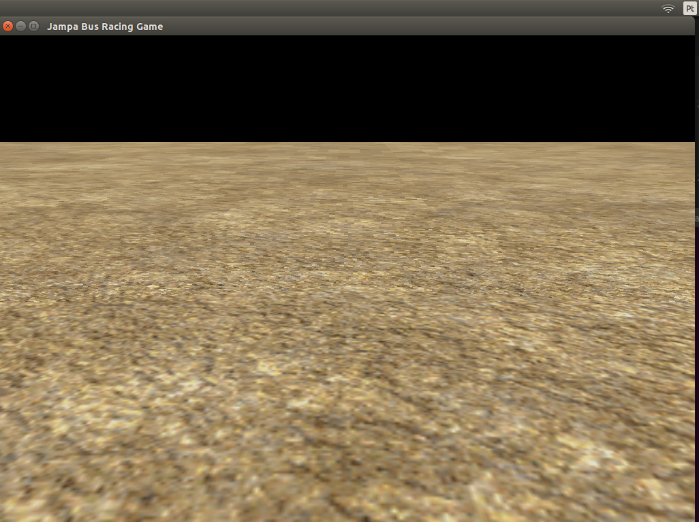
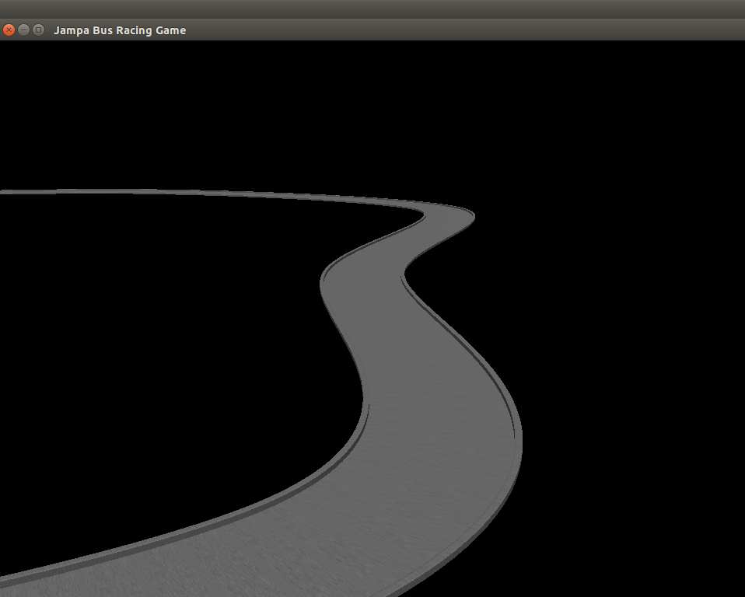
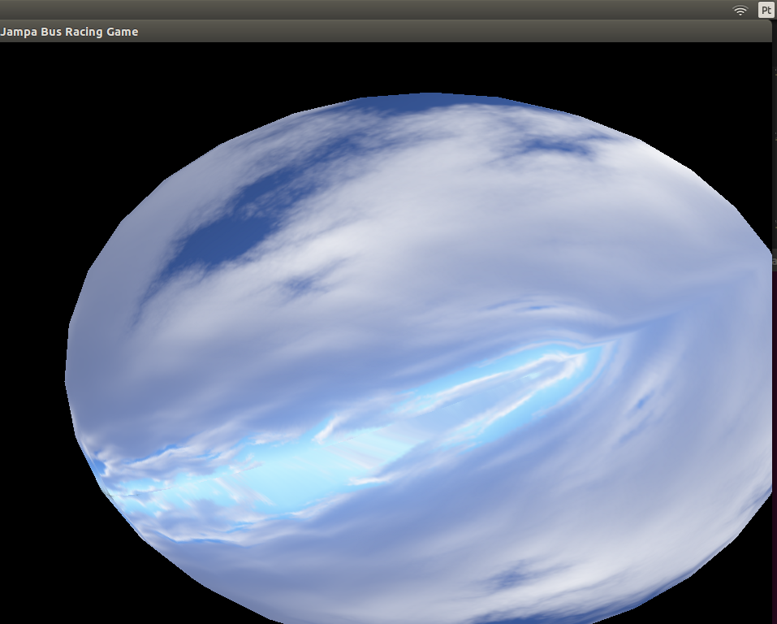
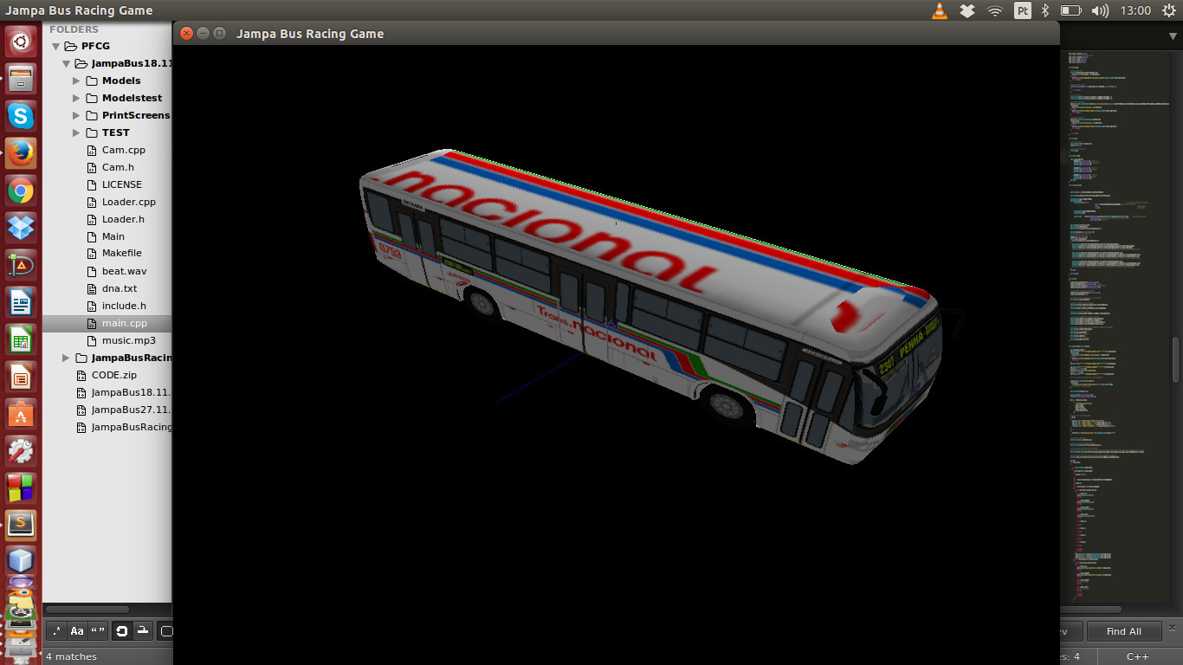
Textures applied

Slide 35
CAMERA

Slide 36
y
C
B
z

Slide 37
y
C
lookat
B
z

Slide 38
LIGHT

Slide 39
Only 1 light source

Slide 40
Only 1 light source
Non-directional

Slide 41
Only 1 light source
Non-directional
Ambient: 0.2

Slide 42
Only 1 light source
Non-directional
Ambient: 0.2
Diffuse: 0.7

Slide 43
Only 1 light source
Non-directional
Ambient: 0.2
Diffuse: 0.7
Specular: 1.0

Slide 44
PHYSICS

Slide 46
acceleration;
position;
velocity;
direction.

Slide 47
direction
acceleration;
position;
velocity;
direction.
P(0,0,0)

Slide 48
pos' = pos + vel*0.1 + acc*0.005
vel' = vel + acc*0.1
acc = dir *0.01
acc = dir *-0.01
direction
P(0,0,0)

Slide 49
pos' = pos + vel*0.1 + acc*0.005
vel' = vel + acc*0.1
acc = dir *0.01
acc = dir *-0.01
direction
pos' = 0 + (−0,001)*0.1 + (-0.01)*0.005
pos' = -0,051
P(0,0,0)

Slide 50
STEERING

Slide 51
STEERING
direction
acceleration;
position;
velocity;
direction.
P(0,0,0)

Slide 52
STEERING
dir' = rotateAlongY(dir, angle)
direction
P(0,0,0)

Slide 53
STEERING
dir' = rotateAlongY(dir, angle)
direction
P(0,0,0)

Slide 54
PROGRAM
flux

Slide 55
INITEVERYTHING
LOADOBJECTS
GENTEXTURES
ENABLELIGHT
!RUNNING
MENU
LOOP

Slide 56
!RUNNING
MENU
LOOP
LOADBMP
BLITBMP
RETURNPRESSED
RUNNINGTRUE

Slide 57
!RUNNING
MENU
LOOP
RUNNING
GAME
LOOP

Slide 58
RUNNING
GAME
LOOP
DISPLAYEVERYTHING
HANDLEKEYS
SWAPWINDOW
EXITCLICKED
RUNNINGFALSE

Slide 59
DISPLAYEVERYTHING
CLEARSCREEN
MODELVIEW
PROJECTION
PERSPECTIVE
LOOKAT
DRAWGROUND
DRAWTRACK
DRAWSPHERE
DRAWBUS

Slide 60
RUNNING
GAME
LOOP
!RUNNING
CLOSE
PROGRAM

Slide 61
RUN?
LET'S

Slide 62
3

Slide 63
DISCUSSION

Slide 64
POSSIBLE
ENHANCEMENTS

Slide 65
Text Rasterization
More realistic physics
Change between cars
Different Cameras
Different Tracks

Slide 66
EXTRA
FEATURES

Slide 67
AI
Collision detection
Music
Multiplayer
Joystick

Slide 68
?
QUESTIONS

