Slide 1
CSE 271
Project Two
By Alyssa Melendez

Slide 2
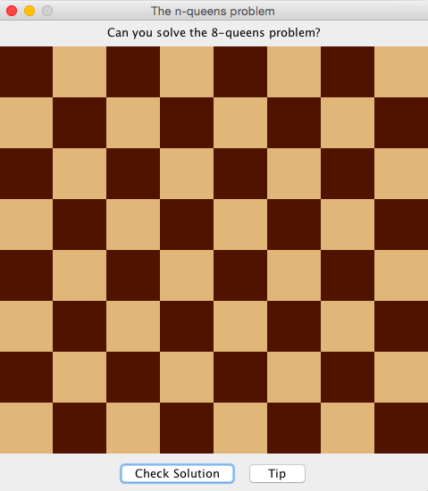
About my solution
Three classes:
nQueensProblem.java
EightQueensFrame.java
BoardSpace.java

Slide 3
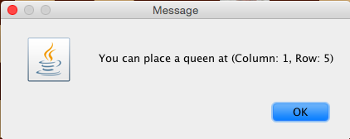
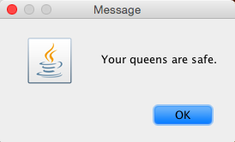

Slide 4
Challenges
Thinking out the structure of the classes and methods
BoardSpace class used to be for all board squares
Initialized my ArrayList in the loop

Slide 5
What I learned
How to better use the graphics class and its methods
The importance of starting early
Something that’s easy for another person won’t necessarily come easy to me

Slide 6
An interesting feature

Slide 7
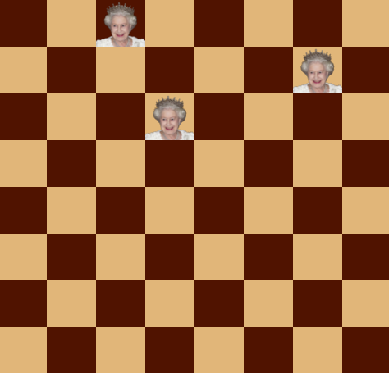

Slide 8
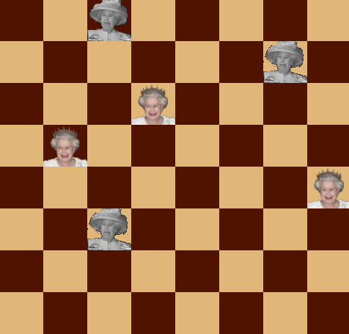

Slide 9
