Slide 1

Deep Learning:
Class Activation Maps Theory
A technique for making Convolutional Neural Network (CNN)-based models more transparent by visualizing the regions of input that are “important” for predictions from these models — or visual explanations

Slide 2
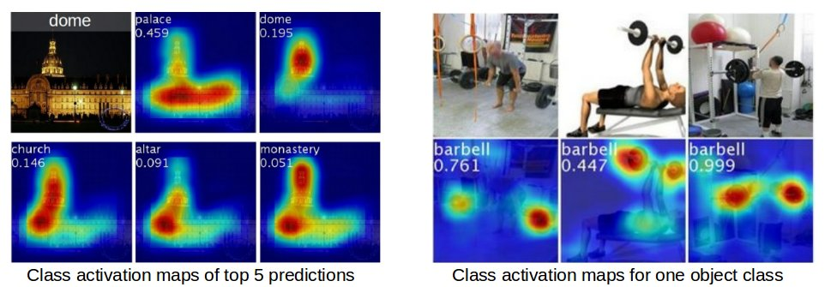
Class Activation Maps

Slide 3
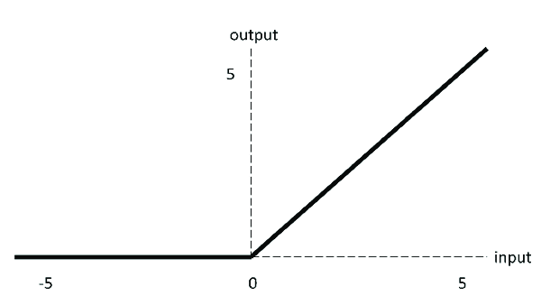
Class Activation Maps
Only need to do classification!
Take any pre-trained CNN, e.g. ResNet.
Image shrinks, but # features increase .
RELU: all features are positive or zero.

Slide 4
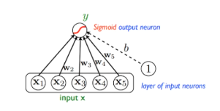
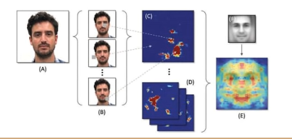
Class Activation Maps
Intuitively, you can think of a feature going into the Logistic Regression as a number denoting whether or not some “thing” appears in the image.
  E.g. One feature for nose, one for eyes, one for lips, hair, ears, etc.
  Positive number if “thing” was found, 0 otherwise.
  E.g. The feature for “wheel” would be 0.

Slide 5
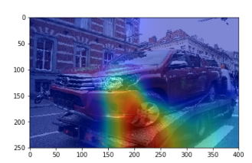
Features
If the picture is of a car, then the feature for “wheel” would be > 0, if a wheel was found.
Now, the nose feature would be 0.

Slide 6
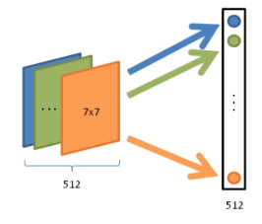
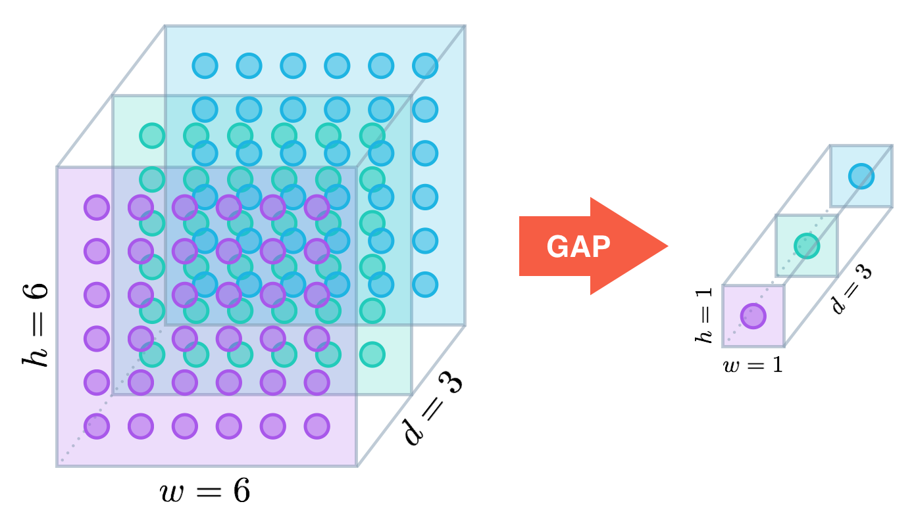
What led to the positive feature?
If a feature is positive, that means the pooling operation must have found some positive numbers in the final image (after going through several layers of convolutions).
i.e. That feature must have been found “somewhere”.
If we simply looked at the image before pooling, then we would know where!

Slide 7
Logistic Regression
If a weight is > 0, then the corresponding feature is positively correlated with this class.
If it is 0, it has no effect.
If it is < 0, the feature makes the image less likely to belong to this class.

Slide 8
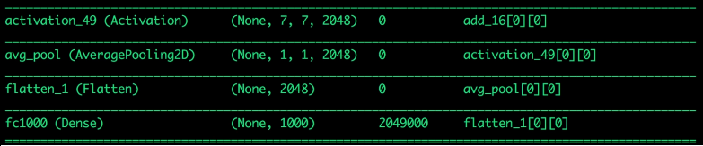
Class Activation Map
Combine these intuitions
Las few layers of ResNet:
  2048 7x7 images before final pooling
  2048 x 1000 dense weights (2048 weights for 1000 classes)

Slide 9
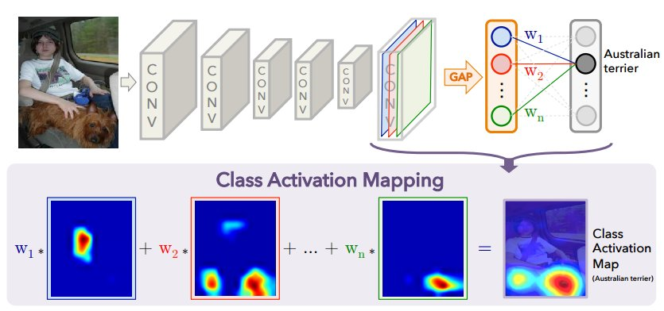
Class Activation Map
We only consider 1 class at a time (usually the predict class).
E.g. w = W[:, human_face_index] # size 2048.
F = 2048 7x7 images.
Class Activation Map = F[0]*w[0] + F[1]w[1] + ... F[2047]w[2047].
Result is a 7x7 heat map.

Slide 10
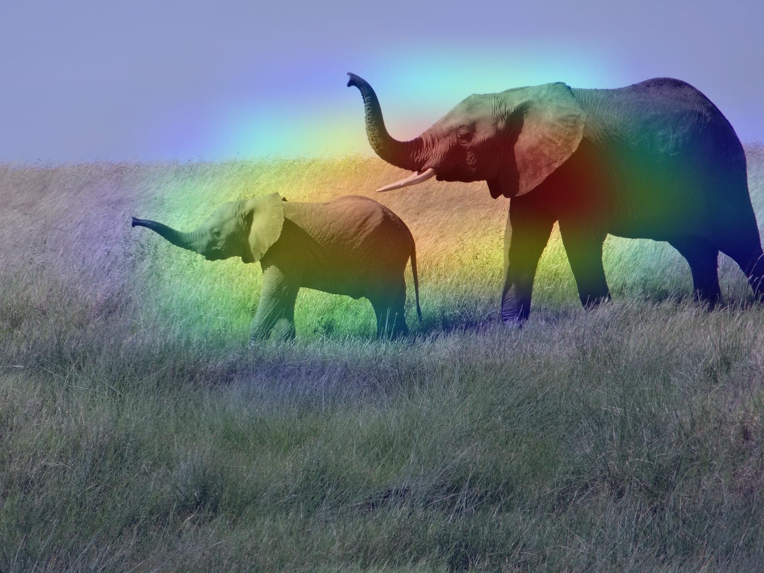
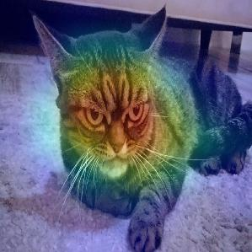
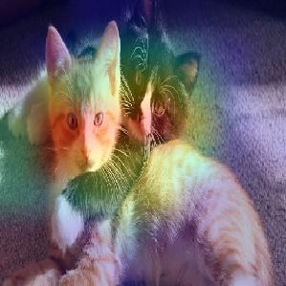
Final Step
Rescale the 7x7 image to the original image’s size (224 x 244 for ResNet), and plot the 2 images over each other.

Slide 11
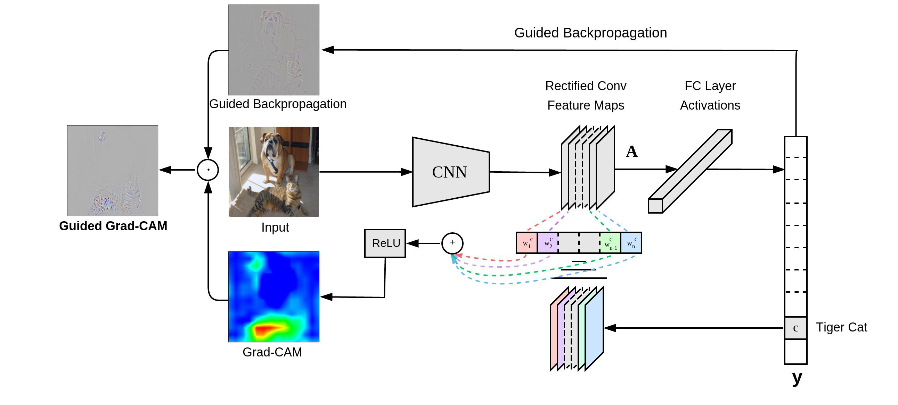
Conclusion

Slide 12
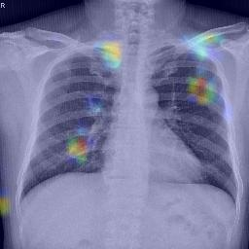
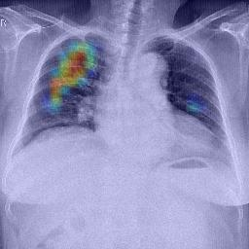
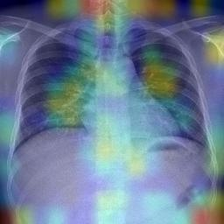
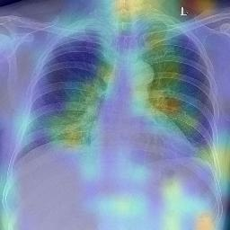
Chest X-Rays
examples using as images of VinBigData and the Inception architecture.

Slide 13
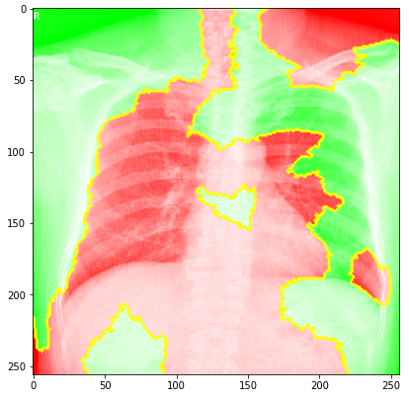
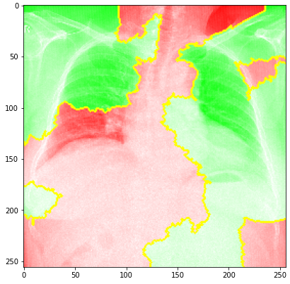
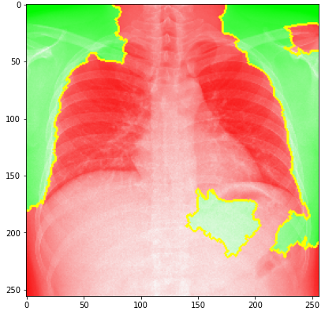
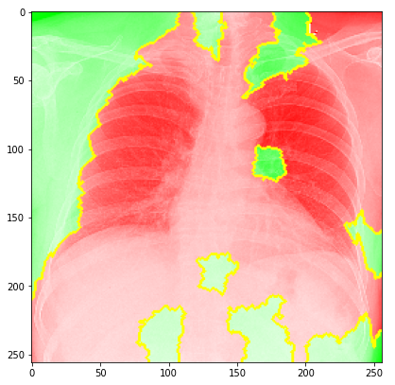
Grad CAM vs. LIME

Slide 14
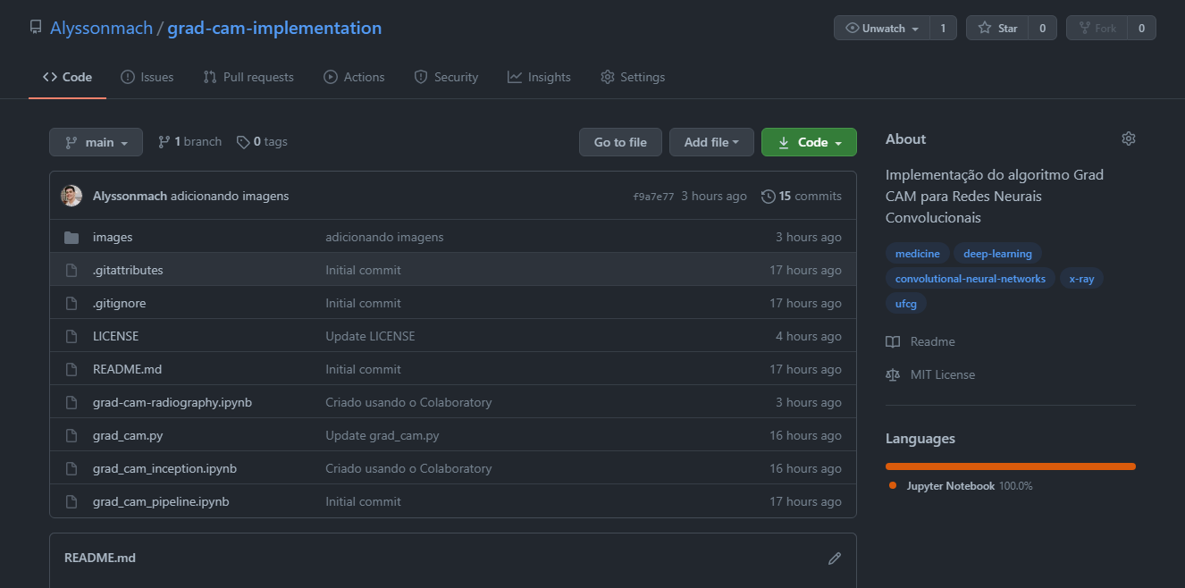
GitHub Repository
https://github.com/Alyssonmach/grad-cam-implementation
https://github.com/keras-team/keras-io/blob/master/examples/vision/grad_cam.py

