Slide 1
Bar chart: every bar is a div, so every bar is an editable shape
Revenue
Cost
400
360
250
200
0
Apr
May
Jun
Jul
Aug

Slide 2
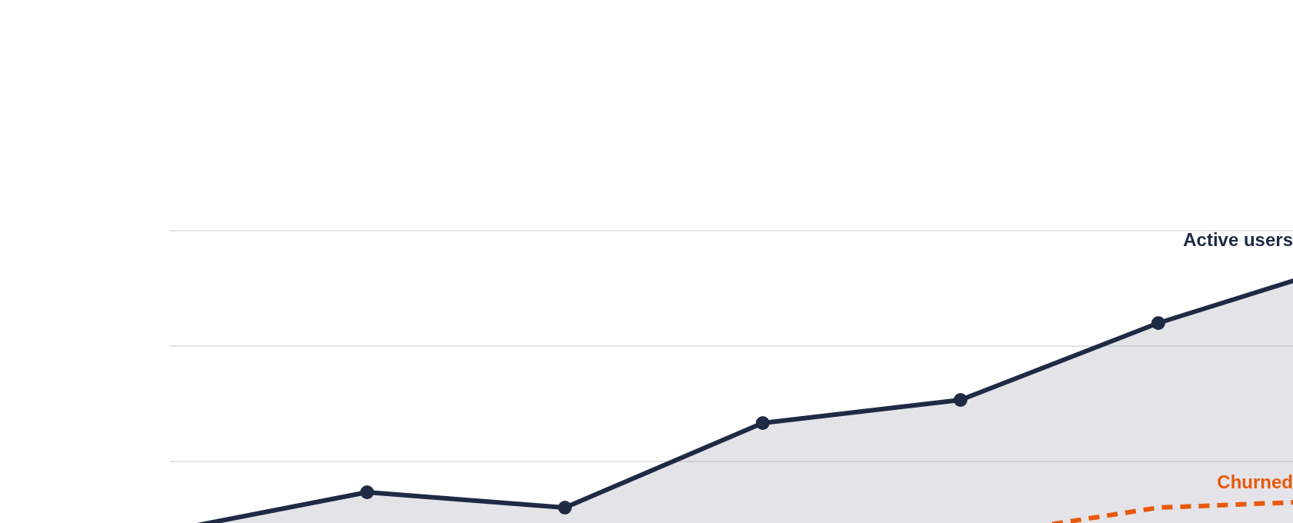
Trend line: one inline SVG, kept as a vector

Slide 3
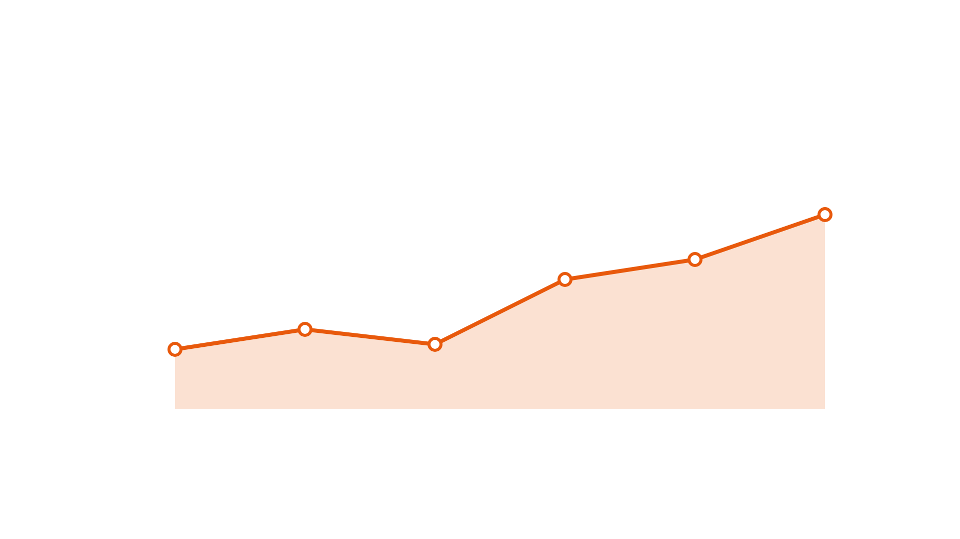
Combo: div bars, an SVG trend on top, a callout on top of that
Margin turned in July.
Rate card by brand went live on the 3rd.
Apr
May
Jun
Jul
Aug
Sep

