Slide 1
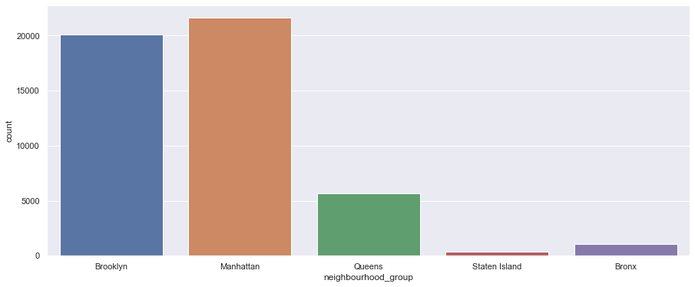
Showing number of listings based on neighborhood:

Slide 2
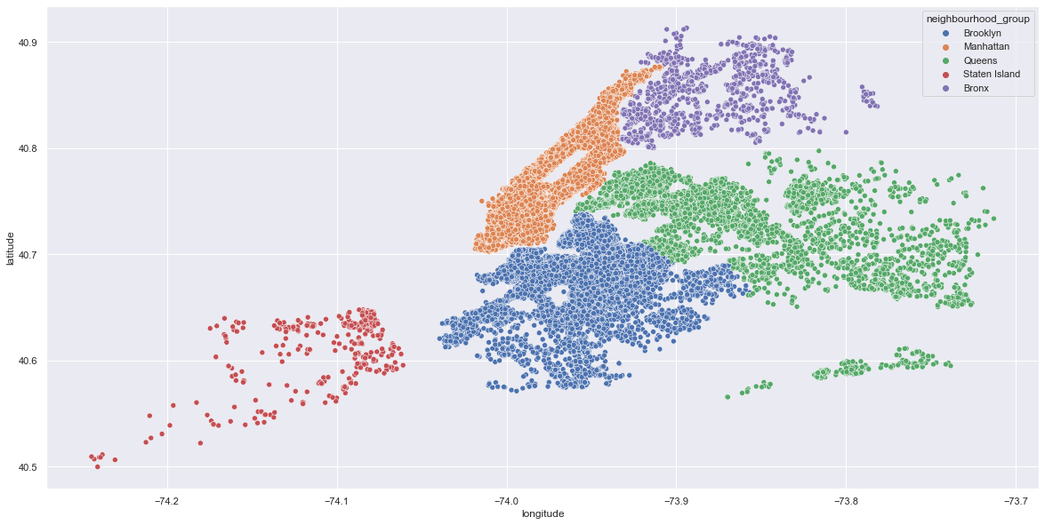
Map of Neighborhood group:

Slide 3
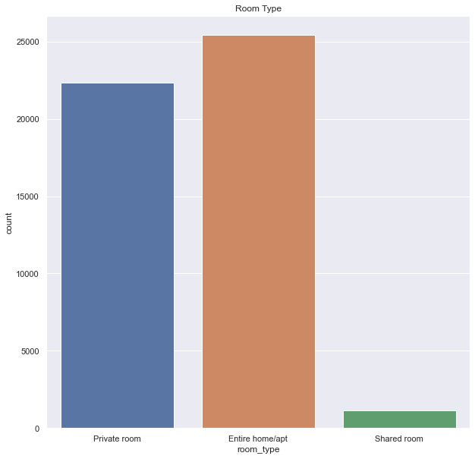
Room type:

Slide 4
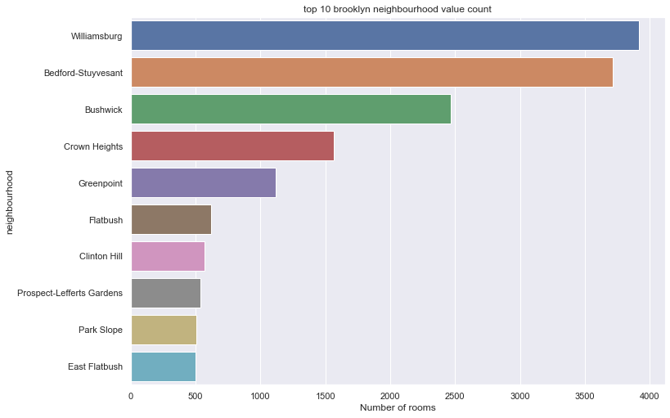

Slide 5
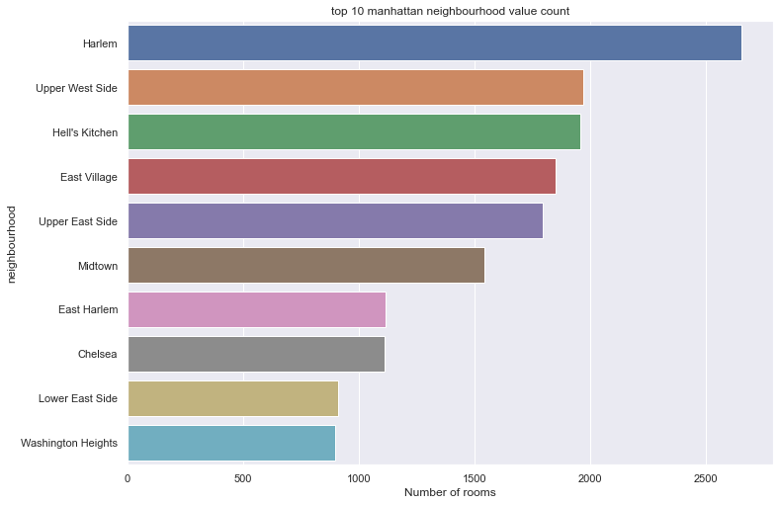

Slide 6
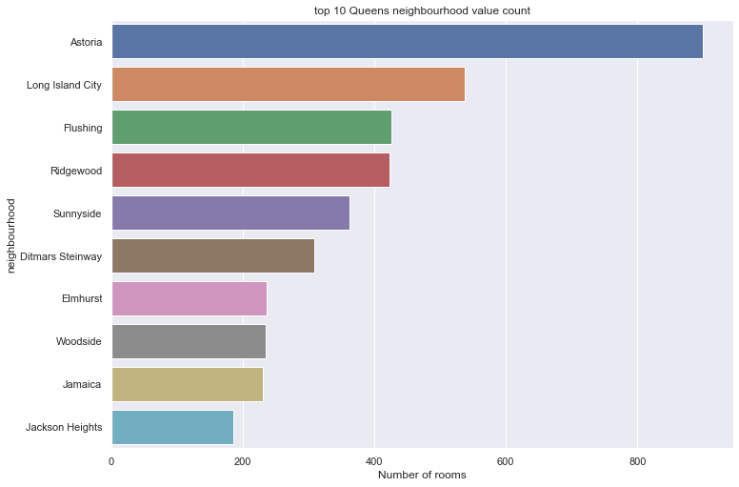

Slide 7
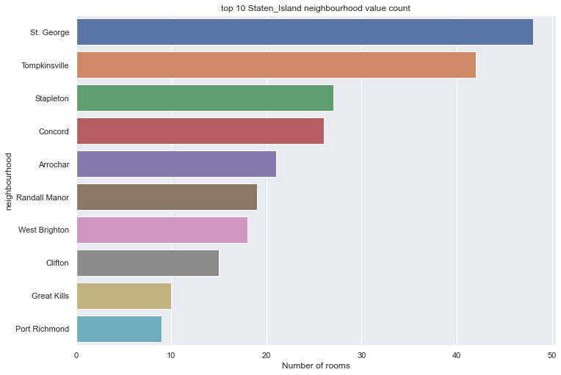

Slide 8
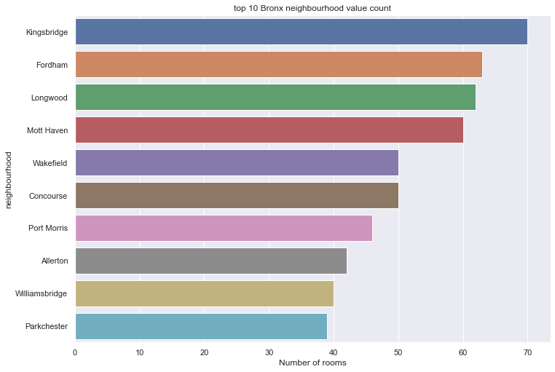

Slide 9
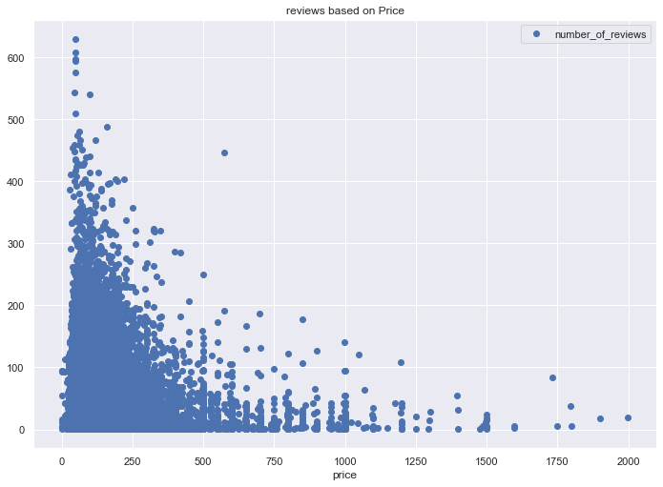
Number of reviews and its affect to price:
1) number of reviews on price range between 0 & 250 is high which mean most people prefer renting rooms which have a price below 250
2) number of reviews decrease as you increase the price

Slide 10
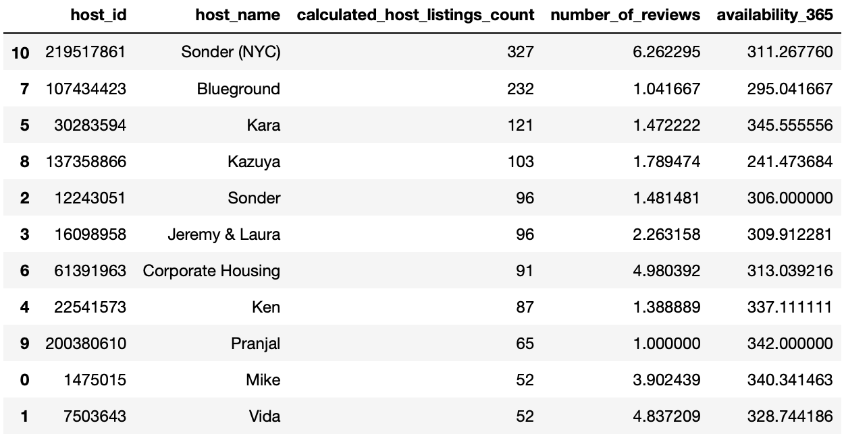
Most 10 busiest hosts:

Slide 11
