Slide 1
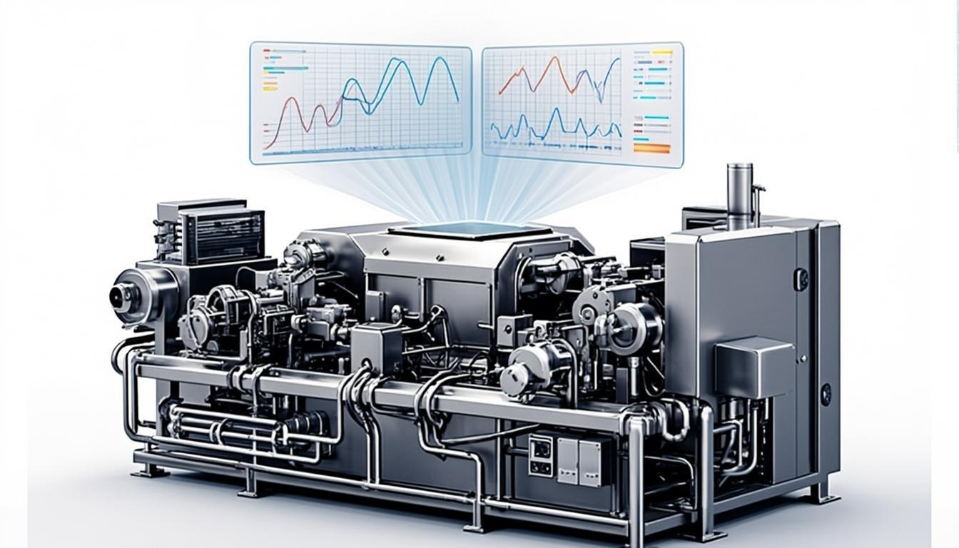
Machine Failure Prediction
Model Comparison Report
Logistic Regression vs SVM vs Neural Network
AI4I 2020 Predictive Maintenance Dataset

Slide 2
Agenda
01
02
03
04
Project Overview
Methodology
Model Results
Comparison
Objective, dataset, and preprocessing
Training pipeline and evaluation
Confusion matrices and metrics
ROC curves and final verdict

Slide 3
Project Overview
Objective
Train and compare three binary classification models for predicting machine failure using the AI4I 2020 dataset, identifying the best algorithm for fault detection.
Key Finding
Neural Network achieved the strongest overall discrimination with the highest AUC (0.877) and F1-score (0.302), making it the best model for this imbalanced task.
Models Compared
Logistic Regression, SVM (RBF Kernel), and Neural Network (MLPClassifier) evaluated via Confusion Matrix, Accuracy, Precision, Recall, Specificity, F1-Score, and ROC.

Slide 4
Dataset and Preprocessing
AI4I 2020 Predictive Maintenance Dataset
10,000 records with 4 columns
Target: Machine failure (0=Normal, 1=Failure)
Features: Rotational speed [rpm], Torque [Nm]
UDI identifier removed (non-predictive)
9,661 normal vs 339 failure cases (imbalanced)
Class imbalance makes recall and F1 more meaningful than accuracy

Slide 5
Methodology
1
Data Split
70% training / 30% testing with stratification
2
Preprocessing
StandardScaler in pipeline for consistent transformation
3
Models Trained
Logistic Regression, SVM (RBF), Neural Network (MLP)
4
Evaluation Metrics
Confusion Matrix, Accuracy, Precision, Recall, Specificity, F1, ROC, AUC

Slide 6
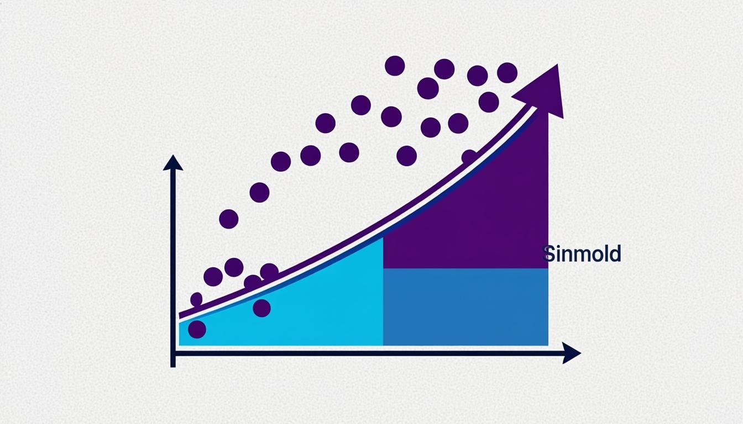
Model 1: Logistic Regression
How It Works
Logistic Regression models the probability of a binary outcome using the sigmoid function. It estimates the log-odds of the positive class as a linear combination of features, then maps to a probability between 0 and 1.
Key Characteristics:
Linear decision boundary
Fast training and inference
Highly interpretable model
Best precision (0.917) among all models

Slide 7
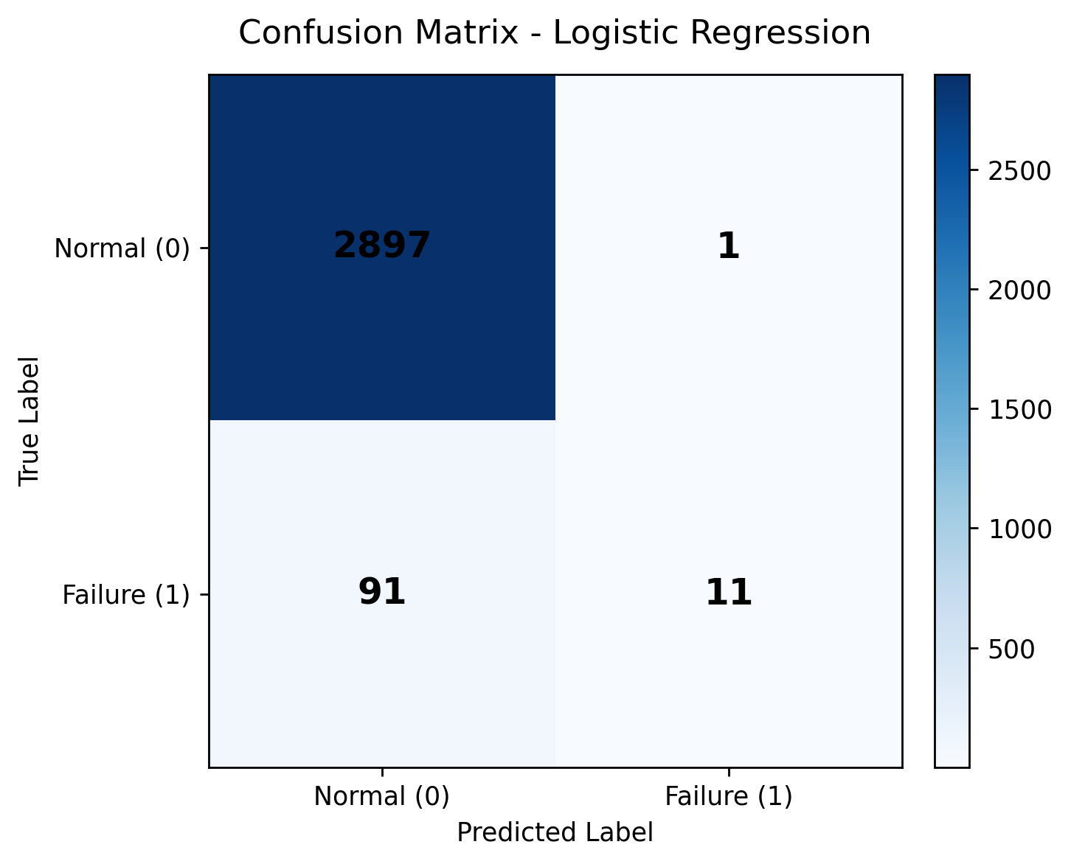
Logistic Regression: Confusion Matrix
True Positives (TP) = 11
Correctly identified 11 out of 102 failure cases
True Negatives (TN) = 2,897
Correctly identified almost all normal cases
False Negatives (FN) = 91
Missed 91 failures - lowest recall among models
False Positives (FP) = 1
Nearly zero false alarms - highest precision

Slide 8
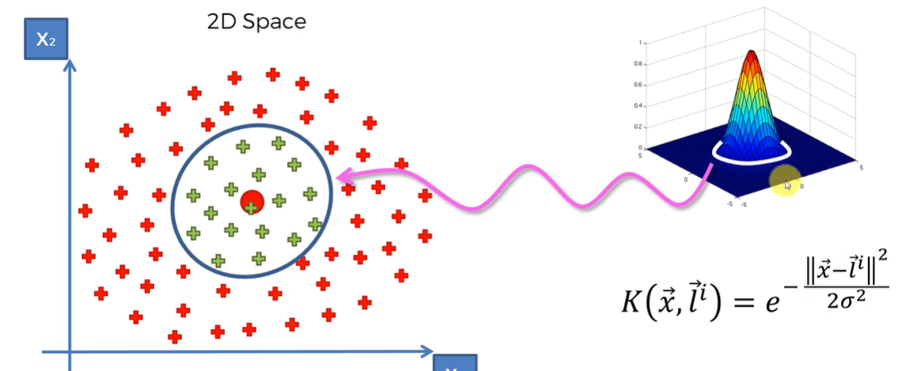
Model 2: Support Vector Machine
How It Works
SVM with RBF kernel finds the optimal hyperplane that maximizes the margin between classes in a transformed feature space. The RBF kernel maps data into higher dimensions where non-linear boundaries become separable, capturing complex patterns.
Key Characteristics:
Non-linear decision boundary via RBF kernel
Maximum margin classification
Effective in high-dimensional spaces
Balanced precision (0.800) and recall (0.157)

Slide 9
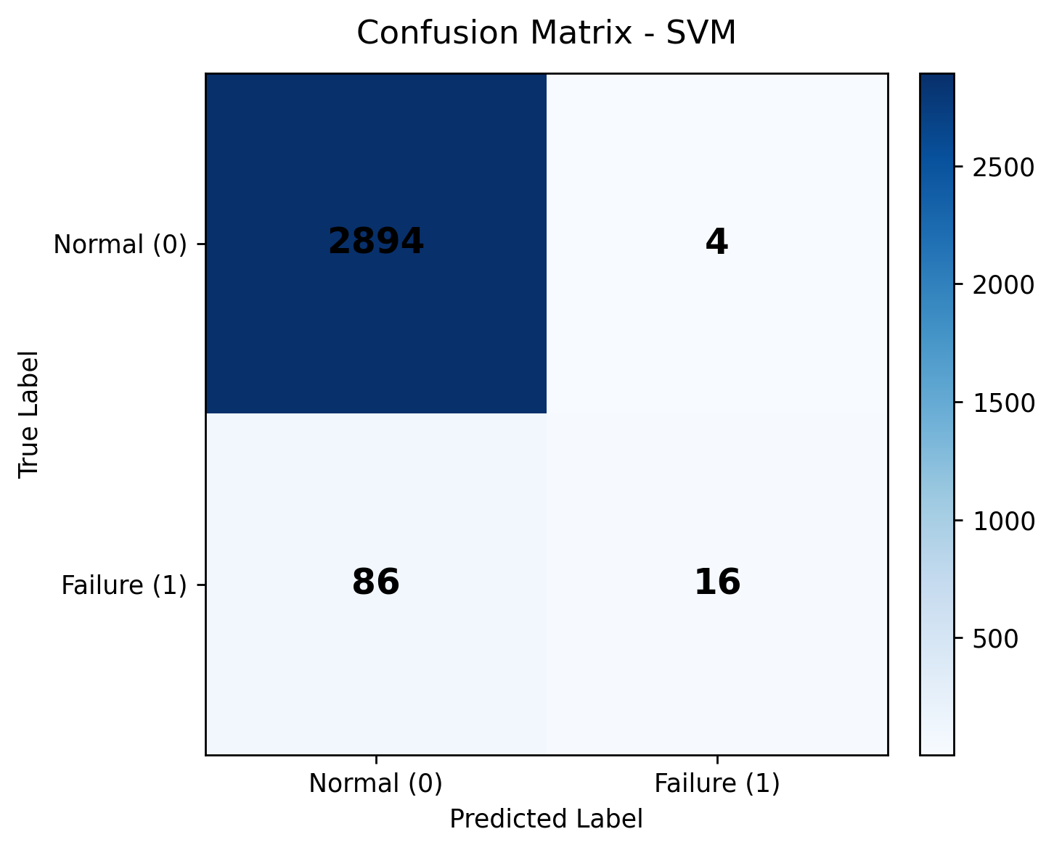
SVM: Confusion Matrix
True Positives (TP) = 16
Detected 16 failures, improving over LR
True Negatives (TN) = 2,894
Very high normal case accuracy maintained
False Negatives (FN) = 86
Still missing majority of failure cases
False Positives (FP) = 4
Very few false alarms - good specificity

Slide 10
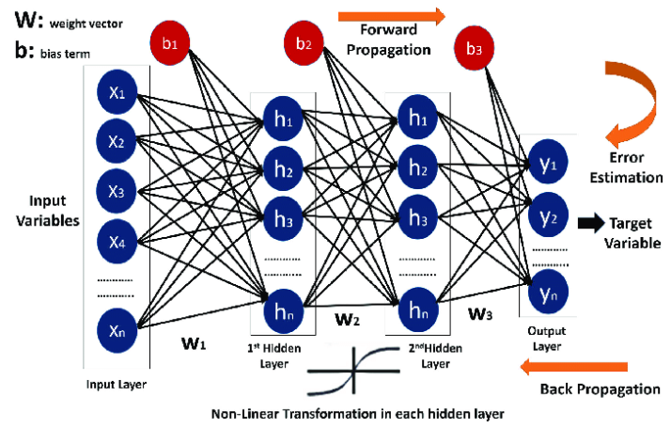
Model 3: Neural Network (MLP)
How It Works
The Multi-Layer Perceptron learns non-linear transformations through weighted connections and activation functions across hidden layers, enabling it to capture complex decision boundaries that linear models cannot represent.
Key Characteristics:
Non-linear hierarchical feature learning
Multiple hidden layers for complex patterns
Best recall (0.186) and F1-score (0.302)
Highest AUC (0.877) - best discrimination

Slide 11
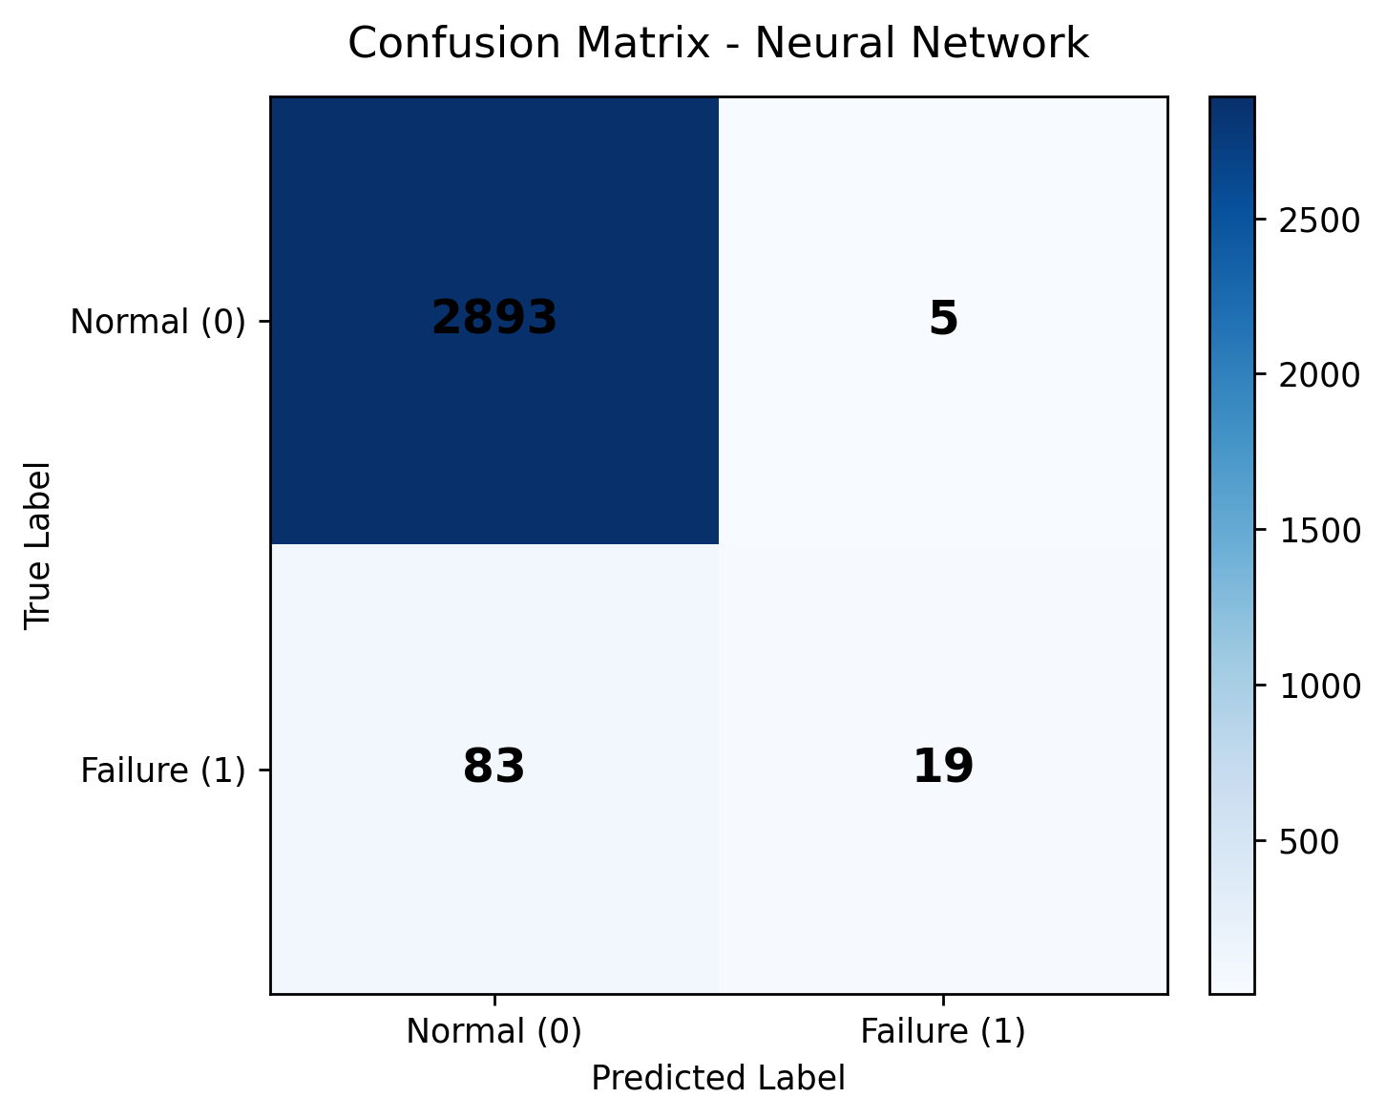
Neural Network: Confusion Matrix
True Positives (TP) = 19
Most failure detections among all three models
True Negatives (TN) = 2,893
Maintains high normal case accuracy
False Negatives (FN) = 83
Fewest missed failures - best recall
False Positives (FP) = 5
Slightly more false alarms but still very low

Slide 12
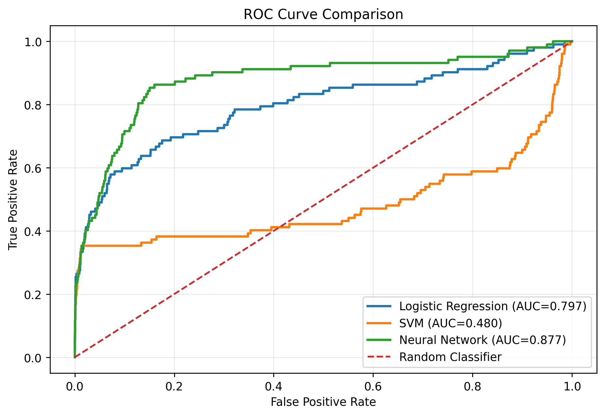
ROC Curve Comparison
0.877
Neural Network AUC
0.797
Logistic Regression AUC
0.480
SVM AUC

Slide 13
Performance Metrics Overview
0.971
0.917
0.186
Best Accuracy
Best Precision
Best Recall
Neural Network
Logistic Regression
Neural Network
0.302
1.000
0.877
Best F1-Score
Best Specificity
Best AUC
Neural Network
Logistic Regression
Neural Network

Slide 14
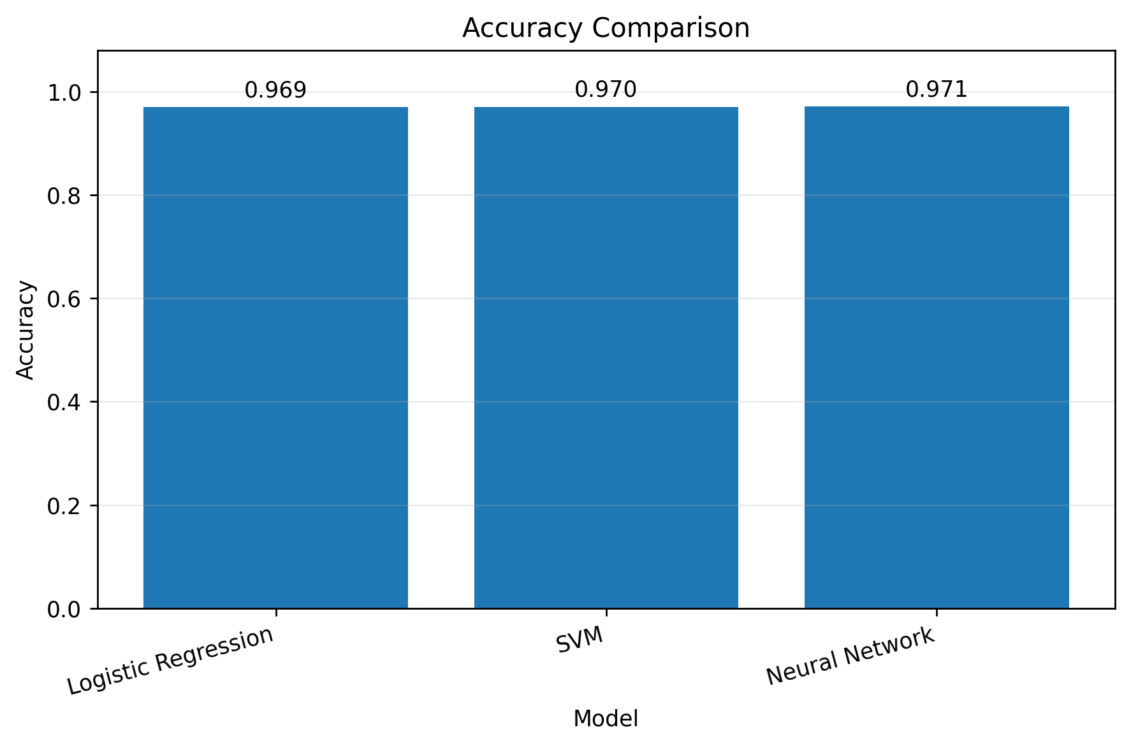
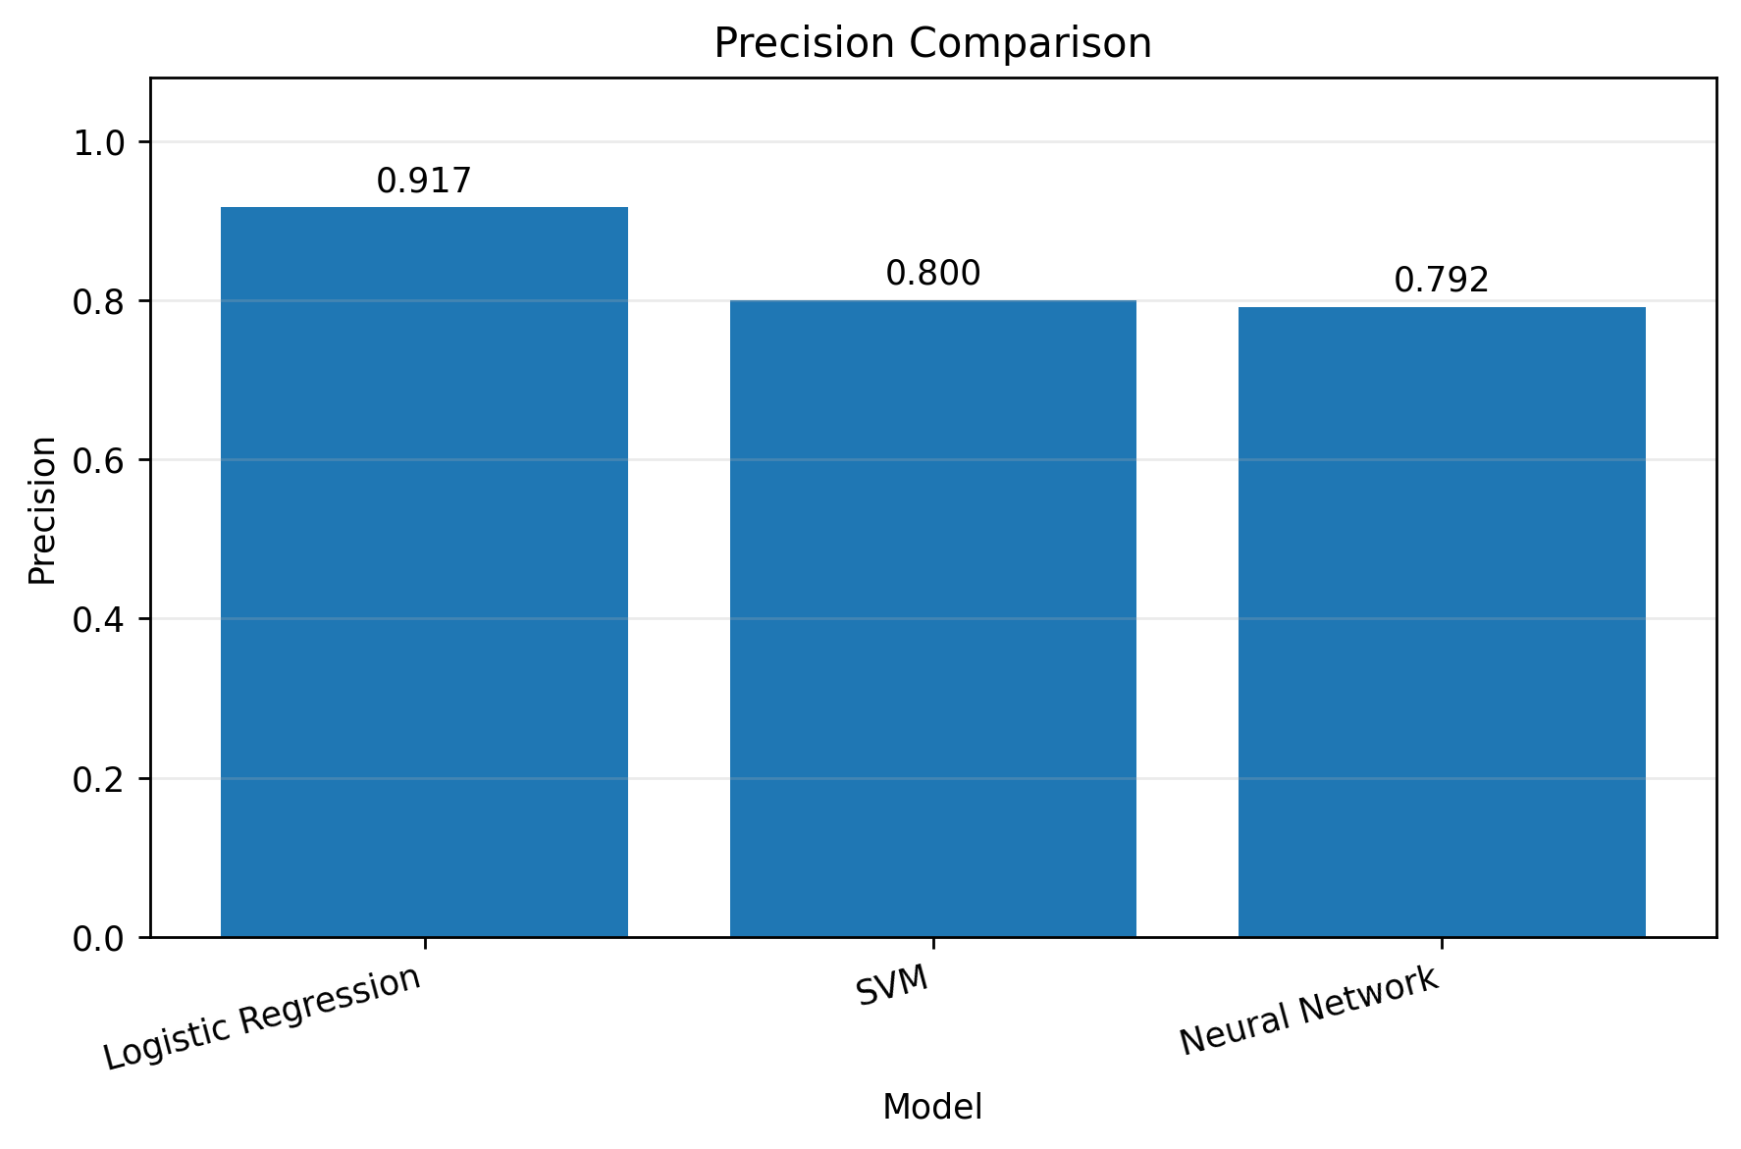
Metric Comparison: Accuracy and Precision
Accuracy Comparison
Precision Comparison

Slide 15
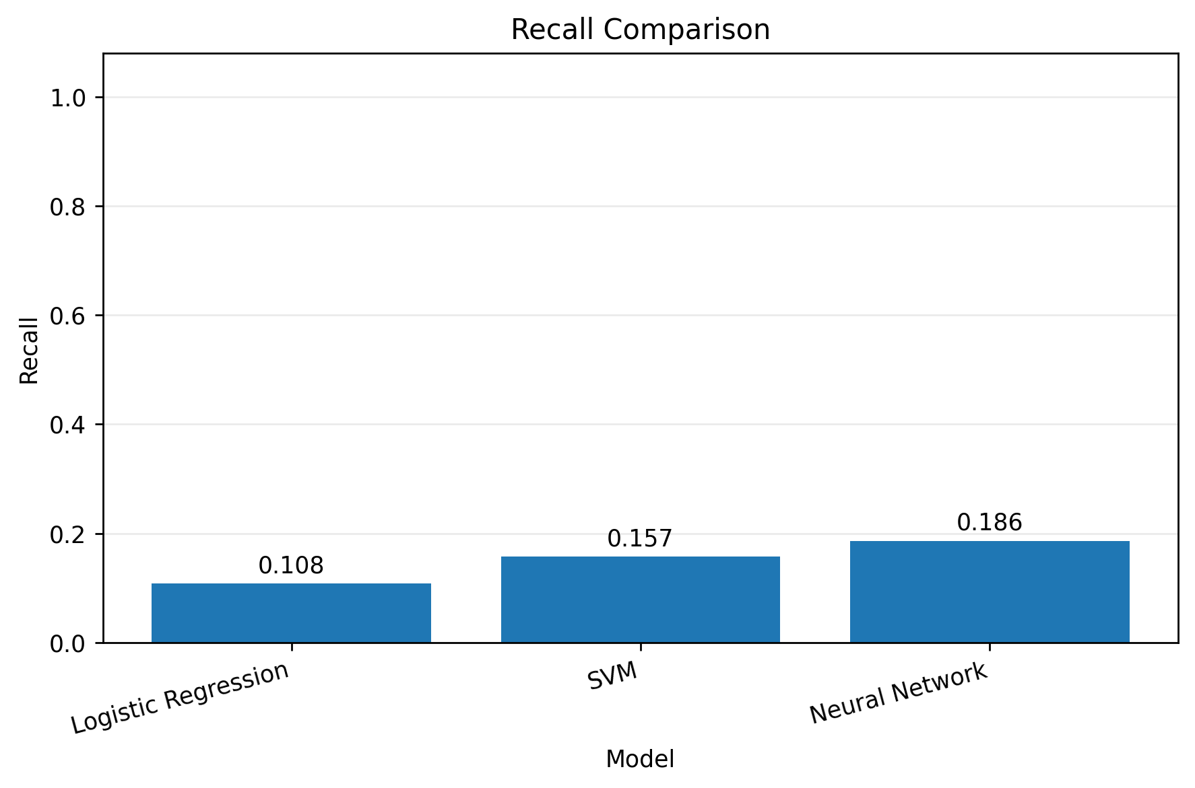
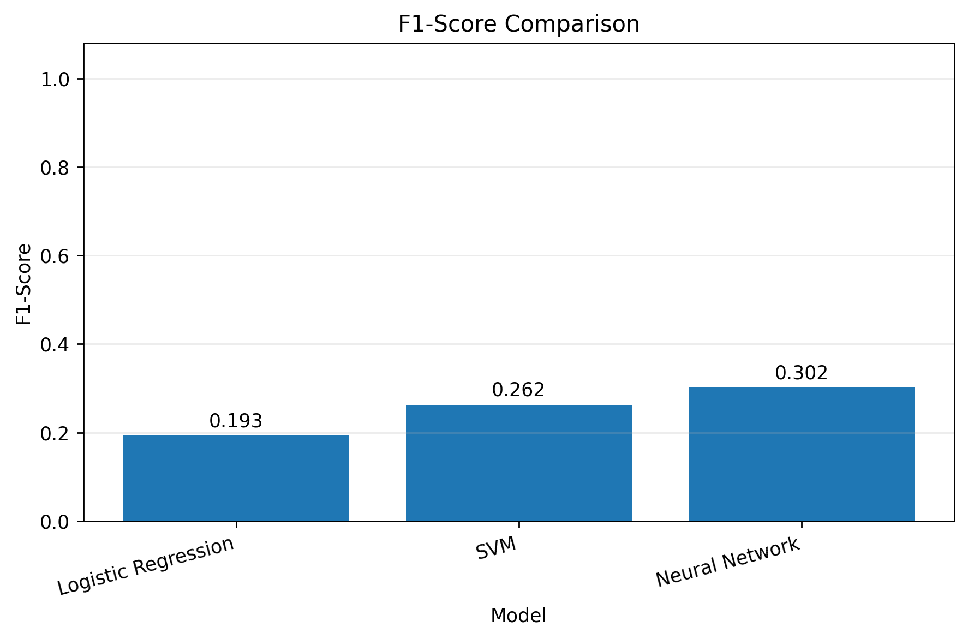
Metric Comparison: Recall and F1-Score
Recall Comparison
F1-Score Comparison

Slide 16
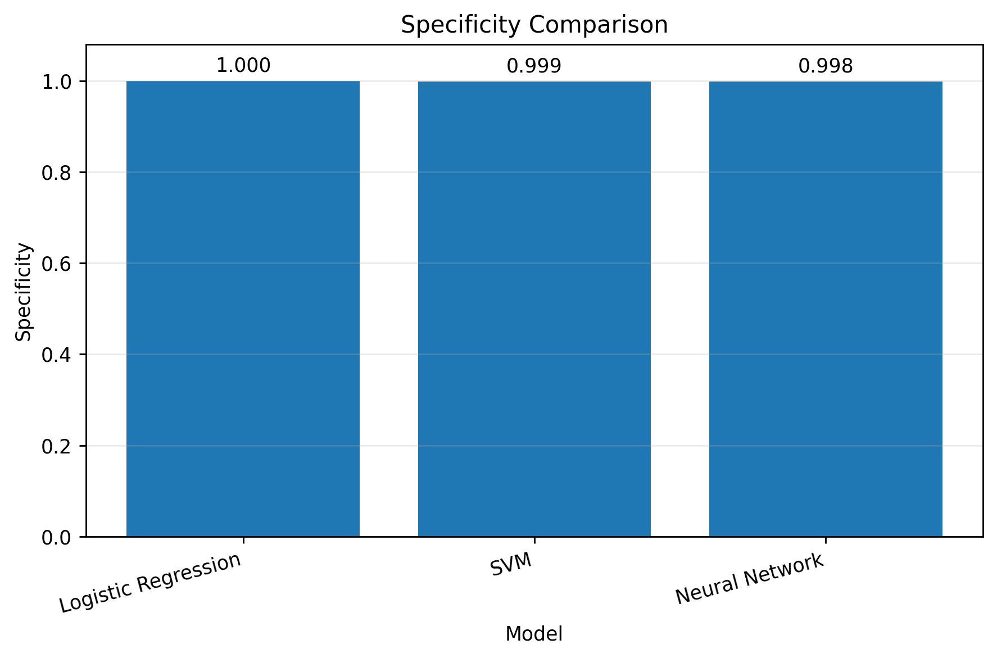
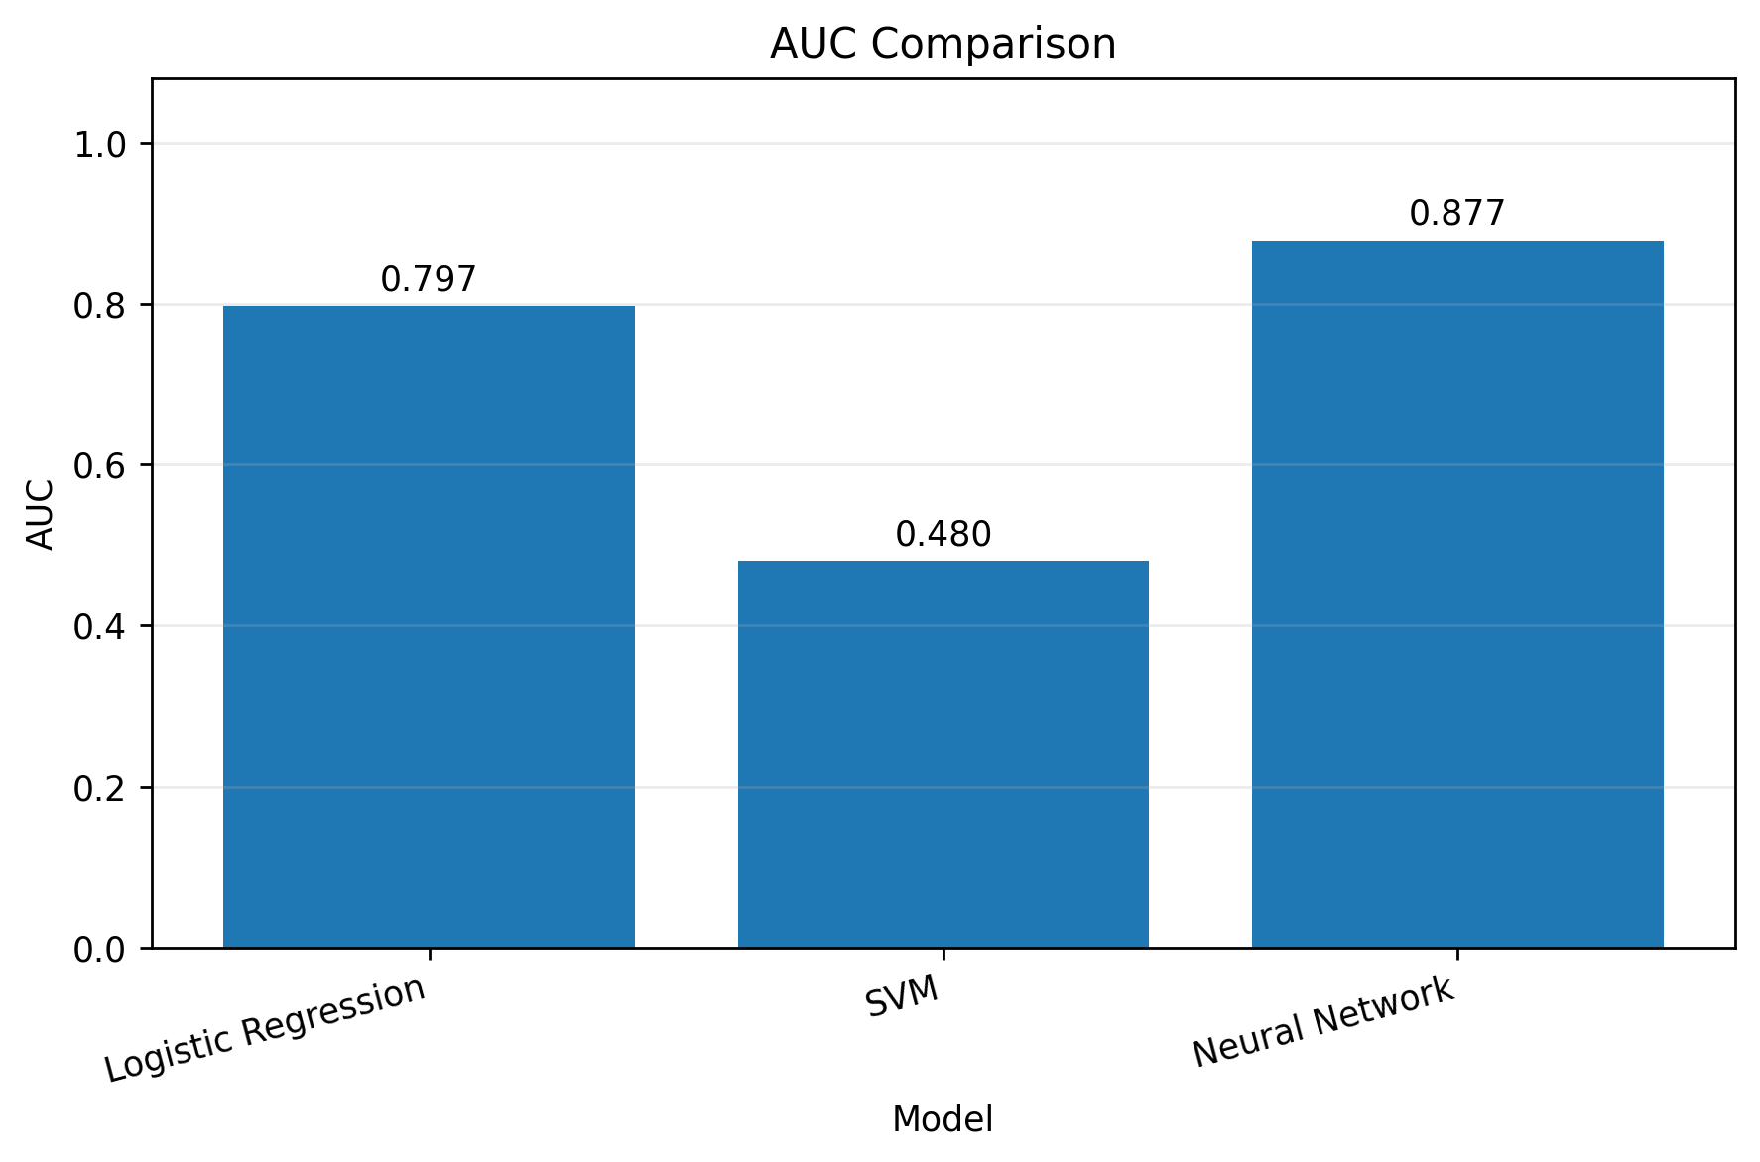
Metric Comparison: Specificity and AUC
Specificity Comparison
AUC Comparison

Slide 17
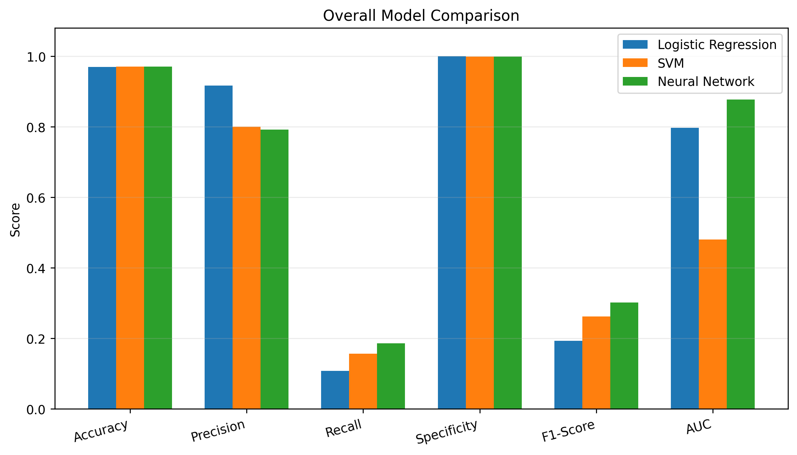
Overall Model Comparison

Slide 18
Comprehensive Comparison Table
Model
Accuracy
Precision
Recall
Specificity
F1
AUC
Logistic Regression
0.969
0.917
0.108
1.000
0.193
0.797
SVM (RBF)
0.970
0.800
0.157
0.999
0.262
0.480
Neural Network
0.971
0.792
0.186
0.998
0.302
0.877
Highlighted values = best result per metric. Neural Network leads in 4 of 6 metrics, including the most critical ones: Recall, F1, and AUC.

Slide 19
Highest AUC (0.877)
Best
Model
Best discrimination ability across all thresholds
Highest F1-Score (0.302)
Best precision-recall balance for imbalanced data
Highest Recall (0.186)
Detects the most actual failures, minimizing missed events
Neural Network (MLPClassifier)
Imbalanced Dataset Consideration
Recall, F1, and AUC matter more than accuracy here

Slide 20
Thank You
Machine Failure Prediction Model Comparison
AI4I 2020 Predictive Maintenance Dataset

