Slide 1
Human Activity Recognition Using IMU sensors
Reference Papers:
1.Feature Representation and Data Augmentation for Human Activity Classification Based on Wearable IMU Sensor.
School of Electronics Engineering, Kyungpook National University, Korea
2.Physical Human Activity Recognition Using Wearable Sensors
Laboratory of Images, Signals and Intelligent Systems (LISSI), University of Paris-Est Créteil (UPEC), France;
Laboratory of Information Science and Systems, University of Toulon, Batiment, France;

Slide 2
Overview
Inertial Measurement Units
Feature Extraction
Data Augmentation
Current Results
Next Steps

Slide 3
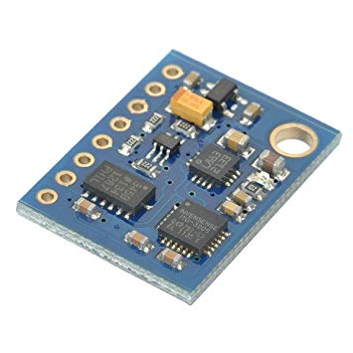
Inertial Measurement Units :
Provide us information regarding the motion of body .
Can have gyroscopes, magnetometers and accelerometers.
Here we have used data from 6 d.o.f IMU sensor having gyroscope and accelerometer.

Slide 4
About the Raw Data
Has been taken from UCI machine learning repository.
Consists of 12 different human activities.
Provides raw gyroscope and accelerometer readings sampled at 50 Hz.
Data has been collected from mobile devices so the placement of sensor is in the thigh region.

Slide 5


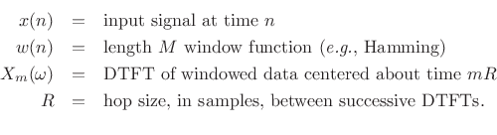
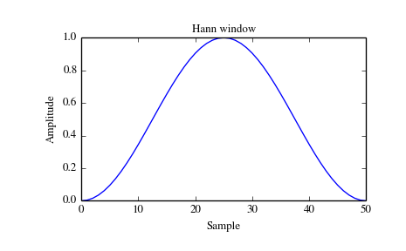
Feature Extraction
Frequency Domain Analysis :
Used sliding window technique. Here Hann window is used (512 data pts with 50% overlap).
S.T.F.T and then Spectrogram made for each window.
All 3 components X, Y, Z of Accn. for each window combined and sorted.
S least and L largest pts. Are taken.
Same done for gyroscope readings.

Slide 6
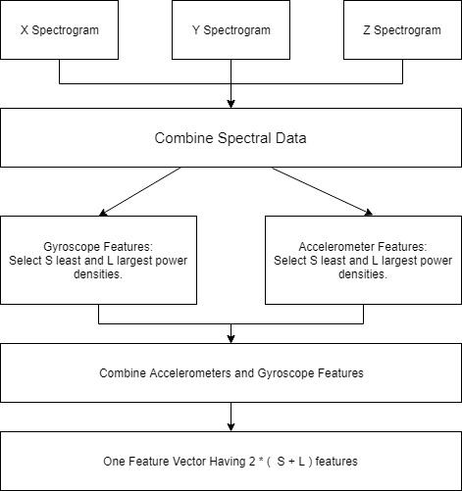

Slide 7
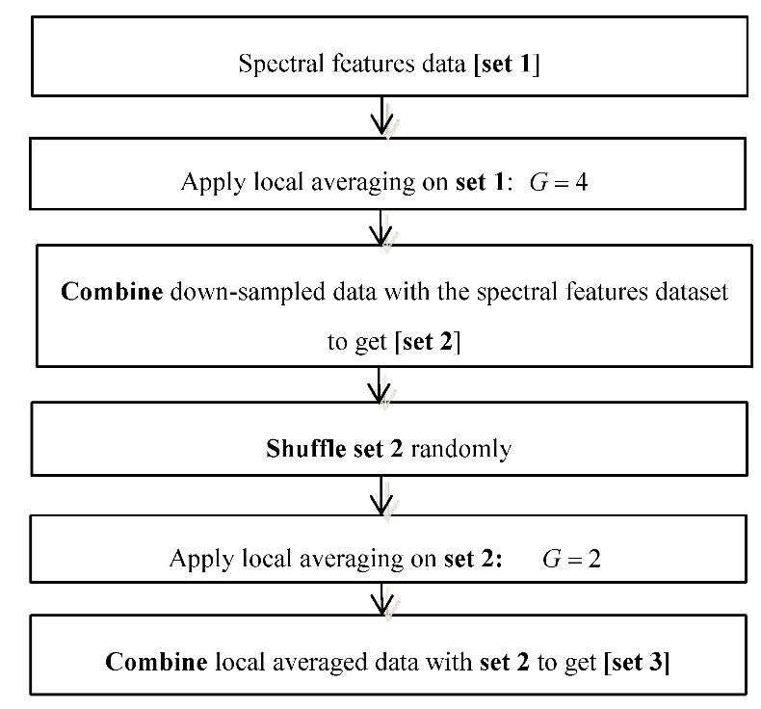
Data Augmentation
The formed dataset is augmented using downsampling with local averaging and then shuffling to ensure that our model generalises well and overfits less.
Problem of small dataset is resolved.
Done for each label separately.

Slide 8
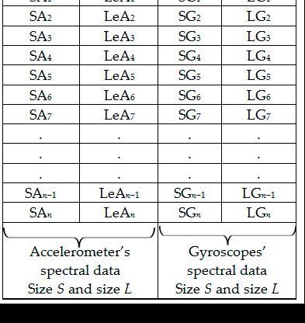
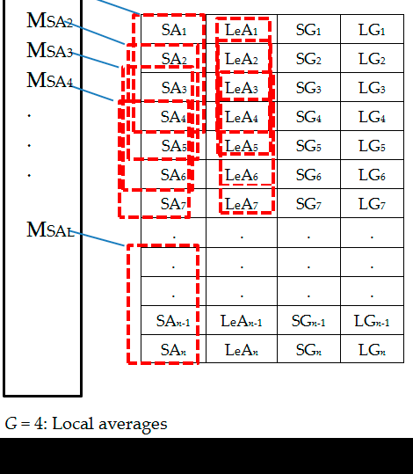

Slide 9
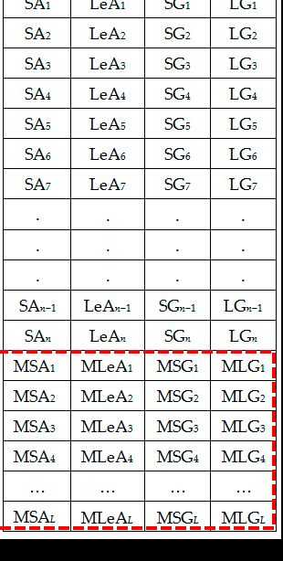
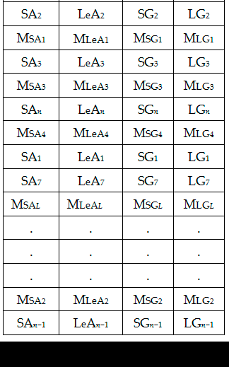

Slide 10
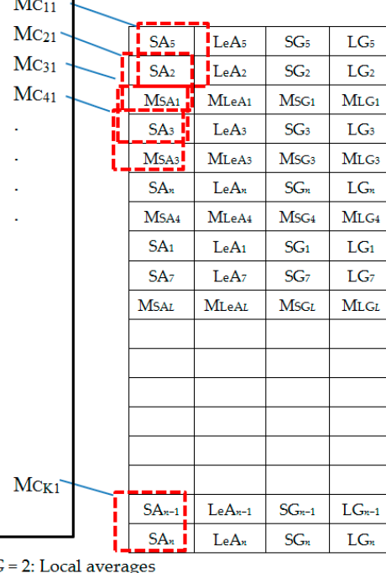
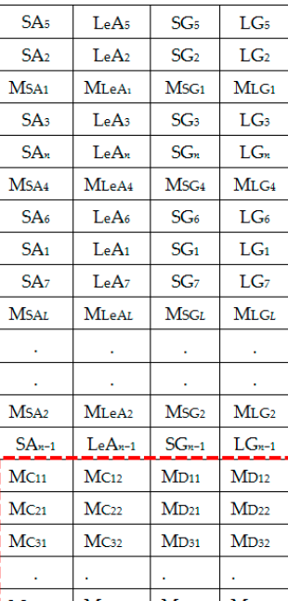

Slide 11
Results

Slide 12
60 , 100 and 200 feature datasets were used for classification using a One vs Rest with SVM using both linear and rbf kernel .
No of Datapoints ⇒ 6068
12 different classes :
1. Walking 7. Stand to Sit
2. Walking Upstairs 8. Sit to Stand
3. Walking Downstairs 9. Sit to Lie
4. Sitting 10. Lie to Sit
5. Standing 11. Stand to Lie
6. Laying 12. Lie to Stand

Slide 13
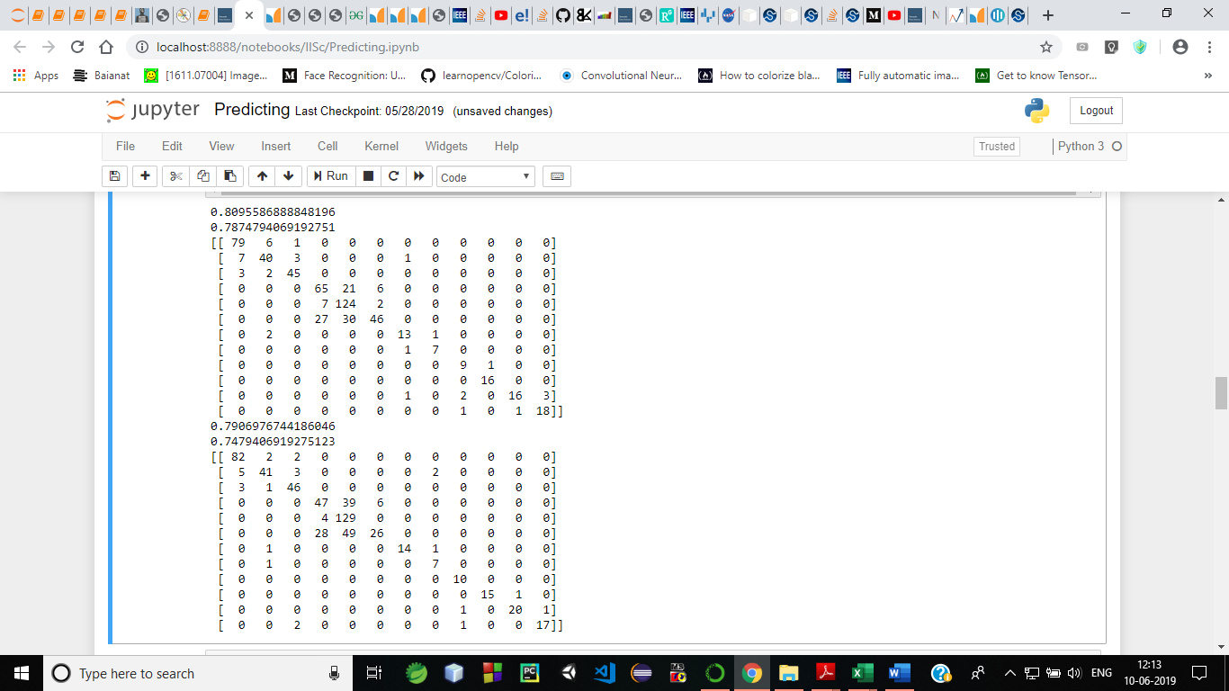
60 feature dataset:

Slide 14
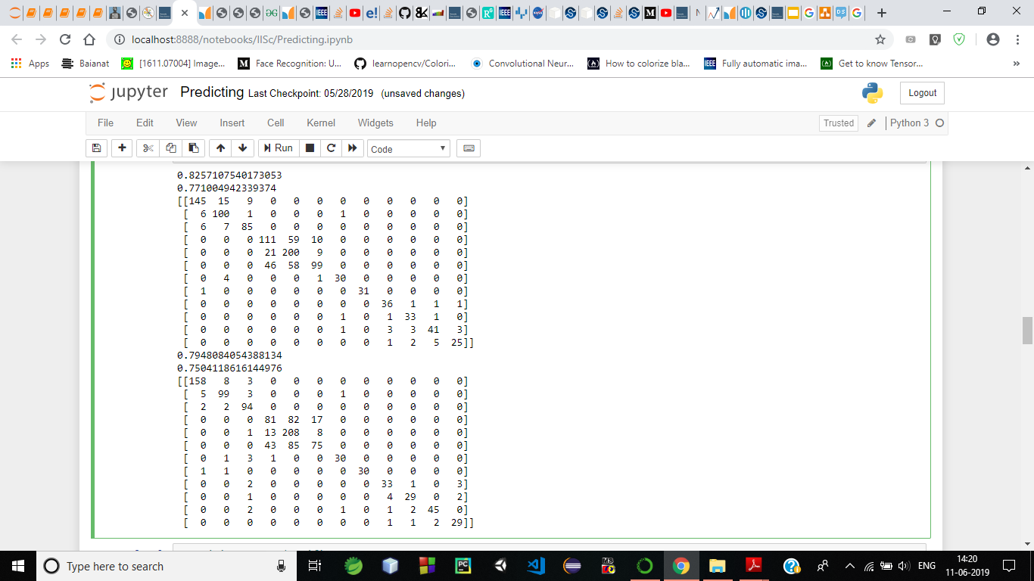
100 feature dataset:

Slide 15
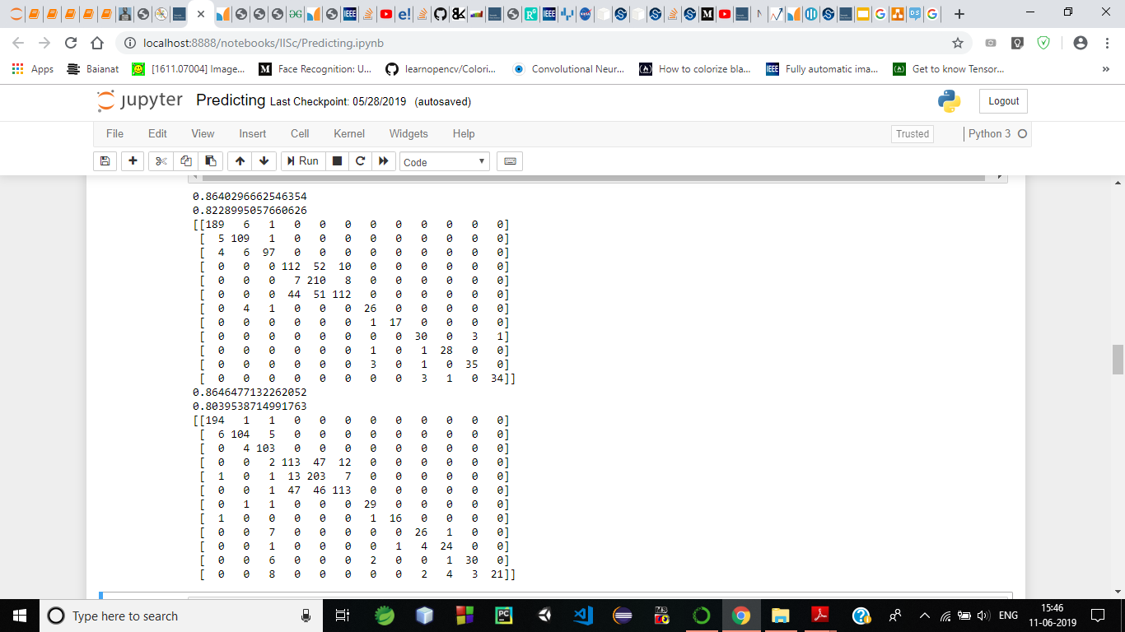
200 feature dataset:

Slide 16
Next step: Include Time Domain Parameter:
Following time domain features considered:
Mean
Variance
R.m.s
Range
Skewness
Median
Kurtosis
Peak to peak
Interquartile Range
Crest Factor

Slide 17
120 feature dataset
Total frequency domain features taken: 60 as of prev. dataset
Total time domain features taken : 60
10 parameters for each ax, ay, az, wx, wy, wz
Therefore ,total time domain features = 6*10 = 60

Slide 18
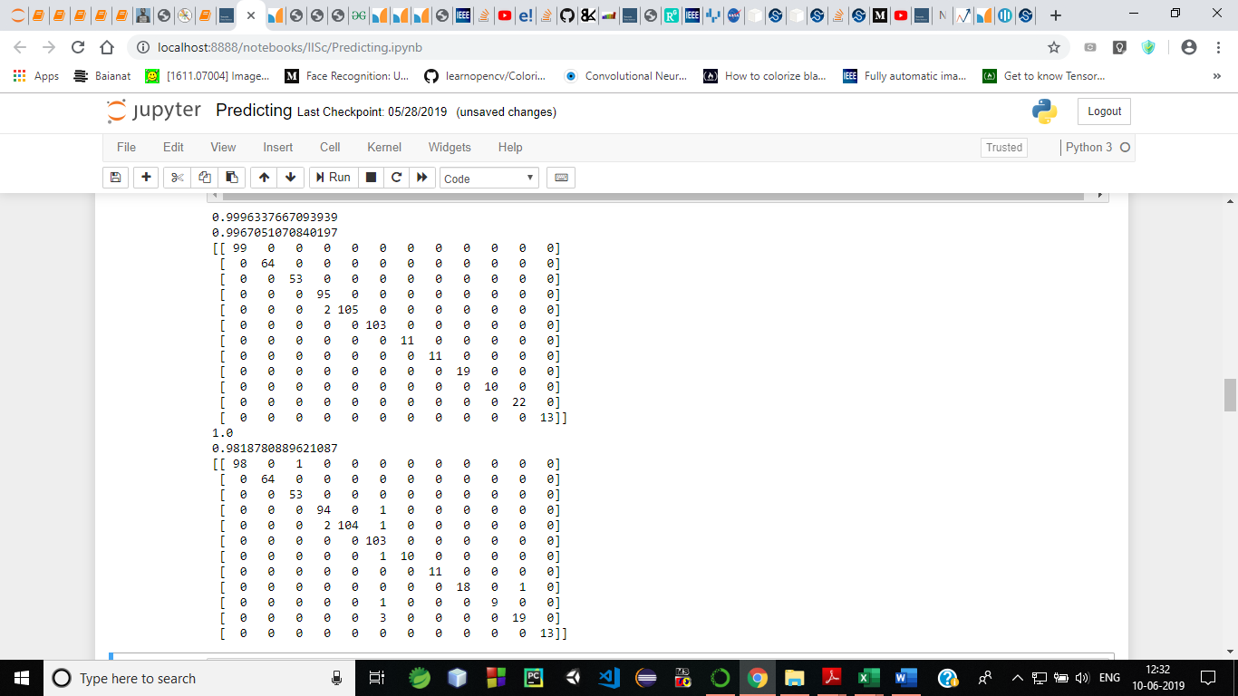
120 feature dataset ( 60 time features + 60 frequency features) :

Slide 19
30 feature time domain dataset:
Parameters taken:
Mean
Variance
Meadian
Peak to peak
R.M.S.

Slide 20
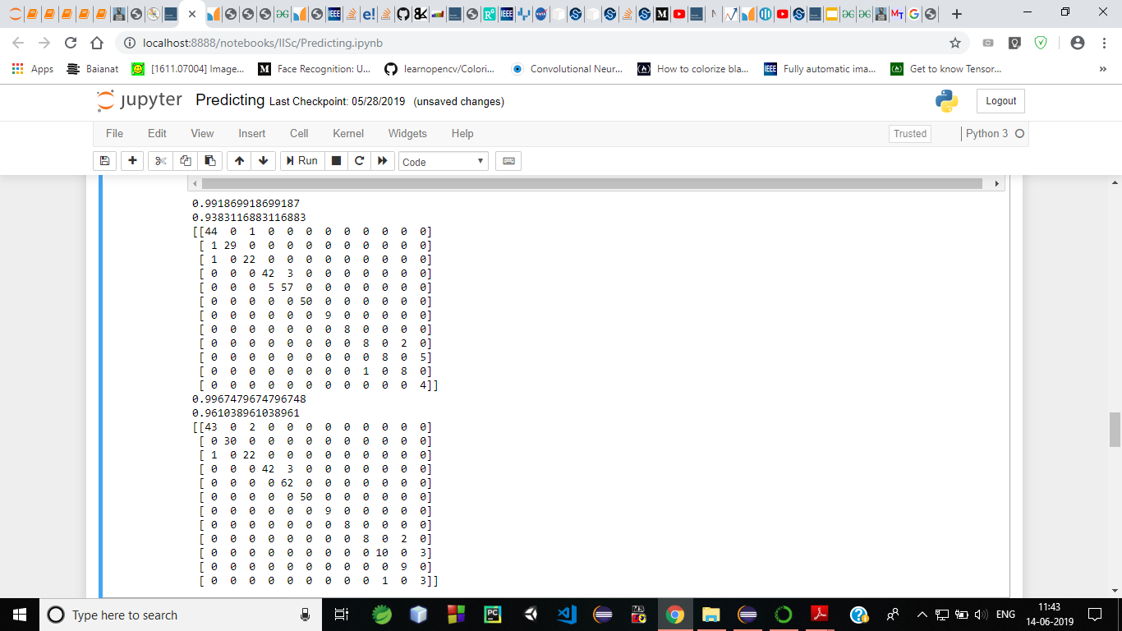
30 feature dataset :

Slide 21
Thanks

