Slide 1


SMART INDIA HACKATHON 2025
Problem Statement ID – 25051
Problem Statement Title- Renewable Energy Monitoring System for Microgrids
Theme-Renewable / Sustainable Energy
PS Category- Hardware
Team ID- 65089
Team Name (Registered on portal) -
Eco_Innovators

Slide 2
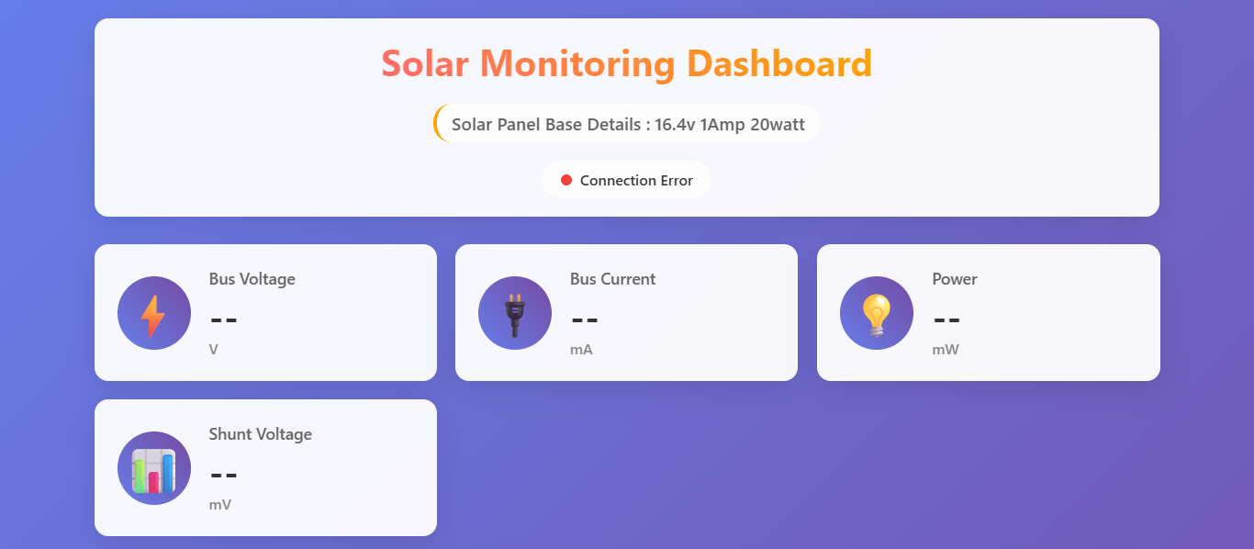
IDEA TITLE
Eco Innovators
Proposed Solution
Detailed explanation of the proposed solution
The system integrates low-cost sensors (current, voltage, power, battery state-of-charge) with Raspberry Pi as the central data hub.
Data on generation, storage, and consumption is transmitted via MQTT to the cloud.
A mobile app and web dashboard visualize real-time performance and provide predictive insights for community operators.
AI/ML models predict future load demand, allowing proactive adjustments in energy generation or storage allocation.
Fig. Dashboard
How it addresses the problem
Innovation and uniqueness of the solution
Tackles energy shortages and blackouts in rural areas by ensuring transparent monitoring.
Improves resource utilization by highlighting inefficiencies (e.g., low solar panel output due to dust).
Enables better decision-making on when to store, use, or conserve energy.
Empowers local communities to manage their energy microgrids with minimal technical expertise.
Combines renewable monitoring + predictive demand forecasting in a single affordable prototype.
Community-level mobile app interface for non-technical operators.
Uses low-cost open-source hardware (Arduino, Raspberry Pi) instead of expensive industrial controllers.
Provides predictive maintenance alerts (e.g., turbine bearing wear, battery health issues).

Slide 3
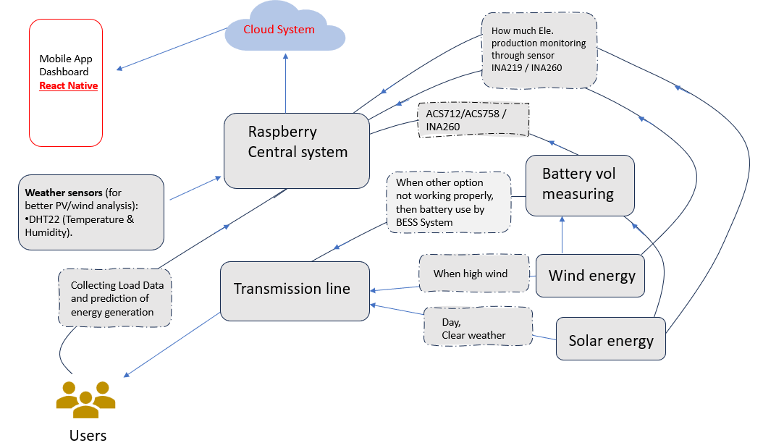

TECHNICAL APPROACH
Eco Innovators
Technologies to be used
MQTT
Programming Languages: Python (backend + data processing), JavaScript (mobile app/React Native).
Frameworks/Tools: Node.js, Express.js, MQTT protocol, Firebase for real-time storage.
Hardware: Raspberry Pi, Current/Voltage sensors (INA219, ACS712, PZEM-004T), Wind turbine RPM sensor, Battery SOC meter.
Cloud & Analytics: HiveMQ (MQTT broker), TensorFlow Lite for demand prediction.
Methodology and Process for Implementation
Data Collection → Sensors measure PV, wind, battery, and load.
Edge Processing → Raspberry Pi preprocesses data and pushes via MQTT.
Cloud Storage & Analytics → Real-time DB + AI for prediction.
Mobile/Web Dashboard → Displays generation, consumption, net energy, and alerts.
Community Action → Operators adjust usage or generation.
Fig. Flow Charts
PROTOTYPE LINK : https://github.com/Am0lShah/SIH_2025

Slide 4
FEASIBILITY AND VIABILITY
Eco Innovators
Technical Feasibility
Uses affordable and widely available components (Raspberry Pi, Arduino, low-cost sensors).
Open-source software frameworks (Python, Node.js, React Native) reduce cost and complexity.
Compatible with existing solar/wind microgrids – no need for major infrastructure changes.
Supports offline-first mode for rural areas with poor internet.
Potential challenges and risks
Unreliable internet connectivity in rural areas.
Hardware maintenance (dust, heat, battery wear).
Community adoption if operators are not tech-savvy.
Power consumption of IoT devices in low-resource environments.
Operational Feasibility
Strategies for overcoming these challenges
User-friendly dashboard & mobile app for local operators with minimal training.
Community adoption made easier with simple, color-coded alerts and reports.
Modular design → can scale from a single household to a village microgrid.
Local technicians can maintain hardware with basic training.
Use offline-first mobile app with periodic data sync.
Employ solar-powered Raspberry Pi setups for continuous operation.
Provide training & user-friendly UI for community operators.
Add redundant sensors and rugged enclosures to withstand harsh environments.
Environmental & Social Viability
Encourages renewable energy adoption in rural areas.
Reduces carbon emissions by minimizing diesel generator usage.
Provides energy transparency, empowering communities to manage their own power supply.
Supports sustainable development goals (SDGs) like clean energy access and climate action.

Slide 5

IMPACT AND BENEFITS
Eco Innovators
Social Benefits
Environmental Benefits
Provides reliable electricity to rural households, reducing outages that affect millions.
Encourages local ownership and skills development so communities can manage their own energy systems.
A practical alternative where traditional power grids are costly or ineffective.
Promotes renewable adoption and aligns with Odisha’s 10.95 GW renewable target by 2030.
Cuts diesel generator dependency, lowering carbon emissions.
Builds sustainable rural infrastructure for future generations.
Economic Benefits
Operational Benefits
Saves money by reducing wastage and hidden losses (dust on panels, battery damage, overflow).
Supports India’s last-mile electrification goals and boosts rural productivity.
Enables better use of energy for irrigation, schools, and small businesses, driving rural growth.
Improves microgrid efficiency by up to 20% through smart monitoring and predictive maintenance.
Prevents frequent system breakdowns (common failure rates up to 60%).
Extends battery and equipment life, making microgrids more cost-effective and scalable.
Ensures systems remain reliable and policy-compliant in the long run.
Explanation Video
PROTOTYPE Video
: https://youtu.be/b1-WUuZc-xk
: https://youtu.be/1unG_kV5LsM

Slide 6
RESEARCH AND REFERENCES
Eco Innovators
1. Sensors journal article (open access): F. Bonavolontà, A. Liccardo, F. Mottola, and D. Proto, “Real-time monitoring of energy contributions in renewable energy communities through an IoT measurement system,” Sensors, vol. 25, no. 5, p. 1402, Feb. 2025. DOI: 10.3390/s25051402.
2.Conference/article (IoT Based Energy Monitoring): S. Shanthala, Ashwini, A. S. Ambilkar, M. P. S., and D. K. Gowda, “IoT based energy monitoring and management system for real-time appliances,” Apr. 2025.
3. IEEE conference paper (solar energy monitoring system): S. M. Patil, M. Vijayalashmi, and R. Tapaskar, “IoT based solar energy monitoring system,” in Proc. 2017 Int. Conf. on Energy, Communication, Data Analytics and Soft Computing (ICECDS), Chennai, India, Aug. 2017. DOI: 10.1109/ICECDS.2017.8389711.
4.Dataset for prediction model
Forecast electricity demand using machine learning
Solar power energy generation dataset

