Slide 1
Acoustic Rain Gauge
Estimating rainfall from the sound of rain — model results & evaluation
780,725 field audio clips · 19 campaigns (Dec 2023 – Jun 2026) · 4 model families + stacking ensemble
July 2026

Slide 2
The Problem & the Approach
Can a cheap microphone replace a rain gauge?
• A low-cost sensor node records 10-second audio clips (8 kHz, mono) in the field
• Each clip is matched to ground-truth rainfall from a co-located gauge
• Two prediction tasks:
– Classification — is it raining in this clip? (rain / no-rain)
– Regression — how much rain? (mm per 10 s clip)
• Why acoustic? Microphones cost a fraction of mechanical gauges, have no moving parts, and can be deployed densely
780,725
labeled audio clips
19
field campaigns
~15%
clips with rain
31 mo
Dec 2023 – Jun 2026
0.893
best classifier ROC-AUC
0.543
best regression R²
Acoustic Rain Gauge — ML Results · July 2026
2

Slide 3
Dataset
Real field recordings matched to gauge measurements
• 780,725 clips across 19 monthly campaigns, Dec 2023 – Jun 2026
• Every clip: 10.0 s, 8 kHz, mono (verified across all campaigns)
• Labels from mechanical / tipping-bucket rain gauges co-located with the microphone
• Heavy class imbalance: ~85% of clips are dry
• Train / test split by campaign to test generalization:
– 607,673 training clips · 151,927 held-out test clips
• Campaign mix varies wildly — some months are almost all dry, one (Feb–Mar 2026) is 93% rainy
Property | Value
Clip length / rate | 10 s · 8 kHz mono
Total clips | 780,725
Train / test | 607,673 / 151,927
Rainy fraction | ≈15%
Ground truth | Tipping-bucket & mechanical gauges
Campaigns | 19 (Dec 2023 – Jun 2026)
Acoustic Rain Gauge — ML Results · July 2026
3

Slide 4
End-to-End Pipeline
From raw WAV files to a rainfall estimate
Scalar features
175-feature store (mel, MFCC stats, wavelets)
XGBoost
classifier + regressor (SHAP top-20 feats)
Raw audio
780k WAV clips 10 s @ 8 kHz
Cleaning & label matching
gauge timestamps → rainfall_mm
Stacking ensemble
XGB meta-model on 5 inputs
MFCC time-series
40 × 157 matrix per clip
CNN · LSTM · Transformer
deep regressors
Infrastructure that made 59-experiment unattended sweeps possible:
• Resume-safe progress manifests (atomic JSON writes) — crash at any point, restart, nothing recomputed
• Per-batch MFCC precompute checkpoints; subprocess isolation so one failed run can't kill the sweep
• Early stopping on validation R² — cut typical DL run from ~36 min to ~11 min with no quality loss
Acoustic Rain Gauge — ML Results · July 2026
4

Slide 5
Feature Engineering
Two views of the same audio
Scalar features (for XGBoost)
MFCC time-series (for deep learning)
• Started with 13 hand-picked features (RMS, spectral centroid, MFCC means…)
• Expanded to a 175-feature master store:
– 40 mel-band energies (mean + std)
– MFCC statistics, wavelet sub-band energy/entropy
– Teager energy, RMS histograms, spectral flux/contrast/rolloff
• SHAP importance ranking → top-20 subset beat the full set
– Classifier AUC: 0.883 → 0.887 with 20 features instead of 13
• SARID paper insight: time-averaging destroys the temporal structure of rain
• Each clip → full 40 × 157 MFCC matrix (40 coefficients × 157 time frames)
• Computed on-the-fly on GPU — avoids 19 GB of precomputed .npy files
• Key fix: removed per-clip peak normalization — absolute loudness carries the rain-intensity signal
Acoustic Rain Gauge — ML Results · July 2026
5

Slide 6
Model Architectures
Four base models, one meta-model
Model | Input | Design | Role
XGBoost classifier | 20 SHAP-selected scalars | 500 trees, depth 8, lr 0.03 (tuned) | Rain / no-rain gate
XGBoost regressor | 20 SHAP-selected scalars | 250 trees, depth 8, lr 0.02 | Intensity (mm)
CNN | MFCC 40 × 157 | Conv blocks over time–frequency map | Intensity (mm)
LSTM | MFCC 40 × 157 | Recurrent over 157 time frames | Intensity (mm)
Transformer | MFCC 40 × 157 | Self-attention encoder (best single DL model) | Intensity (mm)
Stacking ensemble | 4 predictions + rain probability | XGB meta-model, 300 trees, depth 5 | Final estimate
Training: SmoothL1 loss, cosine LR schedule, early stopping on validation R², per-campaign split.
All DL models trained on a single RTX-class GPU; each sweep run finished in 7–18 minutes.
Acoustic Rain Gauge — ML Results · July 2026
6

Slide 7
Classification Results
Rain / no-rain on 151,927 held-out clips
Model | Accuracy | Precision | Recall | F1 | ROC-AUC
Logistic regression (baseline) | 0.647 | 0.217 | 0.546 | 0.310 | 0.660
XGBoost (13 scalar features) | 0.835 | 0.460 | 0.762 | 0.574 | 0.883
XGBoost (SHAP top-20 features) | 0.868 | 0.538 | 0.668 | 0.596 | 0.887
XGBoost tuned (500 trees, depth 8) | — | 0.699* | 0.619* | — | 0.893
• *Tuned model evaluated at the best-F1 threshold of 0.78 (instead of 0.50) — precision jumps from 0.54 to 0.70
• Feature selection + hyperparameter tuning together: AUC 0.883 → 0.893
• Precision is the hard part: dry clips with wind, traffic or handling noise mimic rain acoustically
Acoustic Rain Gauge — ML Results · July 2026
7

Slide 8
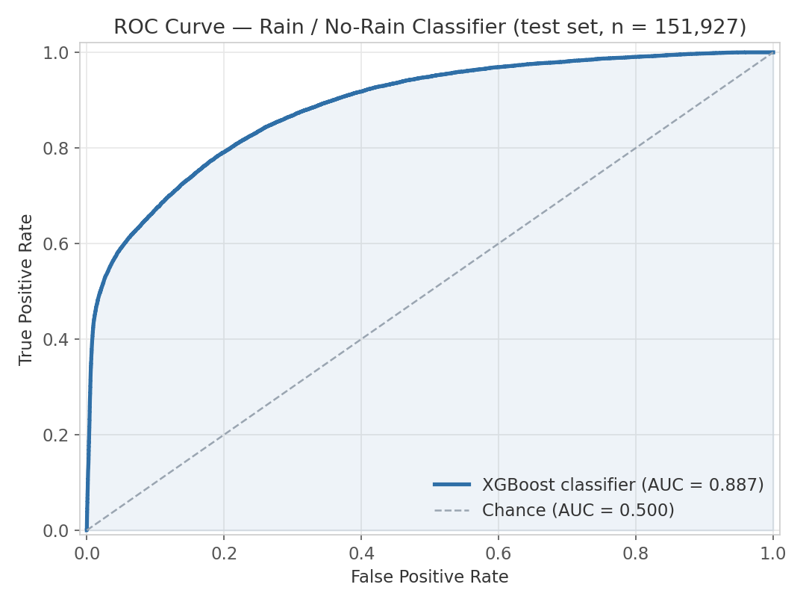
ROC Curve — Rain Classifier
Computed from stored per-clip probabilities on the full test set
• AUC = 0.887 (production SHAP top-20 model, measured from saved predictions)
• Tuned variant reaches 0.893
• Steep initial rise: half of all rain events are caught with almost no false alarms
• Operating threshold is tunable per use-case — 0.78 maximizes F1; higher favors precision
Acoustic Rain Gauge — ML Results · July 2026
8

Slide 9
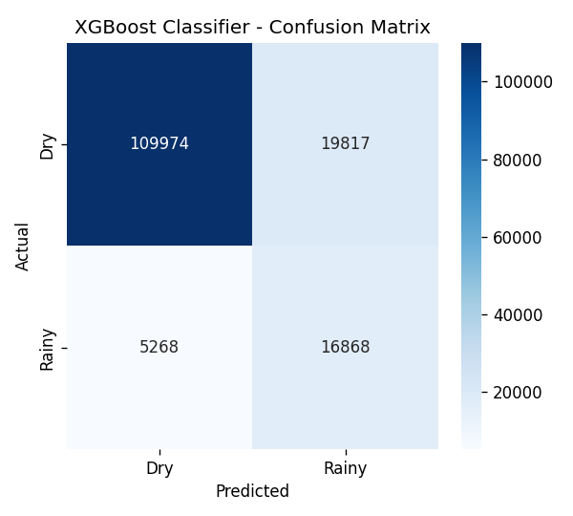
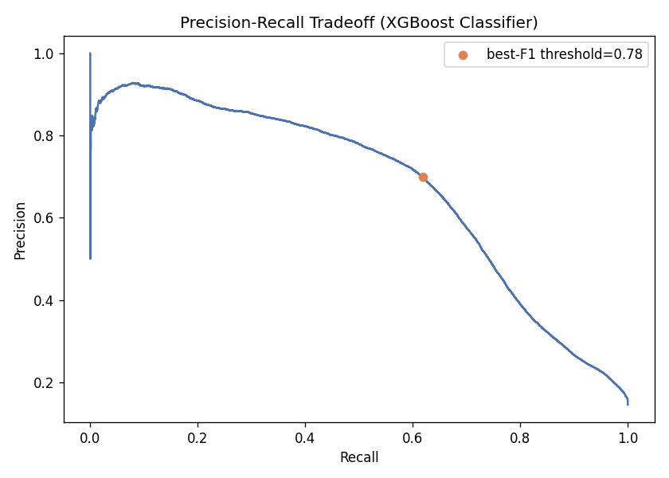
Evaluation Matrices
Confusion matrix @ 0.5 threshold · precision-recall tradeoff
At the default 0.5 threshold the model catches 16,868 of 22,136 rainy clips (76% recall) with 19,817 false alarms — moving to the best-F1 threshold (0.78) trades recall for far fewer false alarms.
Acoustic Rain Gauge — ML Results · July 2026
9

Slide 10
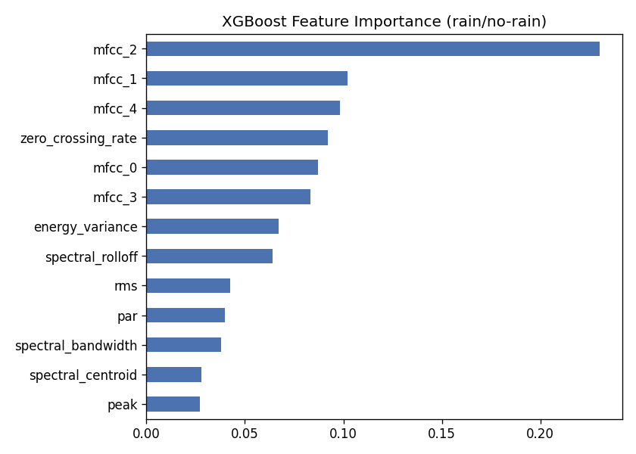
What the Classifier Listens To
XGBoost feature importance (original 13-feature model)
• MFCC coefficients dominate — rain has a distinctive broadband spectral envelope
• Zero-crossing rate and energy variance capture the temporal 'patter' of drops
• This motivated the mel-band / MFCC-heavy 175-feature store — and SHAP later confirmed mel-band means as the top features
Acoustic Rain Gauge — ML Results · July 2026
10

Slide 11
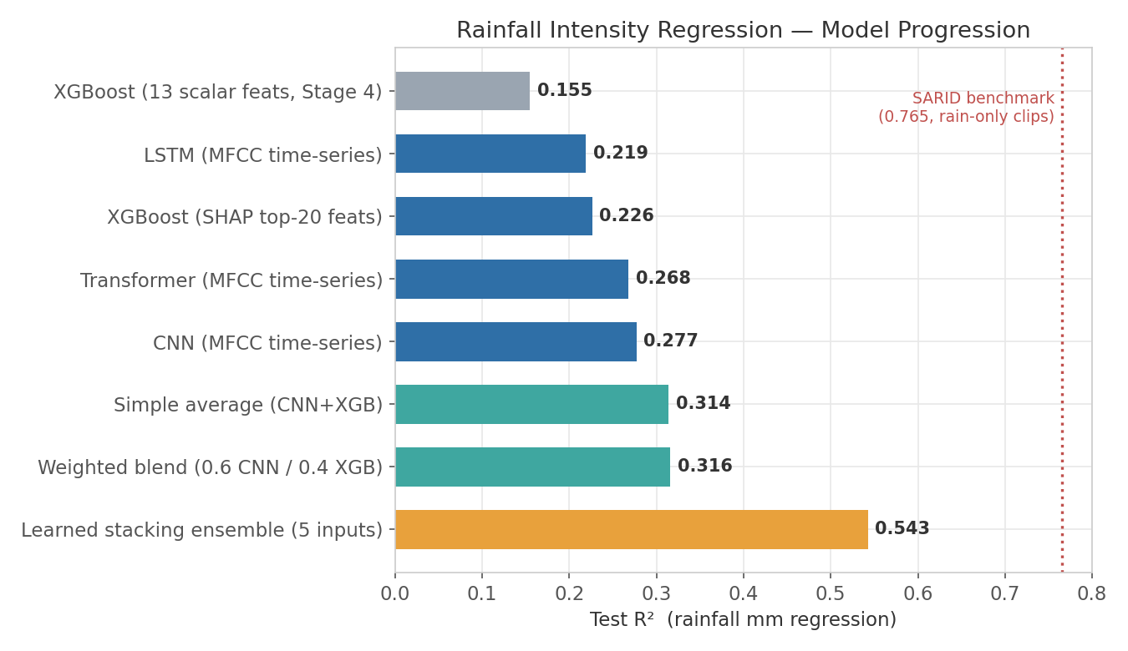
Regression Results — the Full Journey
Test R² for rainfall intensity (mm per clip), all on the same 151,927-clip test set
• 3.5× improvement from first baseline to final ensemble
• Time-series MFCC beats time-averaged scalars for every DL architecture
• SARID's 0.765 is on rain-only clips (12k) — not directly comparable to our all-weather test set
Acoustic Rain Gauge — ML Results · July 2026
11

Slide 12
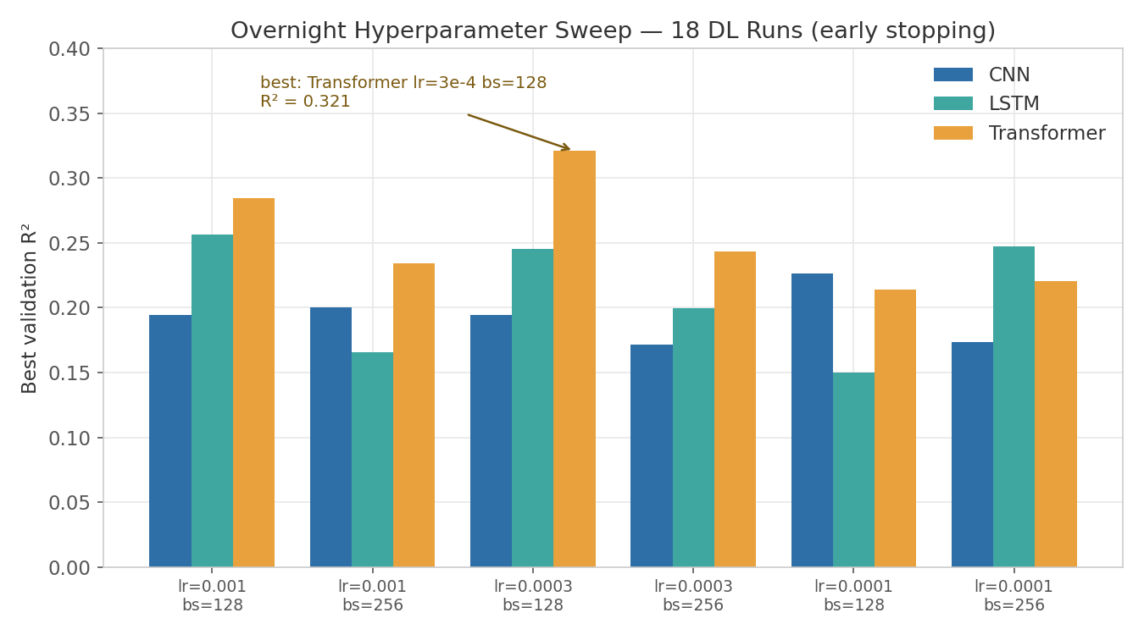
Hyperparameter Sweep — Deep Learning
18 unattended runs: 3 architectures × 3 learning rates × 2 batch sizes
• Transformer wins at every learning rate
• bs=128 consistently beats bs=256
• Best: Transformer, lr 3e-4 → R² 0.321 (single model)
• All runs early-stopped in 6–11 epochs (7–18 min each)
Acoustic Rain Gauge — ML Results · July 2026
12

Slide 13
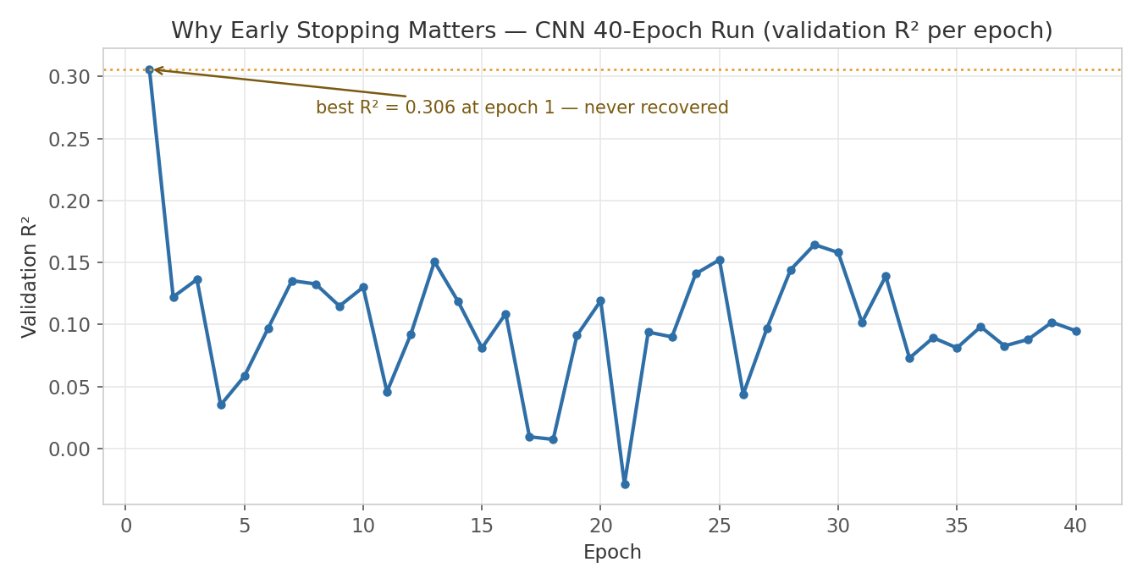
A Hard-Won Lesson — DL Training Instability
Validation R² collapses after epoch 1 and never recovers (CNN, 40 epochs)
• Continued training overfits the skewed target: most clips are 0 mm
• Fixes adopted: best-epoch checkpointing, early stopping, cosine LR decay
• Without them the sweep would have burned ~11 hours to get worse models
Acoustic Rain Gauge — ML Results · July 2026
13

Slide 14
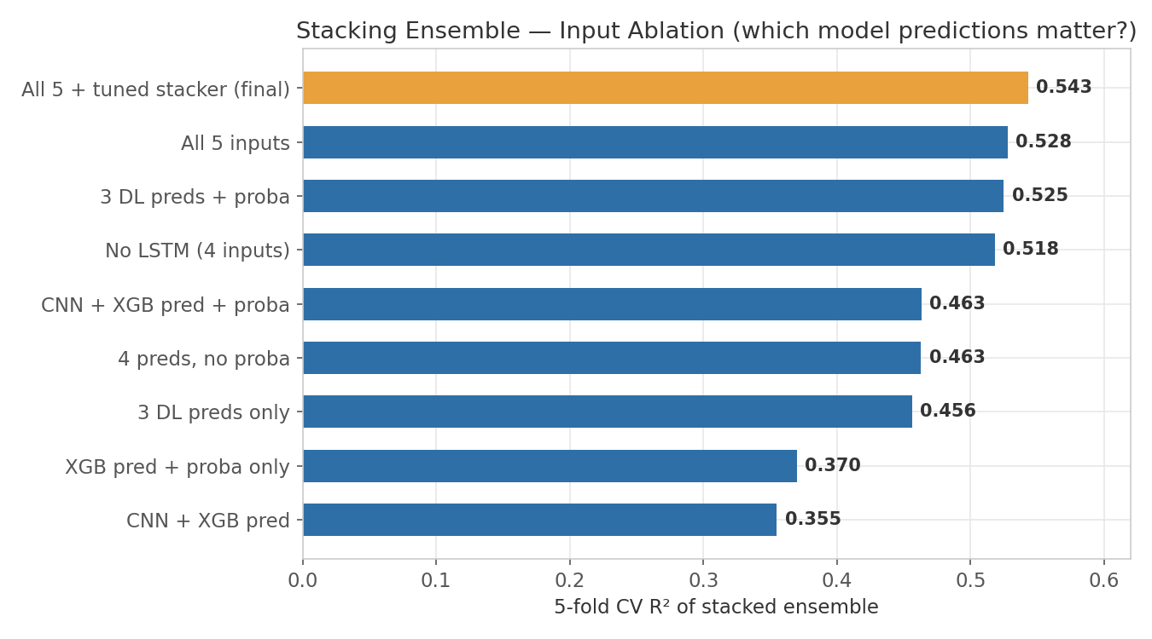
Stacking Ensemble — Input Ablation
5-fold CV R² of an XGBoost meta-model over base-model predictions
• The classifier's rain probability is the single most valuable input (+0.06–0.08 R²)
• Every base model contributes — dropping any input hurts
• Tuning the meta-model adds the final +0.015 → R² = 0.543
Acoustic Rain Gauge — ML Results · July 2026
14

Slide 15
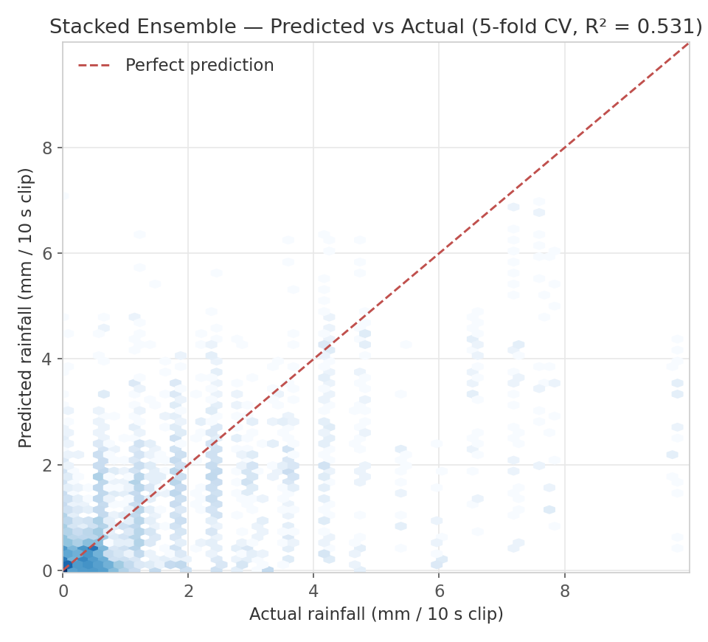
Final Ensemble — Predicted vs Actual
Out-of-fold predictions: every clip scored by a model that never saw it
• Log-density hexbin of 151,927 clips — the mass hugs the diagonal at low intensities
• Locally reproduced R² = 0.531 with the pre-sweep base models; the refreshed sweep checkpoints lift it to 0.543
• Systematic under-prediction of heavy rain (> 4 mm/clip) — few training examples that heavy, and clipping/saturation in loud clips
Acoustic Rain Gauge — ML Results · July 2026
15

Slide 16
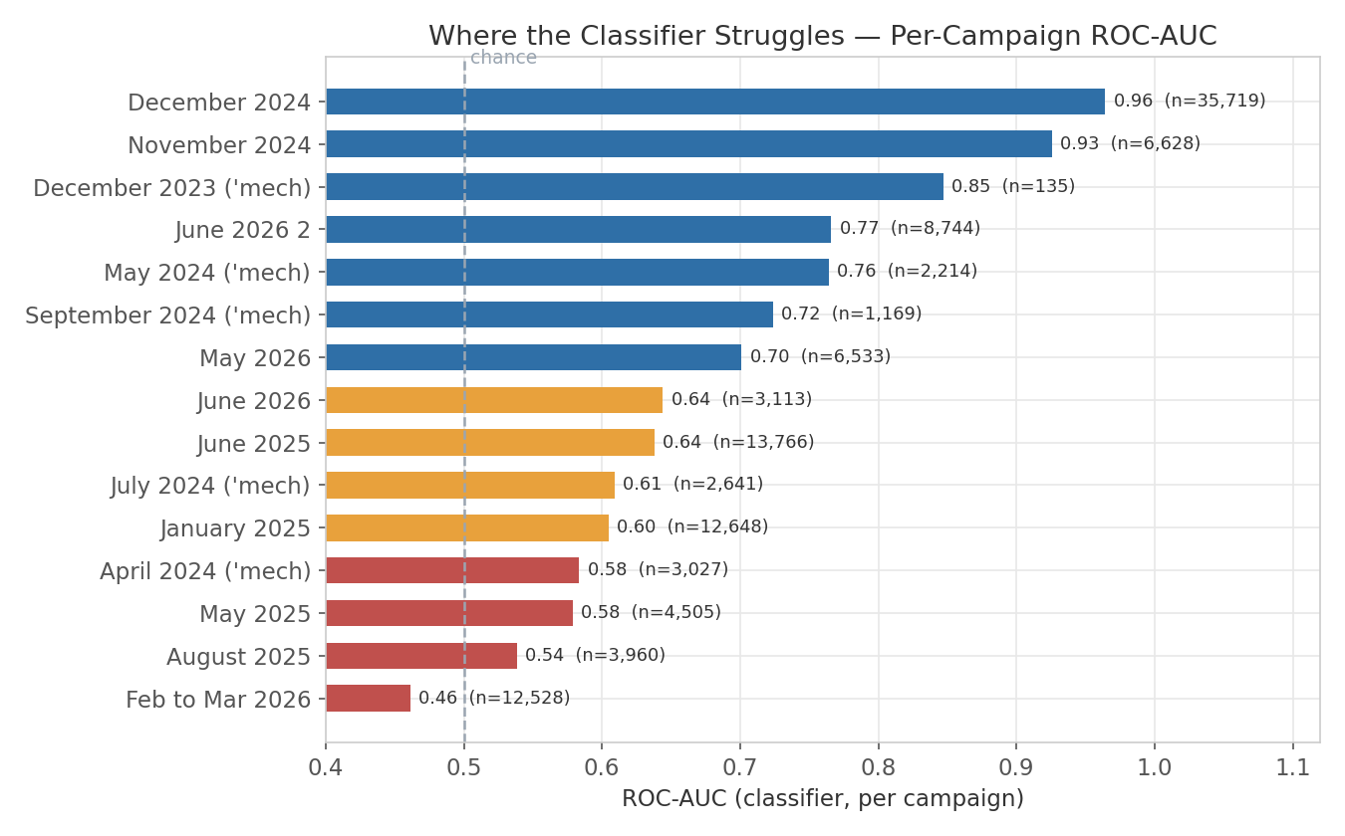
Generalization — Per-Campaign Performance
Classifier ROC-AUC per field campaign (campaigns with both classes)
• Strong on most campaigns (up to 0.96)
• Feb–Mar 2026 is below chance — 93% rainy, likely different sensor placement / conditions
• The spread points to environment covariates the audio alone can't resolve — chiefly wind
Acoustic Rain Gauge — ML Results · July 2026
16

Slide 17
Limitations & Next Steps
What's holding back the next jump in accuracy
Known limitations
Planned next steps
• Wind bias — the biggest identified gap:
– wind noise contaminates the audio signal (lit.: even at 4 m/s)
– gauges themselves under-catch 9–23% in wind — labels are biased too
• Heavy rain (> 4 mm/clip) is underestimated — sparse examples + microphone saturation
• Per-campaign variance: one campaign scores below chance
• DL training is unstable without early stopping / LR scheduling
• Add wind speed (+ temperature / humidity) as model covariates
• New tipping-bucket dataset (Jun 2026 → present) — more accurate labels than the mechanical gauges
• Rain-only regression head (hurdle model) to compare fairly against SARID's 0.765
• Larger DL capacity + augmentation now that the training recipe is stable
Acoustic Rain Gauge — ML Results · July 2026
17

Slide 18
Summary
0.893
rain detection ROC-AUC
0.543
rainfall intensity R² (stacked)
3.5×
R² gain over first baseline
• Rain detection from cheap microphones works: AUC 0.89 across 152k held-out field clips
• Intensity estimation improved from R² 0.155 → 0.543 via time-series MFCC deep models + learned stacking
• Fully automated, resume-safe training infrastructure — 59-experiment sweeps run unattended overnight
• Clear path forward: wind covariates and better tipping-bucket ground truth

