Slide 1


Automated Nutritional Analysis and Diet Recommendation System
Team SaAm Samyak Srivatsa , Aman Ingle

Slide 2
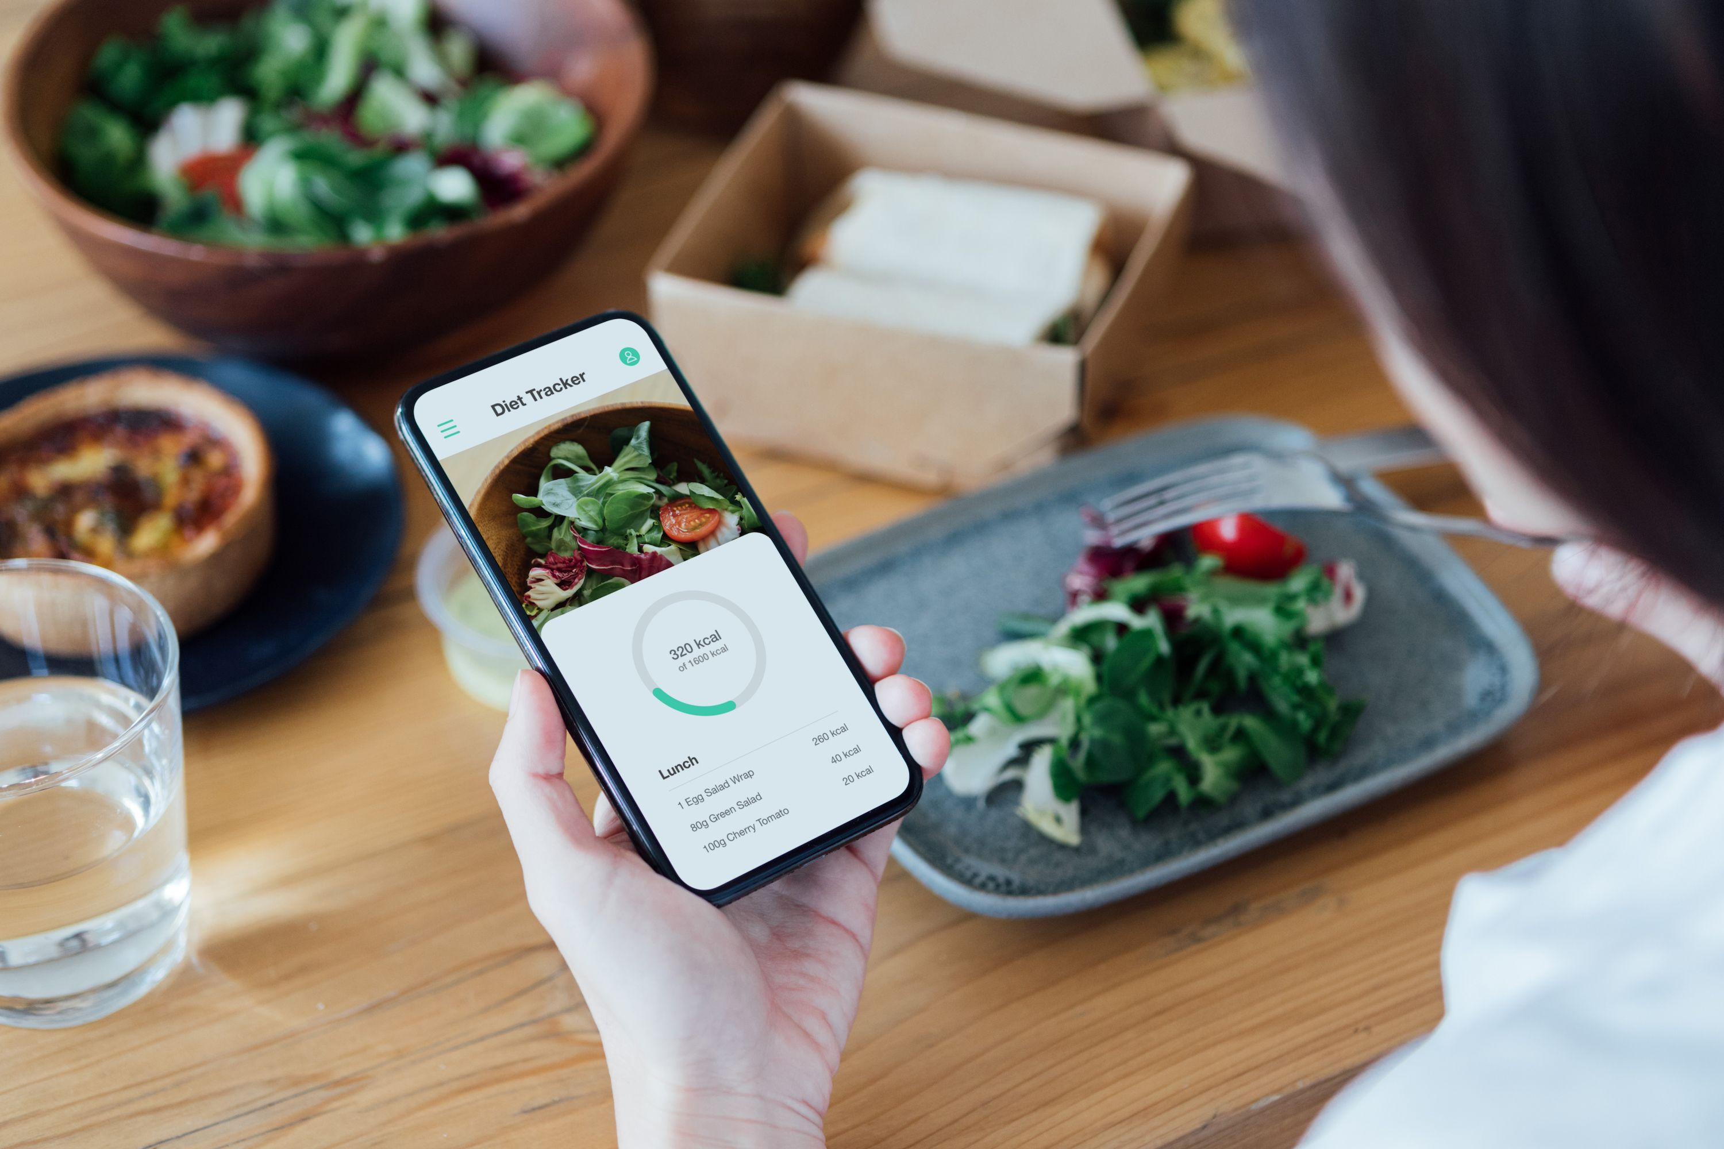
Automated Food Content Analyser and Tracker
Problem Statement
Manual tracking is time-consuming and prone to errors, requiring users to log each food item individually, estimate portions, and look up nutritional information, while AI based input streamlines the process by analyzing an entire meal in one step and could even provide suggestions.

Slide 3
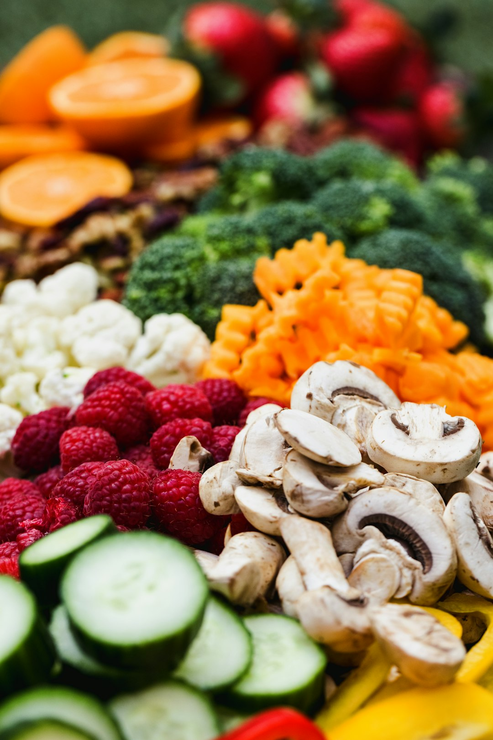
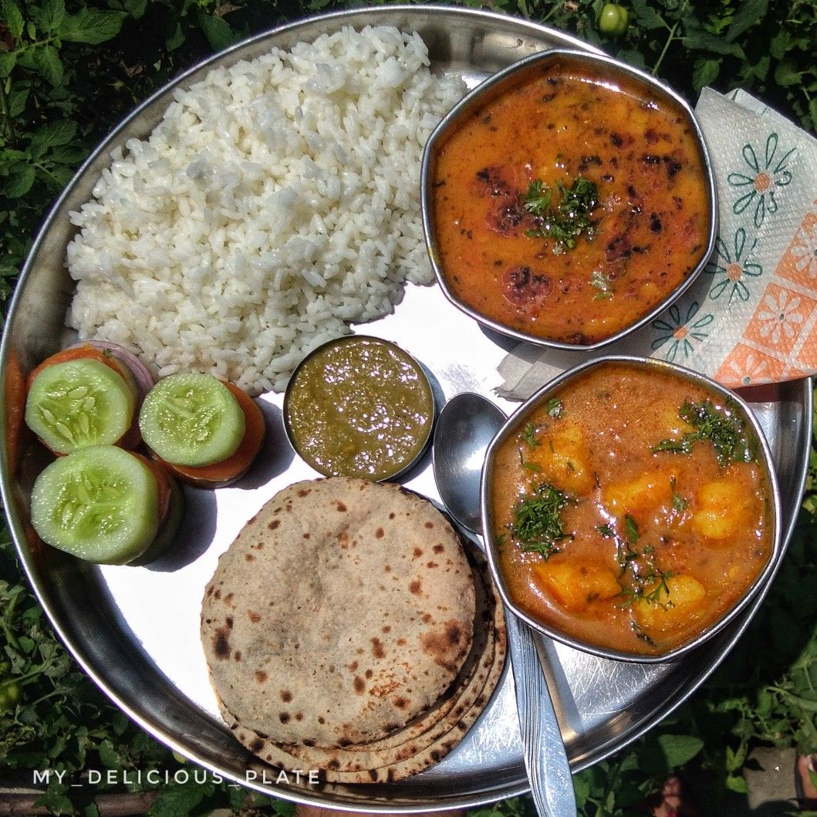
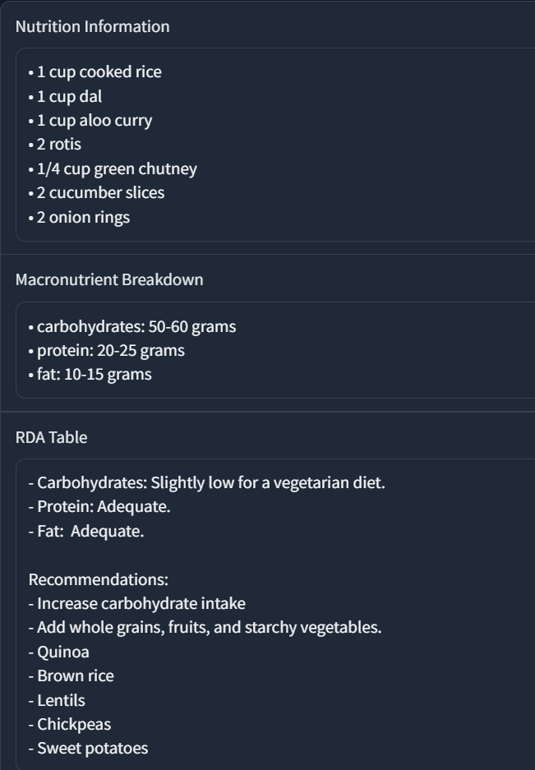
What are we doing?
Yolov8
Detected Food Portion
Gemini 1.5 pro

Slide 4
Benefits
Benefit | Description
Efficient Tracking | Simplifies food intake monitoring and nutrient tracking for enhanced diet management.
Enhanced Personalization | Delivers targeted dietary guidance and meal suggestions based on individual health objectives.
Ease of Use | Anybody can use it to track their calories and nutrient intake very easily without much manual effort
Improved Wellness Outcomes | Leads to better adherence to nutritional goals, supporting overall health improvements.

