Slide 1
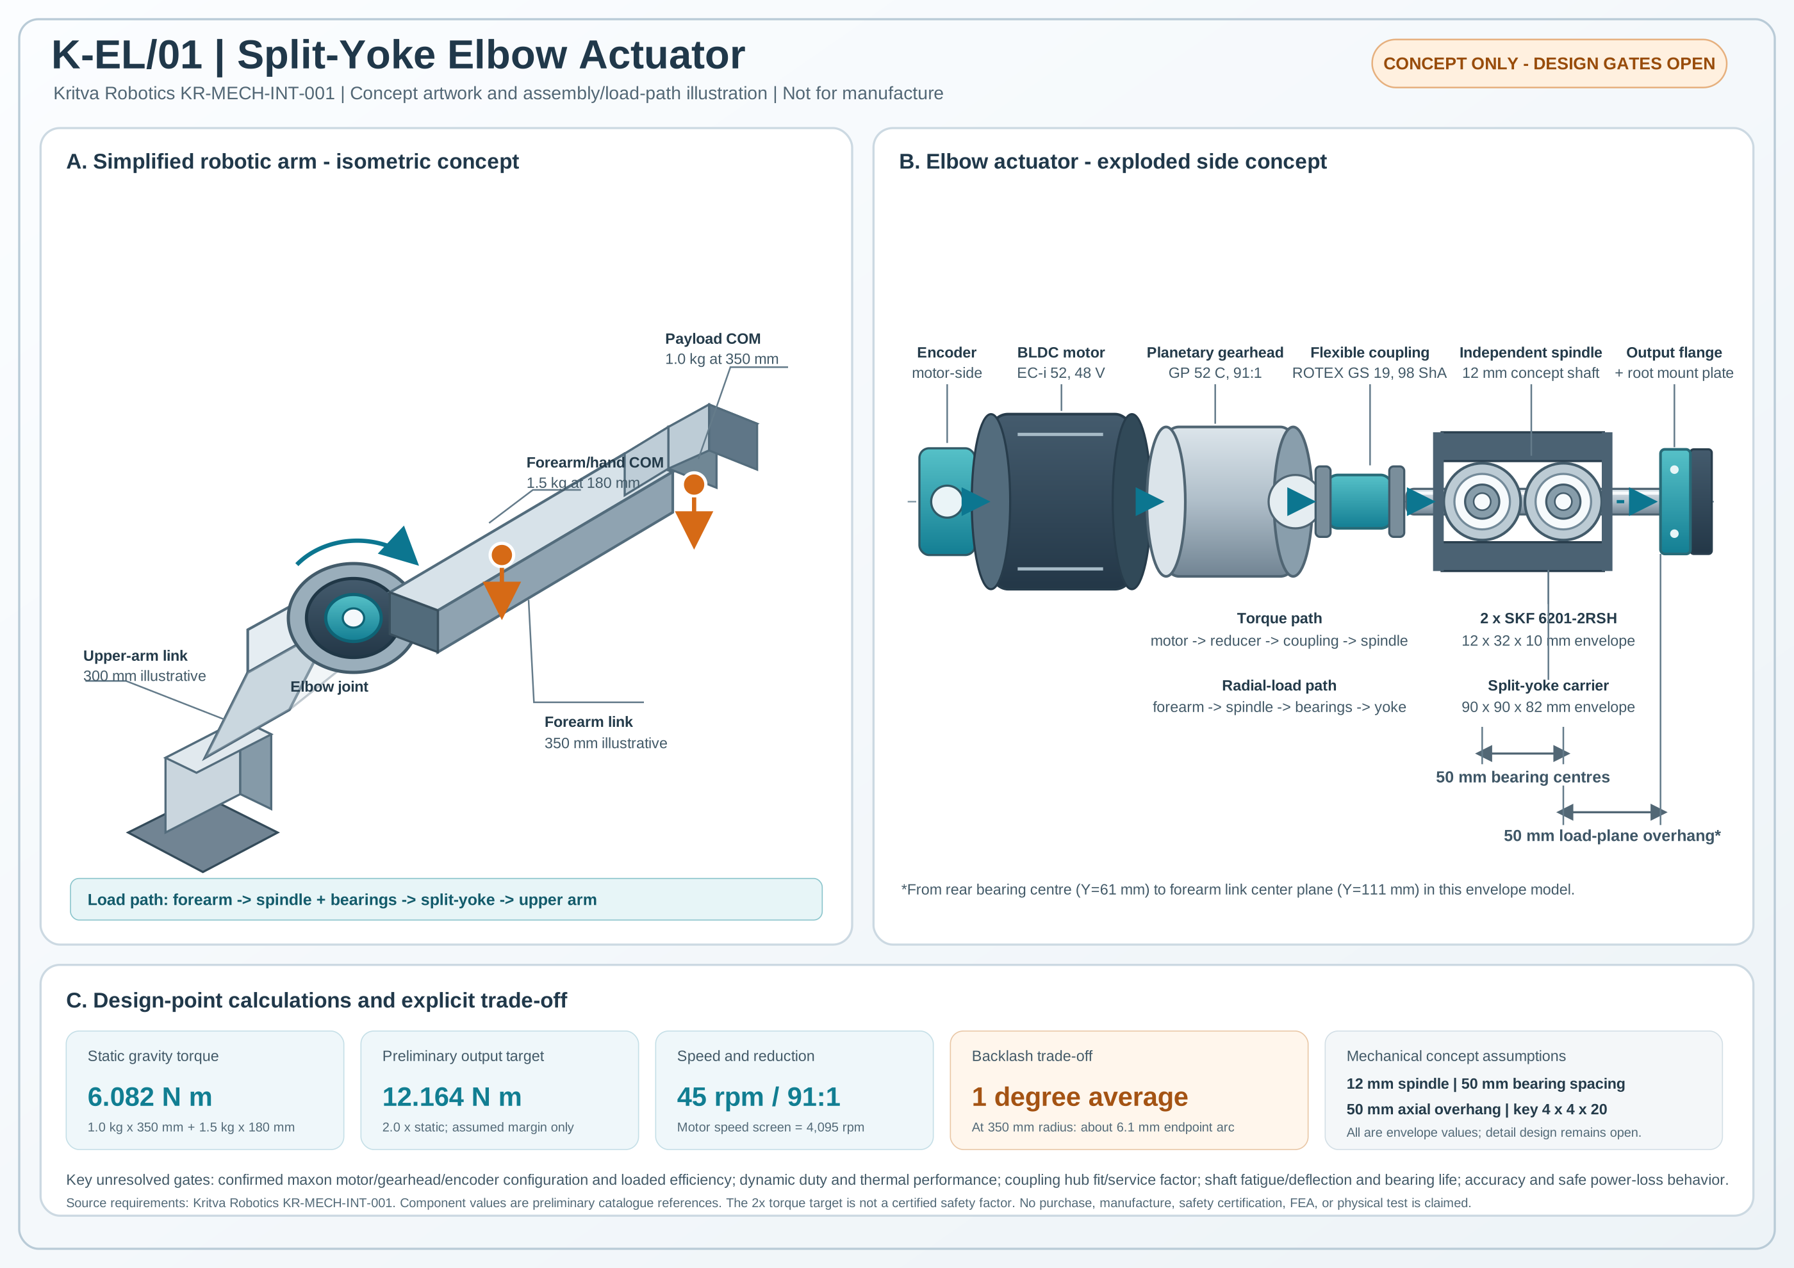
K-EL/01 Split-Yoke Elbow Actuator
Conceptual mechanical design • KR-MECH-INT-001
10-minute design walkthrough
Presenter: Candidate
25 October 2026
K-EL/01 • Concept only • 25 October 2026 1/8

Slide 2
1. Problem & design basis
Use the brief inputs without silently inventing a full mission profile
Payload: 1.0 kg at 350 mm from elbow axis
Forearm + hand: 1.5 kg at 180 mm
Horizontal forearm is the initial gravity-only case
Output target 45 RPM; BLDC/PMSM + encoder; planetary preferred
Illustrative link envelope: 300 mm upper arm / 350 mm forearm
No duty cycle, acceleration, position accuracy, impact or power-loss holding requirement was supplied.
K-EL/01 • Concept only • 25 October 2026 2/8

Slide 3
2. Static torque & preliminary target
Gravity-only result is a baseline, not a complete motion design
Term | Formula | Result
Payload | 1.0 × 9.81 × 0.350 | 3.4335 N·m
Forearm/hand | 1.5 × 9.81 × 0.180 | 2.6487 N·m
Static total | 3.4335 + 2.6487 | 6.0822 N·m
Preliminary target | 2.0 × static | 12.1644 N·m
Ideal output power | 12.1644 × 45×2π/60 | 57.32 W
The 2× multiplier is an assumption, not a certified safety factor.
Dynamics and inertia can dominate peak/RMS sizing.
K-EL/01 • Concept only • 25 October 2026 3/8

Slide 4
3. Drive candidate & key caution
A shortlist is not a frozen supplier configuration
Motor candidate: maxon EC-i 52, 48 V, part 579165; nominal 4470 RPM, 0.423 N·m, 4.59 A.
Gearhead candidate: maxon GP 52 C, 91:1, part 223094; nominal input speed required = 4095 RPM.
At assumed 40% gearhead efficiency: ~0.334 N·m motor torque, ~143 W input screen, ~3.64 A torque-constant current screen.
At assumed 30% efficiency, simple continuous torque/current screen fails.
180 W class vs nominal T×ω ≈198 W: clarify rating point with maxon. EC-i curve is nonlinear; use actual curve, not a constant gradient.
K-EL/01 • Concept only • 25 October 2026 4/8

Slide 5
4. Mechanical load path
Torque transmission and radial support are deliberately separated
Torque: motor → GP52C → ROTEX GS coupling → independent spindle → flange/root plate → forearm.
Radial load: forearm → spindle → two 6201 bearings → split yoke → upper arm.
Bearing centres 50 mm apart; forearm load plane is 50 mm beyond rear-bearing centre.
STEP is simplified envelope CAD: 21 solids, valid geometry; not proof of no interference or strength.
K-EL/01 • Concept only • 25 October 2026 5/8

Slide 6
5. Structural & accuracy screens
Useful for concept decisions; not final verification
Gravity force from specified masses: 24.525 N; overhang moment: 1.22625 N·m = 1226.25 N·mm.
Ø12 mm nominal spindle: bending 7.23 MPa; torsional shear 35.85 MPa; von Mises ~62.52 MPa.
Stress screens omit keyway/notch factors, fatigue, shock, dynamic loads, detailed spindle geometry and deflection.
At 1° average no-load backlash, payload-radius arc is ~6.11 mm at 350 mm.
The final position error also includes compliance, controller/encoder, assembly and load effects.
K-EL/01 • Concept only • 25 October 2026 6/8

Slide 7
6. Major risks & next evidence
Close mission requirements and vendor evidence before freezing hardware
Thermal/duty risk: define trajectory, acceleration, cycles and ambient; obtain loaded motor curve and gearhead efficiency; calculate peak/RMS torque.
Mechanical risk: confirm coupling hubs/keying, spindle section/fits, bearing life, carrier stiffness and fasteners.
Safety risk: clarify gravity hold during power loss; add rated normally-engaged brake or explicitly limit to externally supported supervised use.
Accuracy risk: 1° no-load backlash may be too high; define output-position tolerance and evaluate lower-backlash reducer/output feedback.
Validate with a guarded supervised test only after the configuration is confirmed.
K-EL/01 • Concept only • 25 October 2026 7/8

Slide 8
7. Conclusion & status
Concept submission complete; engineering release is intentionally not claimed
Static target: 6.0822 N·m required; 12.1644 N·m preliminary target.
Candidate 91:1 drive is kinematically plausible but needs supplier-confirmed loaded operation and thermal validation.
Included package: report, workbook/CSVs, BOM, official reference matrix, STEP/source/macro, concept artwork, QA/gap plan, verification plan, presentation and discussion notes.
Native .FCStd was not created because FreeCAD is unavailable in this environment; run included macro on FreeCAD to create it.
No purchase, manufacture, FEA, physical test or certification is claimed.
K-EL/01 • Concept only • 25 October 2026 8/8

