Slide 1
Sorry for my RUSSIAN
thanks

Slide 2

Here will be first picture

Slide 3
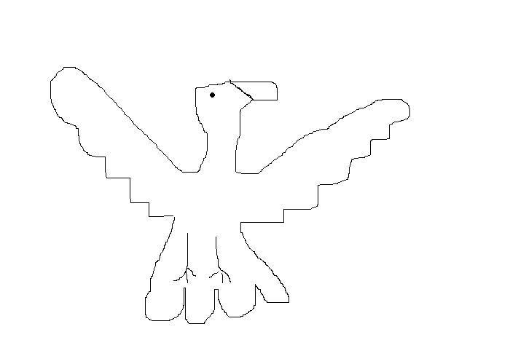
This is a pigeon

Slide 4
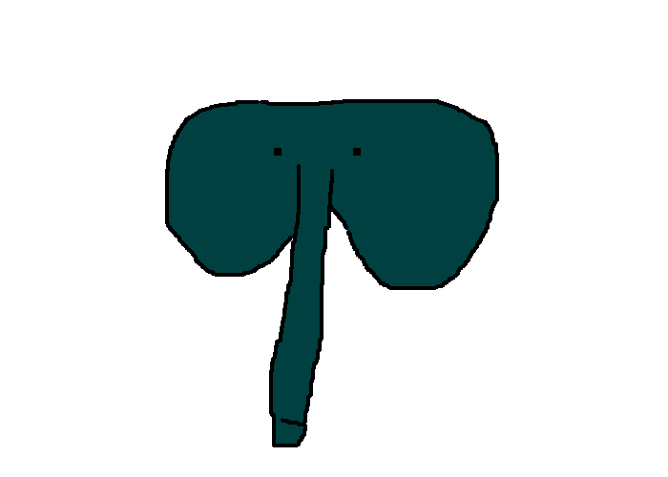
СЛОНИК

