Slide 1
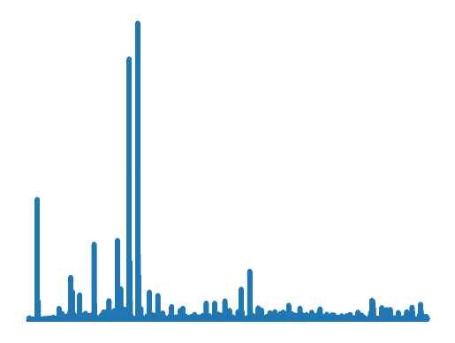
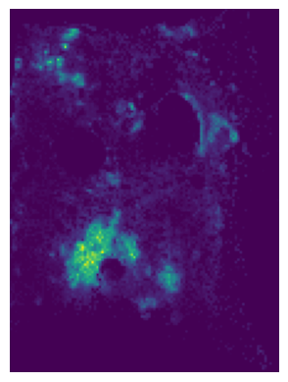
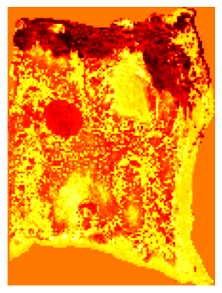
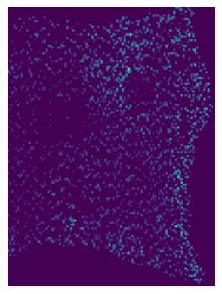
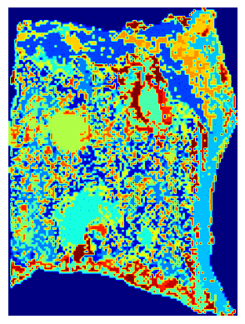
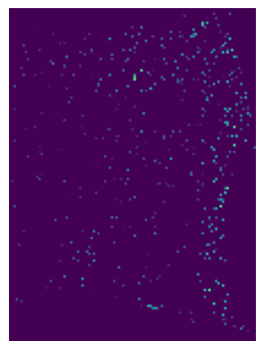
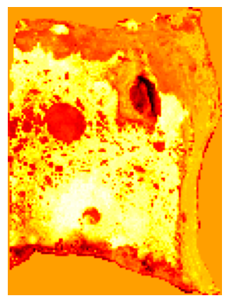
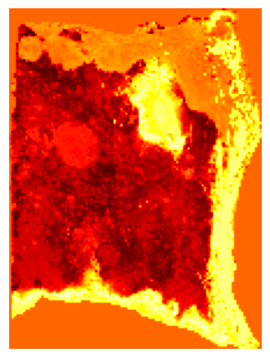
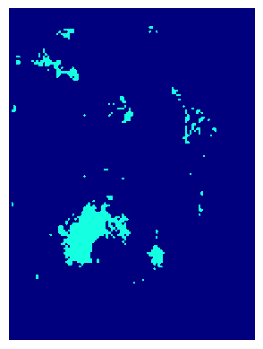
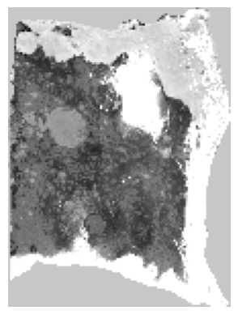

Residual Connection
Residual Connection
Multi-Head
Attention
Feed
Forward
Output
Input
Norm
Norm
Model
Original
MLP
Attention Block
MLP
Reconstraction
Encoder
Decoder
Y
m/z
n_dim
Cluster
Workflow
x
cor
m/z 774
Meta Database
biomarkers indentifacaton
m/z 884
...
m/z 253

Slide 2
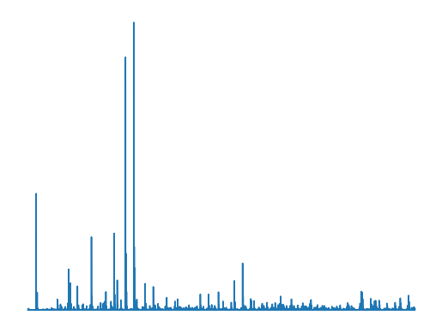
Residual Connection
Residual Connection
Input
Norm
MLP
Output
Norm
MLP
MLP
Norm
Multi-Head Attention
Feed Forward
Model Training
Feed Forward
m/z spectra
m/z spectra
Attention Block
Original data
Predicted data
ENCODER
DECODER
Heat map
Step1 Dimension reduction
by ENCODER
Step2 Clustering
Step3 Correlation
analysis
Step4 Biomarker
identification
Key m/z values
Workflow
m/z 774
Y
m/z 884
Y
m/z
...
dim
m/z 253
X
X
Metabolism database

Slide 3
Residual Connection
Residual Connection
Input
Norm
MLP
Output
Norm
MLP
MLP
Norm
Multi-Head Attention
Feed Forward
Model Training
Feed Forward
m/z spectrum
m/z spectrum
Attention Block
Original data
Predicted data
ENCODER
DECODER
Heat map
Step1 Dimension reduction
by ENCODER
Step2 Clustering
Step3 Correlation
analysis
Step4 Biomarker
identification
Key m/z values
Workflow
m/z 774
Y
m/z 884
Y
m/z
...
dim
m/z 253
X
X
Metabolism database

Slide 4
Residual Connection
Residual Connection
Self-supervised Model Training
MLP
Multi-Head Attention
Feed Forward
Norm
MLP
Output
Input
Norm
m/z spectrum
m/z spectrum
Attention Block
Original data
Predicted data
ENCODER
DECODER
Heat map
Step1 Dimension reduction
by ENCODER
Step2 Clustering
Step3 Correlation
analysis
Step4 Biomarker
identification
Key m/z values
Workflow
m/z 774
Y
Y
m/z 884
m/z
n_dim
...
X
m/z 253
Metabolism database
X

Slide 5
Residual Connection
Residual Connection
Self-supervised Model Training
MLP
Multi-Head Attention
Feed Forward
Norm
MLP
Output
Input
Norm
m/z spectrum
m/z spectrum
Attention Block
Original data
Predicted data
ENCODER
DECODER
Heat map
Step1 Dimension reduction
by ENCODER
Step2 Cluster
Step3 Correlation
analysis
Step4 Biomarkers
identification
Key m/z values
Workflow
m/z 774
Y
m/z 884
m/z
n_dim
...
m/z 253
Metabolism database
x

Slide 6
Residual Connection
Residual Connection
MLP
Multi-Head Attention
Feed Forward
Norm
MLP
Output
Input
Norm
m/z spectrum
m/z spectrum
Attention Block
ENCODER
DECODER
Model Training
Original data
(Training input)
Prediction data
(Loss evaluation)
Workflow
Hot plot
Step1 Dimension reduction
by ENCODER
Step2 Cluster
Step3 Correlation
analysis
Step4 Biomarkers
identification
Key m/z
m/z 774
Y
m/z 884
m/z
n_dim
...
x
m/z 253

Slide 7
Residual Connection
Residual Connection
Model Training
MLP
MLP
Output
Multi-Head Attention
Feed Forward
Norm
Input
Norm
m/z spectrum
m/z spectrum
ENCODER
Attention Block
DECODER
Original data
(Training input)
Prediction data
(Loss evaluation)
Hot plot
Step1 Dimension reduction
by ENCODER
Step2 Cluster
Step3 Correlation
analysis
Step4 Biomarkers
identification
Key m/z
Workflow
m/z 774
Y
m/z 884
m/z
n_dim
...
x
m/z 253

Slide 8
Step1 Dimension reduction
by Encoder
Step2 Cluster
Step3 Correlation
analysis
Step4 Biomarkers
identification
Key m/z
m/z 774
Y
m/z 884
m/z
n_dim
...
m/z 253
x
Hot plot
Encoder
Decoder
Original data
Prediction data
Residual Connection
Residual Connection
m/z spectrum
MLP
Multi-Head Attention
Feed Forward
Norm
MLP
Output
Input
Norm
Attention Block

