Slide 1
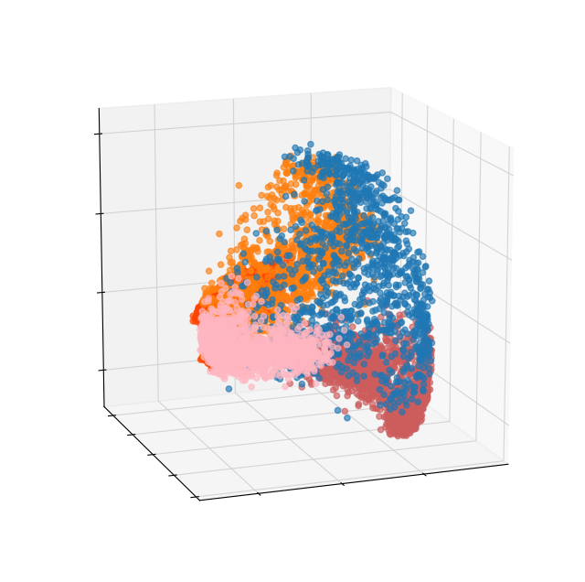
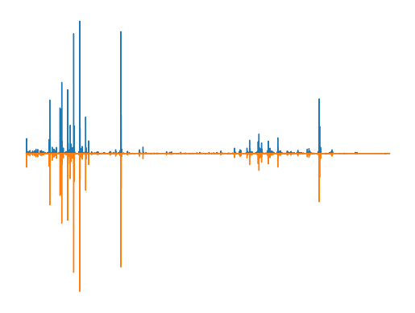
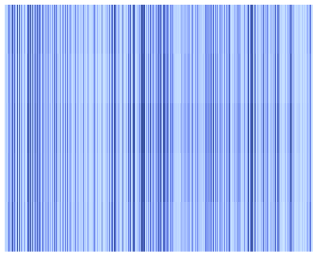
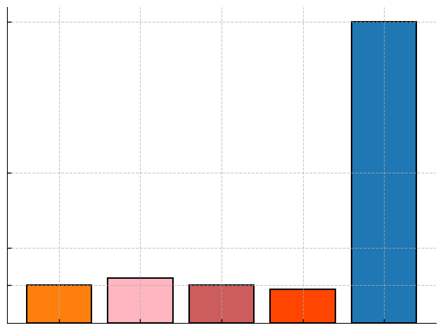




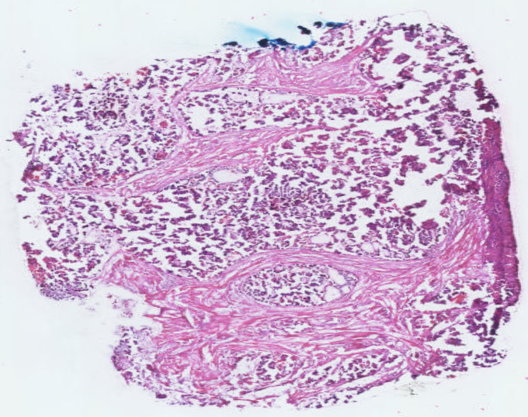




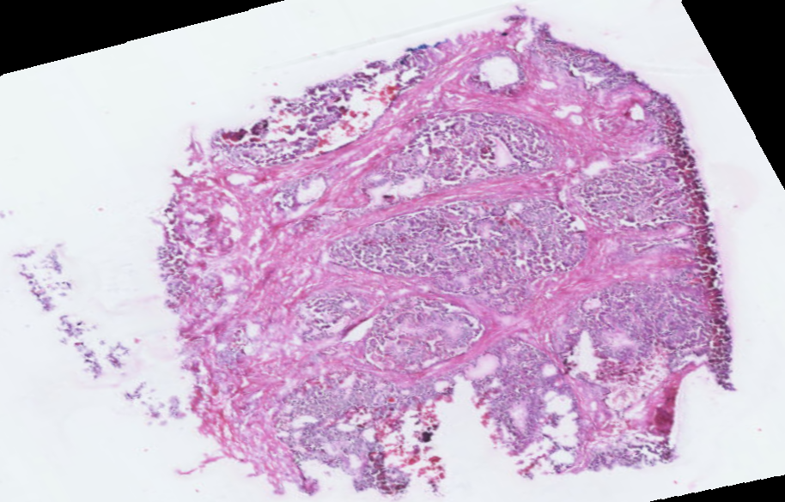




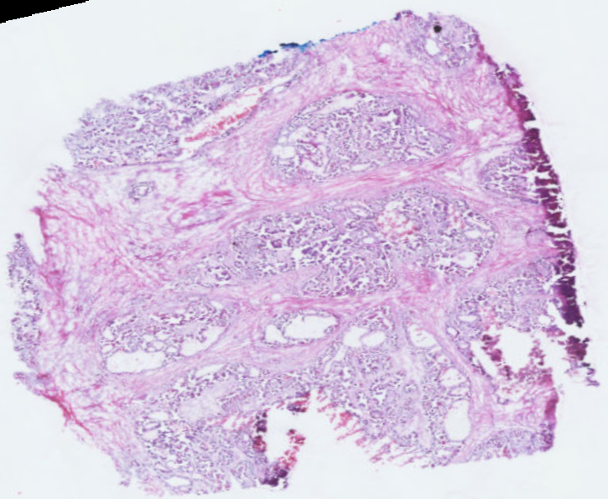

Original Spectra
a
b
Predicted Spectra
0
m/z
Intensity
-5
Cancer
0
MSE=2.1×${10}^{−7}$
-5
Normal
c
-10
-8
-6
-4
d
80
80
5
0.7
4
Counts
3
40
2
20
12
10
10
10
9
1
0.0
mz:720.49
1
2
3
4
5
Frequncy
e
Clustering result
Selected clusters
m/z: 720.49
m/z: 766.53
H&E histology
Section 1
Sectio 11
Section 13

