Slide 1
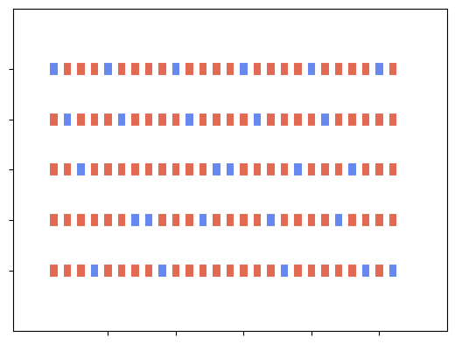
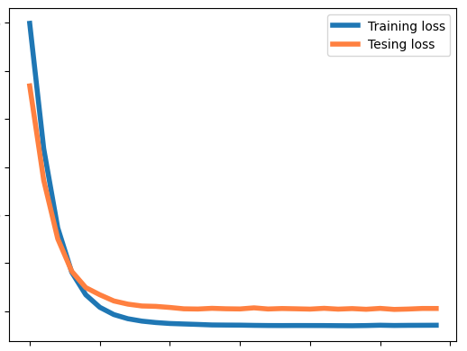
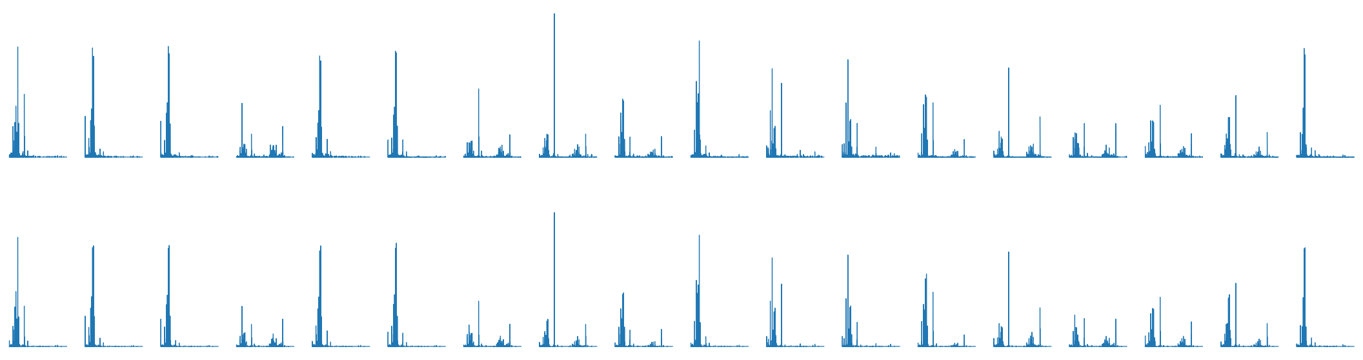




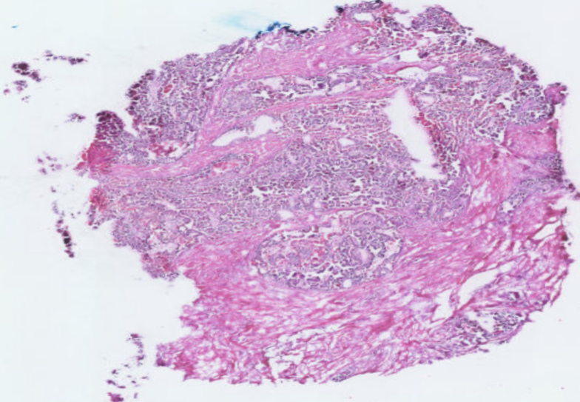




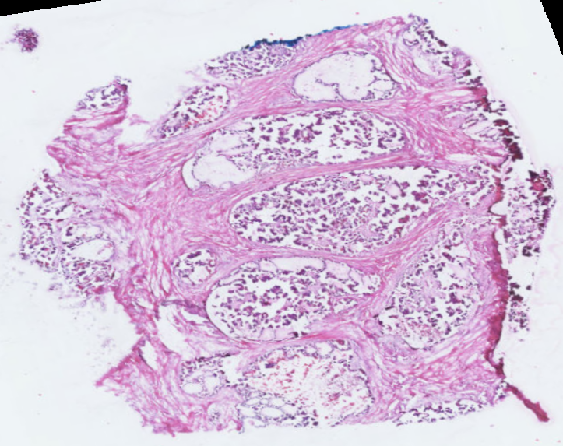




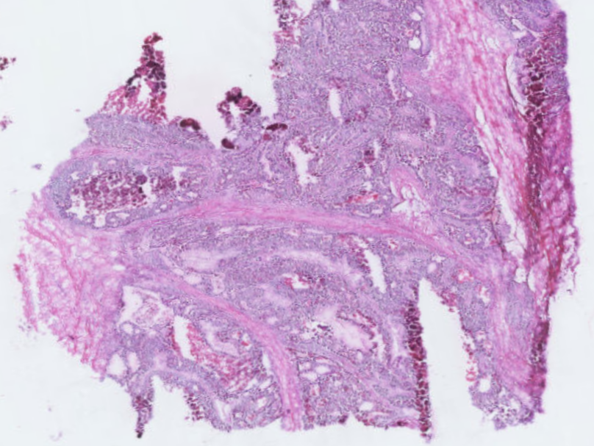

Cross-validation Iterations
Training Sections
b
8.0
Testing Dataset
a
1
Testing Sections
7.5
Training Dataset
2
LOSS
7.0
3
6.5
4
6.0
5
5.5
5.0
c
5
10
15
20
25
0
5
10
15
20
25
30
Section index
Epochs
0
0.05
0.5
1
5
10
20
30
40
50
60
70
80
90
100
110
115
122.4
Sample index($×{10}^{3}$)
Original
Predicted
d
Clustering result
Selected clusters
m/z: 720.49
m/z: 766.53
H&E histology
Section 4
Section 9
Section 26

