Slide 1
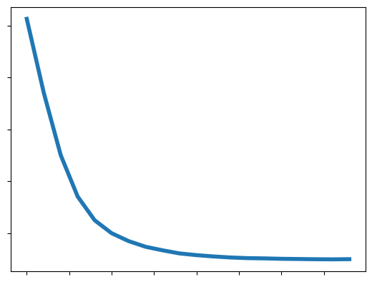
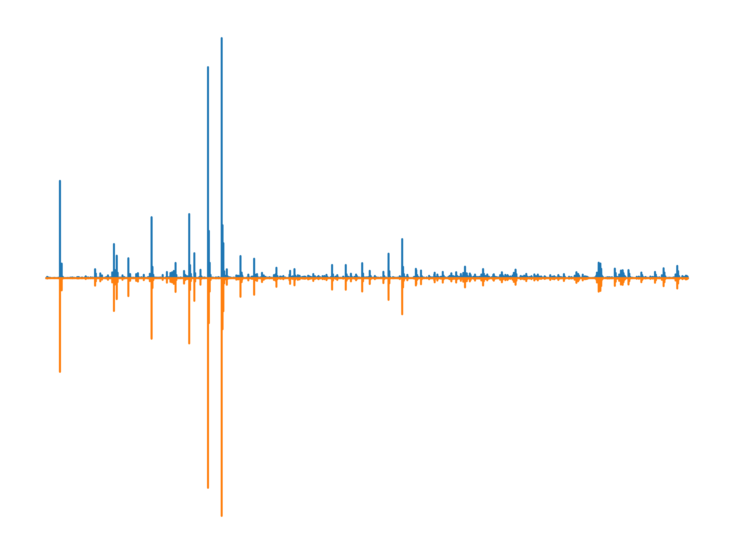
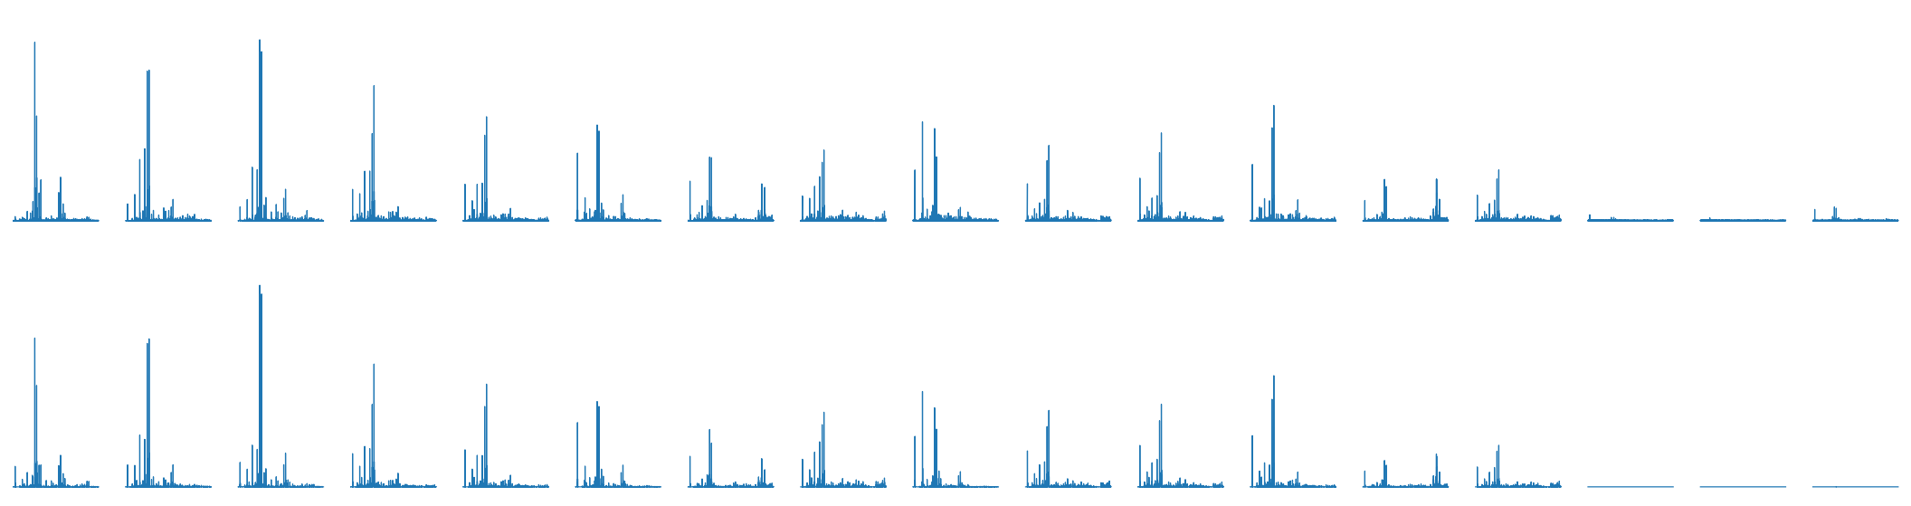
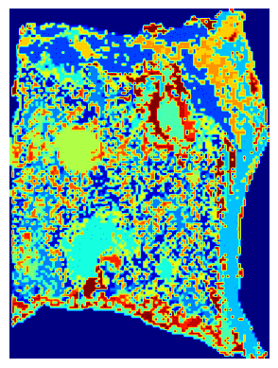
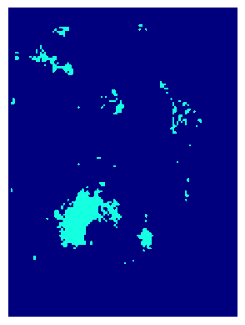
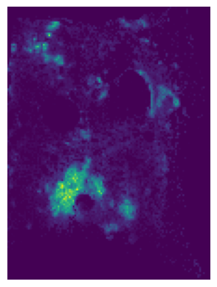
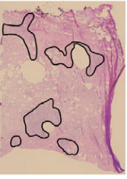


a
b
10.5
Training Loss
Original Spectra
Original Spectra
Intensity
Predicted Spectra
10.0
Predicted Spectra
m/z
9.5
9.0
8.5
MSE = 7.0 ×${10}^{−9}$
c
0
5
10
15
0
0.5
1
1.5
2
2.5
3
4
5
6
7
8
9
10
11
12
12.699
Sample index (${×10}^{3}$)
Original
Predicted
d
g
d
e
f
f
min
m/z 774.5983
max

